Slide 1
PRM Method Development and Data Analysis with Skyline
Tutorial Webinar #17
With
Brendan MacLean (Principal Developer, Skyline)
Eduard Sabidó, Ph.D. (Head of the UPF/CRG Proteomics Unit)
Cristina Chiva, Ph.D. (PRM researcher, CRG Proteomics Unit)

Slide 2
Agenda
Welcome from the Skyline team!
PRM Method Development and Data Analysis with Skyline
  Introduction with Brendan MacLean
  Theoretical concepts and benefits of PRM with Eduard Sabidó
  Tutorial with Cristina Chiva
Audience Q&A – submit questions to Google Form:
https://skyline.ms/QA4Skyline.url

Slide 3
It Began as Targeted MS/MS (pseudo-SRM)
ASMS 2011 – Poster presentation (Birgit Schilling)
  Skyline: Targeted Proteomics with Extracted Ion Chromatograms from Full-Scan Mass Spectra
JPR May, 2012 – Sherrod, et. al (started by Amy Ham, 2009)
  Label-Free Quantitation of Protein Modifications by Pseudo-Selected Reaction Monitoring with Internal Reference Peptides
MCP Nov, 2012 – Peterson, et. al (Coon lab) – named PRM
  Parallel reaction monitoring for high resolution and high mass accuracy quantitative, targeted proteomics
Anal. Chem. 2015 – Schilling, et. al – latest on Skyline PRM for HRMS
  Multiplexed, Scheduled, High-Resolution Parallel Reaction Monitoring on a Full Scan QqTOF…

Slide 4
Recorded Webinars
16 other webinars + this one Coming Soon!
Webinar #3 (2013)
PRM Targeted Proteomics Using Full-Scan MS and Skyline
Bruno Domon
Webinar #9 (2015)
PRM for PTM studies with Skyline
Research-grade targeted proteomics assay development
Jacob D. Jaffe

Slide 5
Interest Remains High
Modern instruments support PRM well
  High resolution, faster cycle times and full scheduling
Viable alternative to SRM with triple quadrupole instrument
Appealing not to need an extra instrument for targeted
Registration for first PRM webinar (431) v 2014 DIA webinar (342)
Registration for this PRM webinar (434) v 2017 DIA webinar (409)

Slide 6
Eduard Sabidó

Slide 7
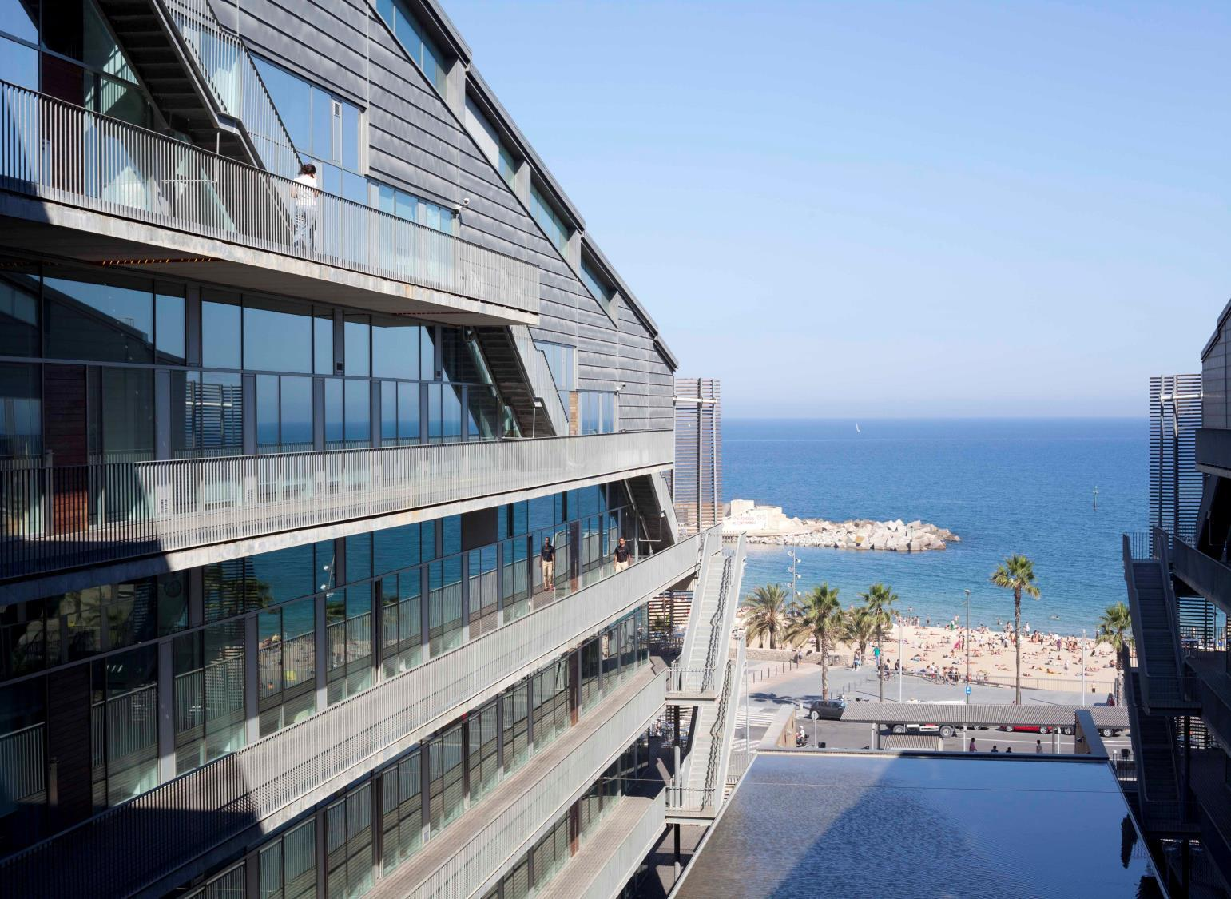


Webinar
PRM theoretical concepts, benefits and instrument acquisition settings
Eduard Sabidó
Cristina Chiva
CRG/UPF Proteomics Unit
Barcelona, Spain
Notes:
7

Slide 8



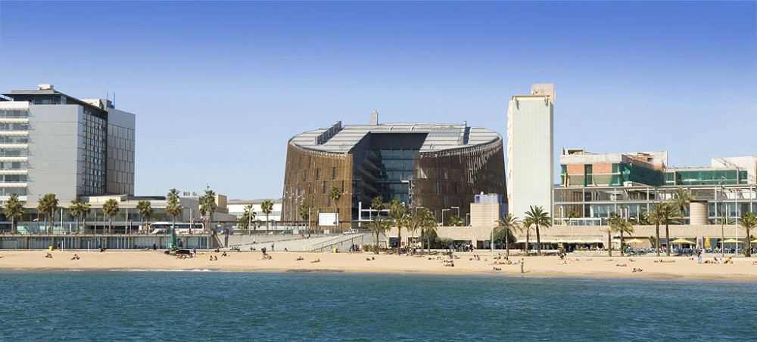
Eduard Sabidó
Cristina Chiva
Lecture on PRM theoretical concepts, benefits and instrument acquisition settings for the Orbitrap Fusion Lumos (30 min).
Hands-on tutorial on PRM method development and step-by-step analysis of Orbitrap Fusion Lumos PRM data with Skyline (1h)
Questions & Answers

Slide 9

PRM is a targeted proteomics workflow
“Targeted proteomics detects proteins of interest with high sensitivity, quantitative accuracy and reproducibility”
“By delivering precise, reproducible quantification of proteins of interest in biological samples, targeted proteomics approaches are allowing researchers to apply the scientific method using mass spectrometry”

Slide 10
PRM is a targeted proteomics workflow
Types of projects suited for targeted proteomics
A biomarkers
B pathways
C interactions

Slide 11
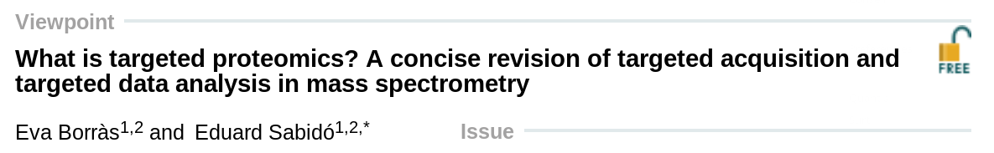

PRM is a targeted proteomics workflow
MS1 Targeted Methods
They rely on the
mass of the entire molecule
MS2 Targeted Methods
They rely on the
fragments of the molecule
Targeted Acquisition
They only acquire the
molecules of interest
Targeted Data Analysis
They acquire everything and later
specific information is extracted

Slide 12
PRM is a targeted proteomics workflow
Parallel Reaction Monitoring (PRM)
Peterson, ..., Coon J, Mol Cell Proteomics. 2012 Nov; 11(11): 1475-1488
Gallien S, ..., Domon B, Mol Cell Proteomics. 2012 Dec; 11(12): 1709-1723

Slide 13
PRM is a targeted proteomics workflow
Parallel Reaction Monitoring (PRM)
Peterson, ..., Coon J, Mol Cell Proteomics. 2012 Nov; 11(11): 1475-1488
Gallien S, ..., Domon B, Mol Cell Proteomics. 2012 Dec; 11(12): 1709-1723

Slide 14
PRM is a targeted proteomics workflow
Parallel Reaction Monitoring (PRM)
co-elution
identification

Slide 15
PRM is a targeted proteomics workflow
Selected Reaction Monitoring (SRM) is sequential (not parallel)

Slide 16

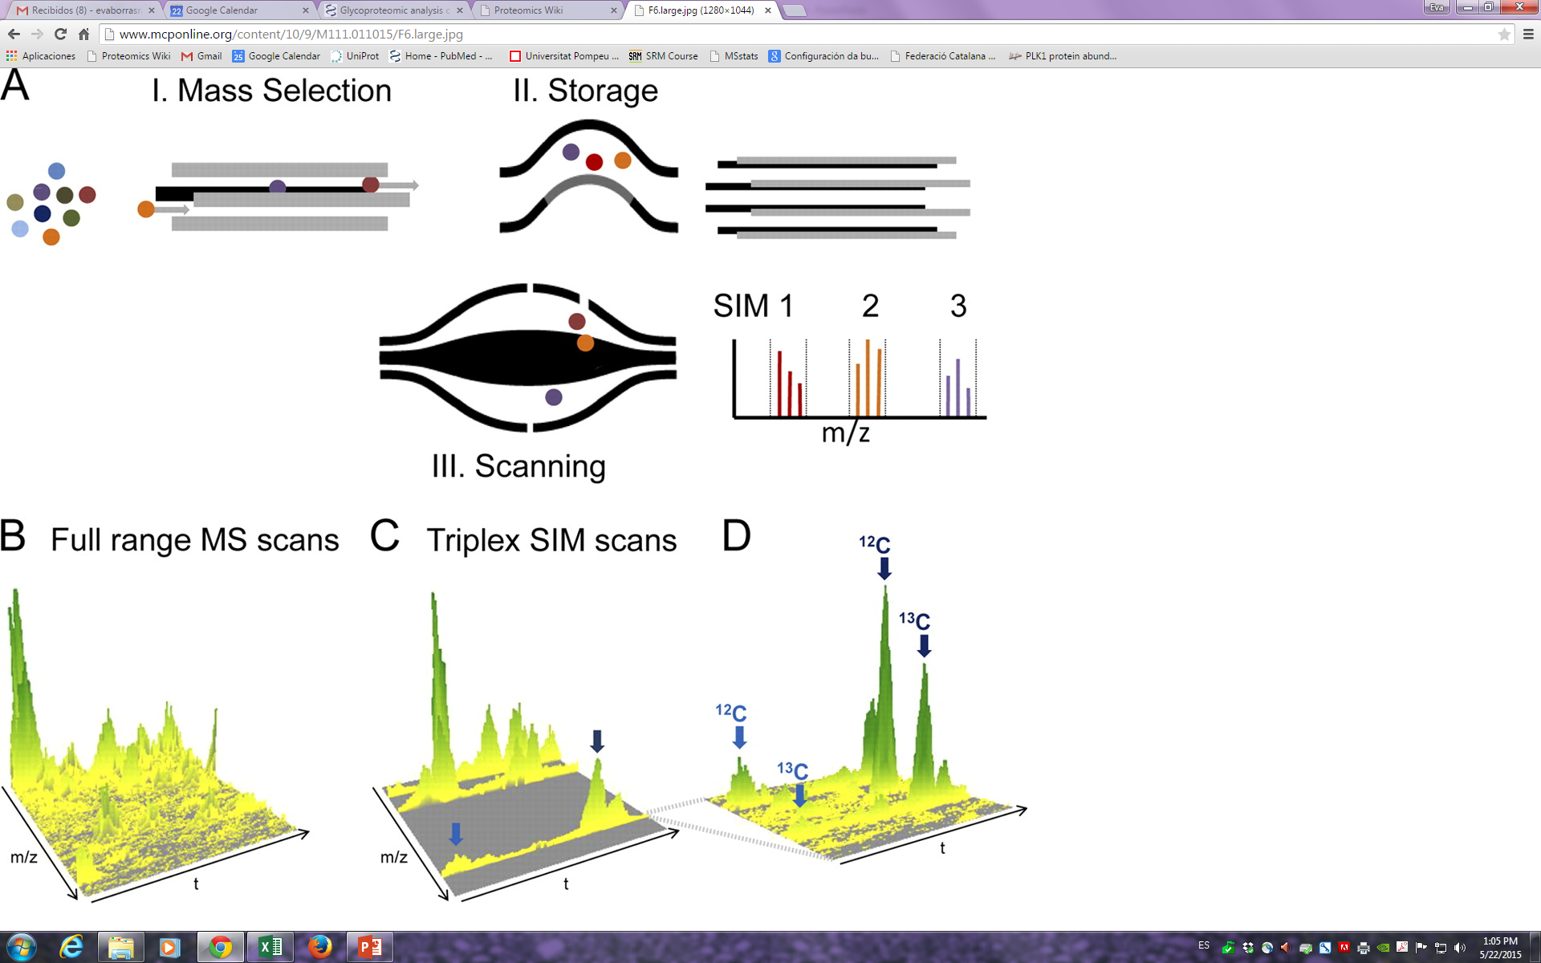
PRM is a targeted proteomics workflow
Mass spectrometry instruments
Low-resolution MS2 signal
One narrow scan per fragment
Hardware selected MS2 fragments
MS1
MS2
SRM
QUADRUPOLE
QUADRUPOLE
(m/z)₁
(m/z)₂
(m/z)₃
Isolation window 0.7 m/z
Isolation window 0.7 m/z
High-resolution MS2 signal
Full scan MS2
Software selected MS2 fragments
PRM
QUADRUPOLE
TOF / OT
Isolation window 1.4 m/z
m/z

Slide 17
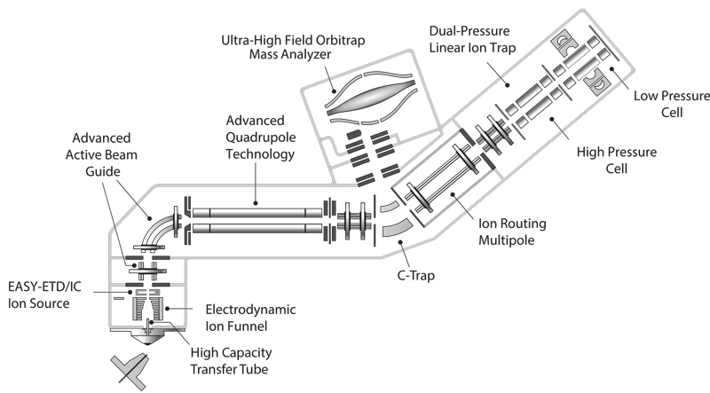
PRM is a targeted proteomics workflow
PRM in the Orbitrap Fusion Lumos
3
Precursor selection in quadrupole
    Isolation window
Precursor fragmentation in collision cell
    Fill time
    Collision energy
Fragment ion detection in the Orbitrap
    Resolving power
1
2
Notes:
In PRM mode, a limited m/z range including the precursor ions of interest is isolated by the quadrupole (1), transmitted via the C-trap to the HCD cell where corresponding fragment ions are generated and accumulated (2). Fragment ions are then transferred back into the C-trap (3) and eventually injected and analyzed in the orbitrap mass analyzer (4). The actual quantification of endogenous peptides is performed on the peak areas of corresponding selected fragment ions.
17

Slide 18
Peptide verification
Making sure that the integrated signal corresponds to the targeted peptide

Slide 19
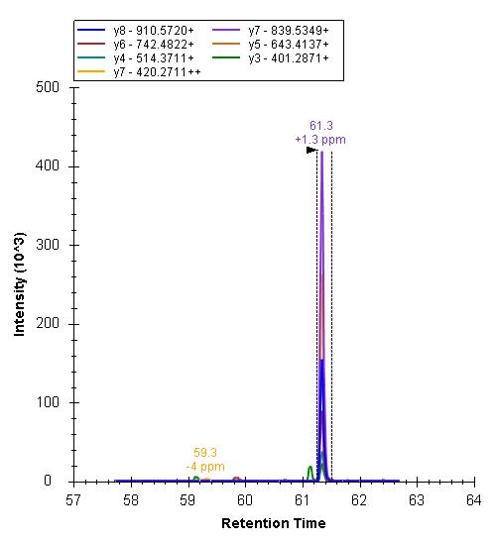
Peptide verification
Making sure that the integrated signal corresponds to the targeted peptide
1. Co-elution of concurrent transitions

Slide 20
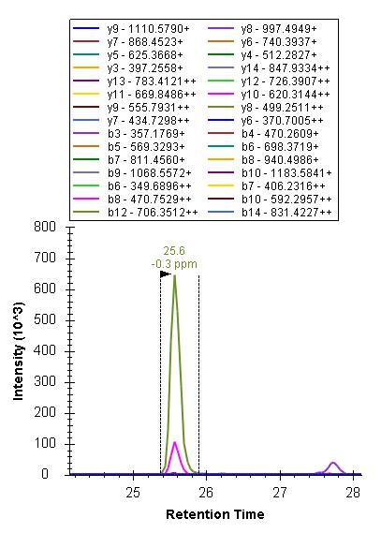
Peptide verification
Making sure that the integrated signal corresponds to the targeted peptide
1. Co-elution of concurrent transitions
2. Sequence information / coverage

Slide 21
Peptide verification
Making sure that the integrated signal corresponds to the targeted peptide
1. Co-elution of concurrent transitions
2. Sequence information / coverage
3. Reference MS2 spectra (libraries)

Slide 22
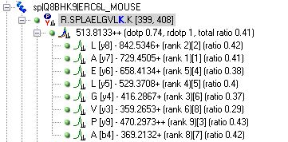
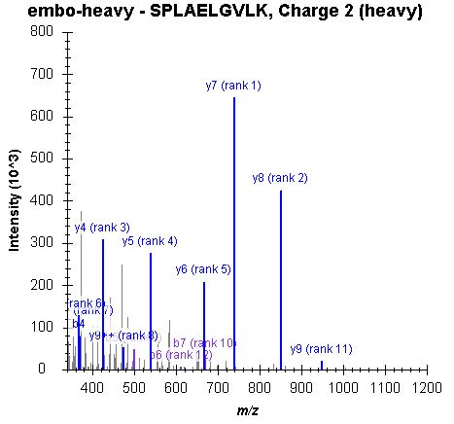
Peptide verification
Making sure that the integrated signal corresponds to the targeted peptide

Slide 23
Peptide verification
Making sure that the integrated signal corresponds to the targeted peptide
1. Co-elution of concurrent transitions
2. Sequence information / coverage
3. Reference MS2 spectra (libraries)
4. Retention time information

Slide 24
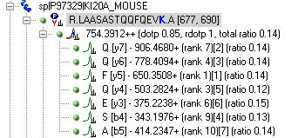
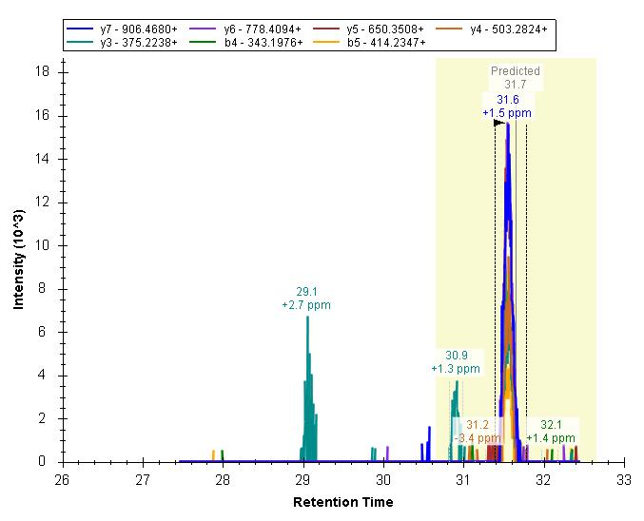
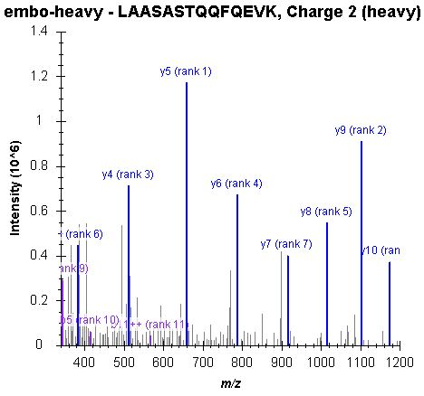
Peptide verification
Making sure that the integrated signal corresponds to the targeted peptide

Slide 25
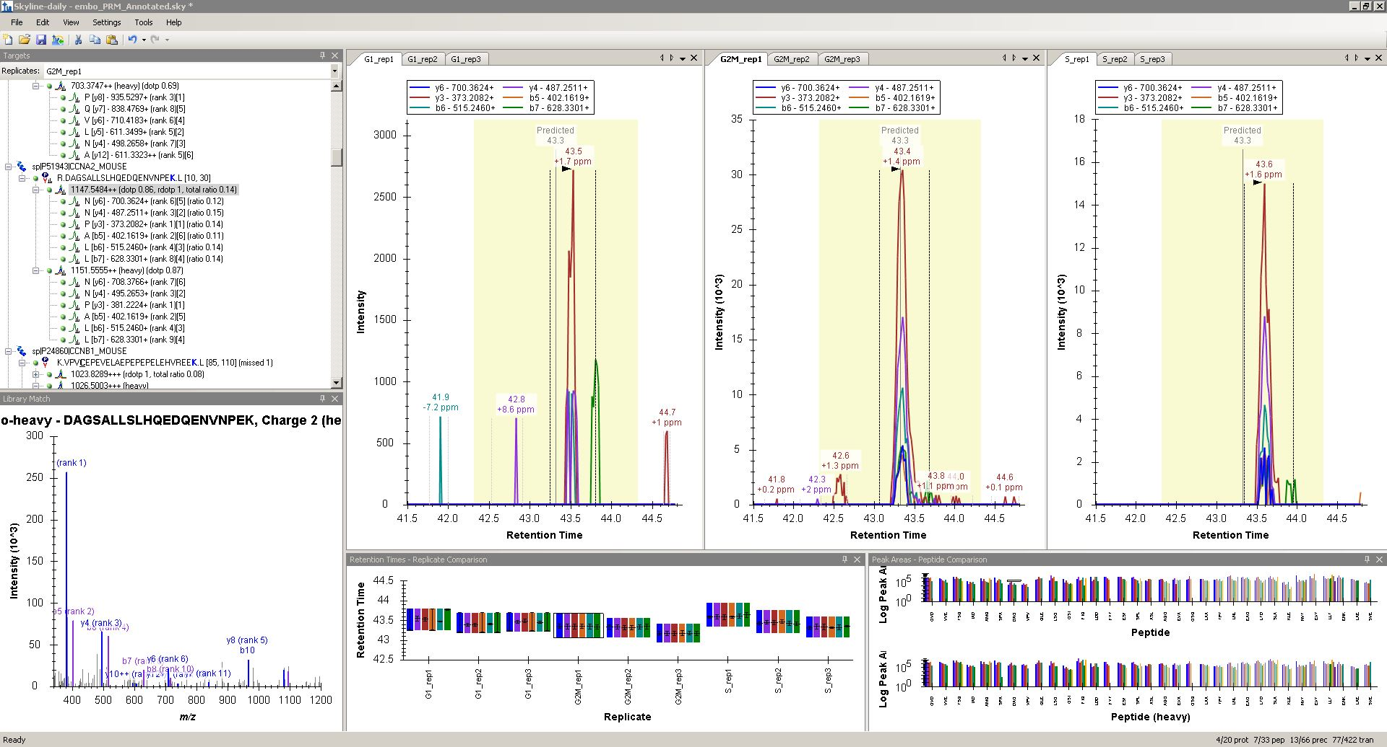
Peptide verification
Making sure that the integrated signal corresponds to the targeted peptide

Slide 26
Peptide verification
Making sure that the integrated signal corresponds to the targeted peptide
Notes:
Reduce matrix complexity: fractionation?
Low throughput
Quantitative challenge (reproducibility, robustness)
26

Slide 27
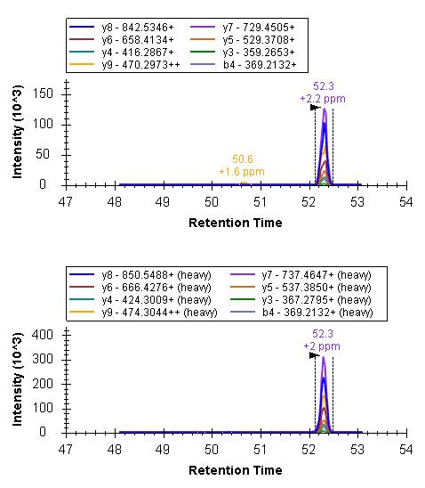
Peptide verification
Making sure that the integrated signal corresponds to the targeted peptide
1. Co-elution of concurrent transitions
2. Sequence information / coverage
3. Reference MS2 spectra (libraries)
4. Retention time information
5. Reference internal standard

Slide 28
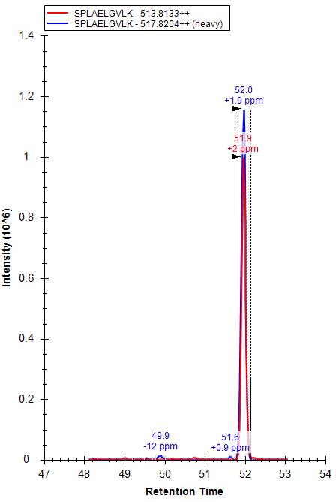
Peptide verification
Making sure that the integrated signal corresponds to the targeted peptide

Slide 29
Peptide quantification
Aim for a peptide quantification with high accuracy and precision

Slide 30
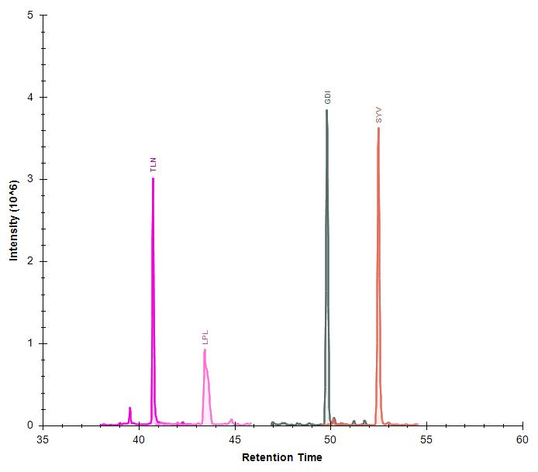
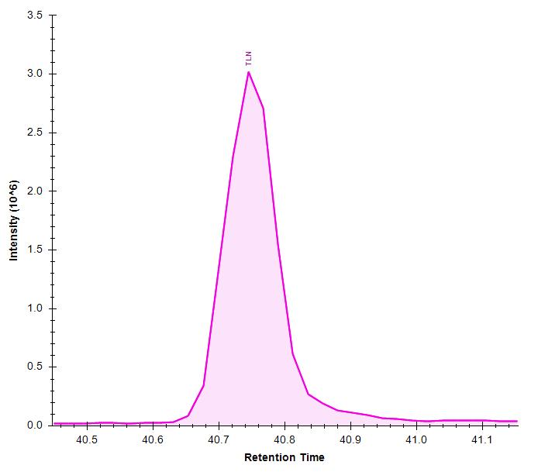
Peptide quantification
Aim for a peptide quantification with high accuracy and precision
8-10 points across chromatographic peak to define elution profile
5
6
4
3
7
2
8
9
1
10
Notes:
Importance of experimental design
30

Slide 31
Peptide quantification
Aim for a peptide quantification with high accuracy and precision
Theoretical
Healthy
Disease
Theoretical
Disease
Healthy
4 points across chromatography peak

Slide 32
Peptide quantification
Aim for a peptide quantification with high accuracy and precision
Calibration strategies with internal standards
Single-point calibration
External calibration curve
Reverse calibration curve
Webinar #13 (2016)
Calibrated Quantification with Skyline
Chris Shuford
Notes:
Importance of experimental design
32

Slide 33
Peptide quantification
Aim for a peptide quantification with high accuracy and precision
Single-point calibration
heavy internal standard
We establish the calibration line with two points
  The response of the heavy internal standard
  The zero — that is, zero response for zero concentration.
We assume a linear range response
Area
endogenous
peptide
0
0
50
100
150
200
250
300
Concentration
Notes:
Importance of experimental design
33

Slide 34
Peptide quantification
Aim for a peptide quantification with high accuracy and precision
Single-point calibration
ULOQ
heavy internal standard
We establish the calibration line with two points
  The response of the heavy internal standard
  The zero — that is, zero response for zero concentration.
We assume a linear range response
Area
endogenous
peptide
LLOQ
LOD
0
0
50
100
150
200
250
300
Concentration
Notes:
Importance of experimental design
34

Slide 35
Sensitivity and selectivity: a double boost for PRM
PRM in the Orbitrap Fusion Lumos
3
Precursor selection in quadrupole
    Isolation window
Precursor fragmentation in collision cell
    Fill time
    Collision energy
Fragment ion detection in the Orbitrap
    Resolving power
1
2
Notes:
In PRM mode, a limited m/z range including the precursor ions of interest is isolated by the quadrupole (1), transmitted via the C-trap to the HCD cell where corresponding fragment ions are generated and accumulated (2). Fragment ions are then transferred back into the C-trap (3) and eventually injected and analyzed in the orbitrap mass analyzer (4). The actual quantification of endogenous peptides is performed on the peak areas of corresponding selected fragment ions.
35

Slide 36
Sensitivity and selectivity: a double boost for PRM
PRM in the Orbitrap Fusion Lumos
3
Precursor selection in quadrupole
    Isolation window
Precursor fragmentation in collision cell
    Fill time
    Collision energy
Fragment ion detection in the Orbitrap
    Resolving power
1
2
SENSITIVITY
SELECTIVITY
Notes:
In PRM mode, a limited m/z range including the precursor ions of interest is isolated by the quadrupole (1), transmitted via the C-trap to the HCD cell where corresponding fragment ions are generated and accumulated (2). Fragment ions are then transferred back into the C-trap (3) and eventually injected and analyzed in the orbitrap mass analyzer (4). The actual quantification of endogenous peptides is performed on the peak areas of corresponding selected fragment ions.
36

Slide 37
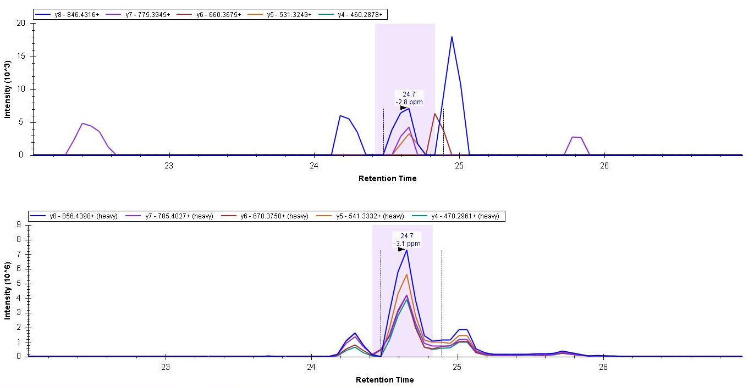
Sensitivity and selectivity: a double boost for PRM
PRM in the Orbitrap Fusion Lumos
Fill time = 60 ms Res Power = 30K
Notes:
In PRM mode, a limited m/z range including the precursor ions of interest is isolated by the quadrupole (1), transmitted via the C-trap to the HCD cell where corresponding fragment ions are generated and accumulated (2). Fragment ions are then transferred back into the C-trap (3) and eventually injected and analyzed in the orbitrap mass analyzer (4). The actual quantification of endogenous peptides is performed on the peak areas of corresponding selected fragment ions.
37

Slide 38
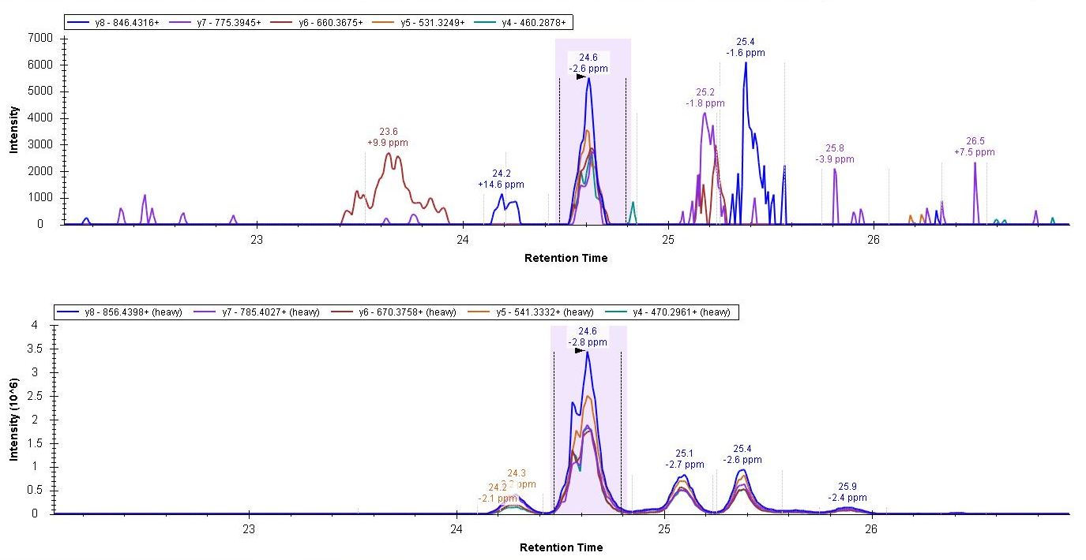
Sensitivity and selectivity: a double boost for PRM
PRM in the Orbitrap Fusion Lumos
Fill time = 250 ms Res Power = 120K
Notes:
In PRM mode, a limited m/z range including the precursor ions of interest is isolated by the quadrupole (1), transmitted via the C-trap to the HCD cell where corresponding fragment ions are generated and accumulated (2). Fragment ions are then transferred back into the C-trap (3) and eventually injected and analyzed in the orbitrap mass analyzer (4). The actual quantification of endogenous peptides is performed on the peak areas of corresponding selected fragment ions.
38

Slide 39
Sensitivity and selectivity: a double boost for PRM
PRM in the Orbitrap Fusion Lumos
3
1
2
P1
P2
P3
P4
P5
Fill Time (120 ms)
Transient length OT (60k 120ms)
120ms
Notes:
In PRM mode, a limited m/z range including the precursor ions of interest is isolated by the quadrupole (1), transmitted via the C-trap to the HCD cell where corresponding fragment ions are generated and accumulated (2). Fragment ions are then transferred back into the C-trap (3) and eventually injected and analyzed in the orbitrap mass analyzer (4). The actual quantification of endogenous peptides is performed on the peak areas of corresponding selected fragment ions.
39

Slide 40
Sensitivity and selectivity: a double boost for PRM
PRM in the Orbitrap Fusion Lumos
3
1
2
P1
P2
P3
P4
P5
Fill Time (120 ms)
Transient length OT (60k 120ms)
120ms
P1
P2
P3
P4
P5
Fill Time (60 ms)
Transient length OT (60k 120ms)
120 ms
P1
P2
P3
P4
P5
Fill Time (120 ms)
Transient length OT (30k 60ms)
120ms
Notes:
In PRM mode, a limited m/z range including the precursor ions of interest is isolated by the quadrupole (1), transmitted via the C-trap to the HCD cell where corresponding fragment ions are generated and accumulated (2). Fragment ions are then transferred back into the C-trap (3) and eventually injected and analyzed in the orbitrap mass analyzer (4). The actual quantification of endogenous peptides is performed on the peak areas of corresponding selected fragment ions.
40

Slide 41
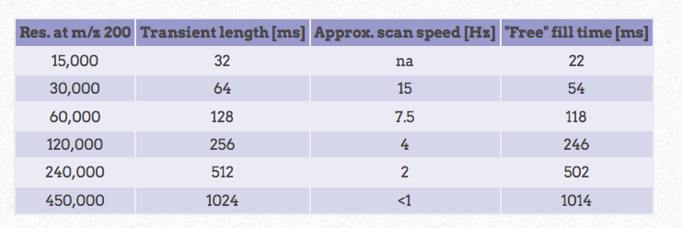
Sensitivity and selectivity: a double boost for PRM
PRM in the Orbitrap Fusion Lumos

Slide 42
Sensitivity and selectivity: a double boost for PRM
PRM in the Orbitrap Fusion Lumos
THROUGHPUT
# peptides
CYCLE
TIME
SELECTIVITY
OT Resolution
SENSITIVITY
Fill Time

Slide 43
Sensitivity and selectivity: a double boost for PRM
PRM in the Orbitrap Fusion Lumos
Scheduled PRM
THROUGHPUT
# peptides
Peptide 5
Peptide 4
Peptide 3
Peptide 2
CYCLE
TIME
Peptide 1
SELECTIVITY
OT Resolution
SENSITIVITY
Fill Time
0
time
90
Chromatographic gradient

Slide 44
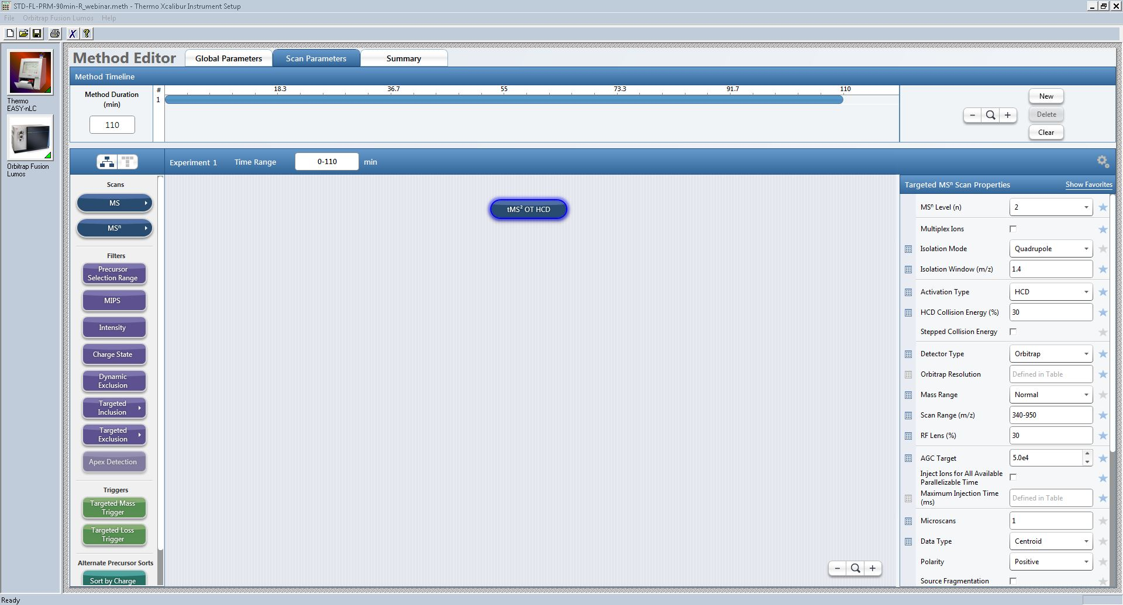
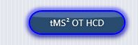
Orbitrap Fusion Lumos Method Editor for PRM

Slide 45
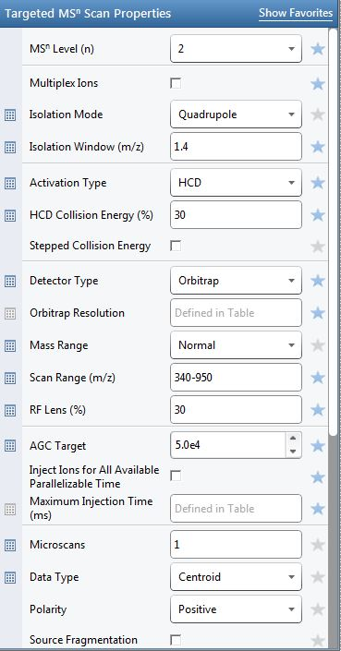

Slide 46
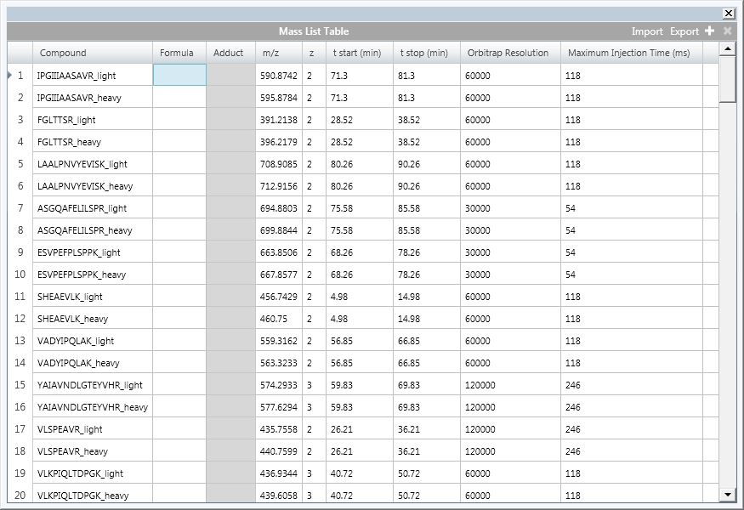
Orbitrap Fusion Lumos Method Editor for PRM

Slide 47
More PRM Webinars
Webinar #3 (2013)
PRM Targeted Proteomics Using Full-Scan MS and Skyline
Bruno Domon
Webinar #9 (2015)
Research-grade targeted proteomics assay development: PRM for PTM studies with Skyline.
Jacob D. Jaffe
Other webinars
https://skyline.ms/wiki/home/software/Skyline/page.view?name=webinars

Slide 48
Hands-on tutorial
PRM method development and step-by-step analysis of Lumos PRM data

Slide 49
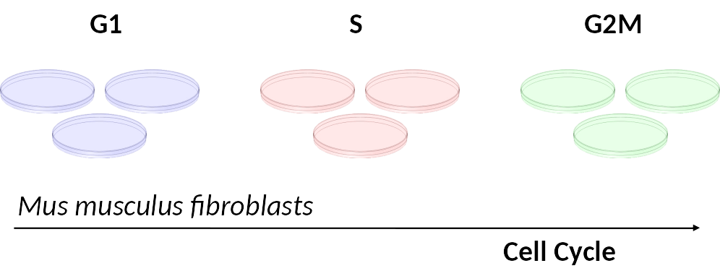
Hands-on tutorial
PRM method development and step-by-step analysis of Lumos PRM data
31 peptides from 19 proteins related to the cell cycle of mouse fibroblasts

Slide 50
Hands-on tutorial
PRM method development and step-by-step analysis of Lumos PRM data
1. Setting up a Skyline document for PRM acquisition
2. Prepare and export the PRM method
3. PRM data analysis

Slide 51
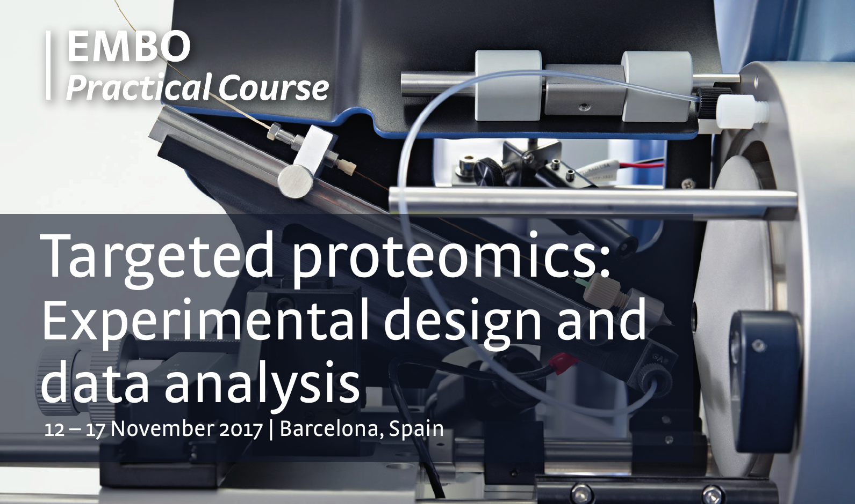
Hands-on tutorial
PRM method development and step-by-step analysis of Lumos PRM data
EMBO Practical Course on Targeted Proteomics
Barcelona, 11-16 November 2018
Registration Opens March 2018
Other courses
https://skyline.ms/project/home/software/Skyline/events/begin.view?

Slide 52
Learn More
Webinar #18: TBD (coming soon)
  Listings updated in Join Us section of Skyline homepage:
  https://skyline.ms/Skyline.url
Weeklong Courses 2018
  Buck Institute, Novato, CA – April 2-6
  NEU, Boston – April 30 – May 11
  ETH, Zurich – July 2-6
  U. of Wa., Seattle – July 30 – August 3
  New! Duke, Durham, NC – September 17-21
  CRG, Barcelona – November 12-16
  Shanghai – October 22-26
Workshops and Conferences 2018
  MSACL, Palm Springs – January 20&21
  pre-Lorne, Melbourne – January 29-31
  IIT Bombay, Mumbai – February
  US HUPO, Minneapolis – March 10&11
  ASMS, San Diego – June 2&3
  User Group Meeting at ASMS, San Diego – June 3
  CNPEM, Campinas, Brazil – November 7-9

Slide 53
Questions?
Ask any questions at the following form:
  https://skyline.ms/QA4Skyline.url
Take the post-webinar survey:
https://skyline.ms/survey4webinar.url

Slide 54
Tutorial Webinar #17
This ends this Skyline Tutorial Webinar.
Please give us feedback on the webinar at the following survey:
https://skyline.ms/survey4webinar.url
A recording of today’s meeting will be available shortly at the Skyline website.
We look forward to seeing you at a future Skyline Tutorial Webinar.

