Slide 1


Using DIA to inform the development of Cerebrospinal Fluid triple quad assays
Webinar #22: Using DIA Data To Create SRM Methods
Deanna L. Plubell MS
PhD Candidate, MacCoss Lab, University of Washington

Slide 2
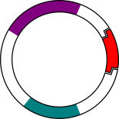


Strategies for building a new targeted triple quad assay:
Analysis of recombinant target proteins
Search for proteins in existing data
Use prediction algorithms for selecting peptides
101001001
001000101
110110100

Slide 3
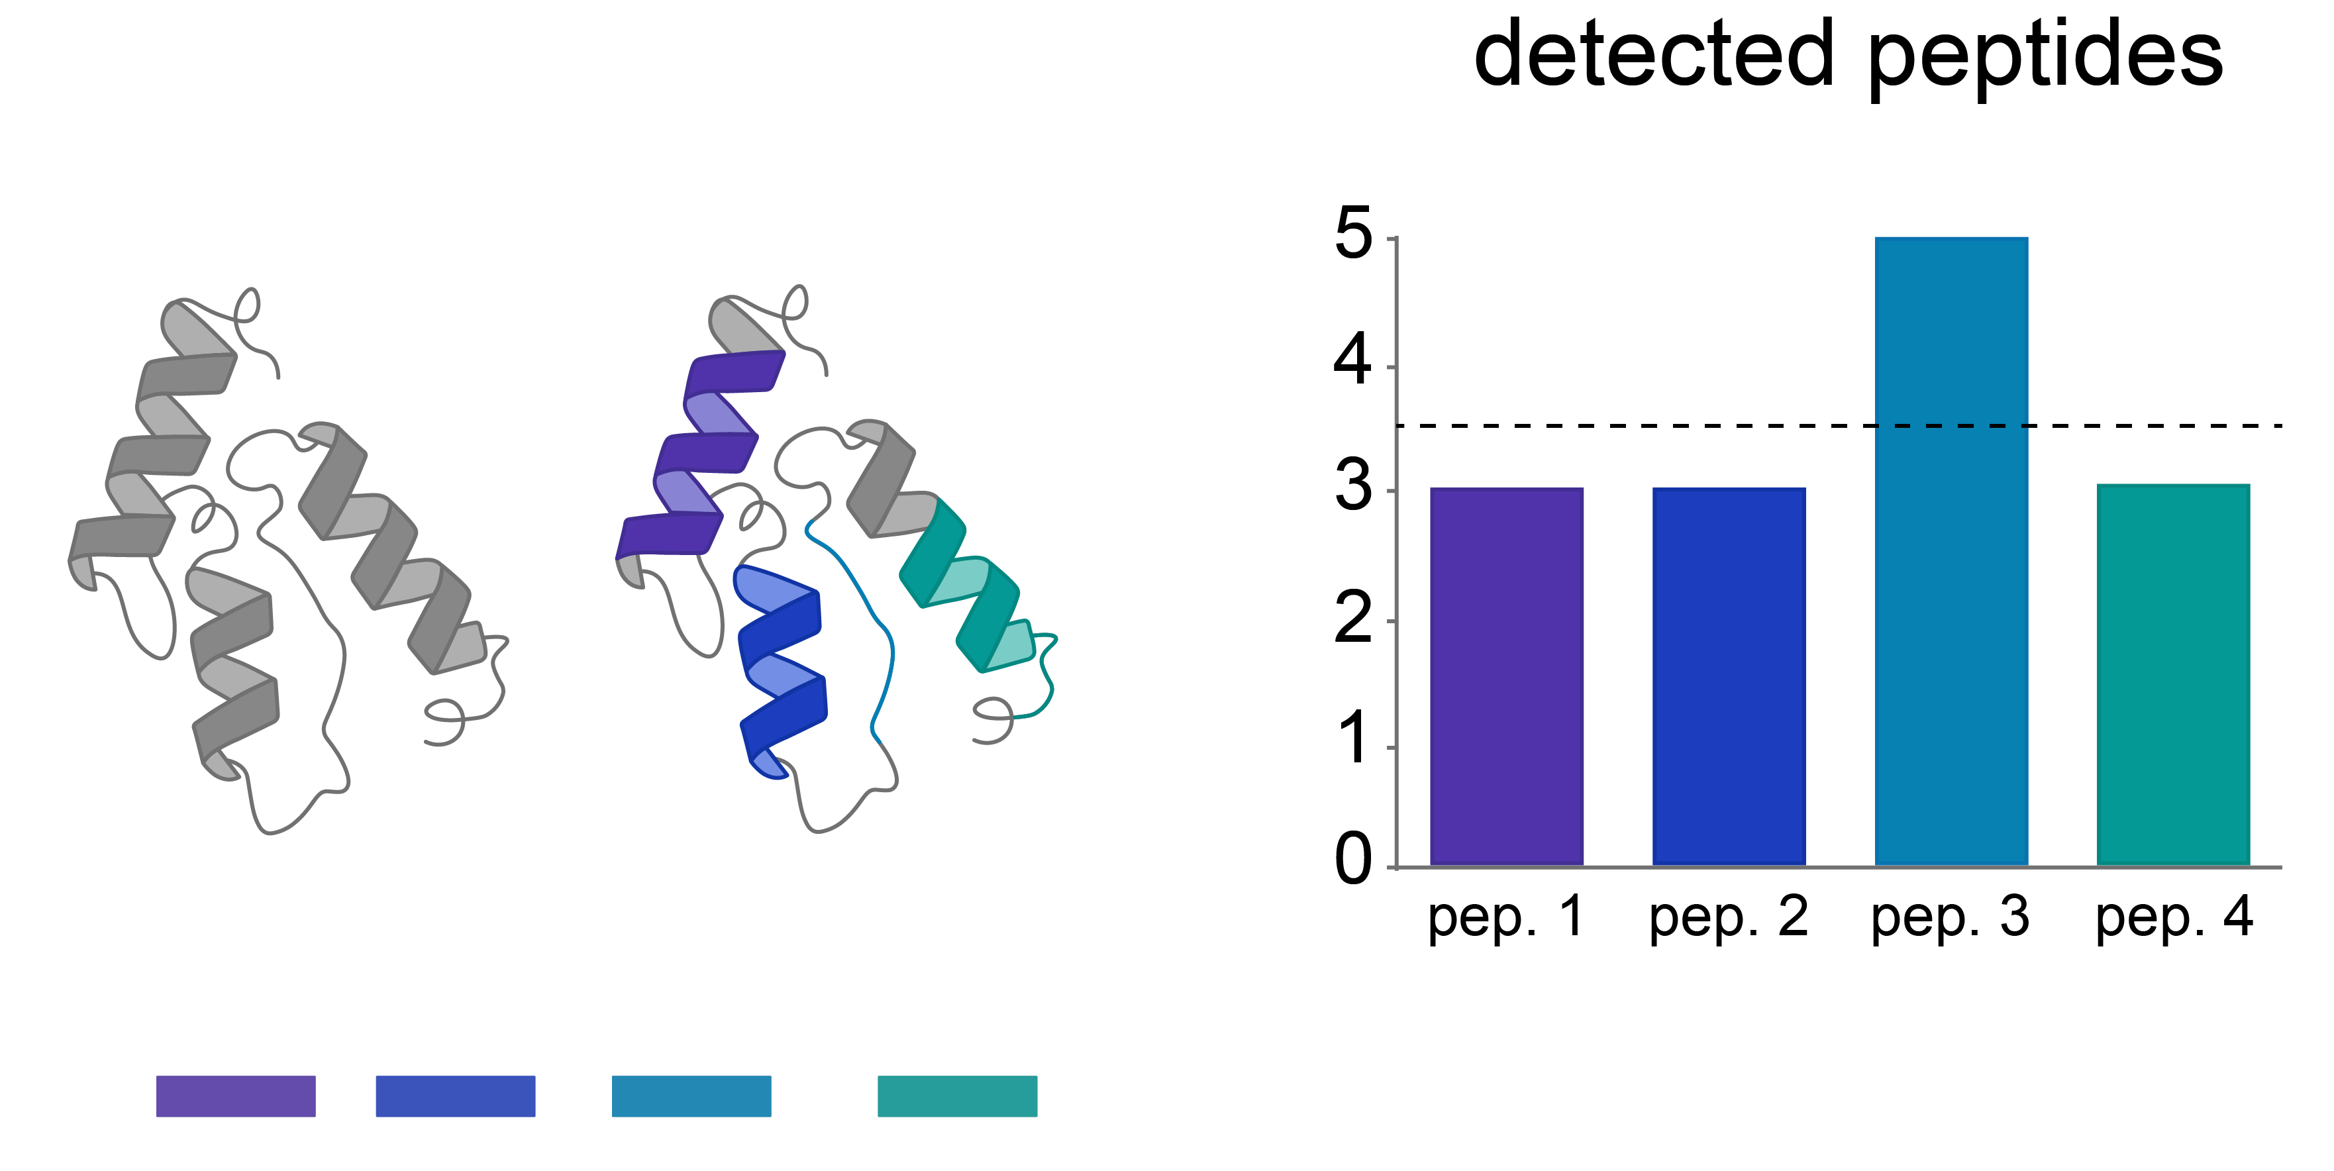
Using recombinant proteins to select peptides
Expand, Purify, & Sequence cDNA clone
In Vitro Transcription and Translation
Enrichment
digestion
detectable?
Measurement in a background matrix is important!
Notes:
Measure each individual protein/peptide
One protein at a time – 227 proteins, 227 digest sample prep separately, individual LC-ms runs
No conformation for folding, correcting for matrix,

Slide 4
Strategies for building a new targeted triple quad assay:
Analysis of recombinant target proteins
Search for proteins in existing data
Use prediction algorithms for selecting peptides
101001001
001000101
110110100

Slide 5
DDA is a poor indicator of SRM peptide performance
SRM
DDA
Apolipoprotein B
Bollinger, ASMS (2014)

Slide 6
Strategies for building a new targeted triple quad assay:
Analysis of recombinant target proteins
Search for proteins in existing data
Use prediction algorithms for selecting peptides
101001001
001000101
110110100

Slide 7
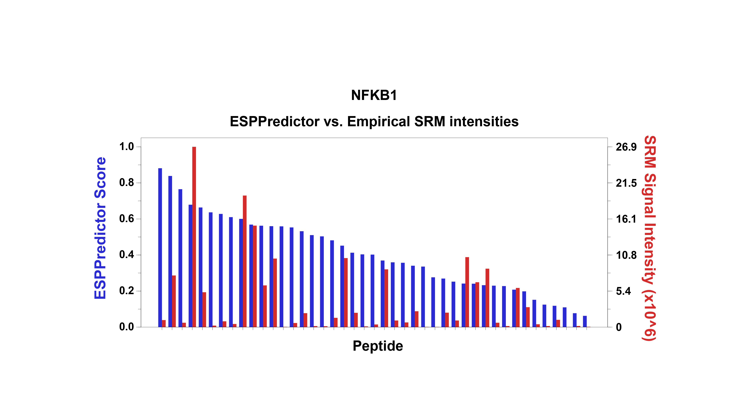
DDA is a poor predictor of SRM peptide performance
Stergachis et al., Nature Methods (2011)

Slide 8
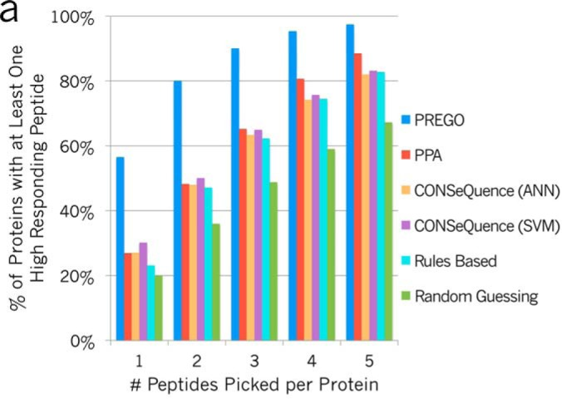
DIA is a better predictor of SRM peptide performance
Searle et al., Mol. Cell. Proteomics (2015)

Slide 9
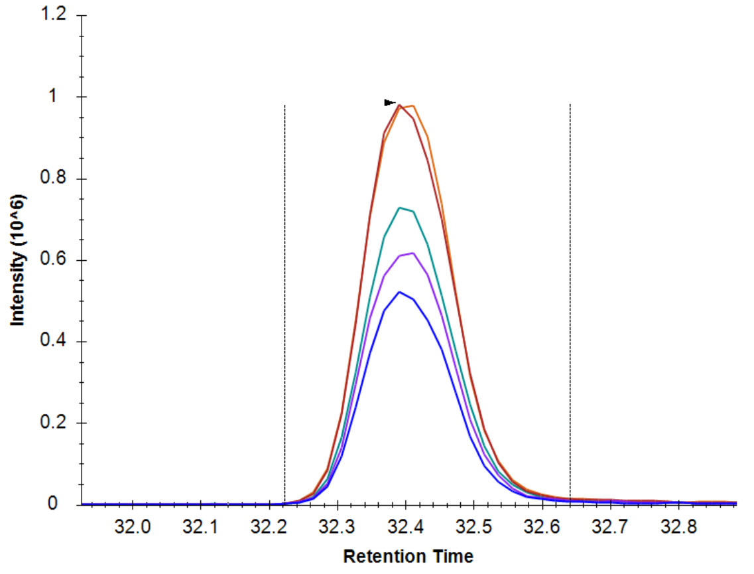
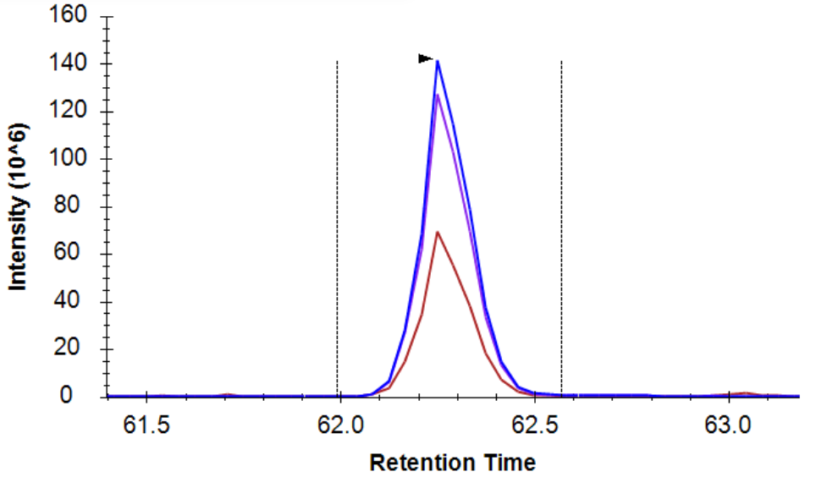
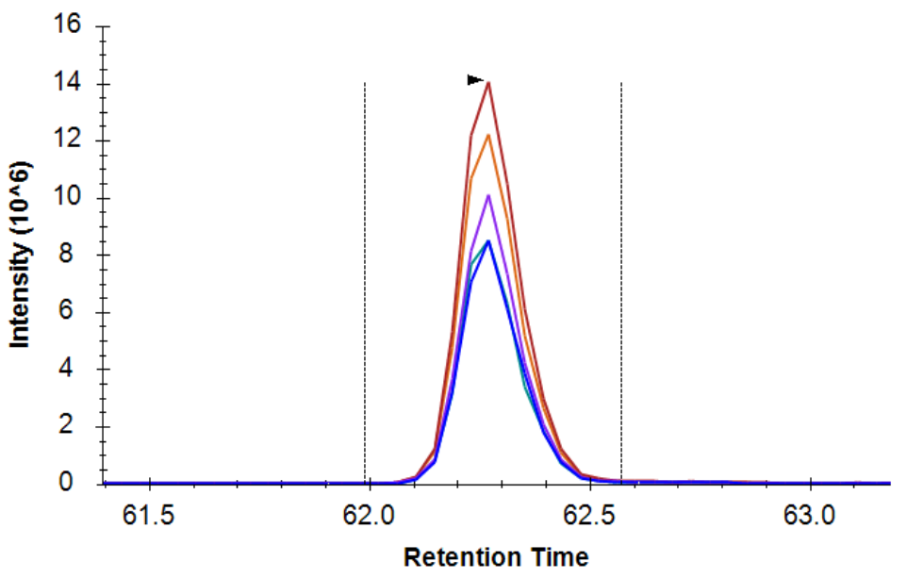
DIA provides evidence useful for SRM peptide selection
DIA more comprehensively measures fragment ions
End goal: fragment ion quant
MS1
MS2

Slide 10
Strategies for building a new targeted triple quad assay:
Analysis of recombinant target proteins
Search for proteins in existing data
Use prediction algorithms for selecting peptides
…now with DIA data
101001001
001000101
110110100

Slide 11
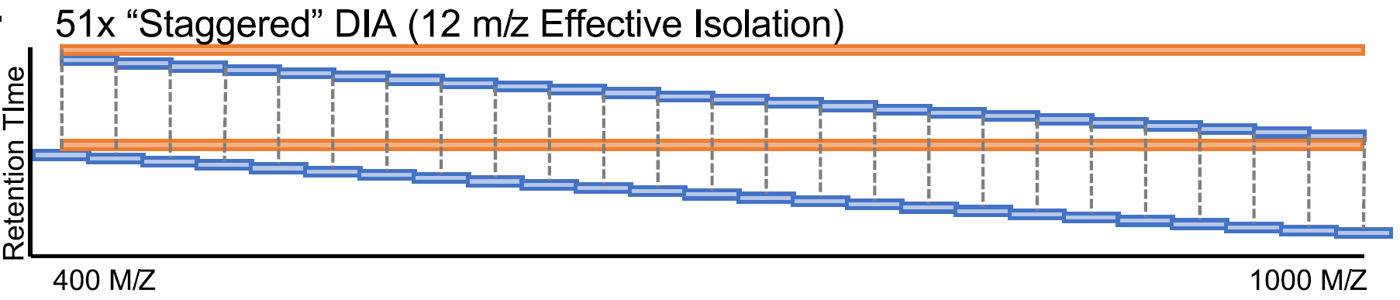
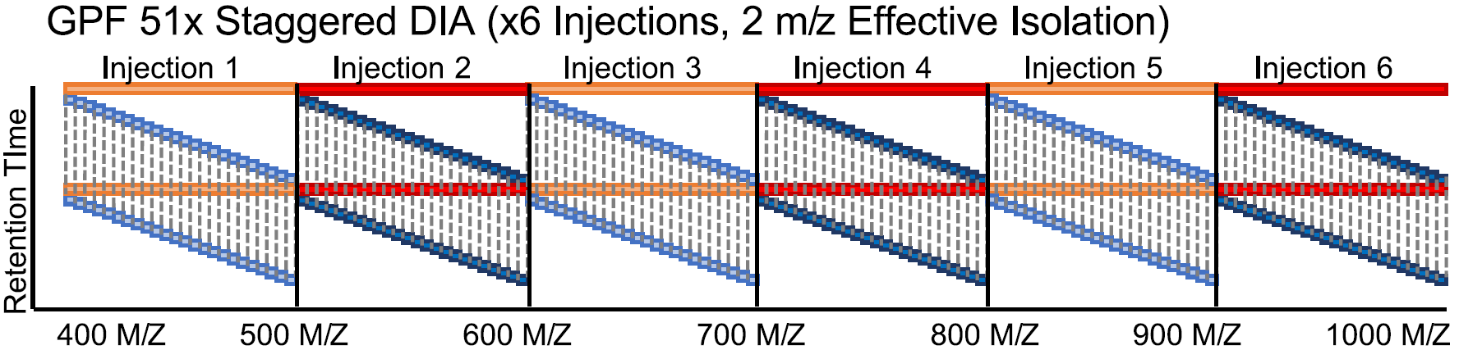
Gas-phase fractionated DIA: narrow isolation
Pino L, et al., Mol. Cell. Prot. (2020)

Slide 12

Gas-phase fractionated DIA: narrow isolation
52 4 m/z-overlapping narrow windows
400
Precursor m/z
500
4 m/z
Time
2 m/z
Panchaud, A, et al., Anal. Chem. (2009); Ting, Y, et al., Nat. Meth., (2017); Searle, B, et al., Nat. Comm., (2019)

Slide 13
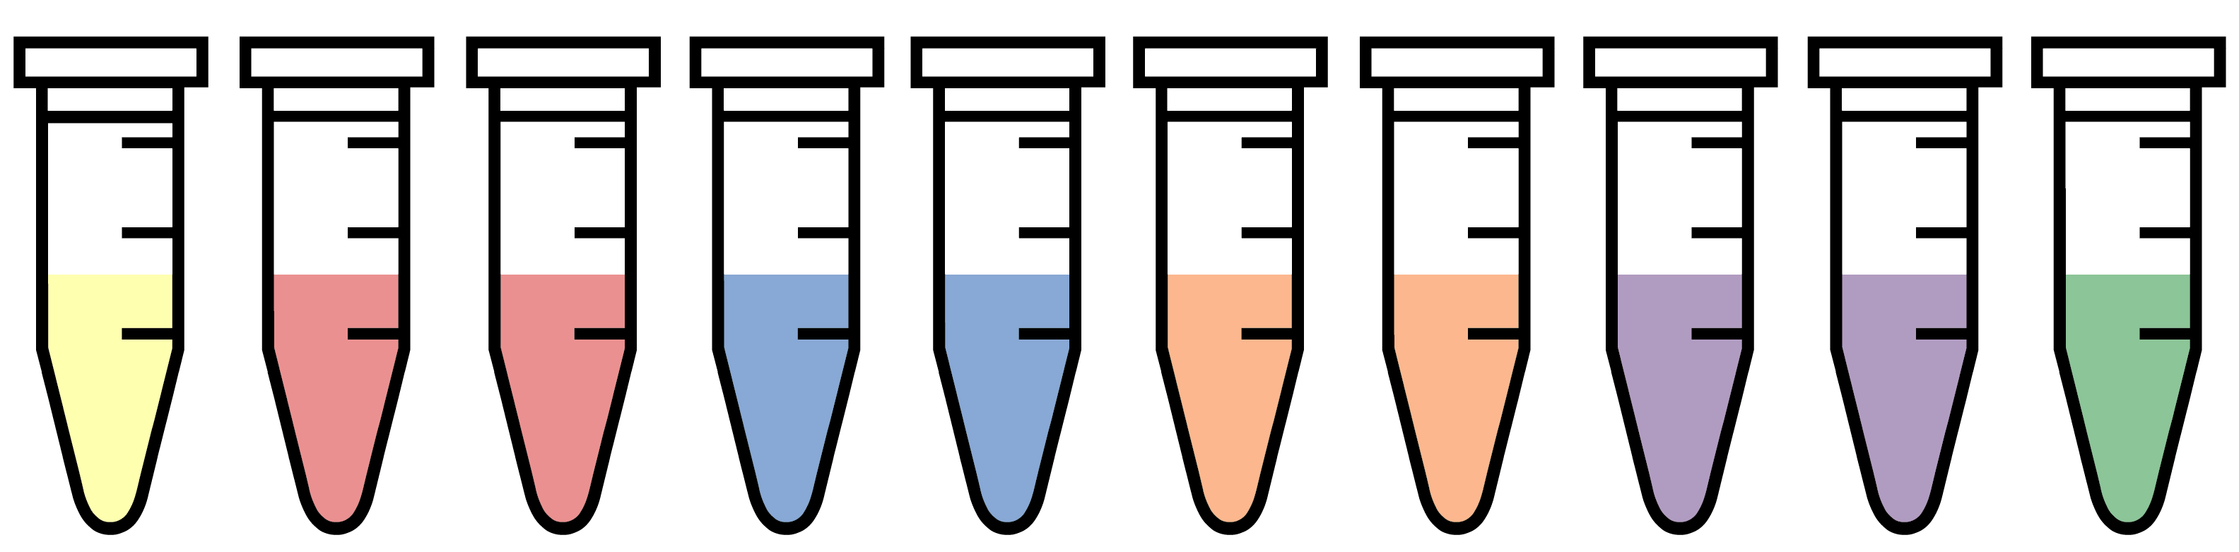

Replicate narrow DIA provide peptide knowledge base
peptide knowledge base
%CV cutoff
day 1
+
pooled
sample
Signal processing
day 2
top ranked transitions
day 3
gas phase fractionated narrow window DIA
chromatogram extraction
peptide & transition filtering
method scheduling
statistical priors

Slide 14
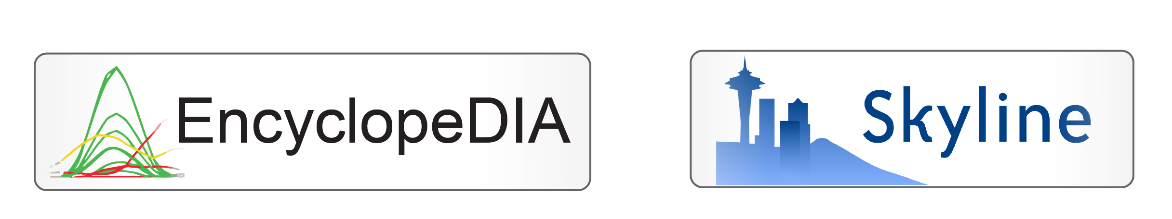
Replicate narrow DIA provide peptide knowledge base
peptide knowledge base
%CV cutoff
day 1
+
pooled
sample
Signal processing
day 2
top ranked transitions
day 3
gas phase fractionated narrow window DIA
chromatogram extraction
peptide & transition filtering
method scheduling
statistical priors
Precursor-product ion pair detection
relative retention time
Co-elution
Searle et al., Nat. Comm (2018)

Slide 15
Replicate narrow DIA provide peptide knowledge base
peptide knowledge base
%CV cutoff
day 1
+
pooled
sample
Signal processing
day 2
top ranked transitions
day 3
gas phase fractionated narrow window DIA
chromatogram extraction
peptide & transition filtering
method scheduling
statistical priors
Quantitation of peptides
Visualization of chromatography

Slide 16
Replicate narrow DIA provide peptide knowledge base
peptide knowledge base
%CV cutoff
day 1
+
pooled
sample
Signal processing
day 2
top ranked transitions
day 3
gas phase fractionated narrow window DIA
chromatogram extraction
peptide & transition filtering
method scheduling
statistical priors
Filtering for well performing peptides & product ions

Slide 17
Replicate narrow DIA provide peptide knowledge base
peptide knowledge base
%CV cutoff
day 1
+
pooled
sample
Signal processing
day 2
top ranked transitions
day 3
gas phase fractionated narrow window DIA
chromatogram extraction
peptide & transition filtering
method scheduling
statistical priors
Schedule new triple-quad method with spike-in iRT standard

Slide 18

Application to Alzheimer’s disease proteins in CSF
day 1
peptide knowledge base
%CV cutoff
+
pooled
sample
day 2
Signal processing
top ranked transitions
day 3
Cerebrospinal fluid:
gas phase fractionated narrow window DIA
statistical priors
chromatogram extraction
peptide & transition filtering
method scheduling
Parkinson’s Disease (n=30)
Alzheimer’s Disease (n=11)
Healthy Control (n=30)

Slide 19
Application to Alzheimer’s disease proteins in CSF
day 1
peptide knowledge base
%CV cutoff
+
pooled
sample
day 2
Signal processing
top ranked transitions
day 3
Cerebrospinal fluid:
gas phase fractionated narrow window DIA
statistical priors
chromatogram extraction
peptide & fragment filtering
method scheduling
Parkinson’s Disease (n=30)
Alzheimer’s Disease (n=11)
Healthy Control (n=30)

Slide 20
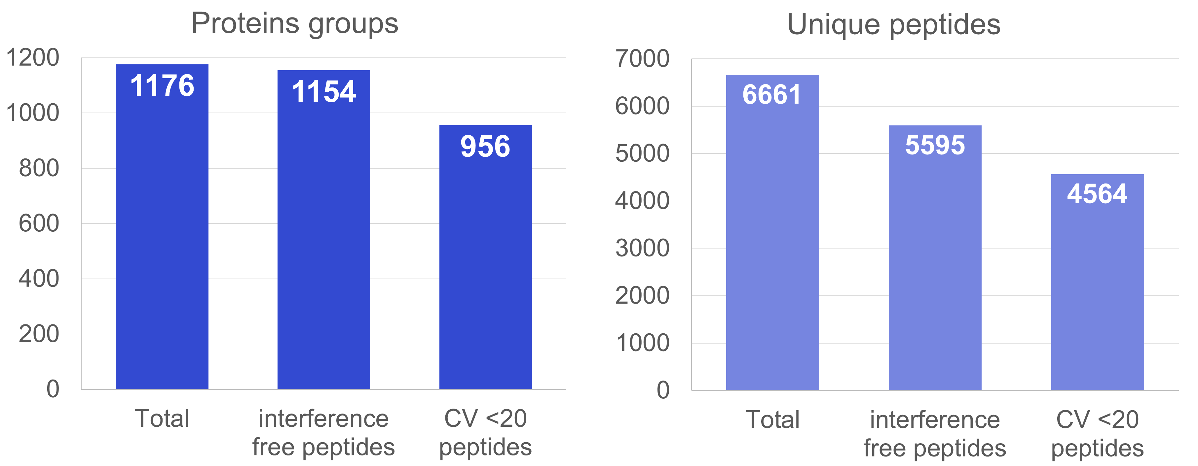
Not all proteins and peptides measured are reproducible

Slide 21
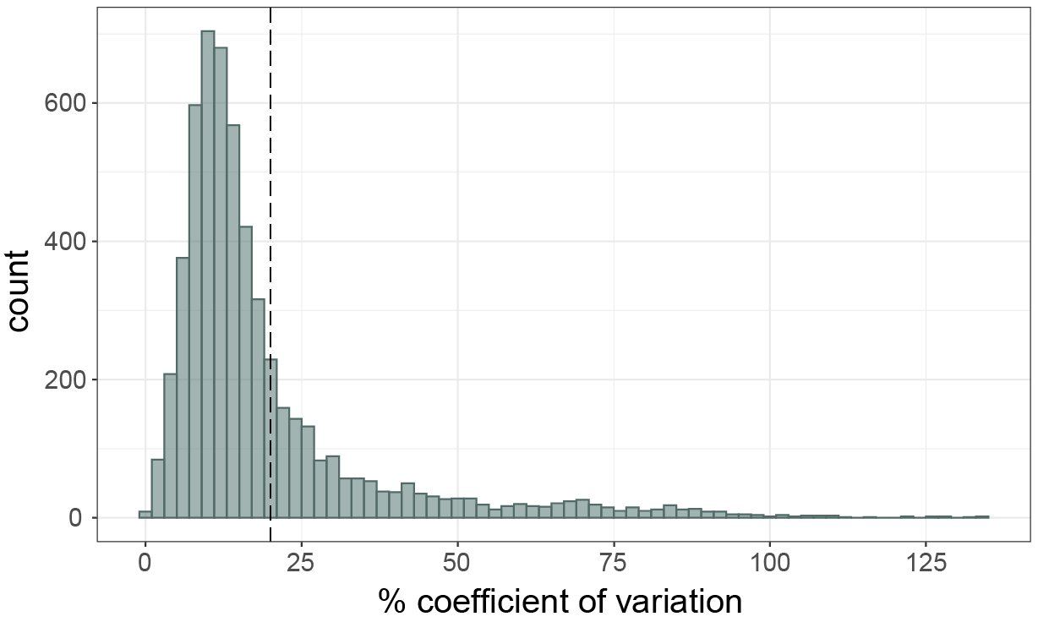
In our DIA a majority of peptides have less than 20% CV
20% CV

Slide 22
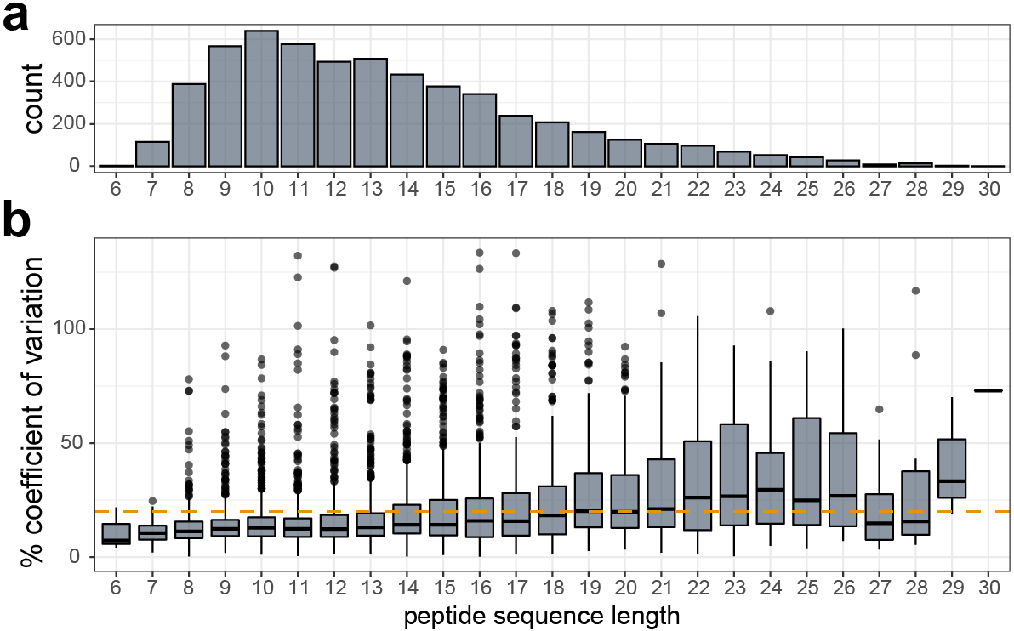
Reproducibility of peptides decreases with increasing sequence length.

Slide 23
Application to Alzheimer’s disease proteins in CSF
day 1
peptide knowledge base
%CV cutoff
+
pooled
sample
day 2
Signal processing
top ranked transitions
day 3
Cerebrospinal fluid:
gas phase fractionated narrow window DIA
statistical priors
chromatogram extraction
peptide & transition filtering
method scheduling
Parkinson’s Disease (n=30)
Alzheimer’s Disease (n=11)
Healthy Control (n=30)

Slide 24
Building an assay for Alzheimer’s disease proteins in CSF
Proteins of interest: 100 from previous Alzheimer’s assay
(Spellman et al., Proteomics Clin. Appl. 2016 )
Peptide filtering criteria for 2 peptides/protein of interest:
  5 interference-free product ions (top ranked intensity)
  <20 %CV
  Rank 1-2 based on total product intensity
Peptides from both previous assay and selected from DIA experiment measured in triplicate by SRM on Thermo Altis
%CV cutoff
+
top ranked transitions
peptide & transition filtering
method scheduling

Slide 25
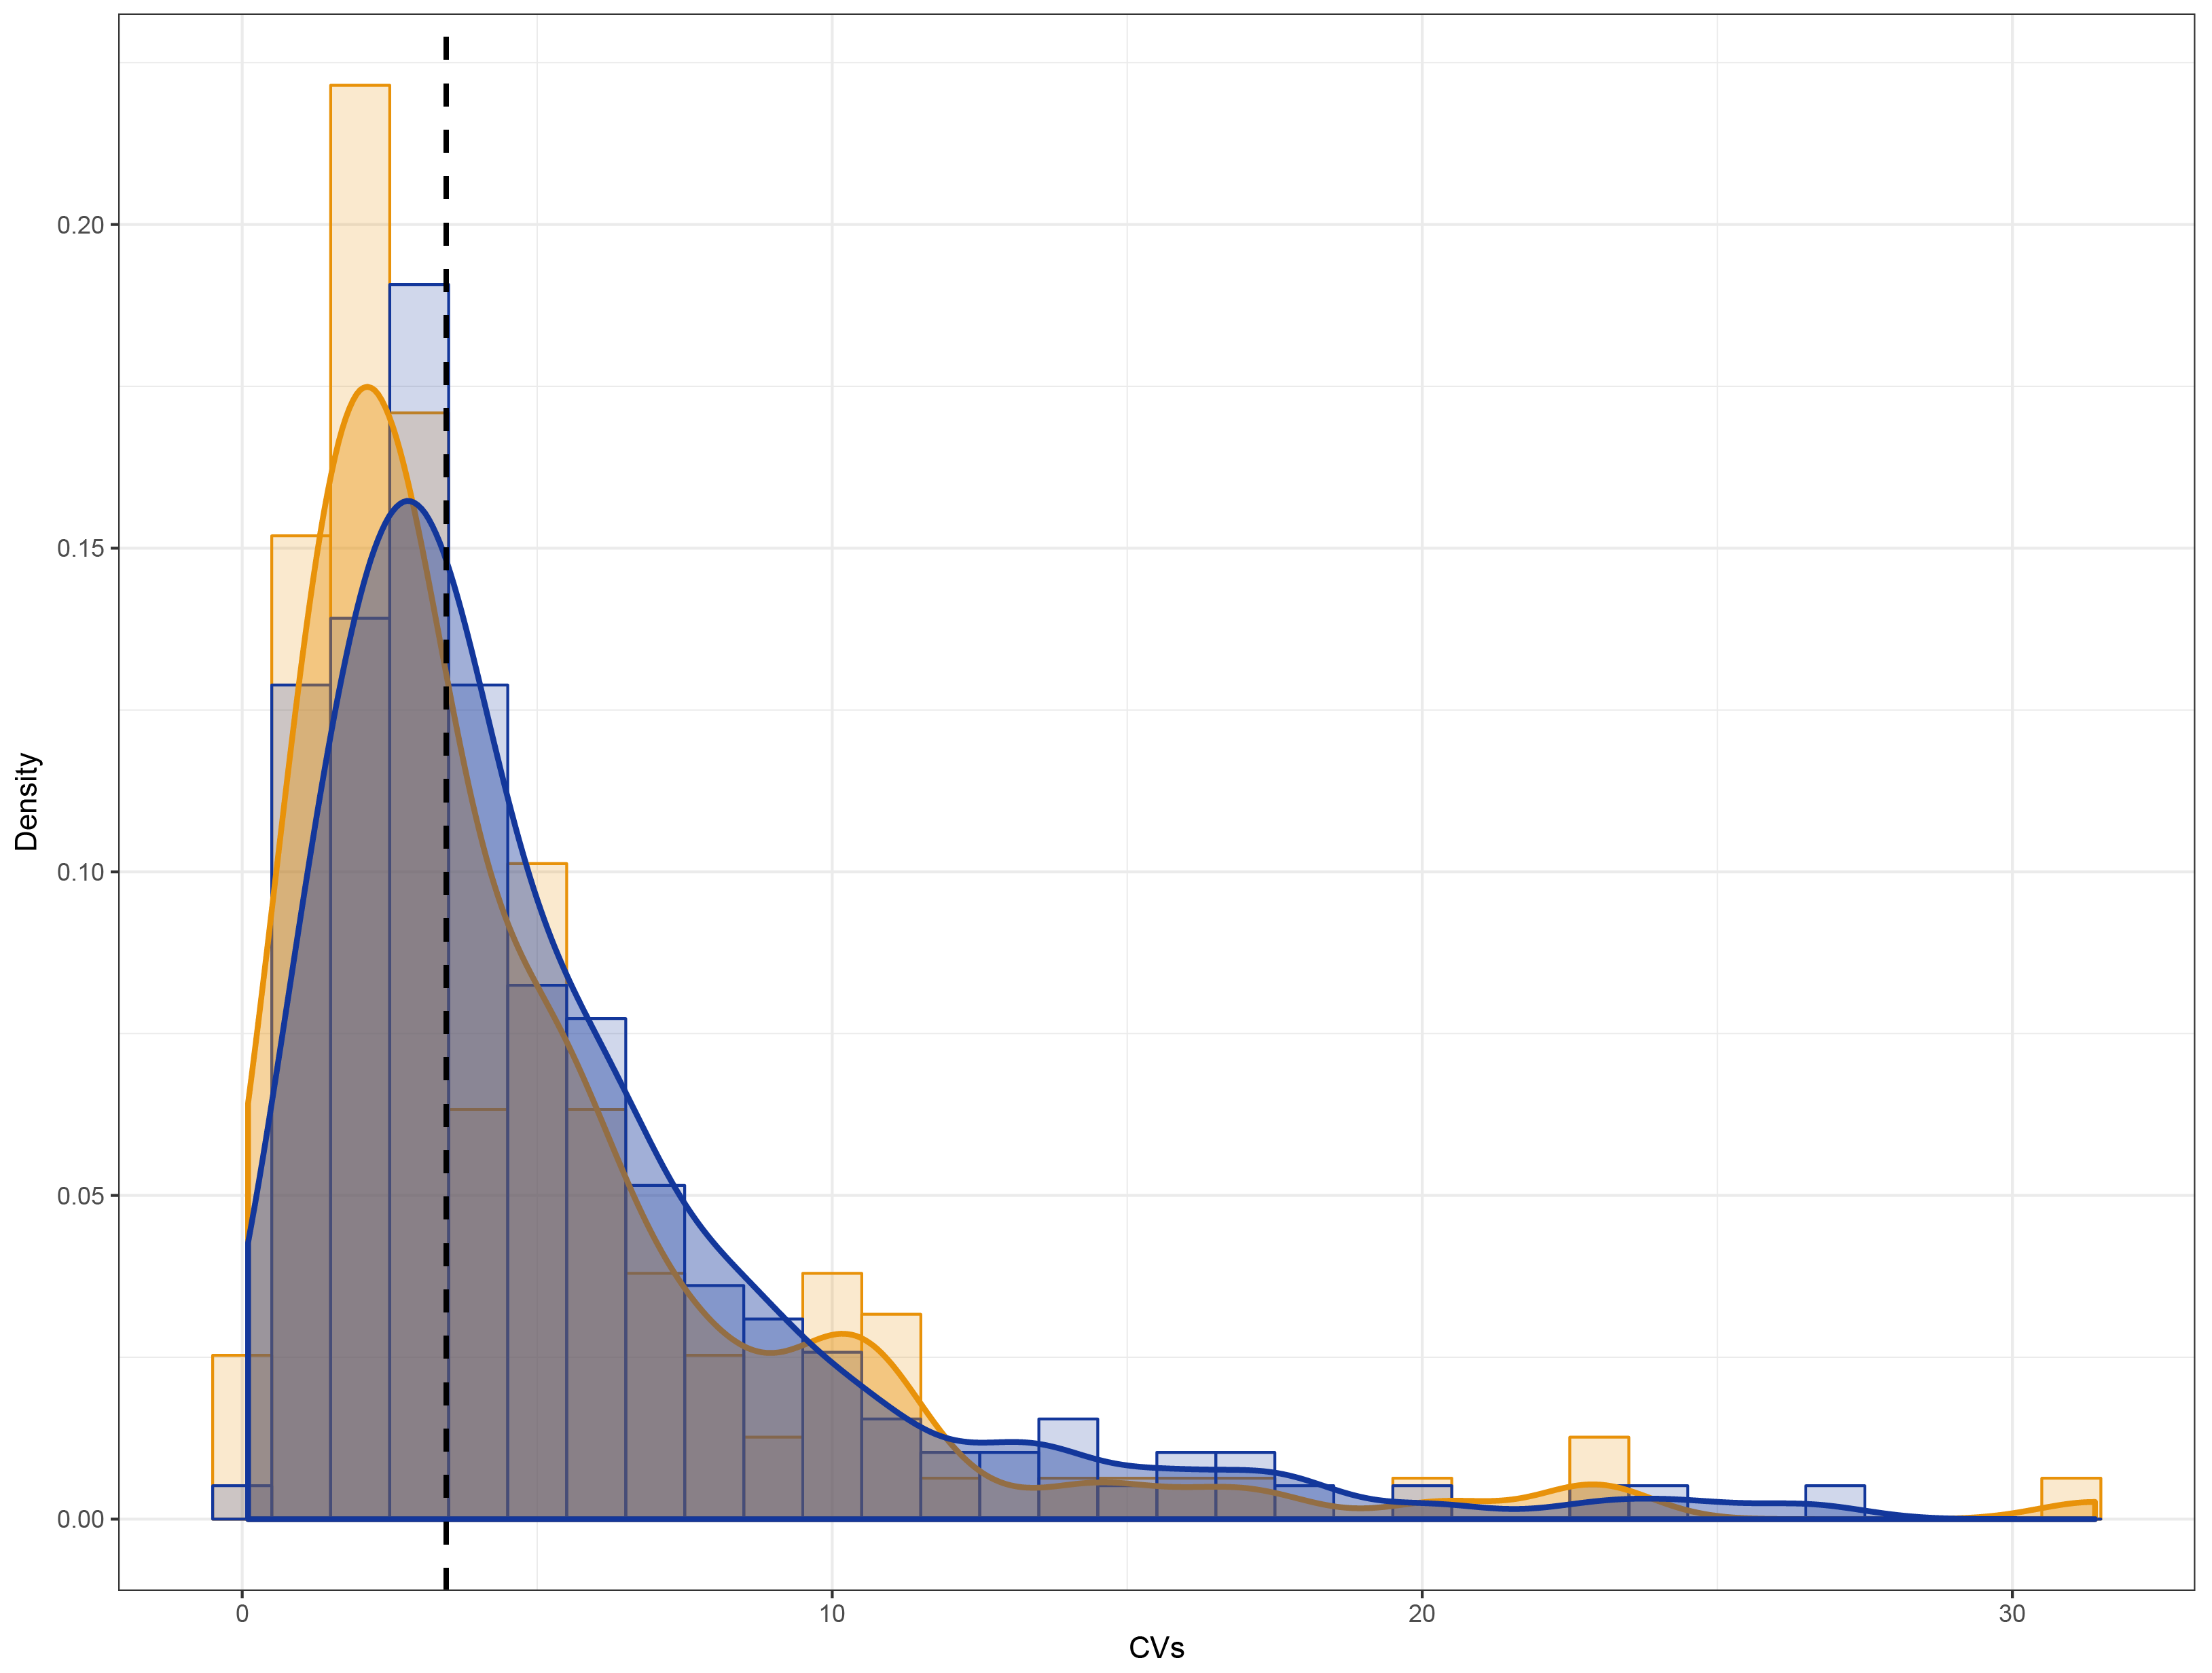
Peptides selected from narrow window DIA results perform similarly to previously characterized Alzheimer’s disease assay peptide selections
Peptides targeted in published assay
DIA peptide median
= 3.45%
122
54
count
146
Peptides selected from DIA results
% coefficient of variation

Slide 26


DIA provides useful information for expediting development of multiple triple quadrupole assays
peptide knowledge base
For precursor & product ion pairs:
Detectable in background
Retention time
Reproducibility
day 1
day 2
day 3
gas phase fractionated narrow window DIA

Slide 27
DIA provides useful information for expediting development of multiple triple quadrupole assays
peptide knowledge base
%CV cutoff
day 1
Multiple assays with good reproducibility
Relatively quick
Turnaround time
+
day 2
top ranked transitions
day 3
gas phase fractionated narrow window DIA
peptide & transition filtering
method scheduling

Slide 28
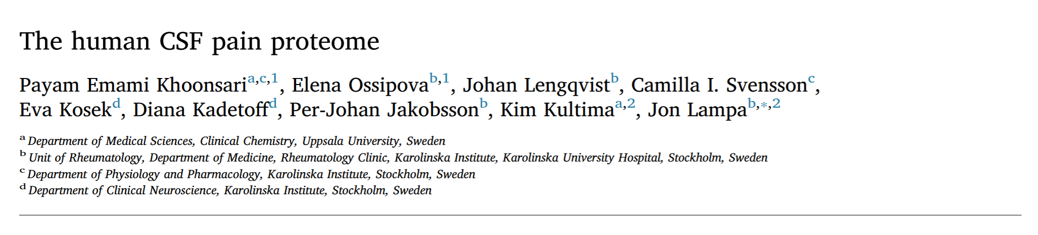
We can mine the same data for different targets
New assay: with 3.06 median %CV!
Khoonsari et al., J. Proteomics (2019)

Slide 29

Acknowledgements
MacCoss Lab
Skyline/Panorama
Stanford
Mike MacCoss
Eric Huang
Gennifer Merrihew
Christine Wu
Julia Robbins
Brendan McLean
Vagisha Sharma
Nick Schulman
Josh Eckels
Tom Montine
Kathleen Poston
UW
C. Dirk Keene
Andy Hoofnagle
Funding:
F31AG069420, 1RF1AG053959-01, U19AG065156

Slide 30
Overview of our Skyline walk-through:
Importing GPF DIA search results into Skyline
Filtering peptides based on %CV
Filtering target proteins then filtering peptides based on intensity
Scheduling & exporting transition lists for SRM methods

