Slide 1
Triggered Acquisition support in Skyline-Daily 20.1.1.69
Nicholas Shulman
March 9, 2020

Slide 2
Introduction: Triggered acquisition methods
In a triggered acquisition method, the mass spectrometer collects MS2 scans for a heavy peptide.
When certain transitions are observed in the heavy spectra, the mass spectrometer begins collecting spectra for the light peptide.

Slide 3
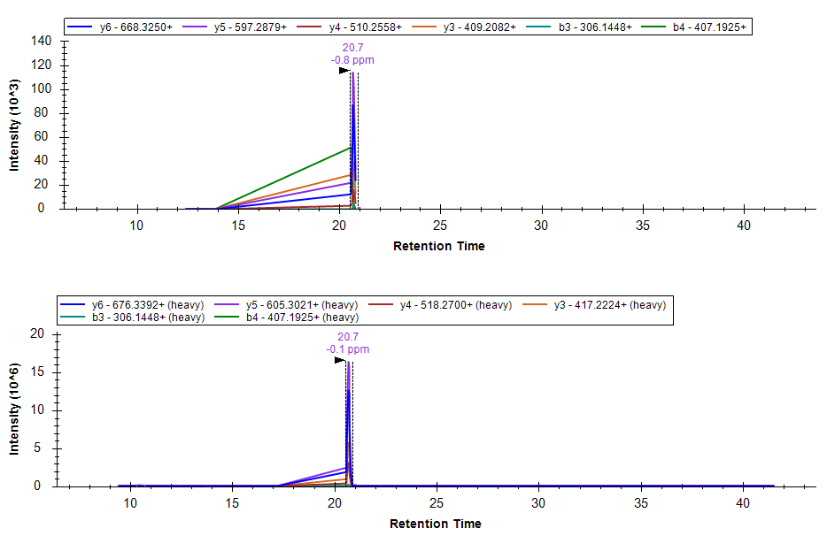
The problem: triggered acquisition results in strange chromatograms
If there are gaps in the times at which matching MS2 scans were collected, they are drawn on the chromatogram as long straight lines.
Peptide: FASTFDK

Slide 4
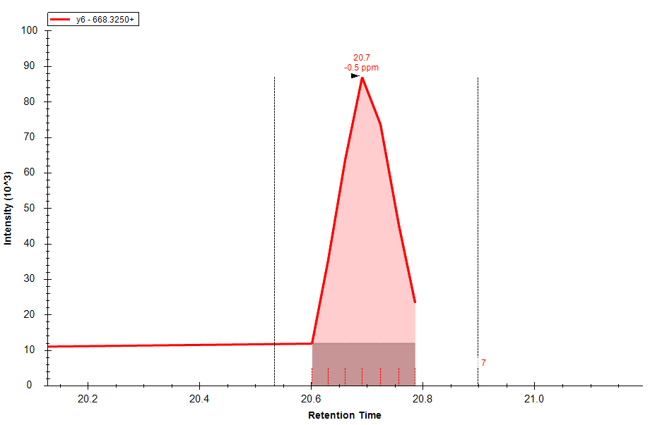
Gaps in collection time result in poor background estimation
Skyline estimates the background level to be the lower of either the intensity at the start of the peak or at the end of the peak.
This does not work well if the entire peak was not acquired.

Slide 5
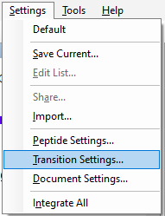
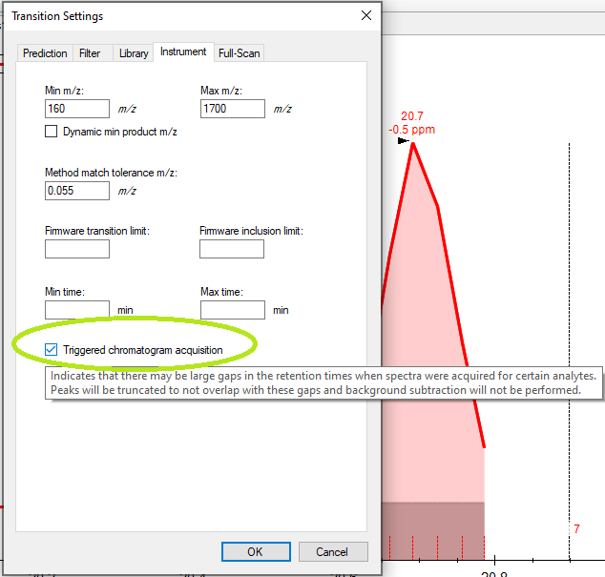
New feature: Triggered Acquisition Setting

Slide 6
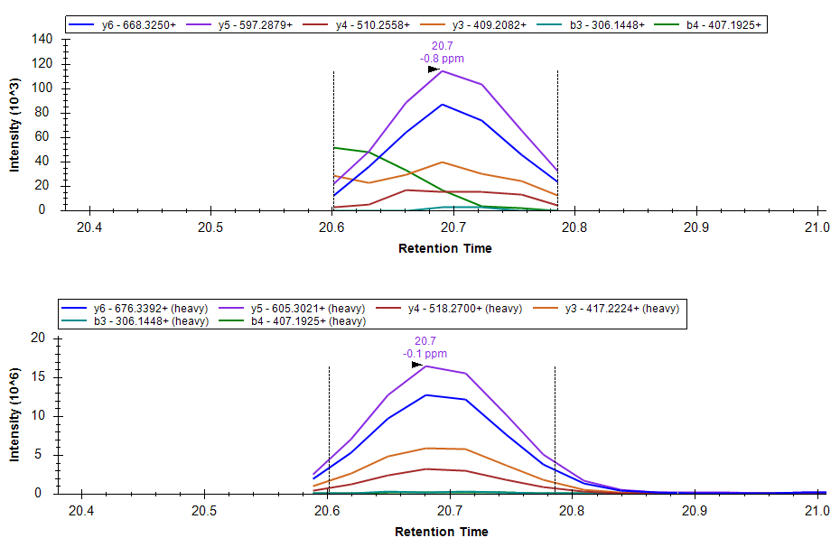
With Triggered Acquisition turned on, Skyline recognizes the gaps in MS2 scan collection
Peak boundaries are constrained to range over which scans were collected for all of the precursors

Slide 7
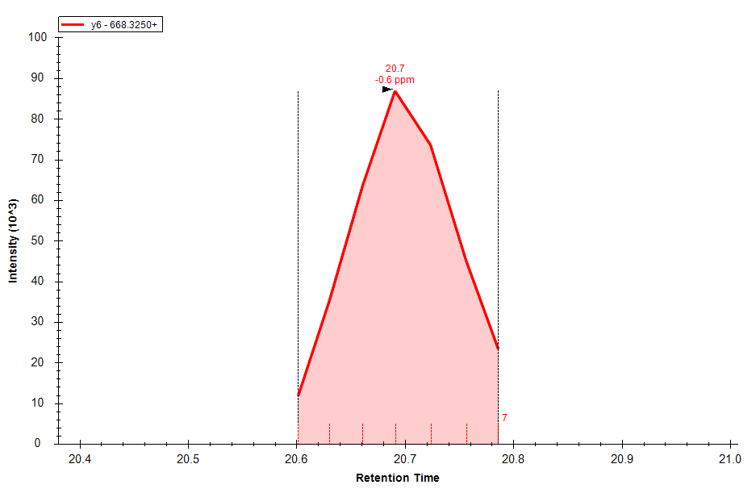
Background subtraction does not happen if Triggered Acquisition is turned on

