Slide 1
Skyline Lists
2019-07-23
Nicholas Shulman

Slide 2
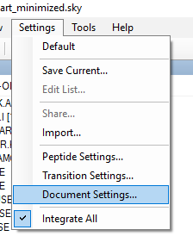
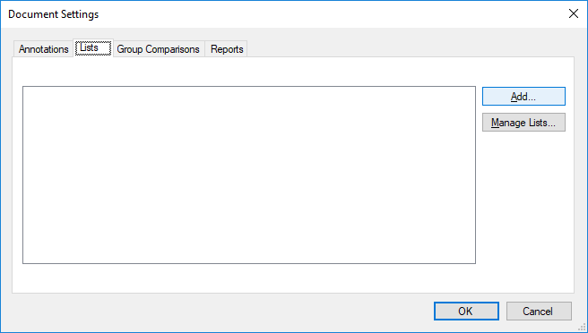
Creating a list

Slide 3
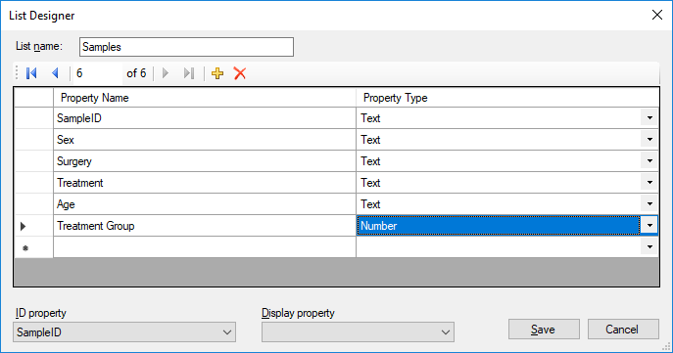
Defining list columns
Specifying an ID property allows other annotations to be declared as lookups into this list

Slide 4
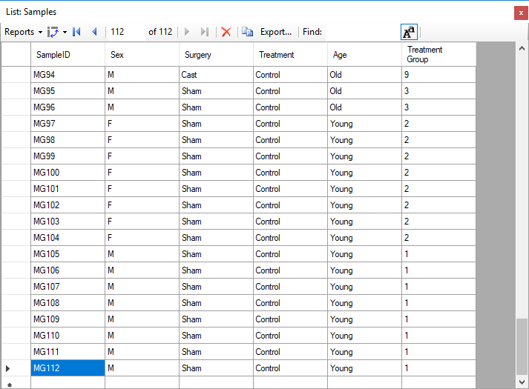
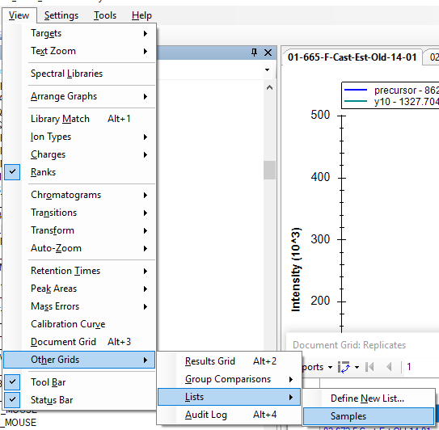
Adding items to the list

Slide 5
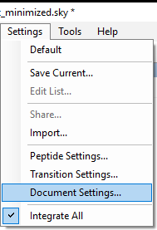
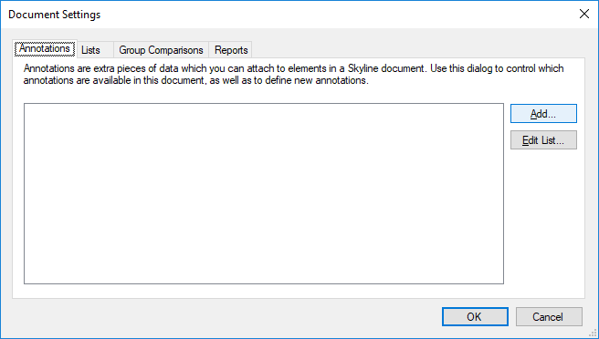
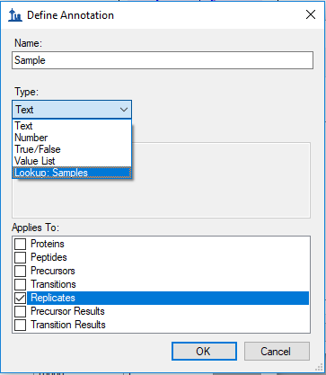
Add replicate annotation which looks up into new list

Slide 6
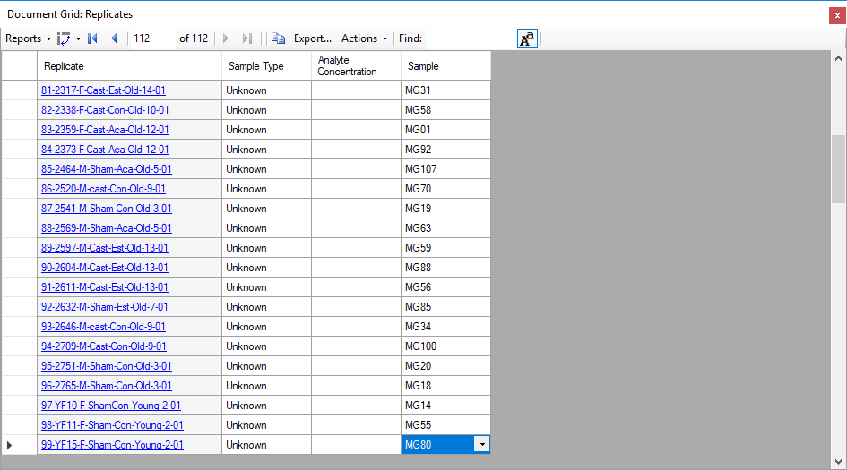
Fill in the replicate annotation value for each replicate

Slide 7
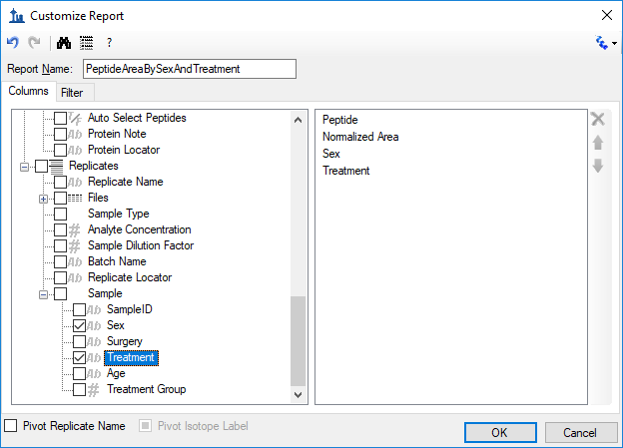
The lookup columns from the list can be added to any report

