Slide 1
Skyline Calibration
November 10, 2015

Slide 2
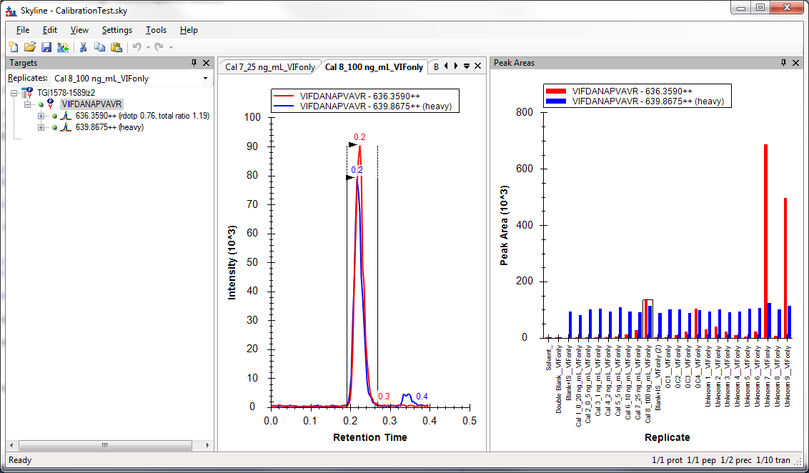
Test Document

Slide 3
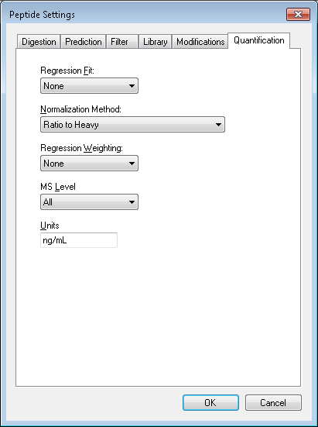
Peptide Settings - Quantification

Slide 4
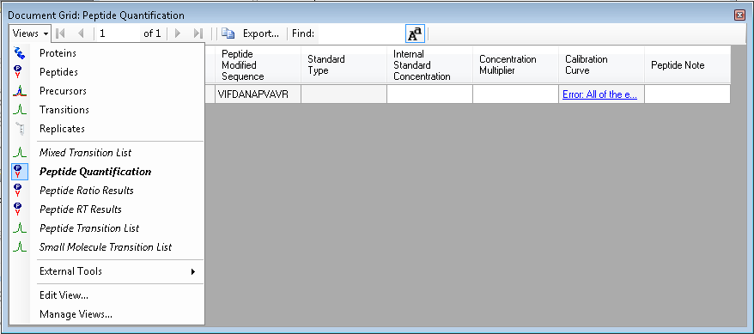
Peptide Quantification View

Slide 5
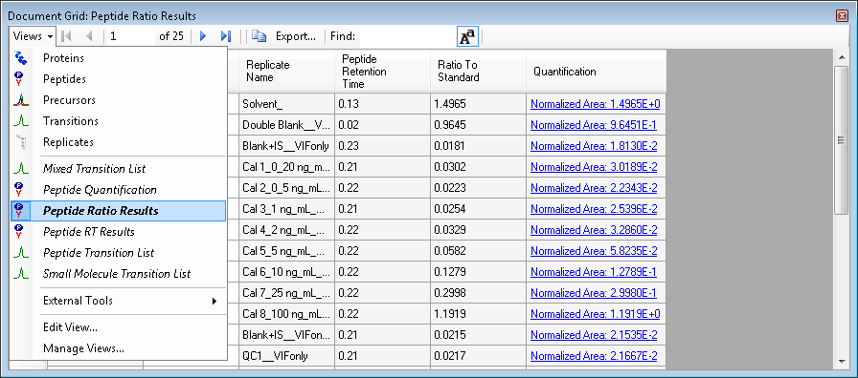
Peptide Ratio Results View
Showing Ratio by Default

Slide 6
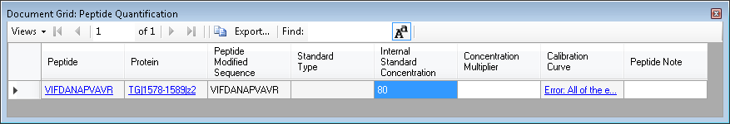
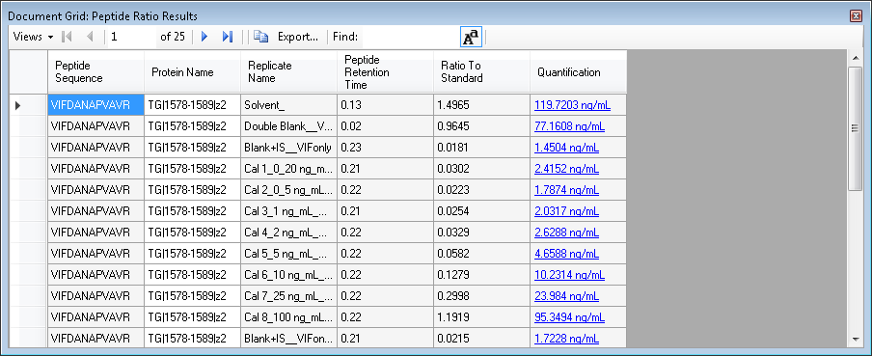
Single Point Internal Calibration
Peptide Quantification
Peptide Ratio Results
Concentration by
Ratio to IS

Slide 7
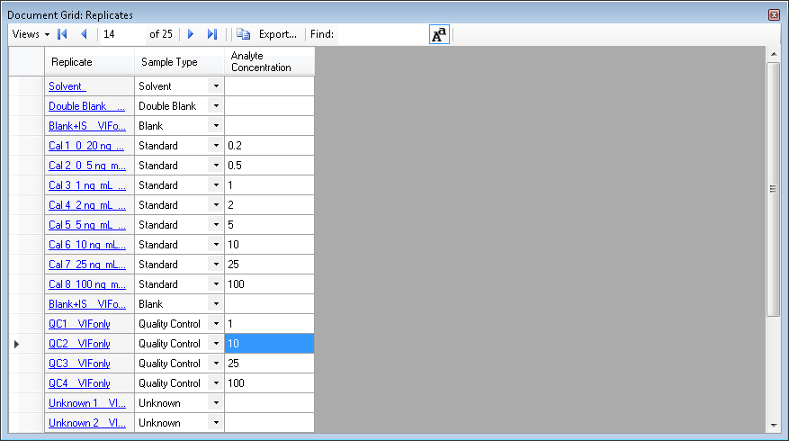
Multi-Point External Calibration
Replicates

Slide 8

Quantification with Regression Fit

Slide 9
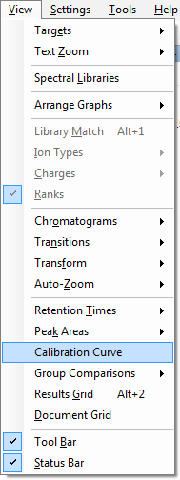
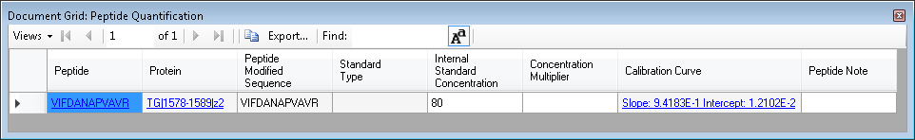
Calibration Curves
Click Menu Item
Click Link
Peptide Quantification

Slide 10
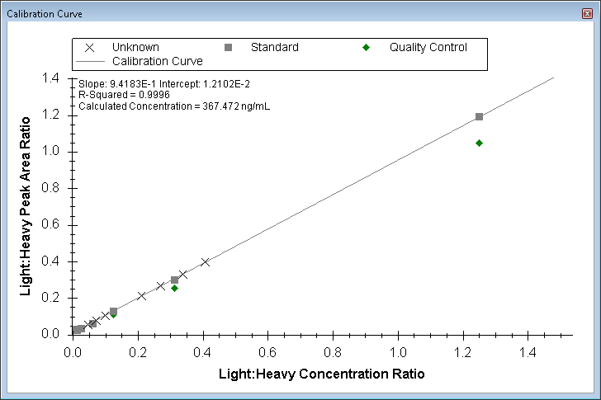
Calibration Curve Graph
Click points to
activate replicates

Slide 11
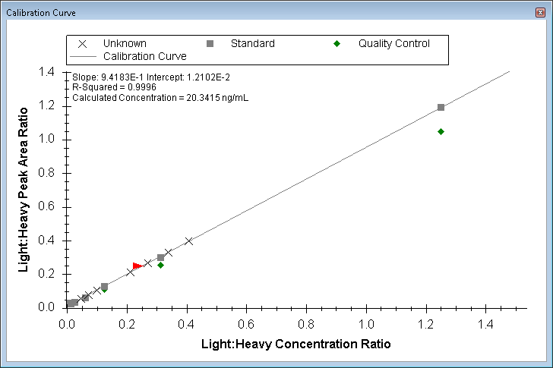
Calibration Curve Selection

Slide 12
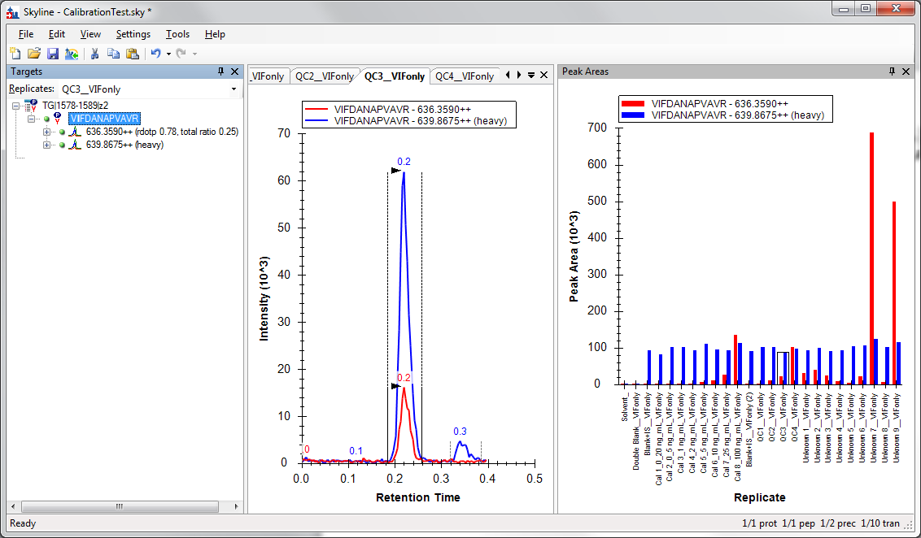
Selection in Skyline Window

Slide 13
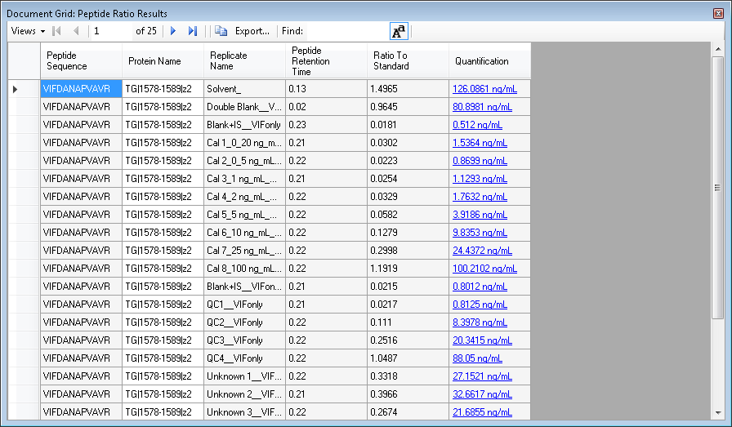
Calibrated Quantification
Peptide Ratio Results

