Slide 1
Importing SWATH data

Slide 2
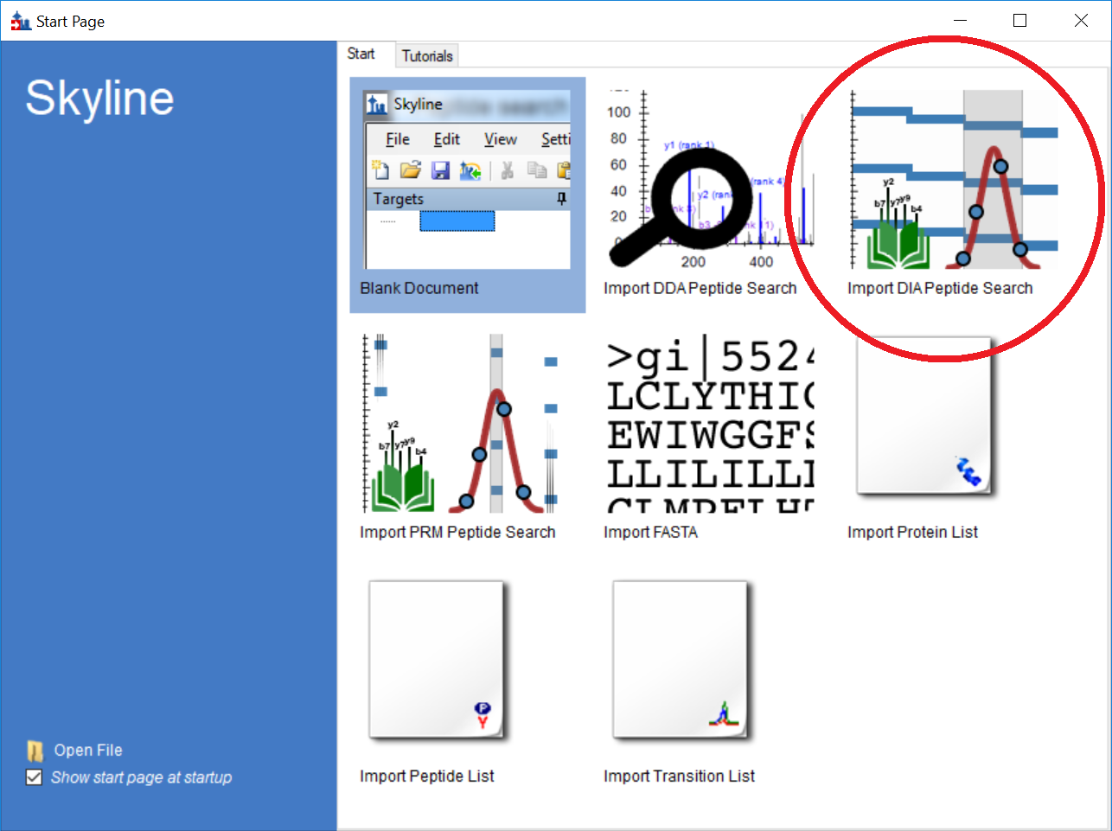
Import a DIA peptide search from the Start Page (or File → Import → Peptide Search…).

Slide 3
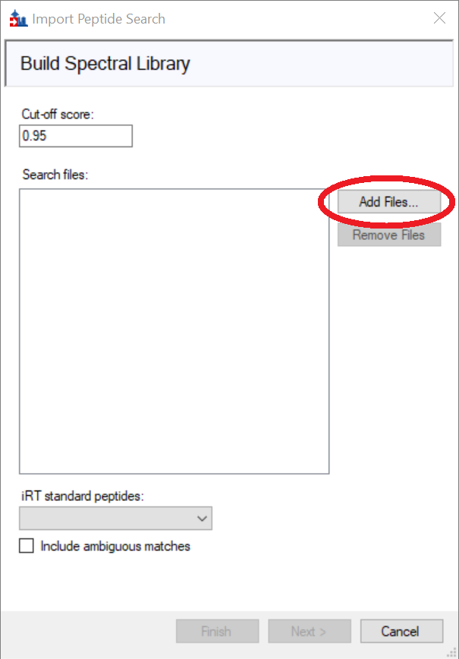
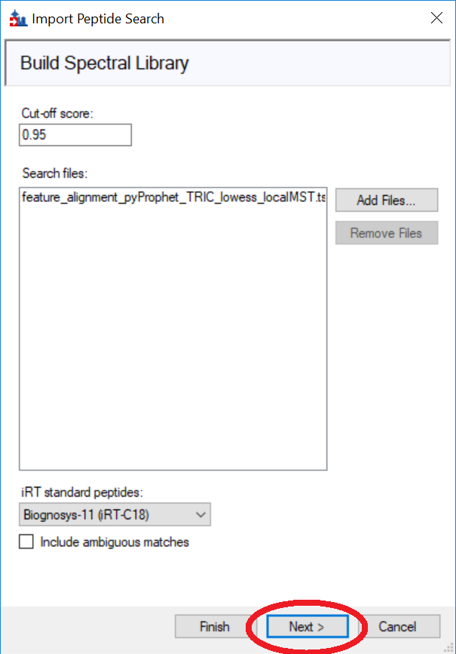
Build the spectral library from .tsv results files.

Slide 4
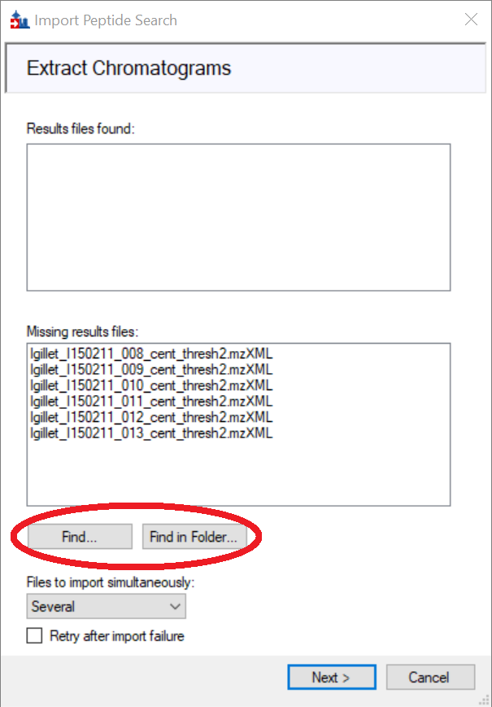
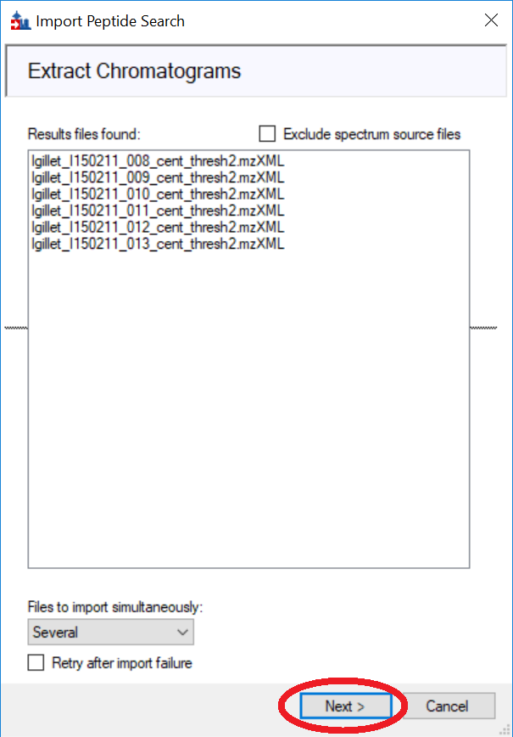
Find the results files, if the wizard does not find them automatically.

Slide 5
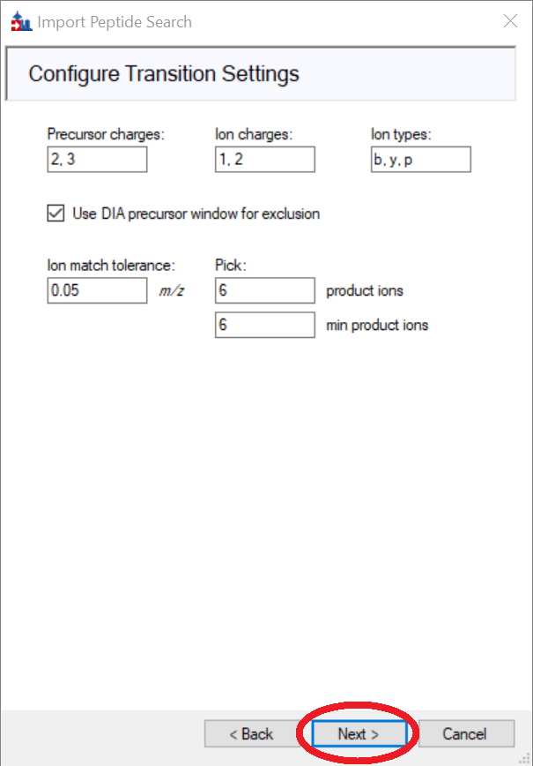
Configure the transition settings.

Slide 6
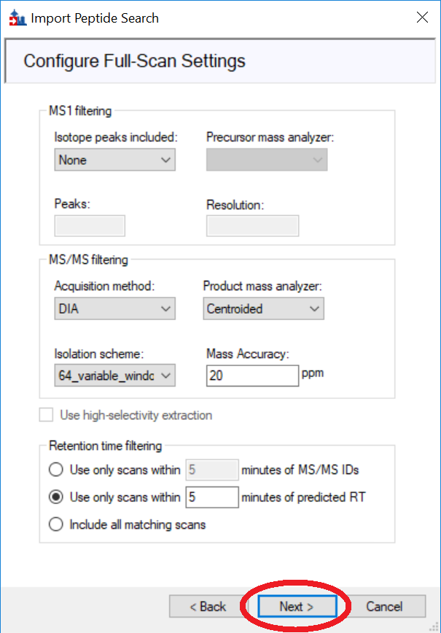
Configure the full-scan settings.

Slide 7
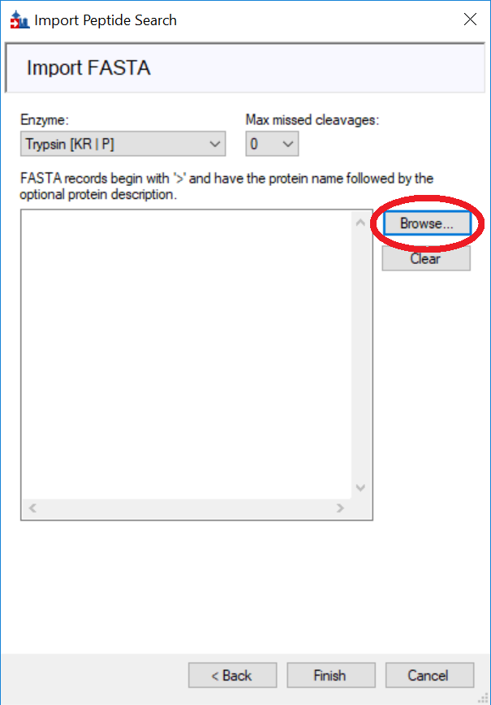
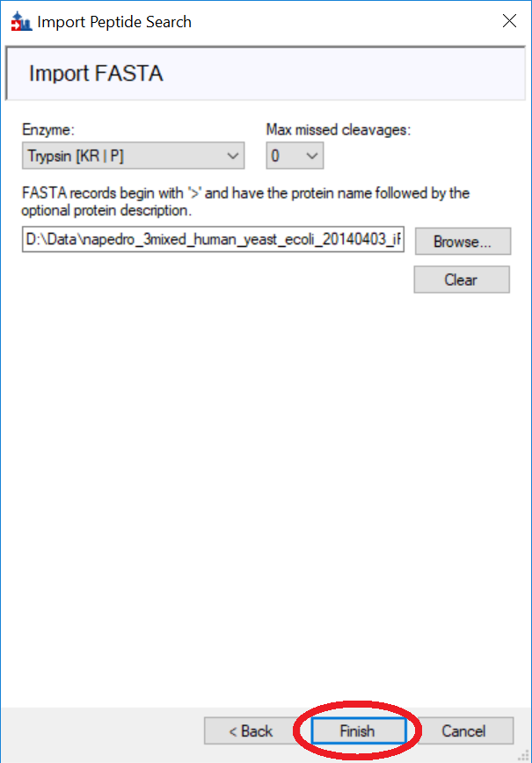
Import FASTA file, or paste the FASTA into the textbox.

Slide 8
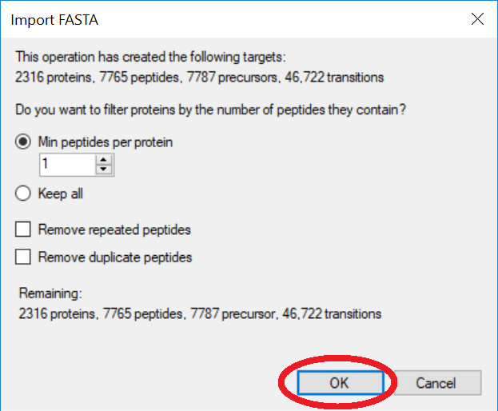
Choose filtering settings for importing the FASTA.

Slide 9
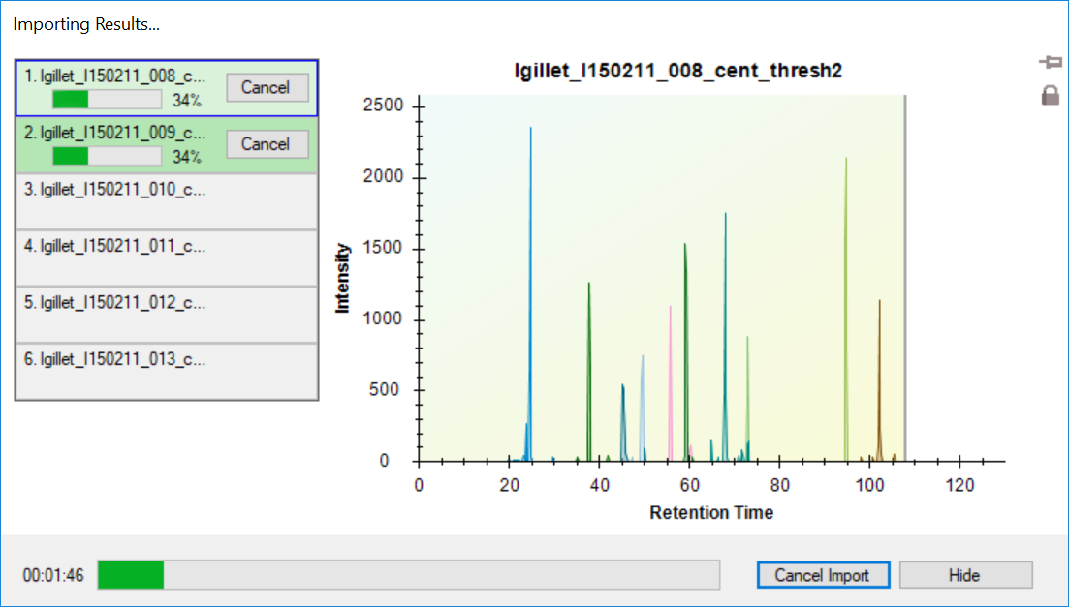
Wait for the results to import.

