Slide 1
DIA: The Cutting Edge
Jarrett Egertson, Ph.D.
University of Washington, Department of Genome Sciences

Slide 2
Cutting Edge DIA Research
Improving Precursor Selectivity with Demultiplexing
  MSX on Q-Exactive
    Egertson JD, Kuehn A, et. al. Nature Methods 2013
DIA on Future Instrument Platforms
  DDA becomes DIA
  What is the Ideal DIA Instrument??

Slide 3
The Precursor Selectivity of DIA Must be Improved

Slide 4
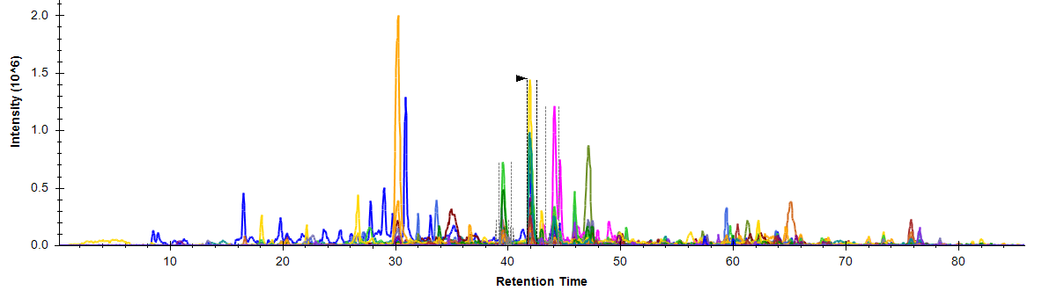
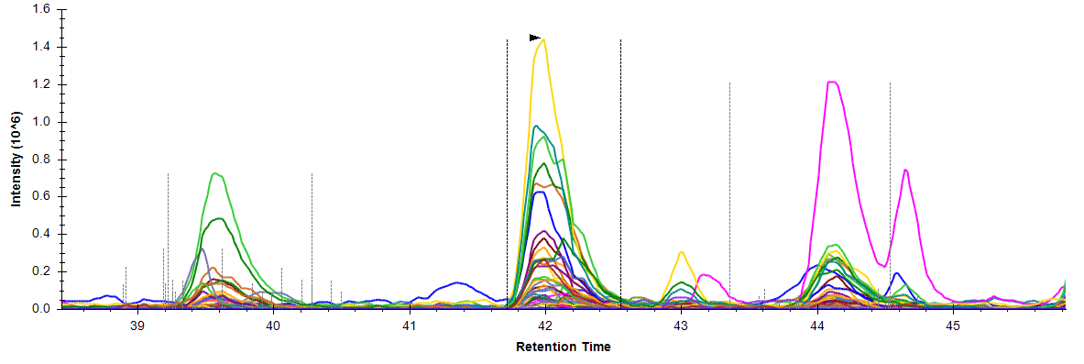
Low PS Makes Picking Peaks Difficult….
FEIELLSLDDDSIVNHEQDLPK S. cerevisiae lysate (soluble) 10 m/z wide window DIA (Q-Exactive)

Slide 5
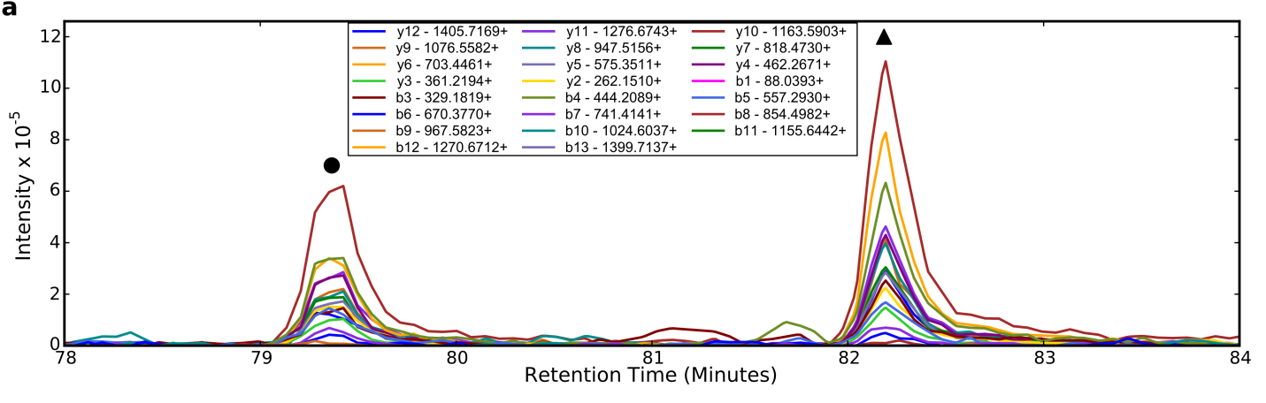
…Especially When Modified Forms are Present
✓
X
890
900
SLQDIIAILGMDELSEEDKLTVSR+++
(897.8 m/z)
SLQDIIAILGMDELSEEDKLTVSR+++
(892.47 m/z)
✓
X

Slide 6
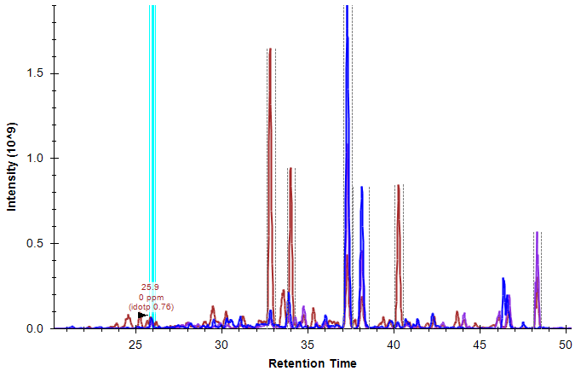
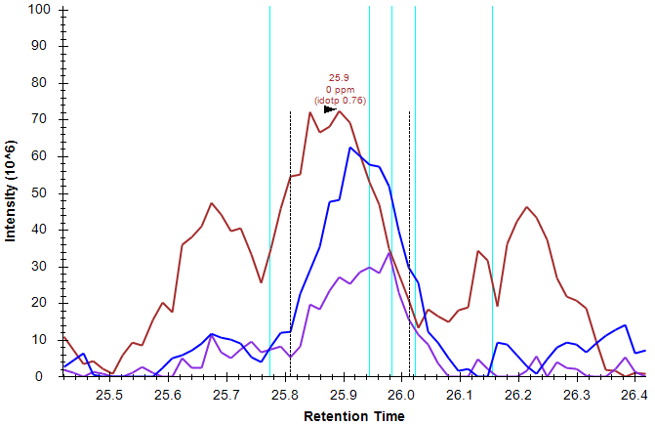
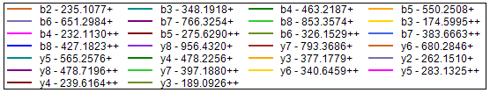
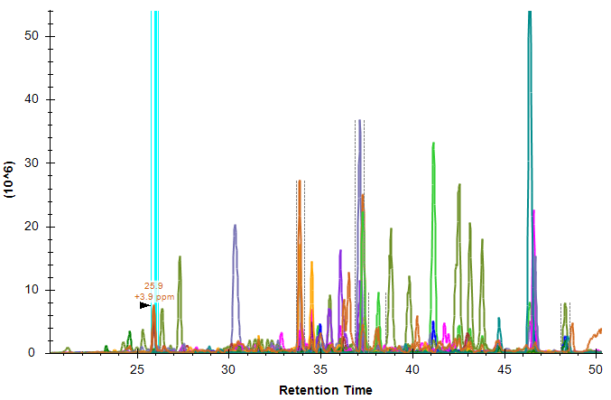
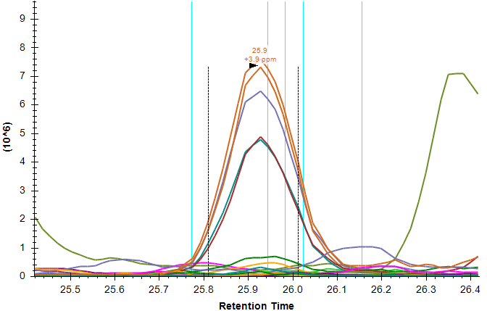
Example: AYIDSTDSR, charge 2
Sonia Ting

Slide 7
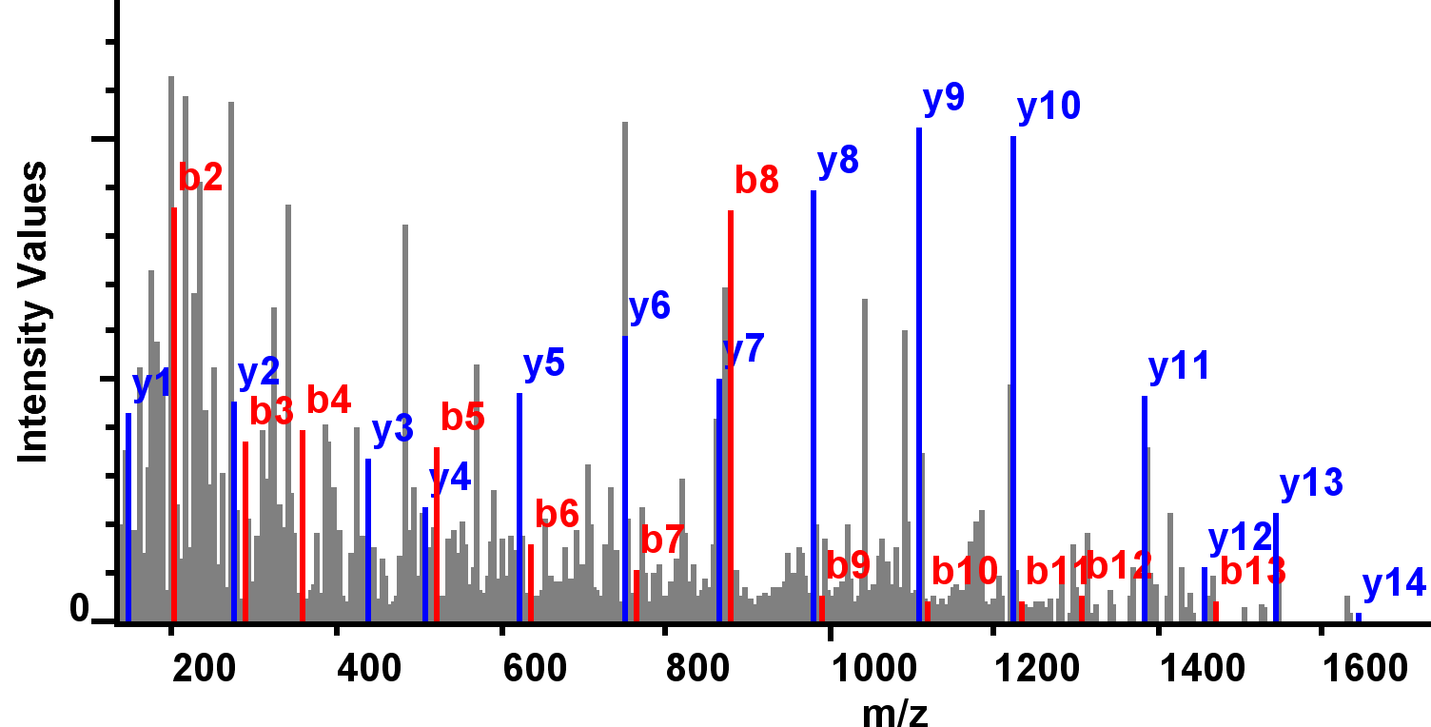
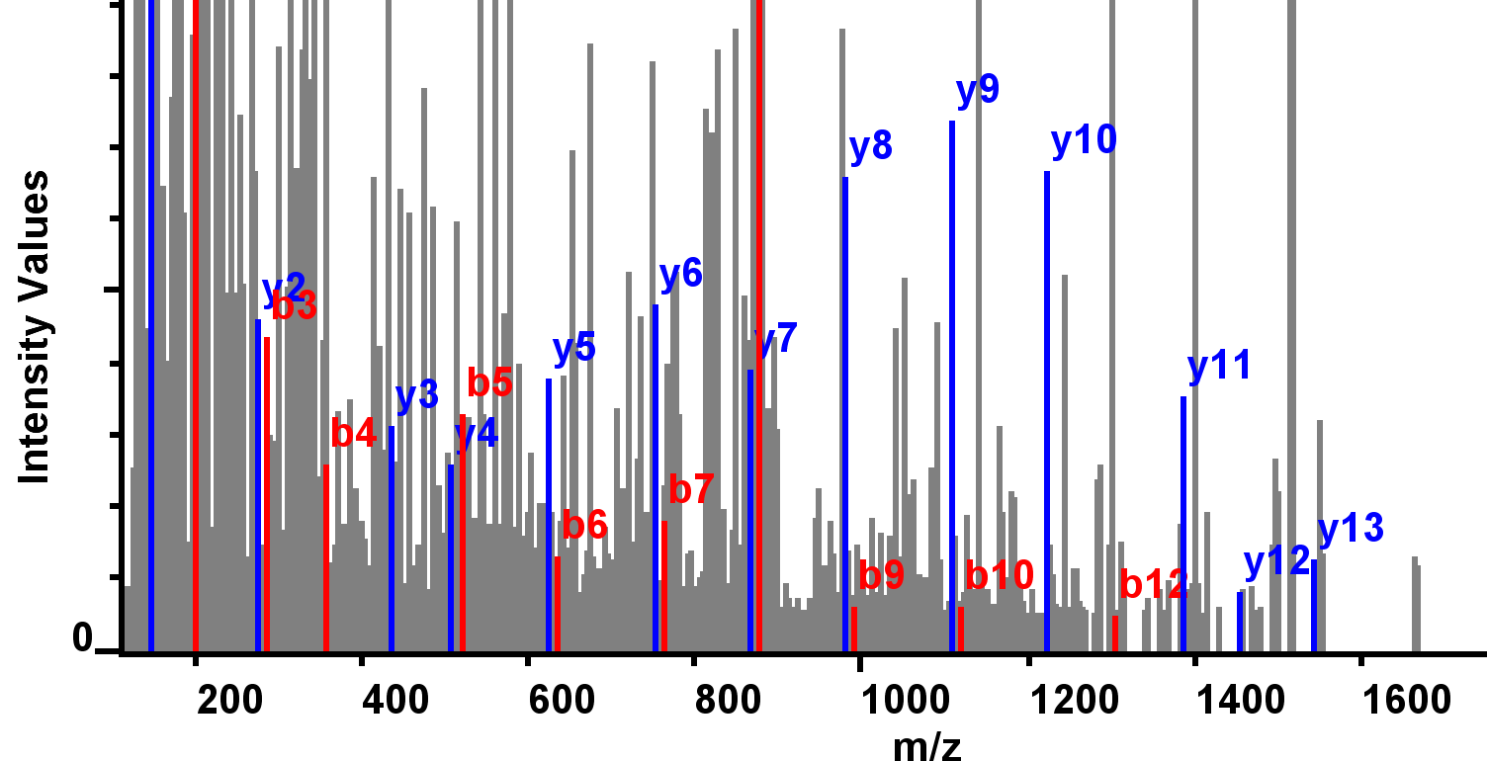
Low Precursor Selectivity Hinders Peak Detection and Quantification
5 m/z-wide windows
Peptide: VTSAYLQDIENAYKK +++
10 m/z-wide windows

Slide 8
Multiplexed DIA on a Q-Exactive
Standard MS/MS on a Q-Exactive
Orbitrap FTMS Acquistion
Orbitrap FTMS Acquisition
C-trap Fill
C-trap Fill
Time
Multiplexed MS/MS on a Q-Exactive
Orbitrap FTMS Acquistion
Orbitrap FTMS Acquisition
C-trap Fill
C-trap Fill
C-trap Fill
C-trap Fill
C-trap Fill
C-trap Fill
C-trap Fill
C-trap Fill
C-trap Fill
C-trap Fill
Time

Slide 9
Multiplexed DIA on a Q-Exactive
100 4 m/z-wide windows = 400 m/z
400
m/z
800
Scan 1

Slide 10
Multiplexed DIA on a Q-Exactive
100 4 m/z-wide windows = 400 m/z
400
m/z
800
Scan 1

Slide 11
Multiplexed DIA on a Q-Exactive
100 4 m/z-wide windows = 400 m/z
400
m/z
800
Scan 1
Scan 2

Slide 12
Multiplexed DIA on a Q-Exactive
100 4 m/z-wide windows = 400 m/z
400
m/z
800
Scan 1
Scan 2
Scan 3

Slide 13
Multiplexed DIA on a Q-Exactive
100 4 m/z-wide windows = 400 m/z
400
m/z
800
Scan 1
Scan 2
Scan 3
. . .
Scan 20

Slide 14
Multiplexed DIA on a Q-Exactive
100 4 m/z-wide windows = 400 m/z
400
m/z
800
Scan 1
Scan 2
Scan 3
. . .
Scan 20

Slide 15
Multiplexed DIA on a Q-Exactive
100 4 m/z-wide windows = 400 m/z
400
m/z
800
Scan 1
Scan 2
Scan 3
. . .
Scan 20

Slide 16
Multiplexed DIA on a Q-Exactive
100 4 m/z-wide windows = 400 m/z
400
m/z
800
Scan 1
Scan 2
Scan 3
. . .
Scan 20
Scan 21

Slide 17
Multiplexed DIA on a Q-Exactive
100 4 m/z-wide windows = 400 m/z
400
m/z
800
Scan 1
Scan 2
Scan 3
. . .
Scan 20
Scan 21

Slide 18
Multiplexed DIA on a Q-Exactive
100 4 m/z-wide windows = 400 m/z
400
m/z
800
Scan 1
Scan 2
Scan 3
Cycle Time
. . .
Scan 20
Scan 21

Slide 19
Demultiplexing
Intensity
m/z

Slide 20
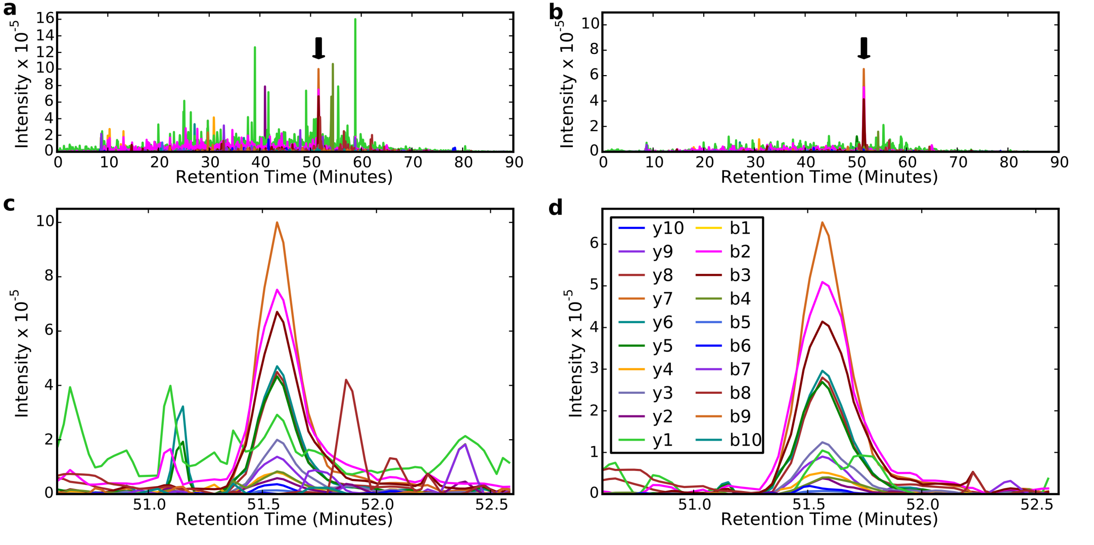
Demultiplexing

Slide 21
Before Demultiplexing…
✓
X
890
900
SLQDIIAILGMDELSEEDKLTVSR+++
(897.8 m/z)
SLQDIIAILGMDELSEEDKLTVSR+++
(892.47 m/z)
✓
X

Slide 22
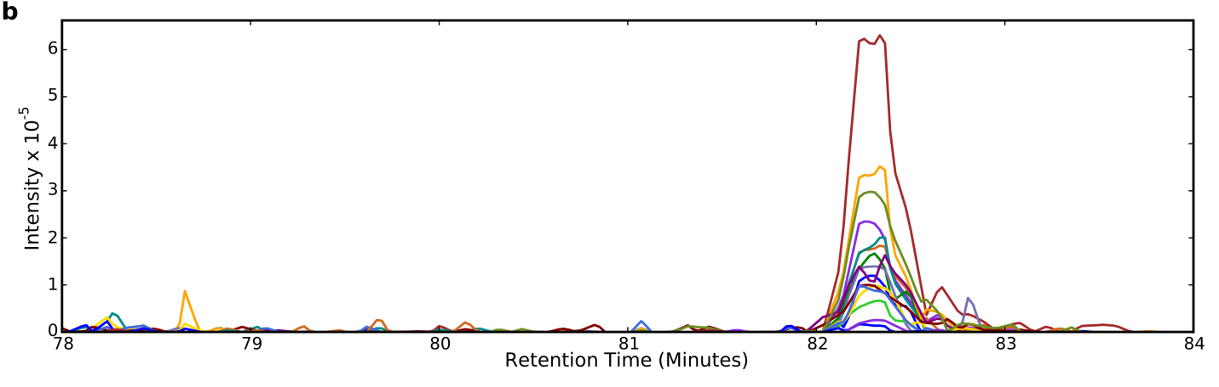
…After Demultiplexing
X
890
900

Slide 23
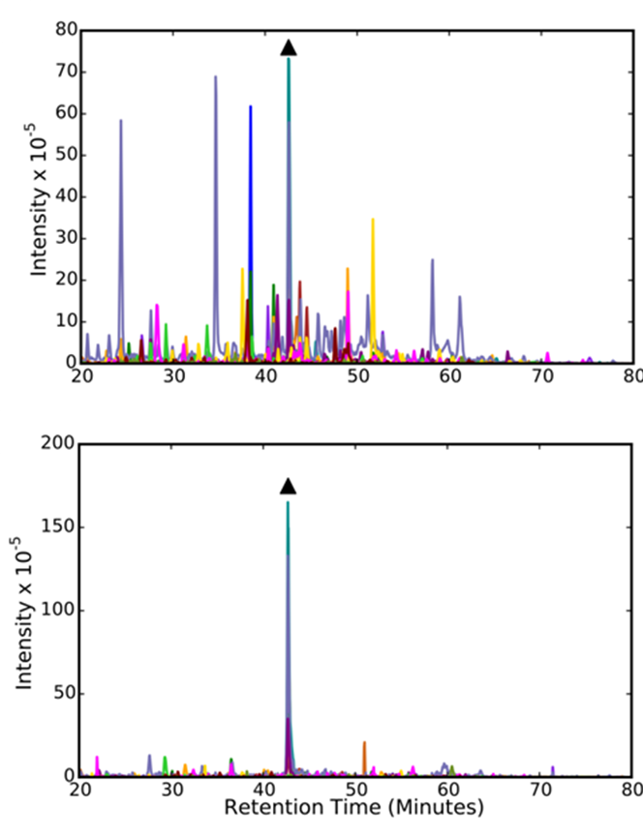
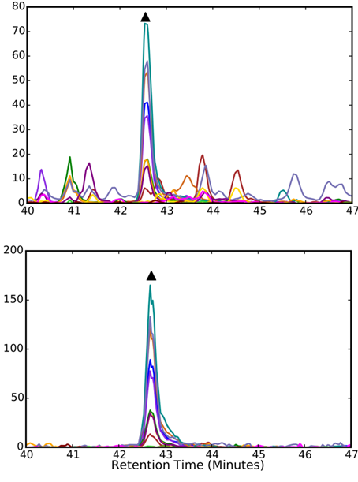
10 m/z DIA and MSX Analysis of ISGLIYEETR++ peptide
10 m/z DIA
MSX

Slide 24
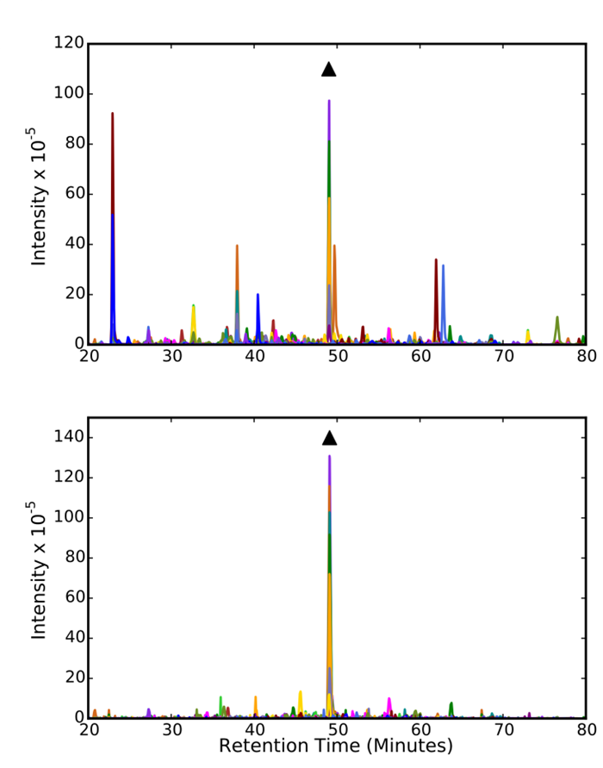
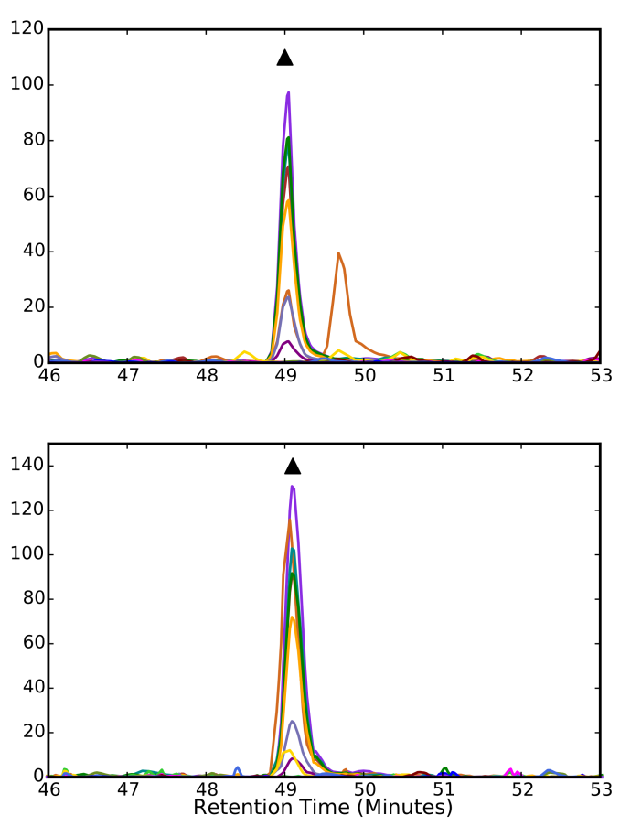
10 m/z DIA and MSX Analysis of NIPGVDVMNVER++ peptide
10 m/z DIA
MSX

Slide 25
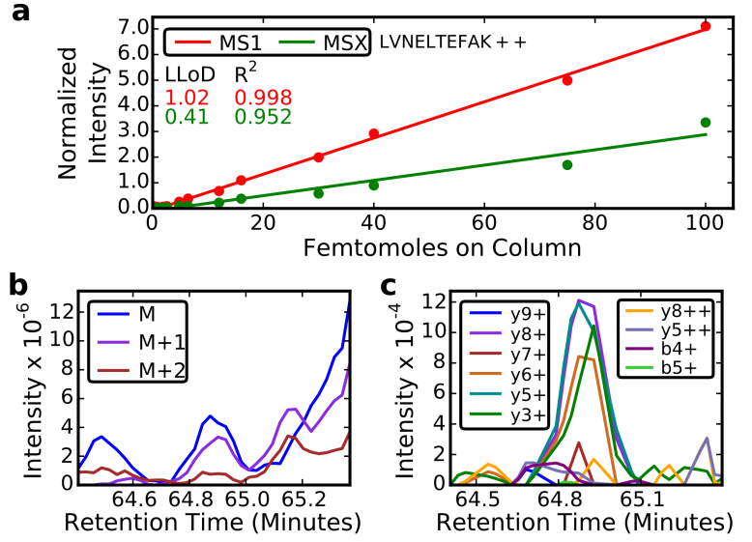
MS1 vs MSX Quantitation

Slide 26
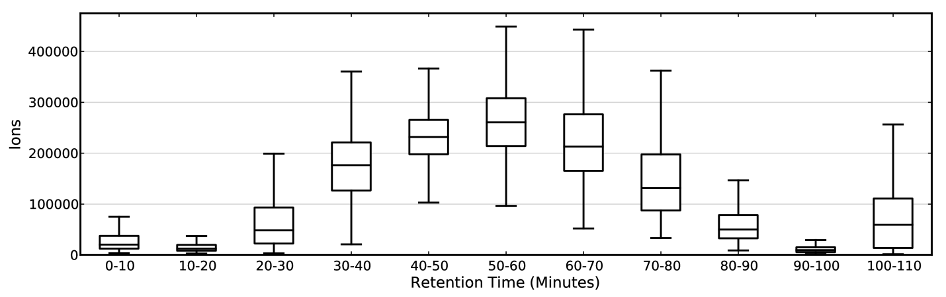
So what’s the problem?

Slide 27
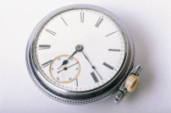
Multiplexed DIA Fill Issue
500
m/z
900
Scan 1
20 ms

Slide 28
Multiplexed DIA Fill Issue
500
m/z
900
Scan 1
20-40 ms

Slide 29
Multiplexed DIA Fill Issue
500
m/z
900
Scan 1
40-60 ms

Slide 30
Multiplexed DIA Fill Issue
500
m/z
900
Scan 1
60-80 ms

Slide 31
Multiplexed DIA Fill Issue
500
m/z
900
Scan 1
80-100 ms

Slide 32
Wide precursor window fragments multiple peptides at once.
MSX does not work on all instruments
Can be limited by fill time.
How do we improve DIA selectivity without using MSX?
Modify Experiment Design
Overlapping isolation windows: Egertson JD – ASMS 2013

Slide 33
Methods we use in our lab on the Q-Exactive HF
Acquisition Method | Precursor Selectivity | Fragment Selectivity | Max Inject Time
20 x 20 m/z windows | 20 m/z isolation | 30k R.P. | 60 ms
20 x 20 m/z overlapping windows | ~10 m/z isolation after demultiplexing | 30k R.P. | 60 ms
40 x 10 m/z windows | 10 m/z isolation | 15k R.P. | 17 ms
40 x 10 m/z overlapping windows | ~5 m/z isolation after demultiplexing | 15k R.P. | 17 ms
4 x 5 m/z MSX | ~5 m/z isolation after demultiplexing | 30k R.P. | 15 ms
Sensitivity

Slide 34
Methods we use in our lab on the Q-Exactive HF
Acquisition Method | Precursor Selectivity | Fragment Selectivity | Max Inject Time
20 x 20 m/z windows | 20 m/z isolation | 30k R.P. | 60 ms
20 x 20 m/z overlapping windows | ~10 m/z isolation after demultiplexing | 30k R.P. | 60 ms
40 x 10 m/z windows | 10 m/z isolation | 15k R.P. | 17 ms
40 x 10 m/z overlapping windows | ~5 m/z isolation after demultiplexing | 15k R.P. | 17 ms
4 x 5 m/z MSX | ~5 m/z isolation after demultiplexing | 30k R.P. | 15 ms
Selectivity

Slide 35
Improved Demultiplexing Algorithm

Slide 36

Demultiplexing
Isolation Windows
1
7
28
81
84
Intensity
m/z

Slide 37
Demultiplexing
Isolation Windows
1
7
28
81
84
Intensity
m/z

Slide 38
Demultiplexing
Isolation Windows
1
Intensity
m/z

Slide 39
Demultiplexing
Isolation Windows
1
7
28
81
84
Intensity(100) = I1 + I7 + I28 + I81 + I84
Intensity
m/z

Slide 40
Demultiplexing
Isolation Windows
3
10
74
75
92
Intensity(99) = I3 + I10 + I74 + I75 + I92
Intensity
m/z

Slide 41
Demultiplexing
Intensity(99) = I3 + I10 + I74 + I75 + I92
Intensity(100) = I1 + I7 + I28 + I81 + I84
10 Unknowns
Intensity
m/z

Slide 42
Demultiplexing
Intensity(99) = I3 + I10 + I74 + I75 + I92
Intensity(100) = I1 + I7 + I28 + I81 + I84
2
Knowns
10 Unknowns
Intensity
m/z

Slide 43
Demultiplexing
Intensity(50) = I3 + I11 + I34 + I35 + I90
…
…
100 Scans
5 Duty
Cycles
~15 seconds
Intensity(99) = I3 + I10 + I74 + I75 + I92
Intensity(100) = I1 + I7 + I28 + I81 + I84
…
…
Intensity(150) = I17 + I44 + I52 + I55 + I99
100 knowns
100 unknowns
Solve by non-negative least squares optimization

Slide 44
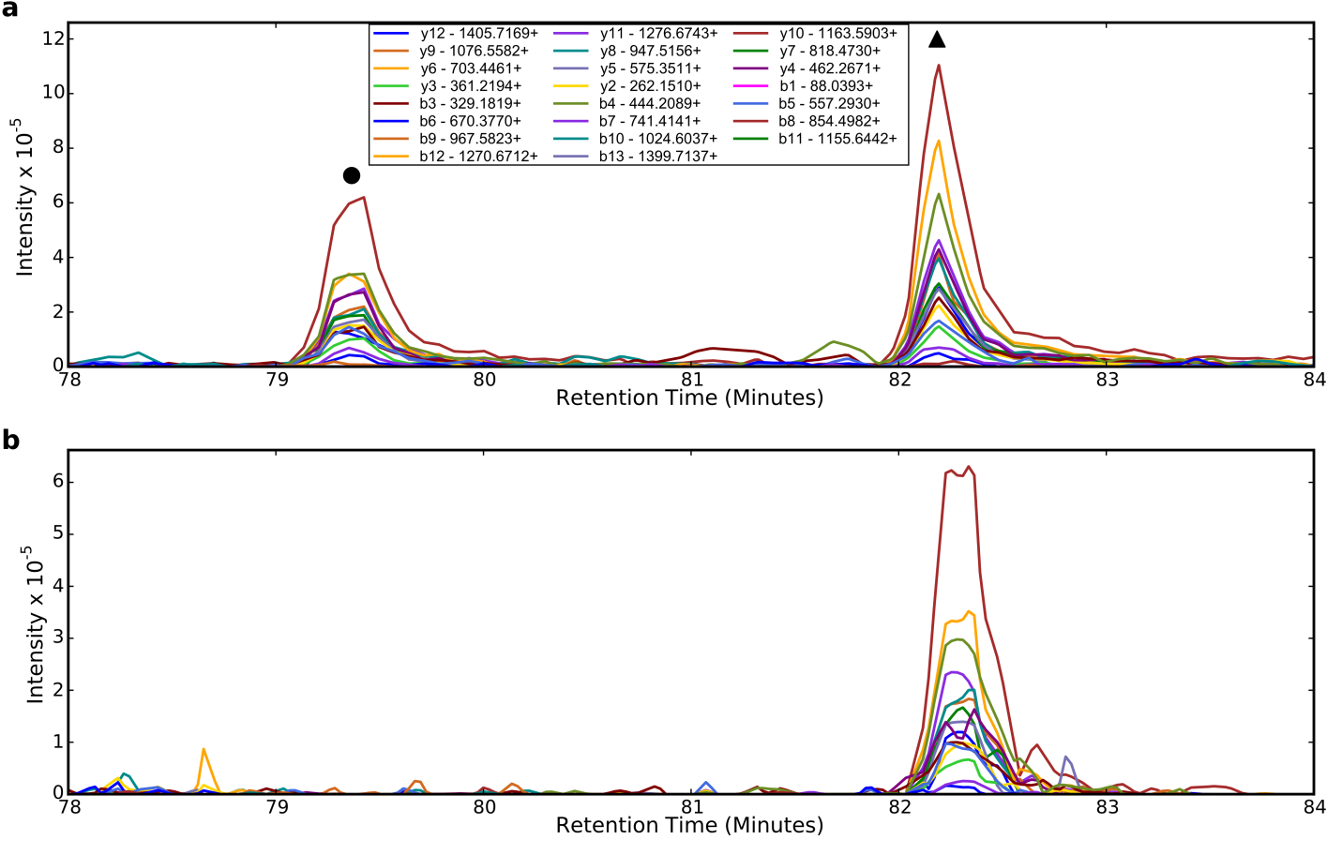
Demultiplexing by NNLS

Slide 45
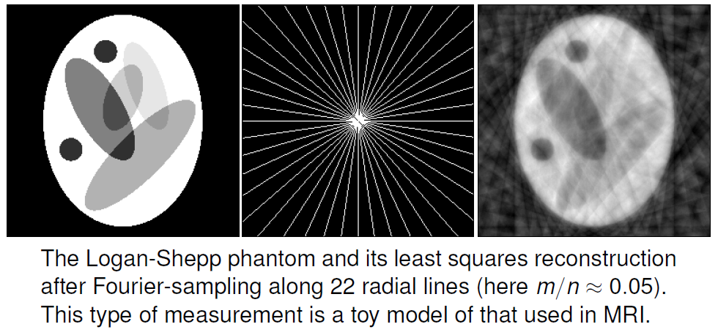
Least Squares
Terence Tao “Compressed Sensing: Or the equation Ax = b, revisited”

Slide 46
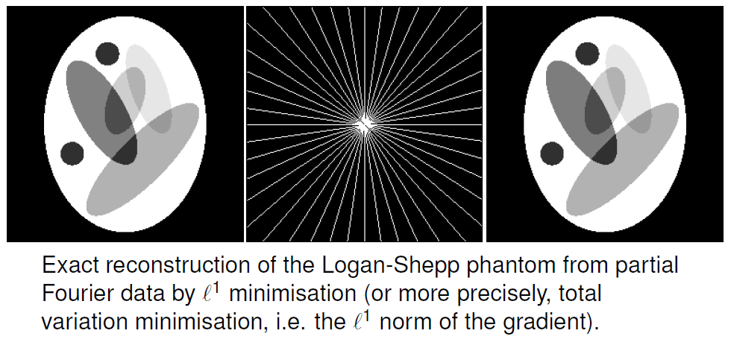
Basis Pursuit
Terence Tao “Compressed Sensing: Or the equation Ax = b, revisited”

Slide 47
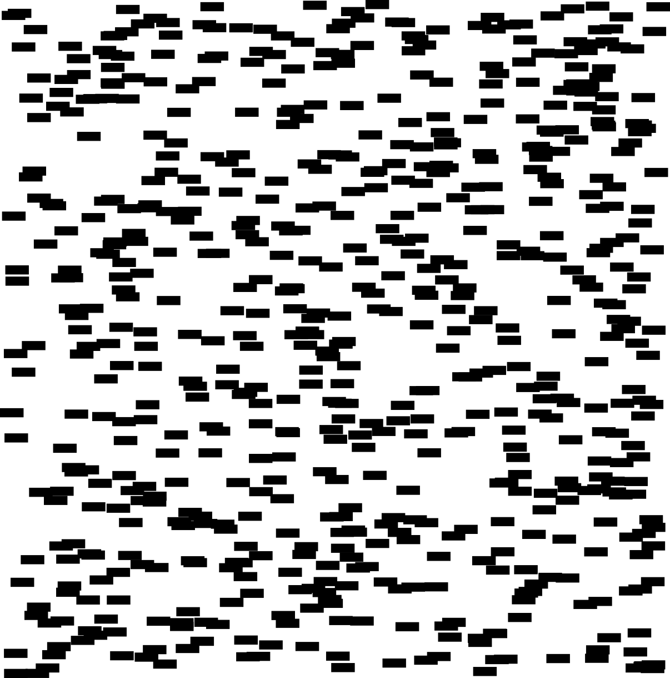




DDA on Future Instruments
m/z
At some point, DIA will be a no-brainer
Retention Time

Slide 48
Conclusions
Multiplexing greatly improves precursor selectivity
Substantial room for improvement of multiplexing
  Hardware innovations
  Demultiplexing algorithm

