Slide 1
Introduction to Data Independent Acquisition
Jarrett Egertson, Ph.D.
MacCoss Lab

Slide 2
Part 1: How Does DIA Work?

Slide 3
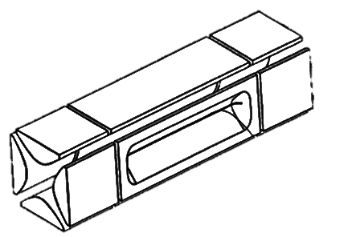
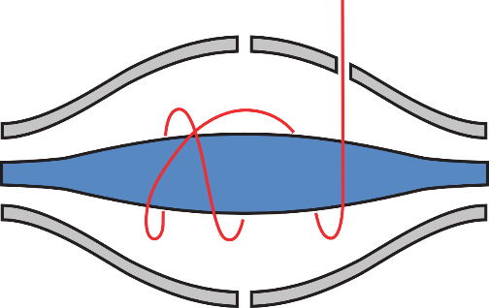
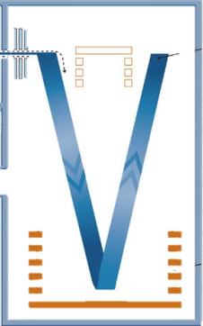
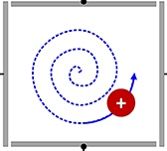
Data Independent Acquisition
“All” Reaction Monitoring (coined by Bruce Lab)
20 20 m/z-wide windows = 400 m/z
500
m/z
900
Measure all fragment ions for all precursors between 500 and 900 m/z
Orbitrap
Linear Ion Trap
TOF
FT-ICR

Slide 4
Comprehensive MS/MS Acquisition
20 20 m/z-wide windows = 400 m/z
500
m/z
900

Slide 5
Comprehensive MS/MS Acquisition
20 20 m/z-wide windows = 400 m/z
500
m/z
900
Scan 1

Slide 6
Comprehensive MS/MS Acquisition
20 20 m/z-wide windows = 400 m/z
500
m/z
900
Scan 1
Scan 2

Slide 7
Comprehensive MS/MS Acquisition
20 20 m/z-wide windows = 400 m/z
500
m/z
900
Scan 1
Scan 2
Scan 3
Scan 4
Scan 5
Scan 6
Scan 7
…
Scan 20
Scan 21

Slide 8
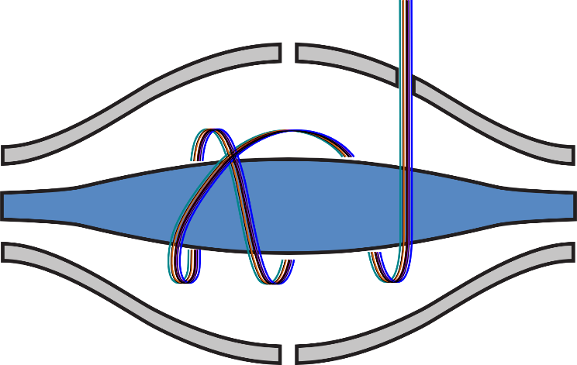
Comprehensive MS/MS Acquisition
20 20 m/z-wide windows = 400 m/z
500
m/z
900
~2 seconds
Precursor Filter
780-800 m/z
Orbitrap Mass Analyzer
Time

Slide 9
Comprehensive MS/MS Acquisition
20 20 m/z-wide windows = 400 m/z
500
m/z
900
MS Scan
~2 seconds (Q-Exactive)
Time

Slide 10


DIA Data Acquisition
Comprehensive MS1 and MS2 Sampling
500
m/z
900
Consistent Sampling
Chromatographic Time Scale
2
sec
Un-Targeted
Time
Un-Biased
500
m/z
520
m/z
20 m/z
Wide Isolation

Slide 11
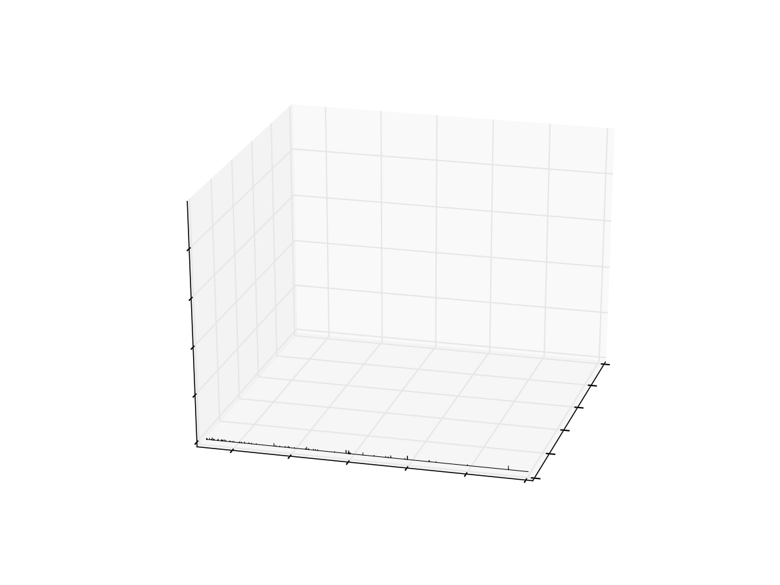
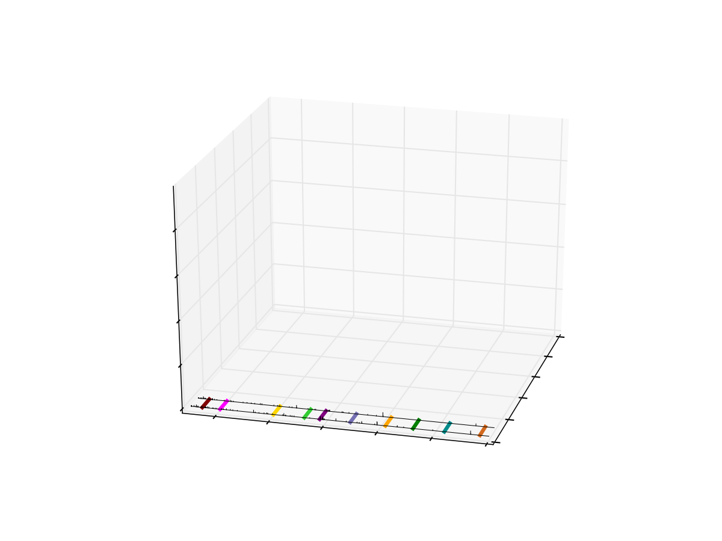
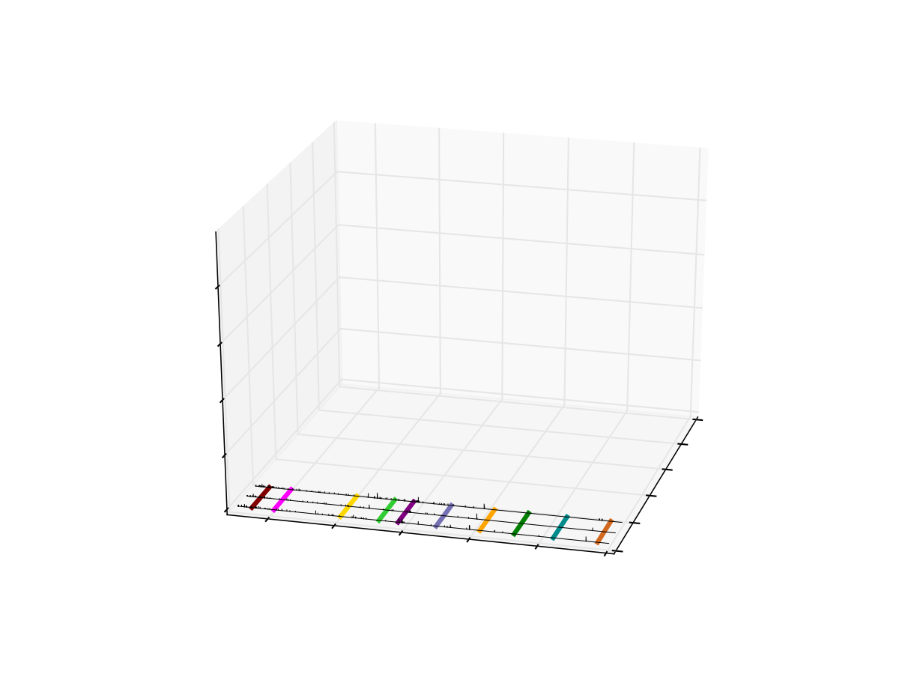
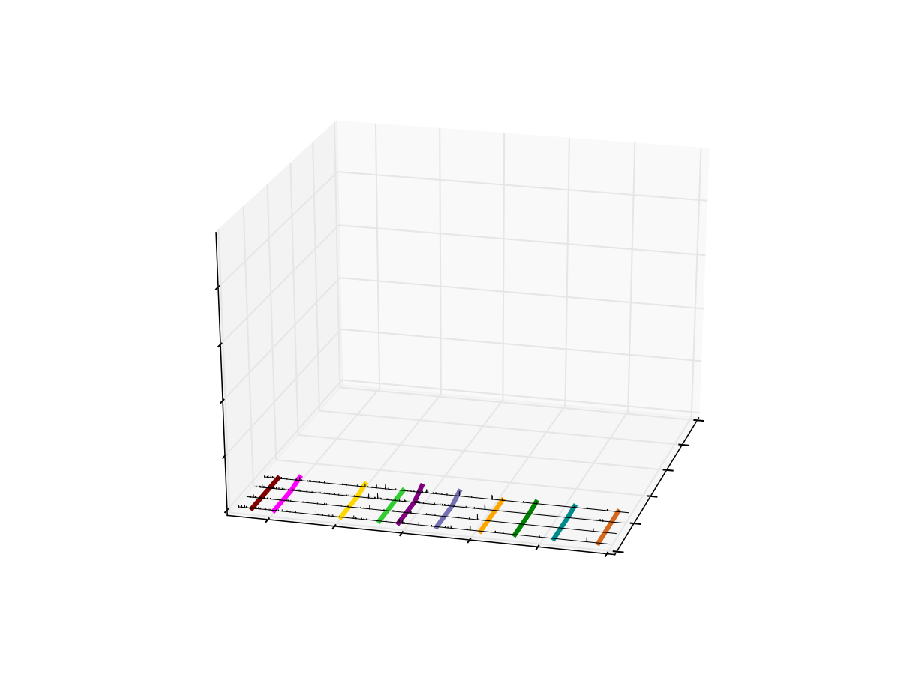
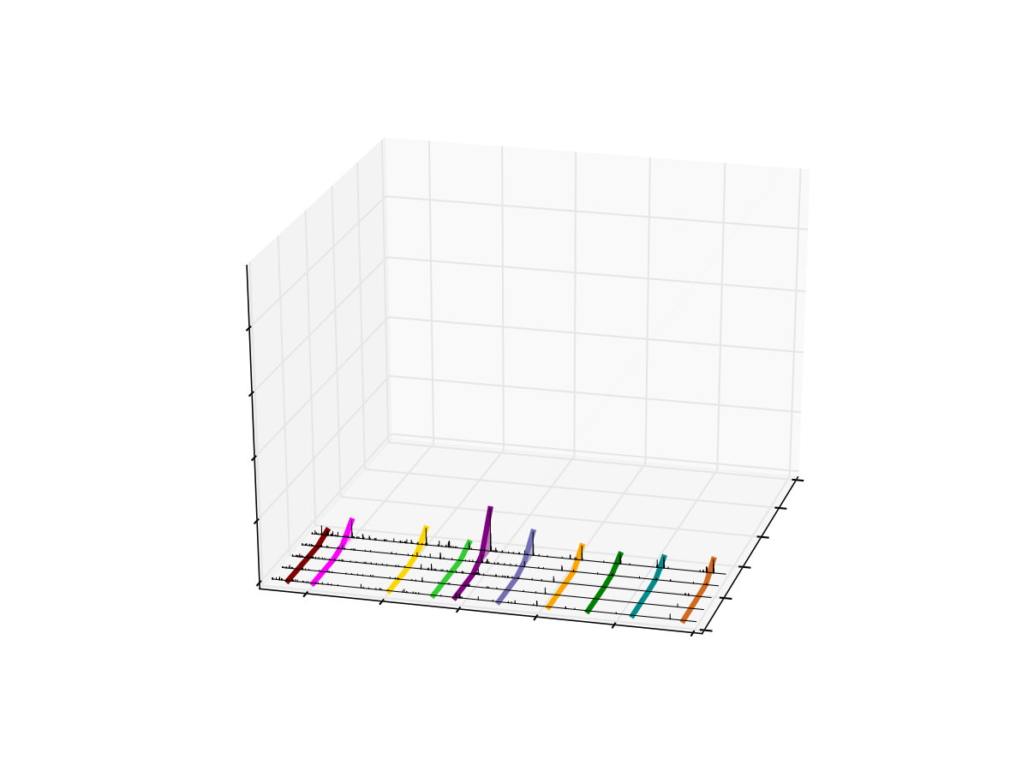
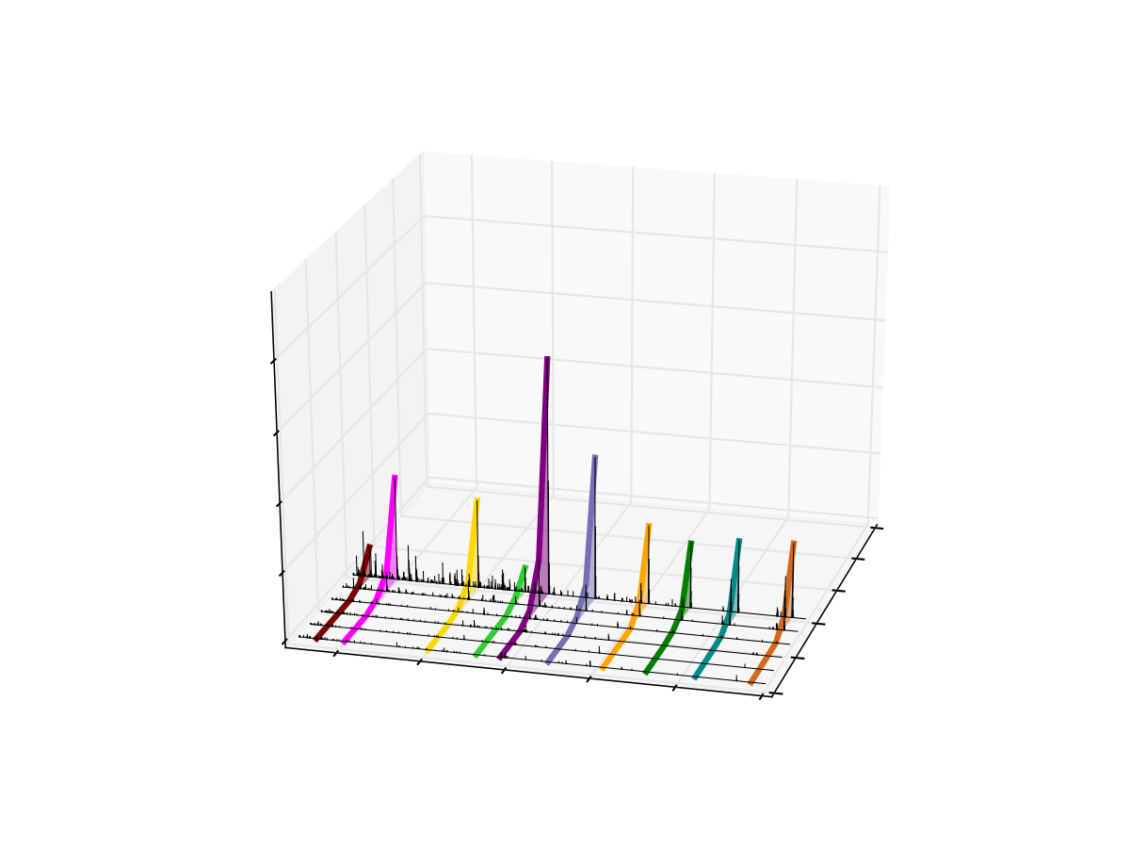
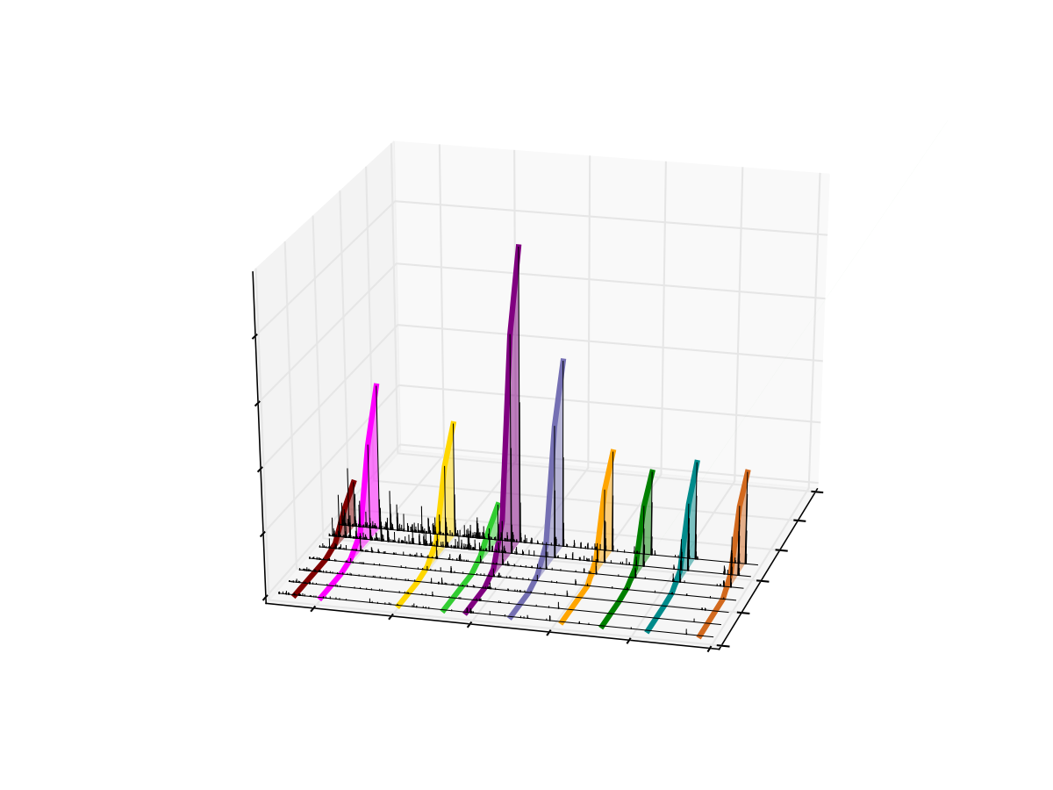
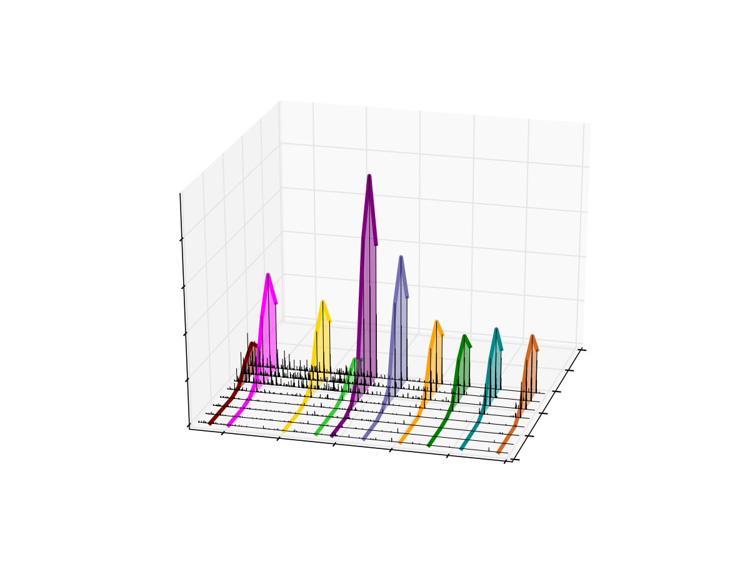
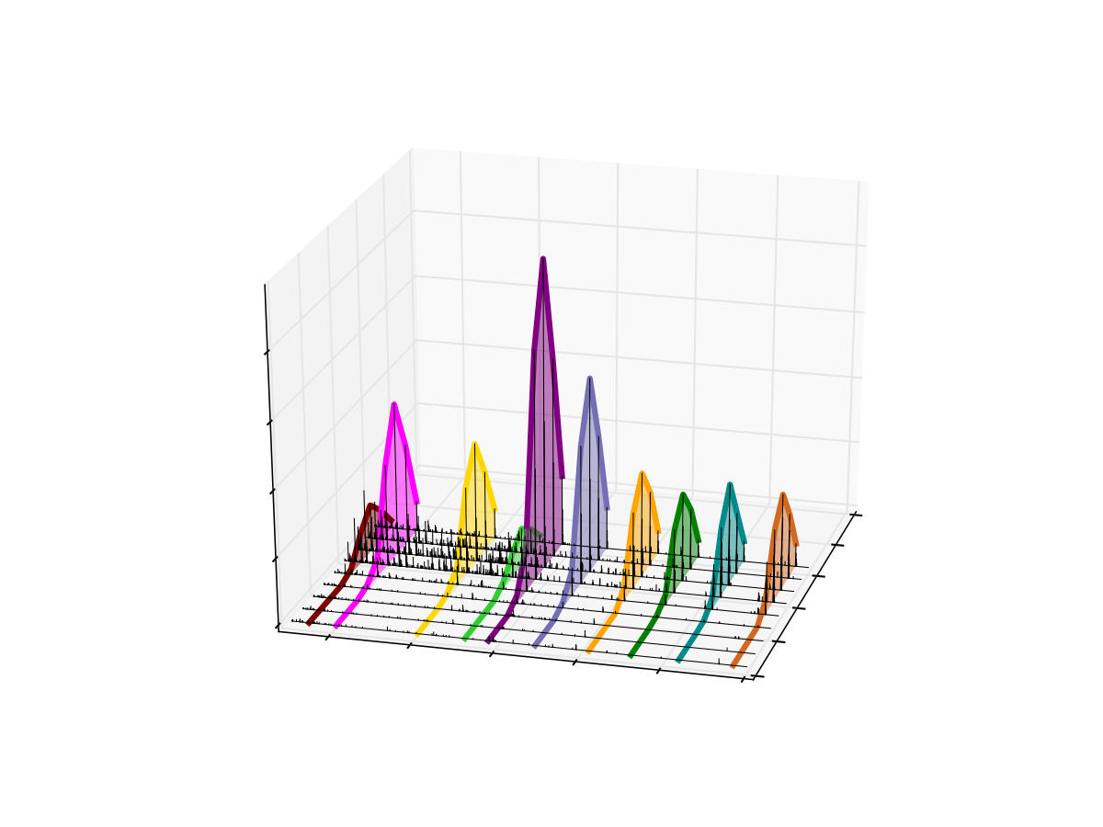
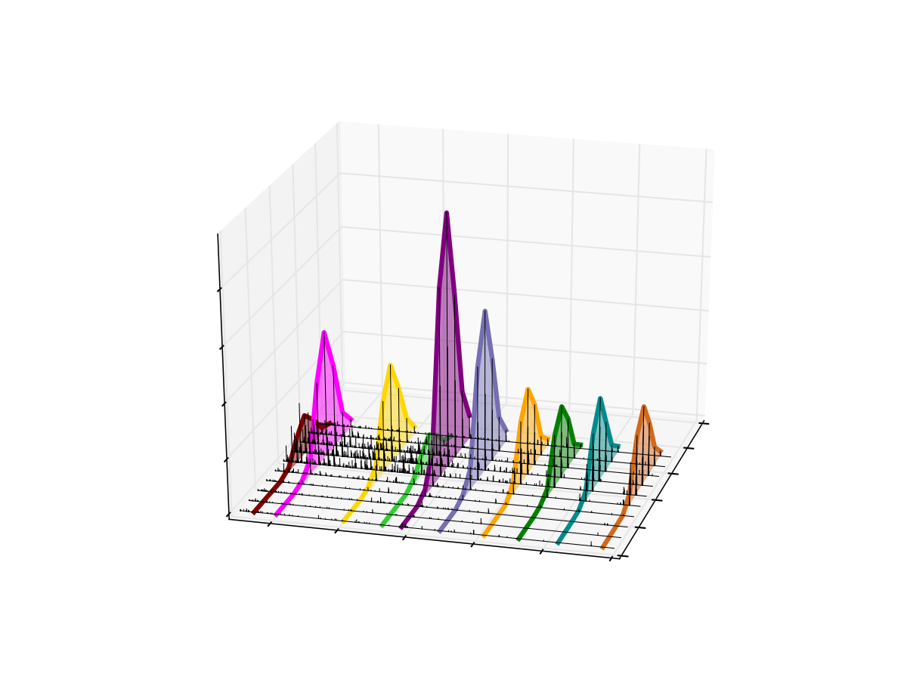
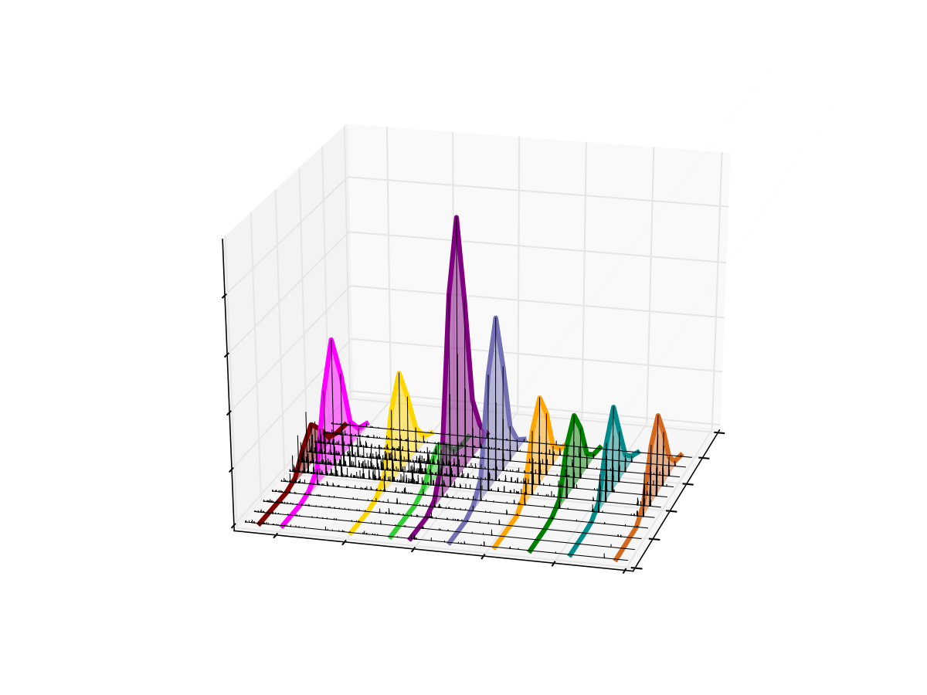

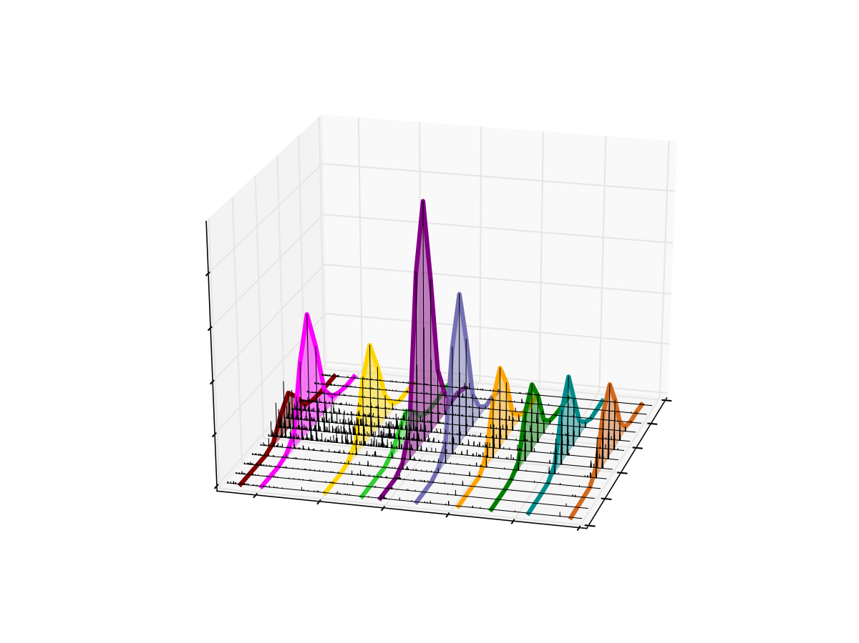
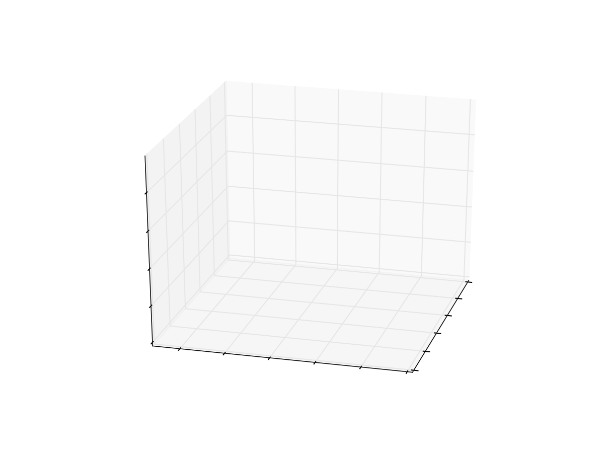
Targeted Chromatogram Extraction for VLENTEIGSDSIFDK++ (790.4 m/z)
500
m/z
900
4
3
Intensity x 10⁻⁵
780m/z
800
m/z
2
51.7
51.6
1
51.5
51.4
0
Retention Time
400
51.3
600
800
1000
51.2
1200
1400
m/z

Slide 12
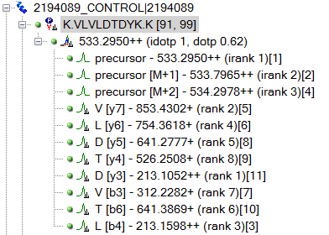
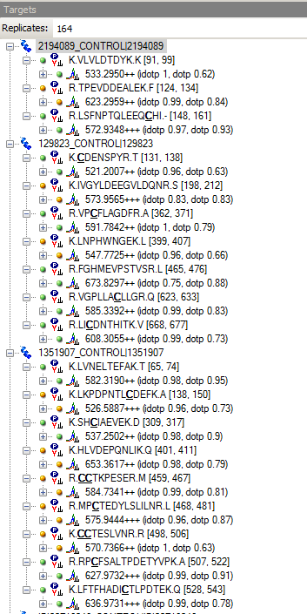
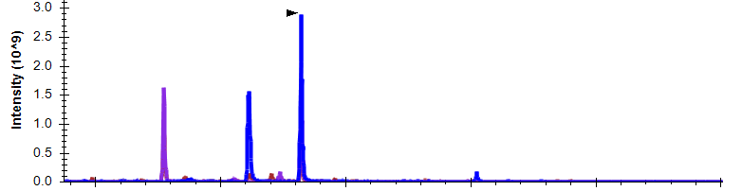
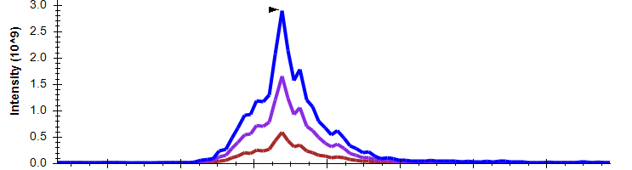
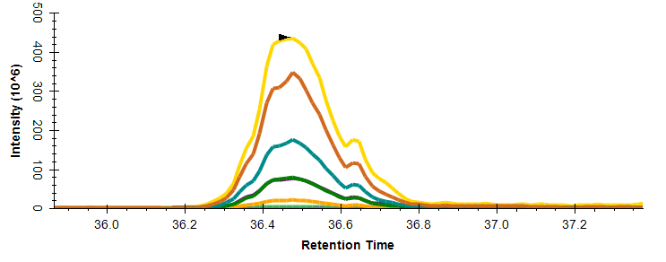
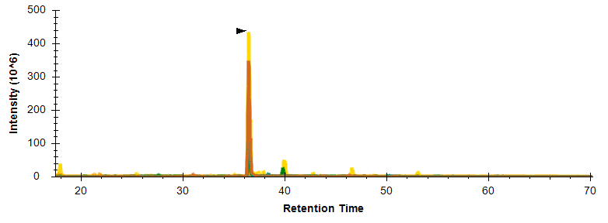
DIA Data Analysis
Set Peak Boundaries
Extract Chromatograms
Select Chromatographic Peak
Select Target Peptides
MS1
MS2

Slide 13
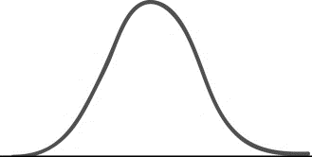
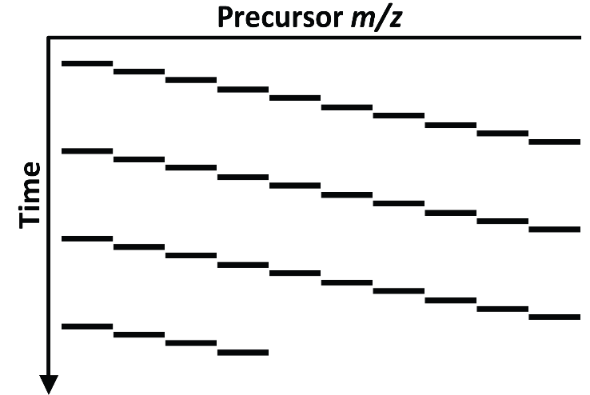
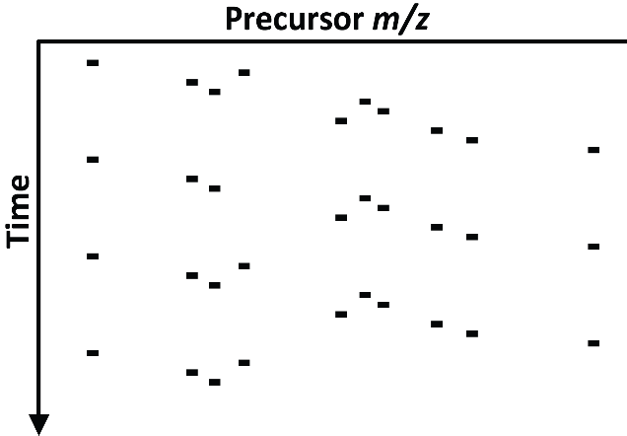
“SRM” on “All”
DIA
PRM/SRM

Slide 14
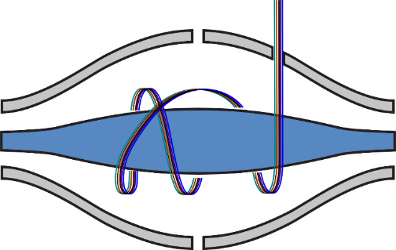
DIA
Targeted Extraction
Un-Targeted
Wide
Full Scan
HR/AM
Isolation
20 m/z Isolation Window
Mass Analysis
Targeted Acquisition
Targeted
Narrow
Mass Filter
Low Resolution
0.7 m/z Isolation Window
SRM

Slide 15
The Advantages of DIA

Slide 16
DIA
SRM
Data Acquisition
Hypothesis Generation
Hypothesis Generation
Peptide Selection
RT Scheduling
Peptide Selection
Transition Selection or Refinement
Chromatogram Extraction
Peak Integration
Data Acquisition
Transition Refinement
Peak Integration
Hypothesis Test
Hypothesis Test

Slide 17
DIA
SRM
Data Acquisition
Hypothesis Generation
Hypothesis Generation
Peptide Selection
RT Scheduling
Peptide Selection
Transition Selection or Refinement
Chromatogram Extraction
Peak Integration
Data Acquisition
Transition Refinement
Peak Integration
Hypothesis Test
Hypothesis Test

Slide 18
DIA
SRM
Data Acquisition
Hypothesis Generation
Hypothesis Generation
Peptide Selection
RT Scheduling
Peptide Selection
Transition Selection or Refinement
Chromatogram Extraction
Peak Integration
Data Acquisition
Transition Refinement
Peak Integration
Hypothesis Test
Hypothesis Test

Slide 19
DIA
SRM
Data Acquisition
Hypothesis Generation
Hypothesis Generation
Peptide Selection
RT Scheduling
Peptide Selection
Transition Selection or Refinement
Chromatogram Extraction
Peak Integration
Data Acquisition
Transition Refinement
Peak Integration
Hypothesis Test
Hypothesis Test

Slide 20
DIA vs. SRM and PRM
 | SRM | PRM | DIA
Isolation | Targeted | Targeted | Comprehensive
 | Narrow | Narrow | Wide
Mass Analysis | Targeted | Full Scan | Full Scan
 | Mass Filter | HR/AM | HR/AM
DIA Acquires Comprehensive AND Selective Data on a Peptide Mixture

Slide 21
DIA: Comprehensive and Selective
 | DDA |  | DIA |  | SRM
 | MS1 | MS2 | MS1 | MS2 | MS2
Comprehensive | Yes | No | Yes | Yes | No
Selective | No | Yes | No | Yes | Yes
Matches to observed MS1 precursor 1312.6003 +/- 10 ppm | Sequence | Mass | XCorr
 | R.HGESAWNLENR.F | 1312.6029 | 3.5356
 | K.EVAVADYTSSDR.V | 1312.6016 | 0.2337
 | K.KPYECTLCNK.T | 1312.6024 | 0.1140
 | K.NSSSEQLFSSAR.L | 1312.6128 | 0.1054
 | R.NDTHPTTGSASPK.H | 1312.6128 | 0.0628
Observed

Slide 22
Why Do We Need DIA?
DDA can identify and quantify peptides
  Database search for ID
  Spectral count or MS1 quantification
Why do we need DIA?
  Can query the data for any peptide (peptide detection)
  More selective and sensitive quantification

Slide 23
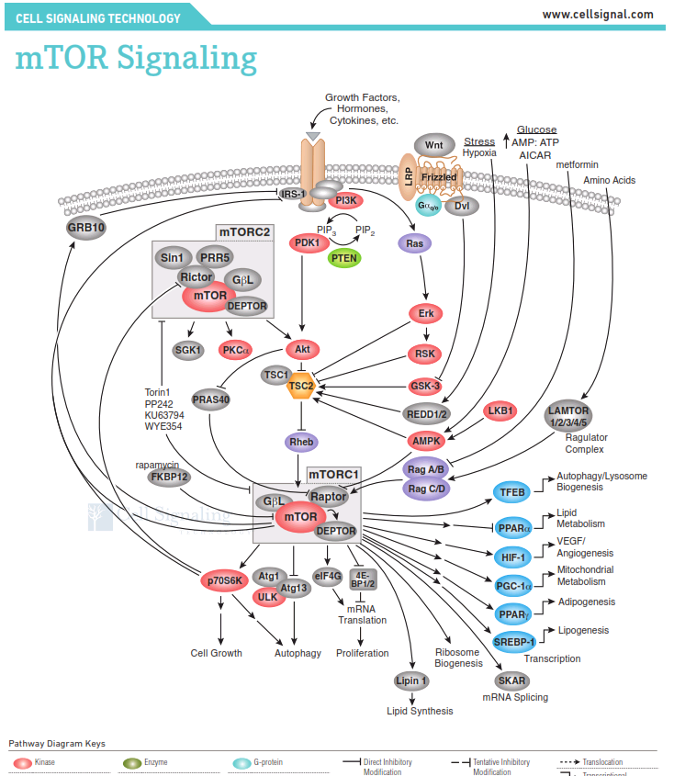
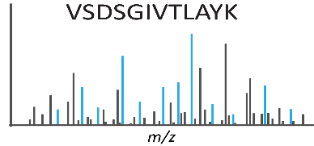
Why do we age?
WT
tor1
WT
tor1
WT
tor1
DDA
DDA
PSMs
PSM
PSM
MS1 AUC

Slide 24
Why do we age?
??
??
??
Is Lipin 1 Detected in the Sample?
Does Lipin 1 Change in Abundance?

Slide 25
What Does DDA Miss?
Detected
??
Sampled
??
Identified

Slide 26













Harry
Potter
Conclusion: Harry Potter was not identified, so the library does not have it.
Gone with the Wind
War and Peace
Don Quixote
Kite Runner
The Hobbit
Life of Pi
Catch-22
Identification is not a proxy for
detection

Slide 27
Harry
Potter
Conclusion: Harry Potter was detected, the library has it
A
B
C
D
E
F
G
H
I
J
K
L
M
N

Slide 28
250
200
)
6
^
0
150
1
(
y
t
i
s
n
100
e
t
n
I
50
0
37
38
39
40
41
Retention Time

Slide 29

The Promise of DIA
Acquire a “molecular image” or “digital archive” of the sample
  Mine it over and over
  No scheduling
Direct queries (and p-values) for peptides of interest
Better quantitation than DDA

Slide 30



The Challenges of DIA

Slide 31
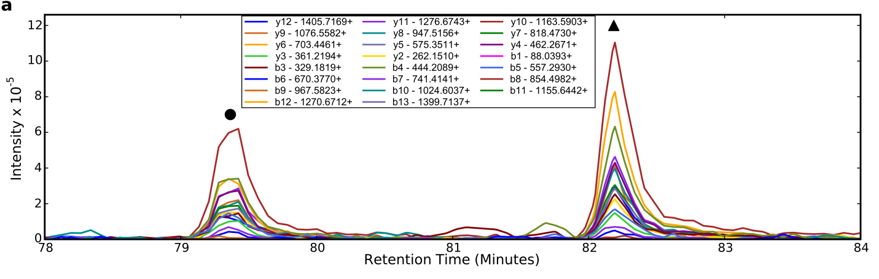
Precursor Selectivity
✓
X
890
900
SLQDIIAILGMDELSEEDKLTVSR+++
(897.8 m/z)
Multiplexed Methods Improve This Substantially
SLQDIIAILGMDELSEEDKLTVSR+++
(892.47 m/z)
✓
X

Slide 32
Peak Picking is Challenging
Peptide: NLPFSVENK ++
New Peptide Detection Algorithms (PECAN) and use of Known Retention Time and Fragmentation Information Help

Slide 33
Automated Peak Integration
4.0
120
3.5
100
3.0
)
)
80
9
2.5
6
^
^
0
0
1
1
(
(
y
y
t
2.0
t
60
i
i
s
s
n
n
e
e
t
t
n
n
I
1.5
I
40
1.0
0.5
20
0.0
38.0
38.5
39.0
39.5
0
30
31
32
33
34
Retention Time
Retention Time
70
60
)
50
6
^
0
1
40
(
y
t
i
s
n
e
30
t
n
I
20
10
0
38.0
38.5
39.0
39.5
Retention Time

Slide 34
Image Quality

Slide 35

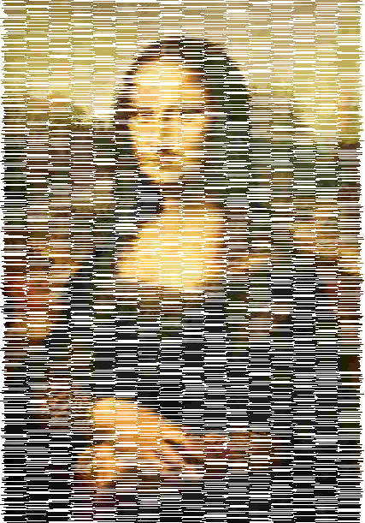


DDA vs. DIA vs. SRM
DDA
DIA
SRM/PRM
MS Quantification
MS/MS Quantification
High Selectivity MS/MS
Quantification
on semi-random subset
on almost everything
on targets

Slide 36
Next Sessions
DIA Method Design, Data Acquisition, and Quality Control
  There is no “one size fits all” DIA method
DIA Data Analysis
  Using DDA to inform DIA Analysis
Future Directions
  Multiplexed Acquisition
  Future Instrumentation
  Algorithmic Improvements

