Slide 1
Volcano Plot Formatting

Slide 2
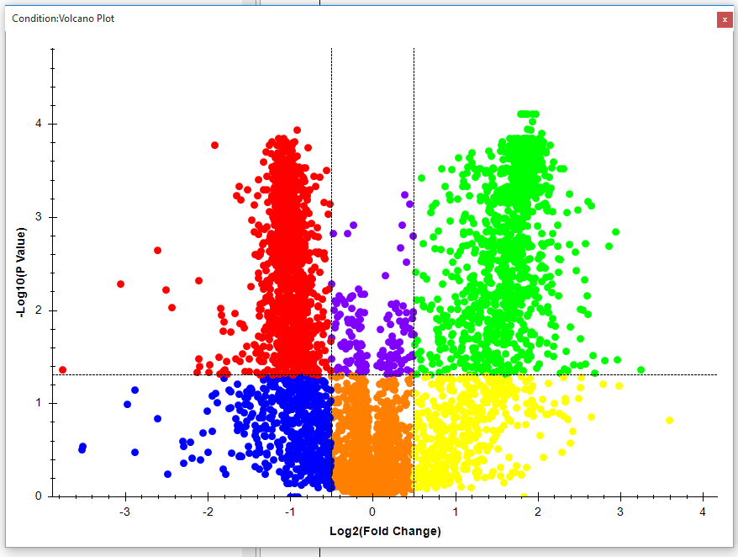
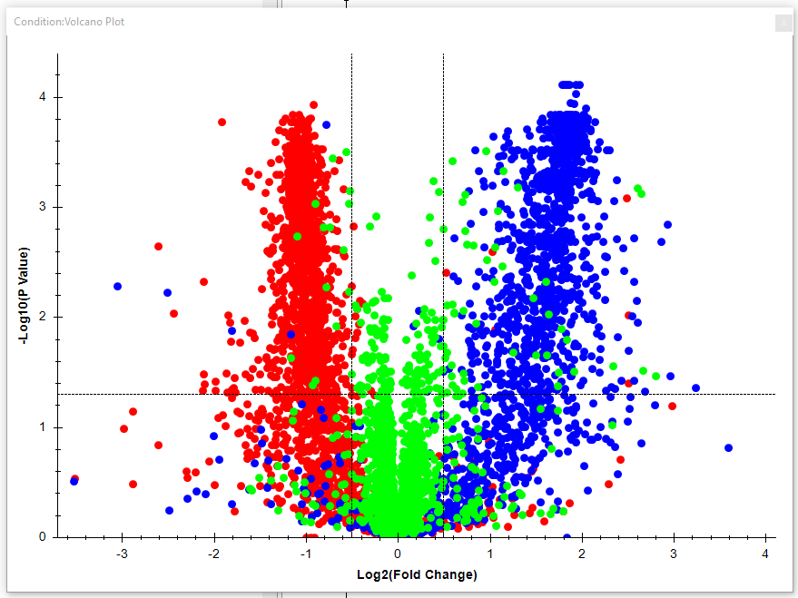
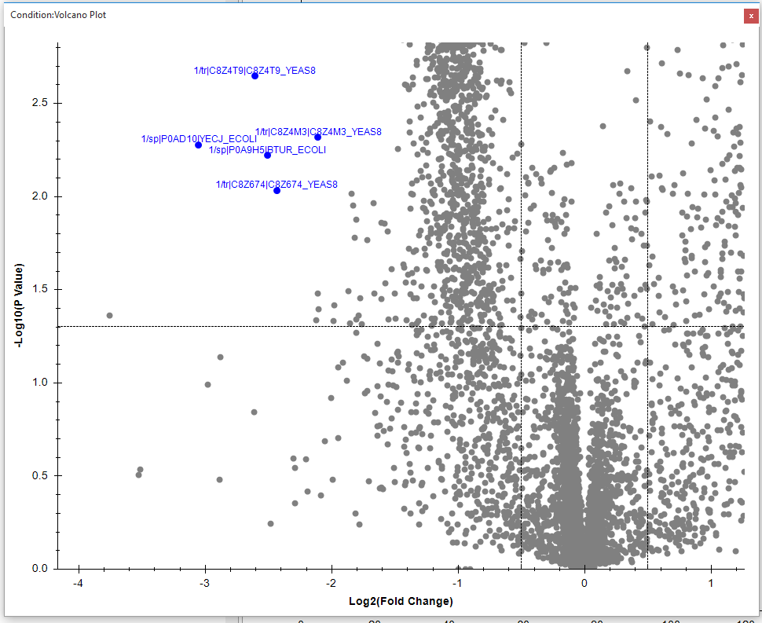
Overview
With the addition of the Volcano Plot formatting options, individual points on the volcano plot and regions specified by the Fold Change and P-Value cutoffs can be colored and labeled.
Data from 3 organism mix in Navarro, Nature Biotech. 2016

Slide 3
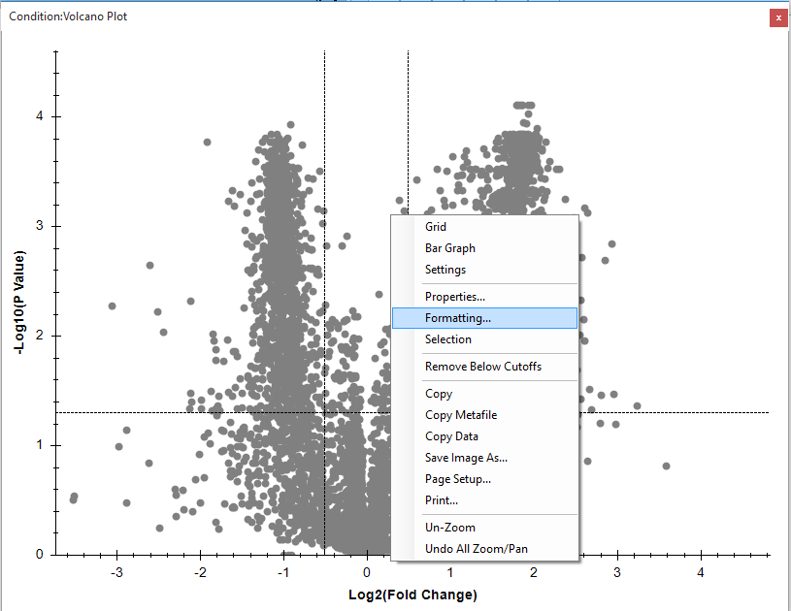
Opening the Formatting Dialog
The formatting dialog can be found in the right-click menu of the Volcano Plot under “Formatting…”:

Slide 4
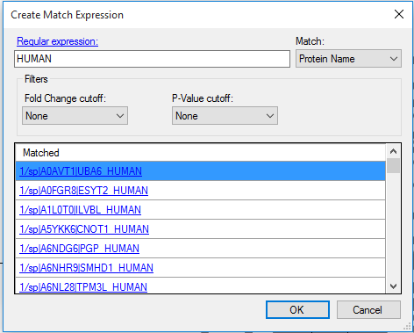
Matching by Regular Expression
Clicking on the button next to the expression column will bring up the Create Match Expression dialog. In this example we match the Protein name, and enter the simple regular expression “HUMAN”, to show all human proteins. We repeat this step using “ECOLI” and “YEAS”.

Slide 5
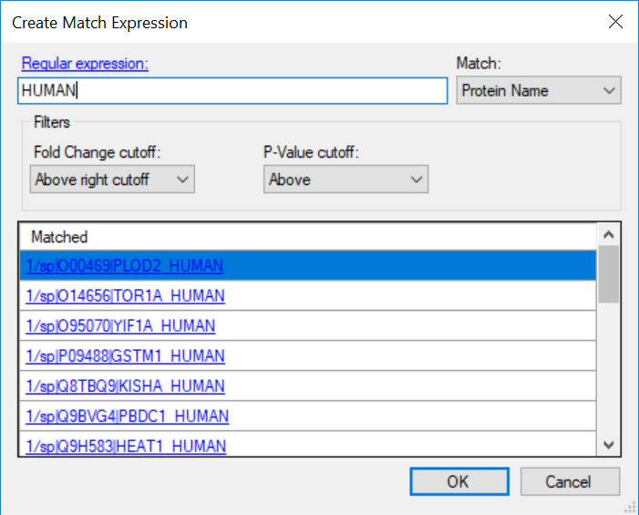
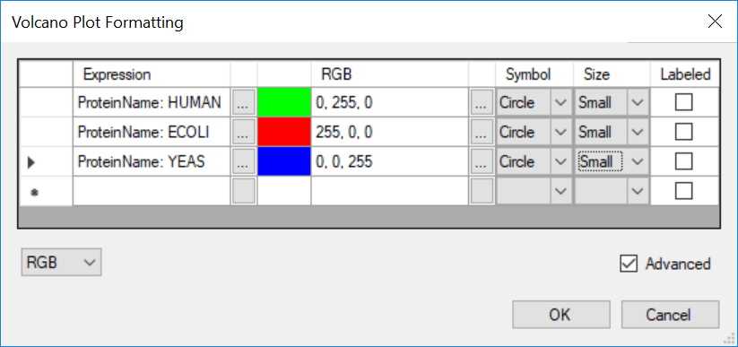
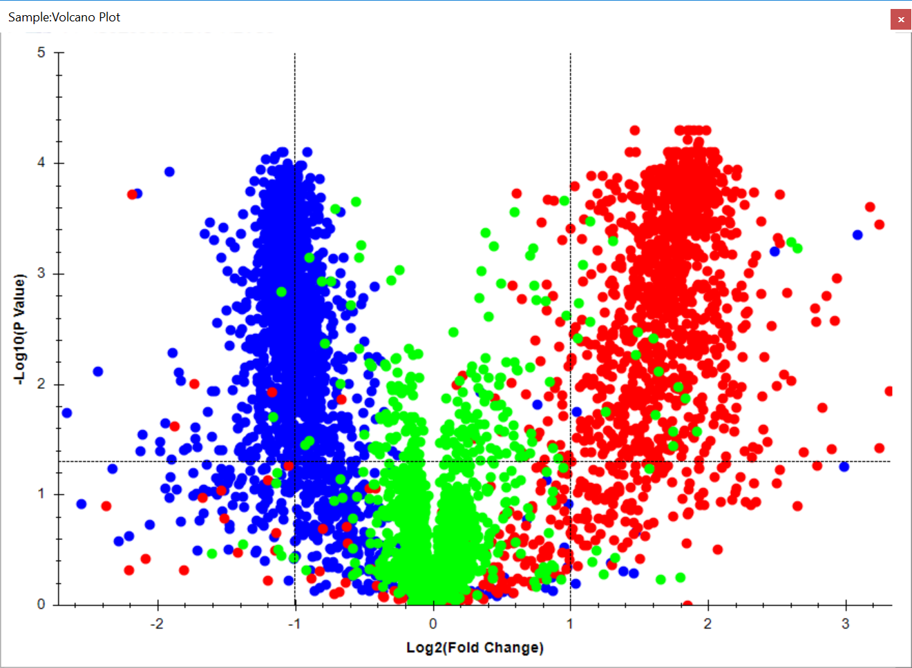
After clicking OK, the new expression will be added to the grid and it can be customized. By clicking on the button next to the RGB column, the color can be changed:

Slide 6
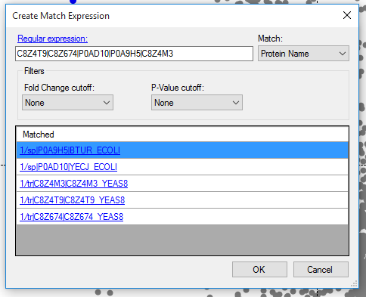
Labeling and coloring individual proteins/peptides
By entering a simple “or” expression, we can filter out specific proteins, which we can then label and color:

Slide 7
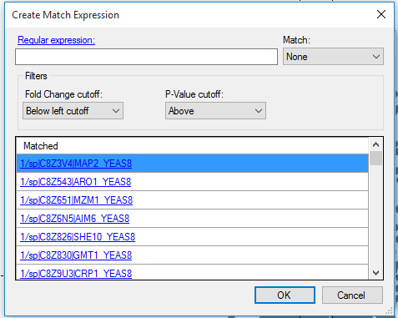
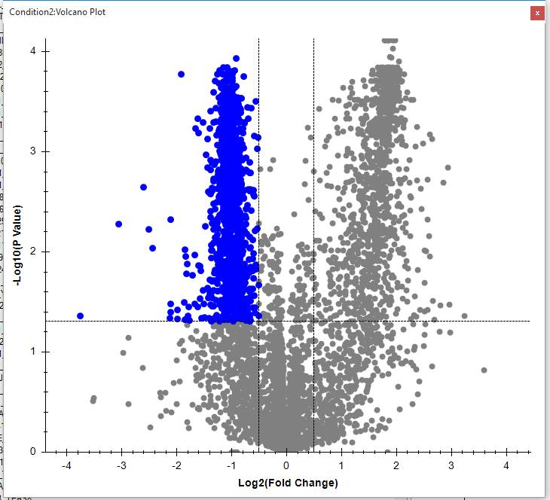
Using the cutoffs
By combining the two cutoff filters, we can highlight specific regions on the volcano plot. For example:

Slide 8
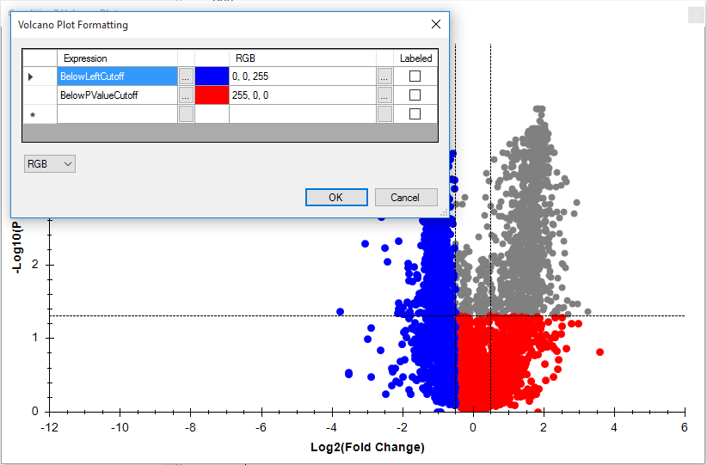
Order of expressions
The order of expressions in the formatting grid matters. If two expressions match the same protein, the protein will be formatted according to the expression that comes first in the table. For example:
The first expression matches all proteins below the left fold change cutoff. The second expression matches all proteins below the P-Value cutoff. Since the Fold Change cutoff expression comes first, the proteins that are below both cutoffs are blue.

