Slide 1
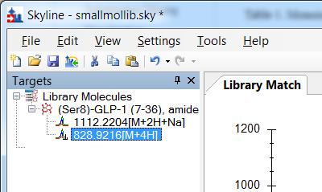
Skyline's internal model for small molecules has been aligned with that of peptides - the Targets tree now contains neutral molecules with children that have adducts (i.e. precursors).
The ability to declare multiple adducts for a single molecule (an extension of Skyline's longstanding support for multiple protonated states for peptides) greatly extends the number of Skyline features that can be used with small molecules.

Slide 2
You can easily create small molecule spectral libraries with the newly extended .ssl format
file scan charge adduct inchikey retention-time chemicalformula moleculename otherkeys
demo.ms2 136 3 [M+3H] RYYVLZVUVIJVGH-UHFFFAOYSA-N 20.0 C8H10N4O2 Caffeine "CAS:58-08-2 HMDB:01847"
demo.ms2 140 3 [M+3H] LFQSCWFLJHTTHZ-UHFFFAOYAB C2H6O Ethanol
demo.ms2 142 3 [M+3H] YAPQBXQYLJRXSA-UHFFFAOYSA-N 60.0 C7H8N4O2 Theobromine

Slide 3
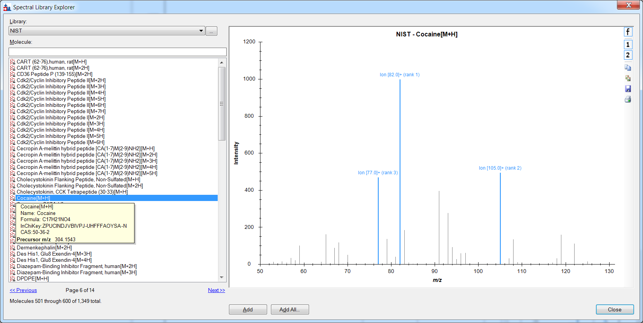
Small molecule spectral libraries can be imported and used to create target lists
The NIST .msf format is the first to be supported, with more on the way.

Slide 4
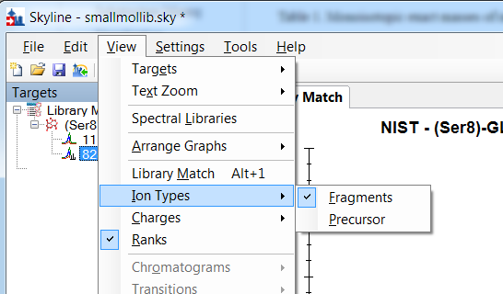
The popup menus for selecting ion types in graphs no longer offer A, B, C, X, Y, Z, and Precursor when working with small molecules, but instead offer Fragments and Precursor.
we use the catch-all "Fragments" since we don't have an inherent sense of fragment type for generalized small molecules.

Slide 5
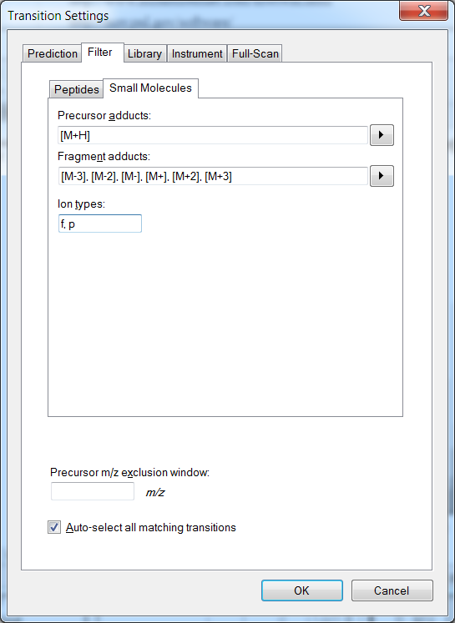
The Transition Settings Filter tab now has a sub-tab just for small molecule settings: you will notice that there are adduct lists for precursor and fragment filtering similar to the charge state lists for peptides.
Note that you can pick adducts from a popup list, but you can always compose your own as well. Typically fragment ions are known by mass and charge only, so adduct descriptions like [M+] and [M-] are suitable here.

Slide 6
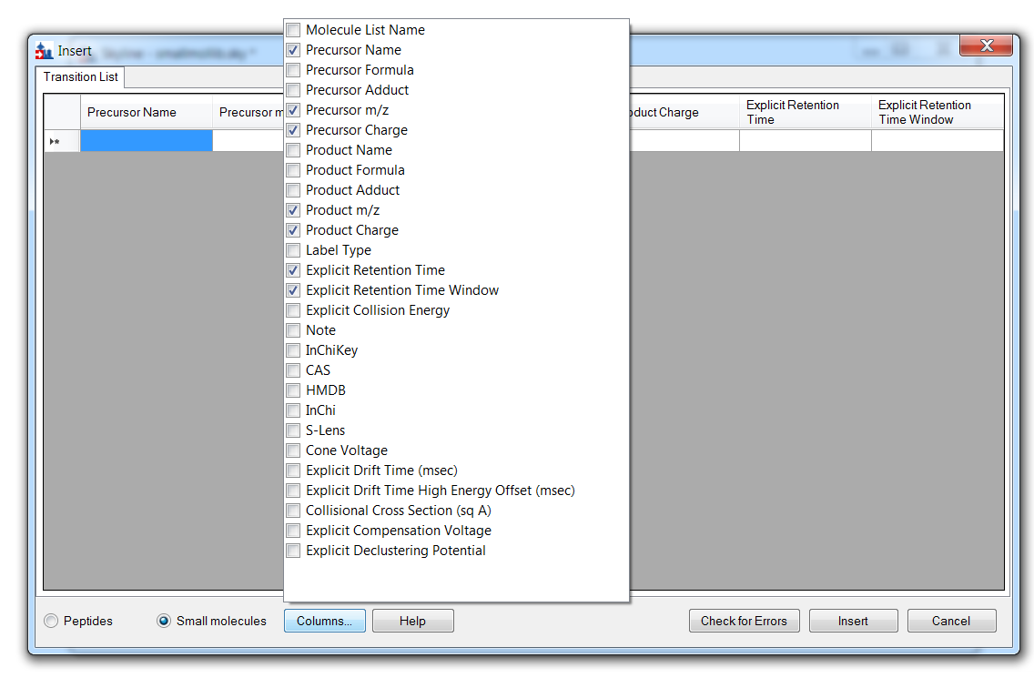
The transition list reader has new columns for importing InChiKey, InChi, CAS and HMDB identifiers.
Standardized molecular identifiers make it easier to match entries in existing spectral libraries.

