Slide 1
Hierarchical Clustering and PCA Plots in Skyline Daily
January 8, 2021
Nicholas Shulman

Slide 2
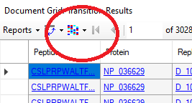
“Cluster” button on the Document Grid
A “Cluster” button appears on the Document Grid (and related windows) in the newest release of Skyline-Daily.
When you push that button, Skyline will choose a set of numeric columns to perform hierarchical clustering on
The clustering works best if some numeric columns have been pivoted by replicate

Slide 3
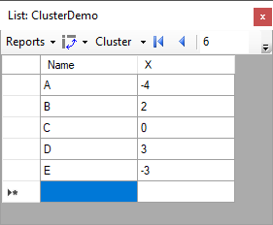
What is hierarchical clustering?
Finds which points are closest to each other, and then finds which points or groups of points are closest to each other.
In this case, A&E are close to each other, and B&D are close to each other. After that, C is closer to B&D than it is to A&E.
A
E
C
B
D
-5
0
5

Slide 4
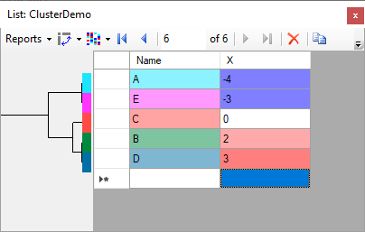
What hierarchical clustering looks like in the Document Grid
Rows get reordered so that the dendrogram can be drawn without the lines crossing
Values in “Text” column get colored arbitrarily
Values in “X” column get colored based on how far they are from zero
A
E
C
B
D
-5
0
5

Slide 5
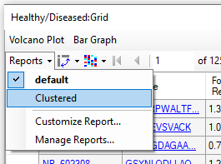
Group Comparisons
The Group Comparison grid in Skyline-Daily now has an additional report available “Clustered”.
Also, pushing the colorful cluster button automatically switches the report from “default” to “Clustered.

Slide 6
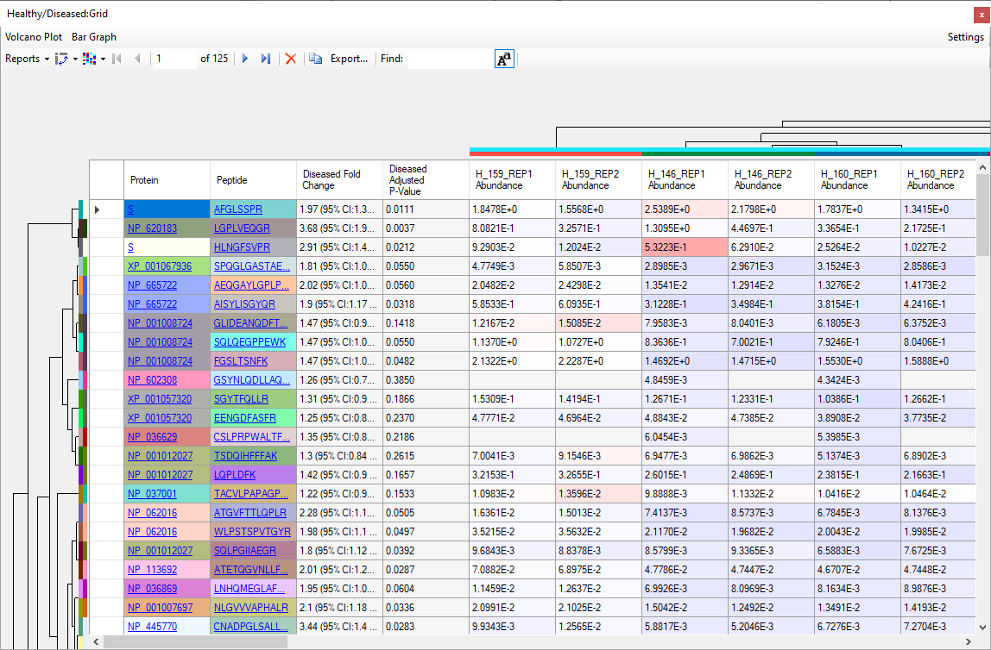
Clustered Group Comparison Report
The “Clustered” comparison report displays the replicate abundances in separate columns.
Hierarchical clustering is performed on the replicate columns, as well as the peptide or protein rows.

Slide 7
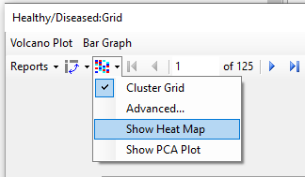
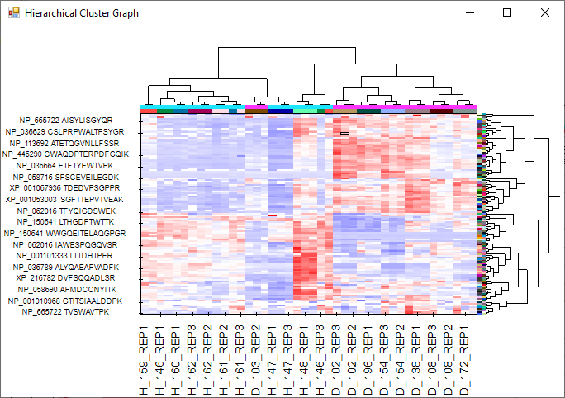
Displaying the heat map graph
There is a dropdown menu item from the cluster button which brings up a heat map graph.

