Slide 1
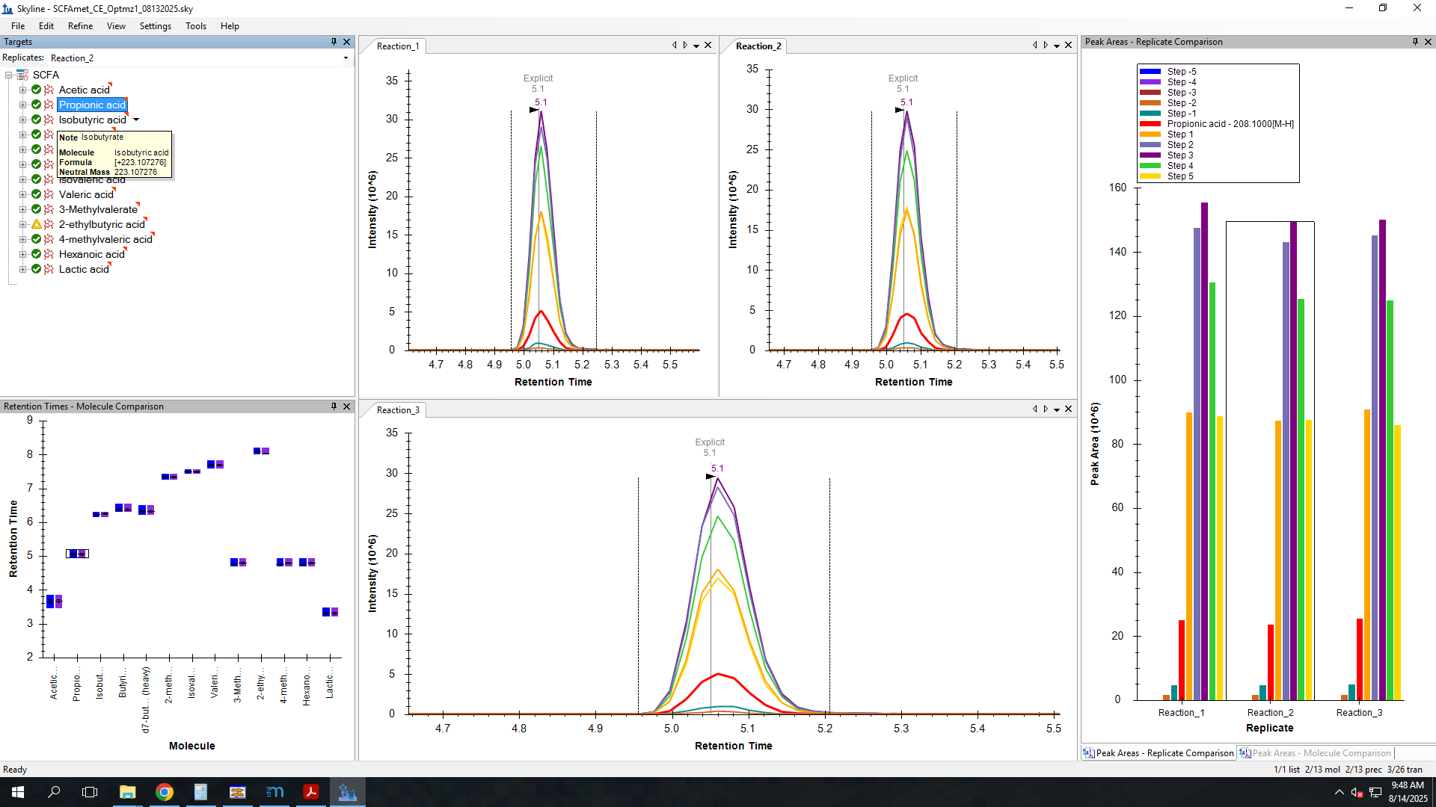
Propionate
Peak areas are shown for respective CEs

Slide 2
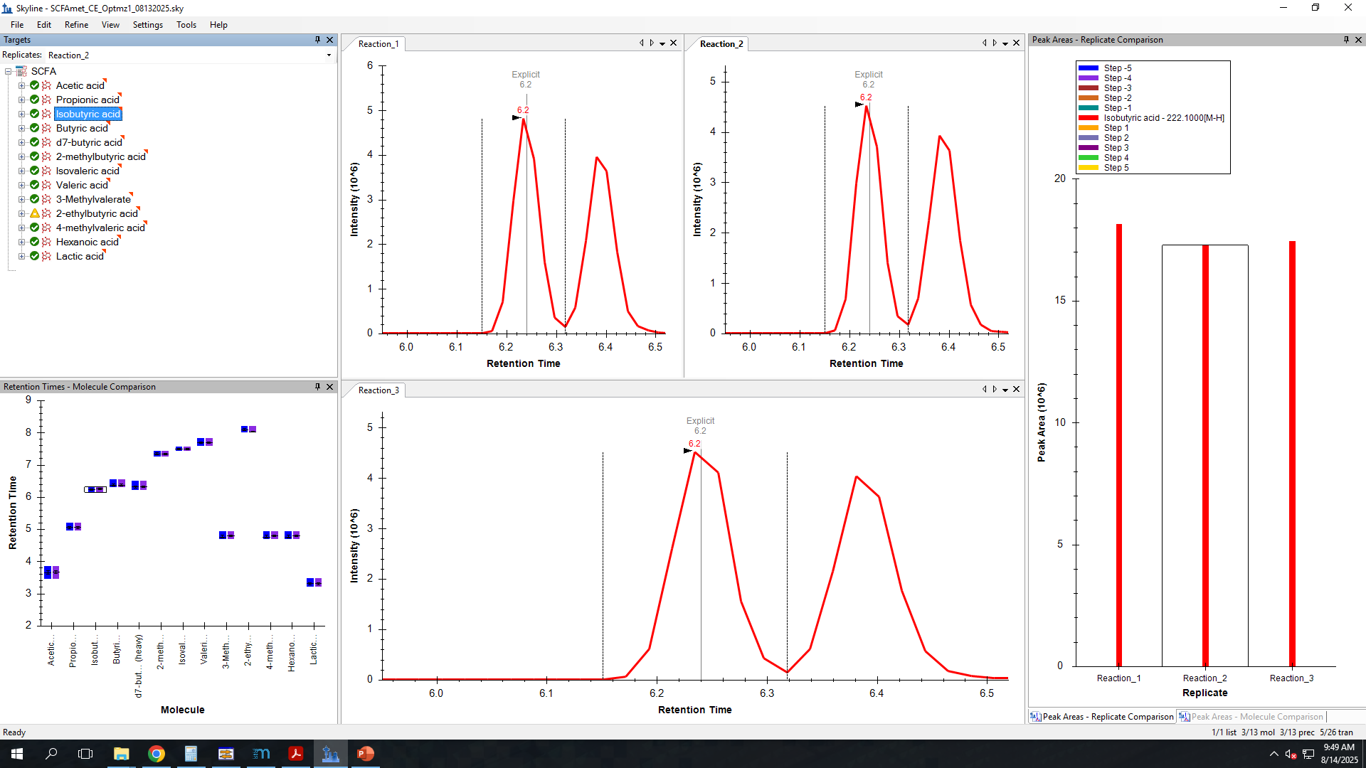
Isobutyrate
Peak areas are not shown for respective CEs

Slide 3
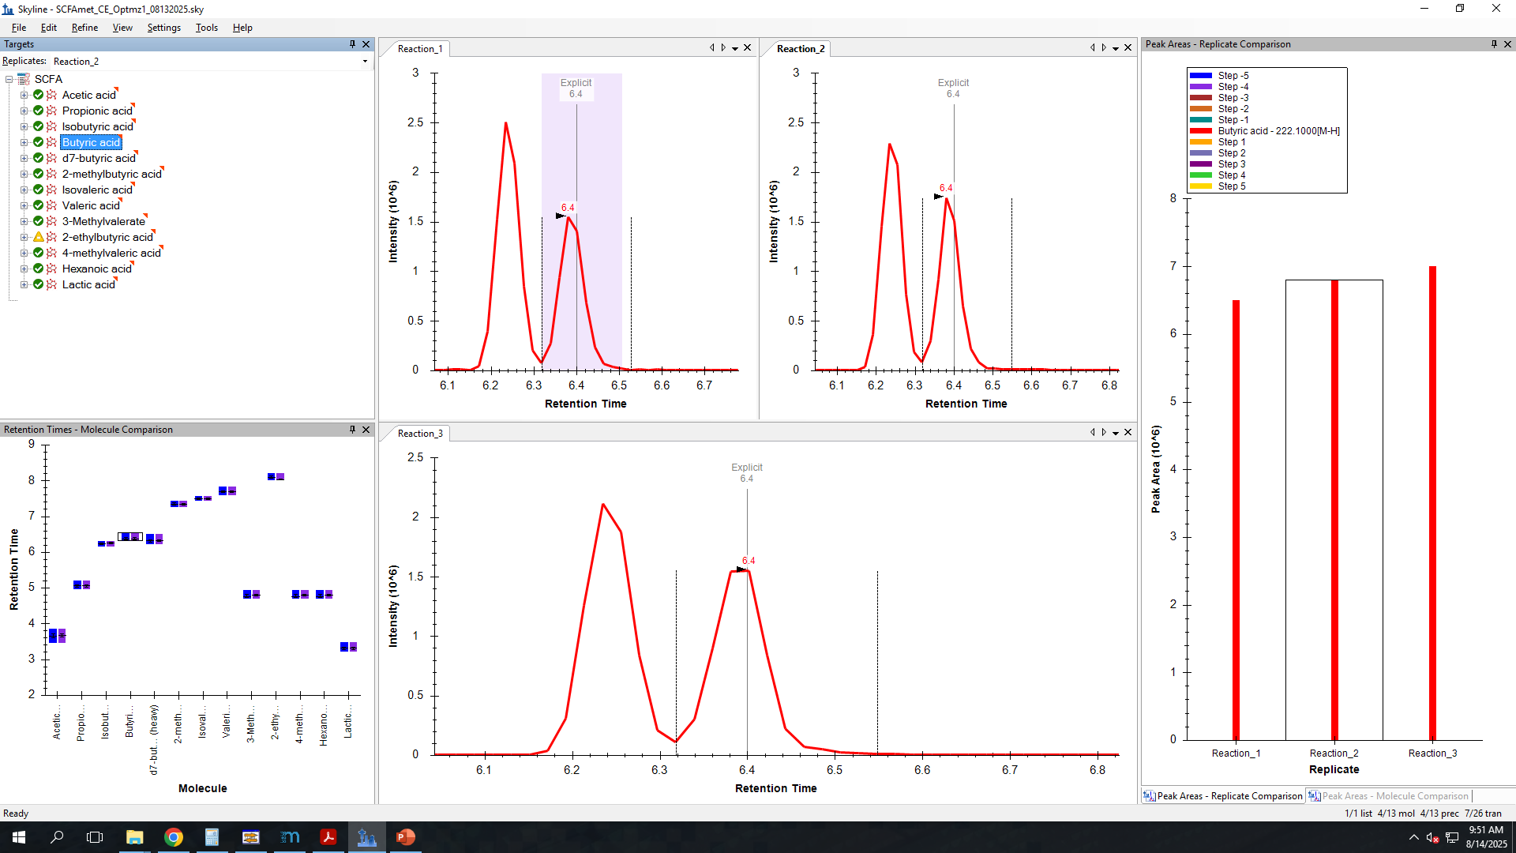
Butyrate
Peak areas are not shown for respective CEs

