Slide 1
The Human Transcription Factor Proteome
Andrew Stergachis
Stamatoyannopoulos Lab
Dept. of Genome Sciences
University of Washington

Slide 2
Overview
Part I – Brief background on transcription factors (TFs)
Part II – High-throughput generation of SRM methods
Part III – Compartmentalization of TFs within the nucleus

Slide 3
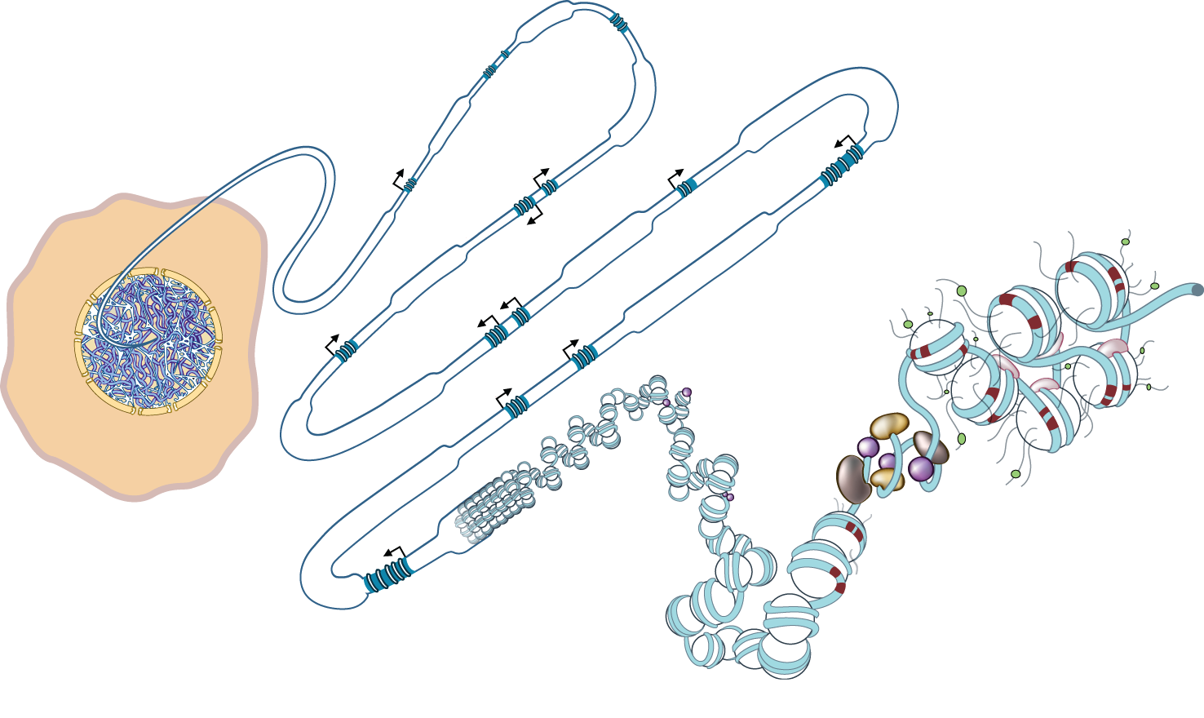
The nuclear proteome
Nuclear proteins:
Histones
Structural components
Ribosomal proteins
…
Transcription factors (TFs):
Sequence-specific DNA-binding proteins that mediate transcriptional regulation
(~1,400 human TFs)
Millions of copies per nuclei
Thousands of copies per nuclei

Slide 4
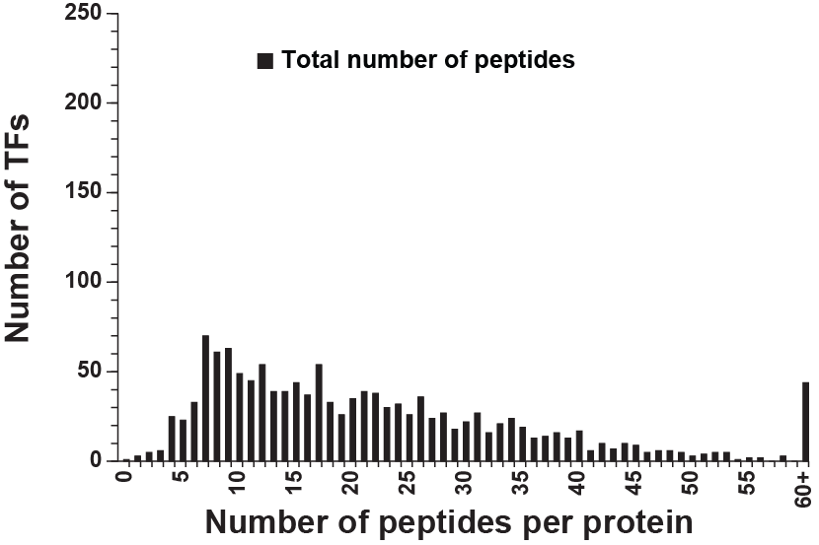
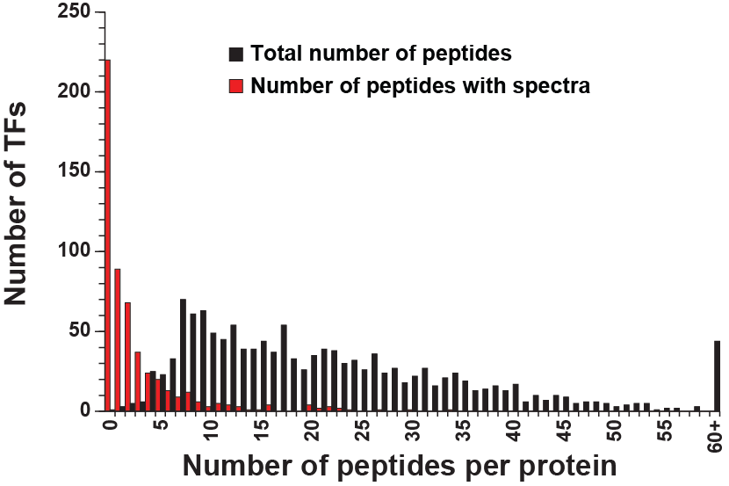
Need a new experimental paradigm for TFs
Most human TFs lack good antibodies
Most human TFs have gone unseen by ‘shotgun’ proteomics approaches
Selected Reaction Monitoring (SRM) should be more sensitive
Need to identify for each TF protein:
Best responding, ’proteotypic,’ peptides
Fragmentation patterns of these ‘proteotypic peptides
2011_05_26 NIST H. sapiens Ion Trap peptide spectral library

Slide 5
Part II
High-throughput empirical generation of SRM methods

Slide 6
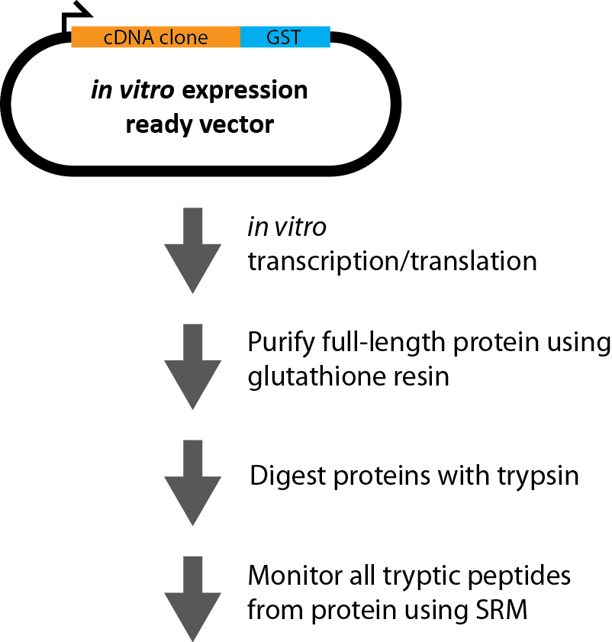
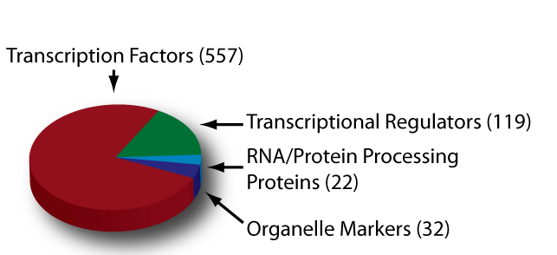

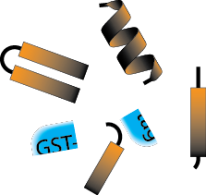
Empirical identification of proteotypic peptides
Able to identify:
Best responding, ’proteotypic,’ peptides
Fragmentation patterns of these ‘proteotypic peptides
Stergachis et al., Nature Methods 8, 1041 (2011).

Slide 7
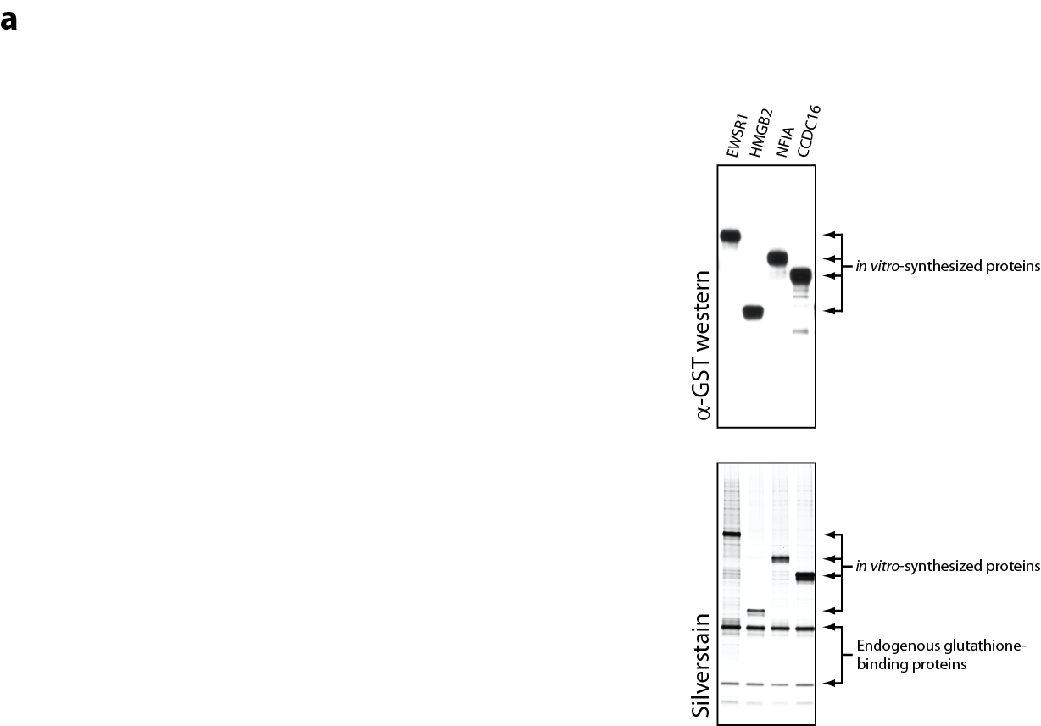
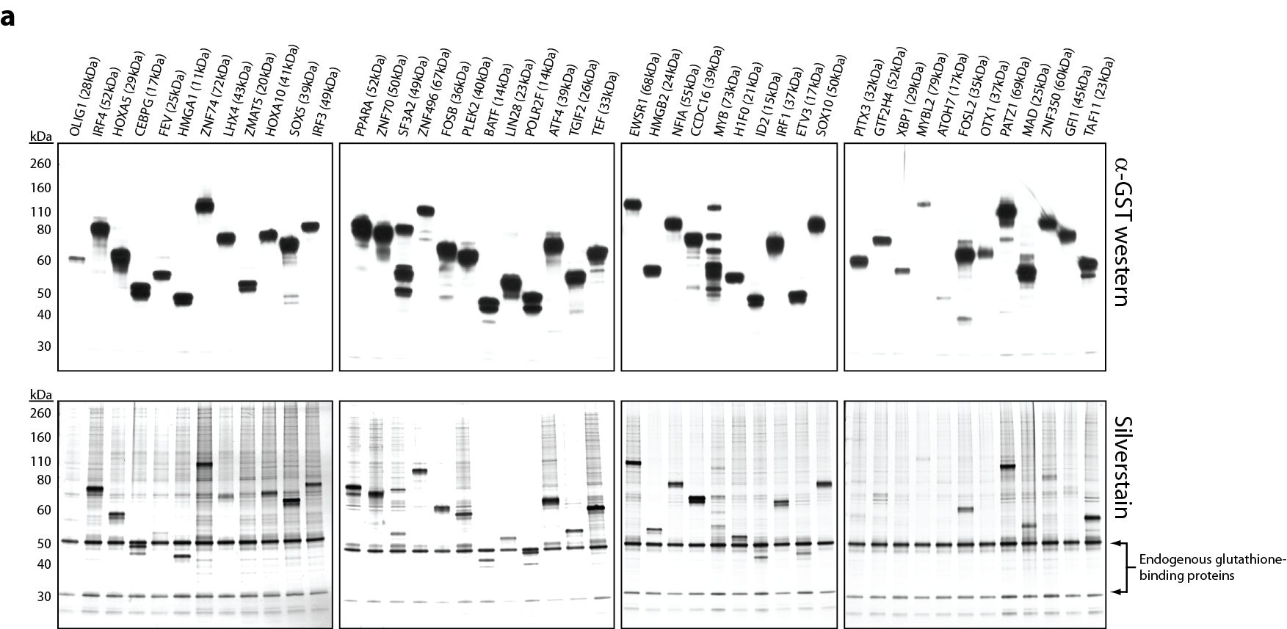
Rapid production of enriched full-length proteins

Slide 8
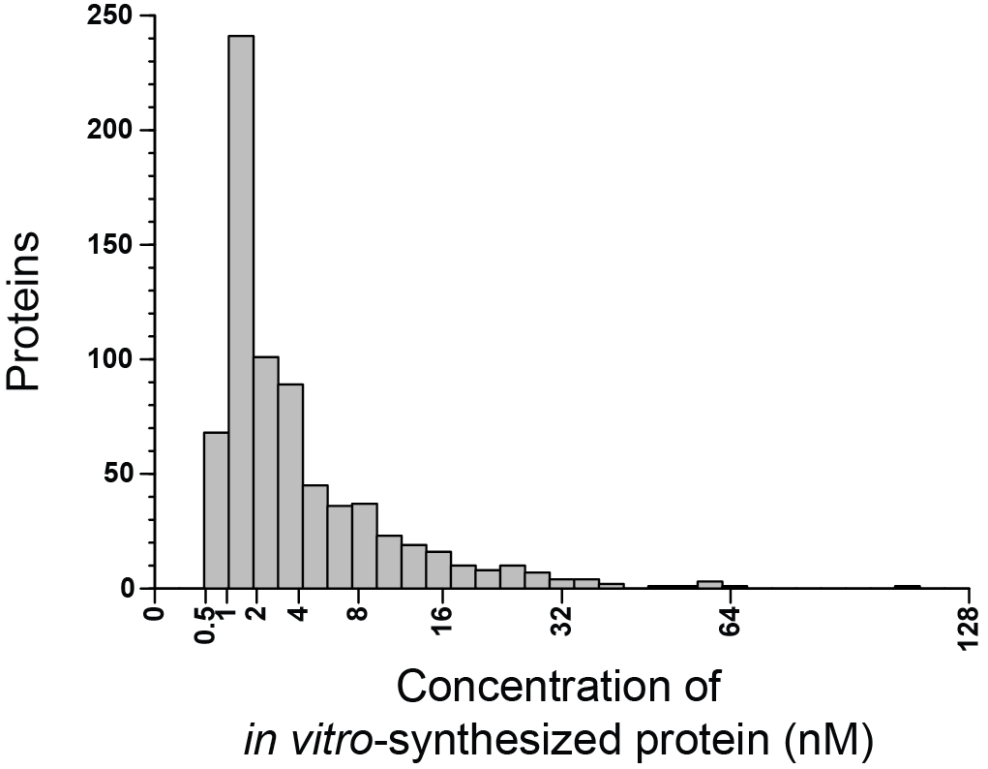
Rapid production of enriched full-length proteins
Performed absolute quantification on all 730 in vitro-synthesized proteins
GST peptides quantified:
LLLEYLEEK
IEAIPQIDK
More details are available through the Absolute Quantification tutorial posted on the Skyline website

Slide 9
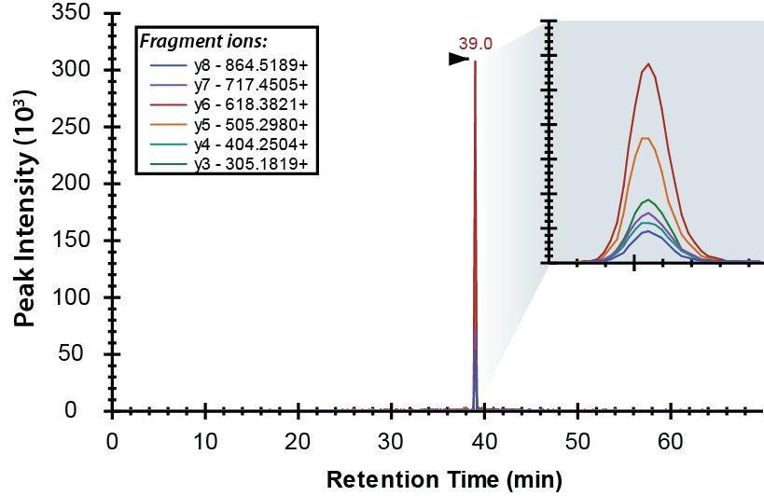
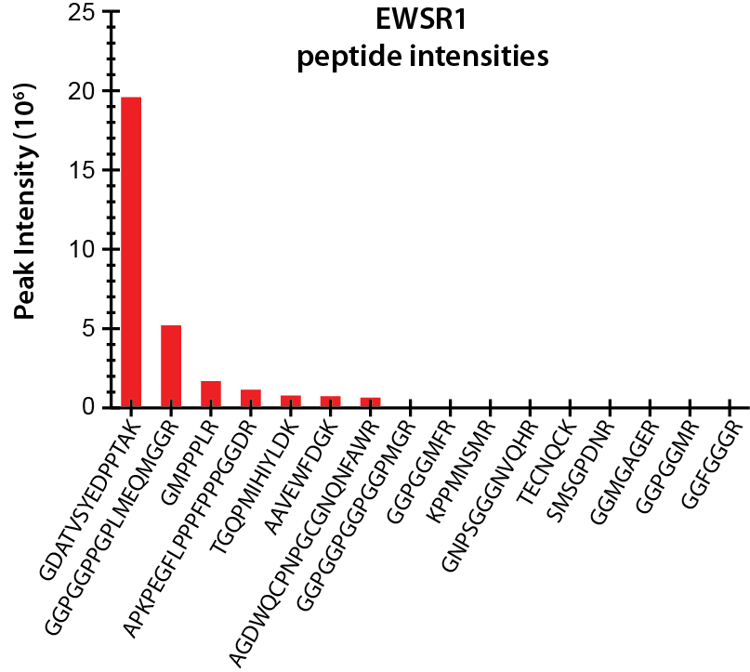
Identification of proteotypic peptides
Using Skyline, we monitored for each protein:
Fully tryptic peptides
7-23 amino acids in length (+2 charge state monoisotopic)
y₃ to y_{n-1} product ions (+1 charge state monoisotopic)
In total, we monitored >100,000 product ions
Panorama (WP407) – Vagisha Sharma

Slide 10
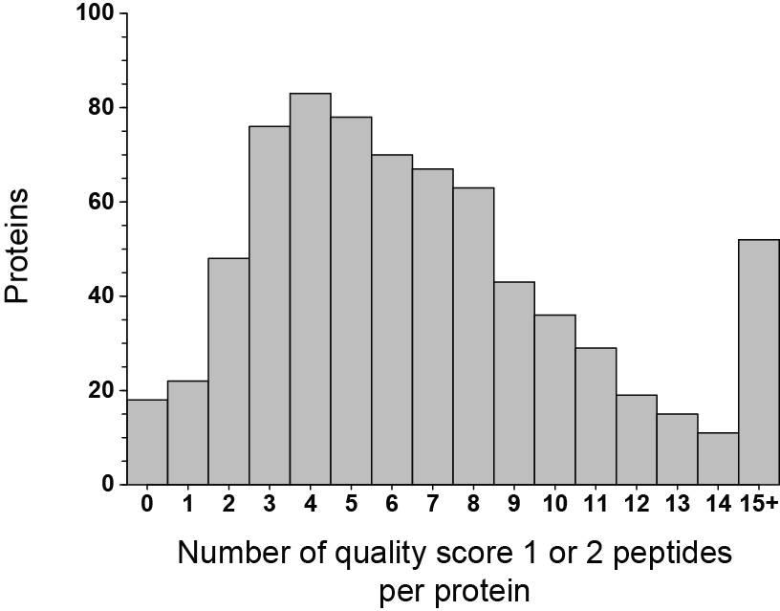
Identification of proteotypic peptides
Data was acquired for 12,344 peptides
Annotated each peptide to identify those of high quality (quality score 1 or 2)
4,927 peptides were identified with a quality score of 1 or 2
Criterion used to determine peptide quality:
A) A prominent chromatographic peak with a signal intensity of at least 60,000
B) Two or more data points were collected across the peak
C) Three or more product ions not including y₃ co‐eluted to contribute to this peak signal
D) The chromatographic peak had a Gaussian elution profile
Stergachis et al., Nature Methods 8, 1041 (2011).

Slide 11
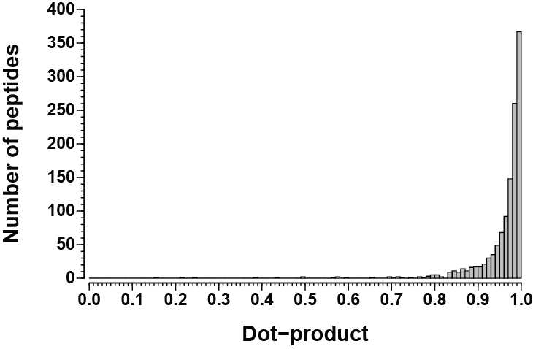
Correspondence with spectral databases
Dot-product: Measure similarity between our SRM observed fragmentation patterns and database fragmentation patterns for the same peptide (1 = perfect match)
22% (1,093/4,927) of the quality score 1 and 2 peptides in our data were represented in NIST
2011_05_26 NIST H. sapiens Ion Trap peptide spectral library

Slide 12
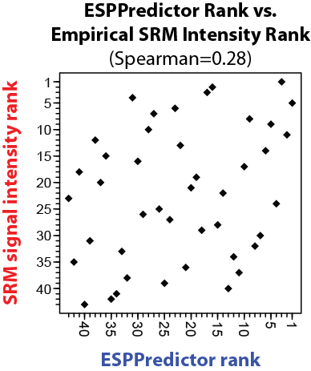
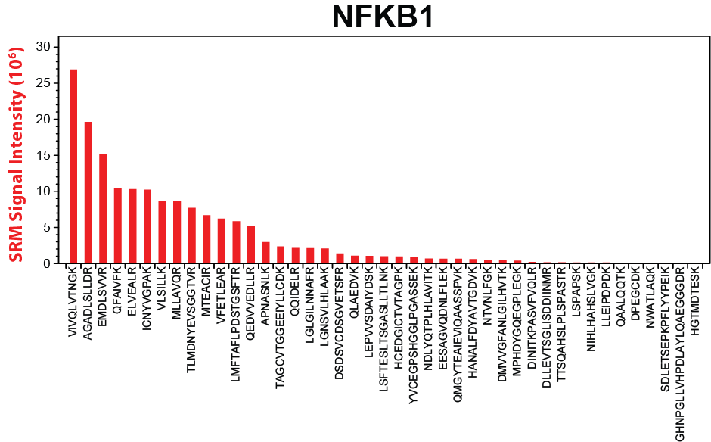
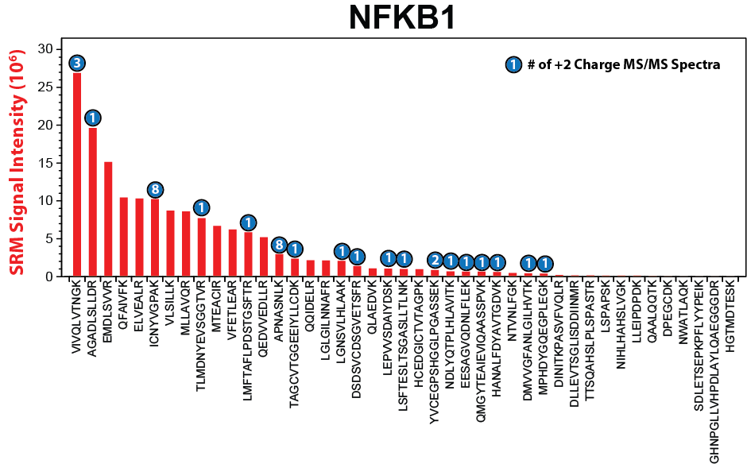
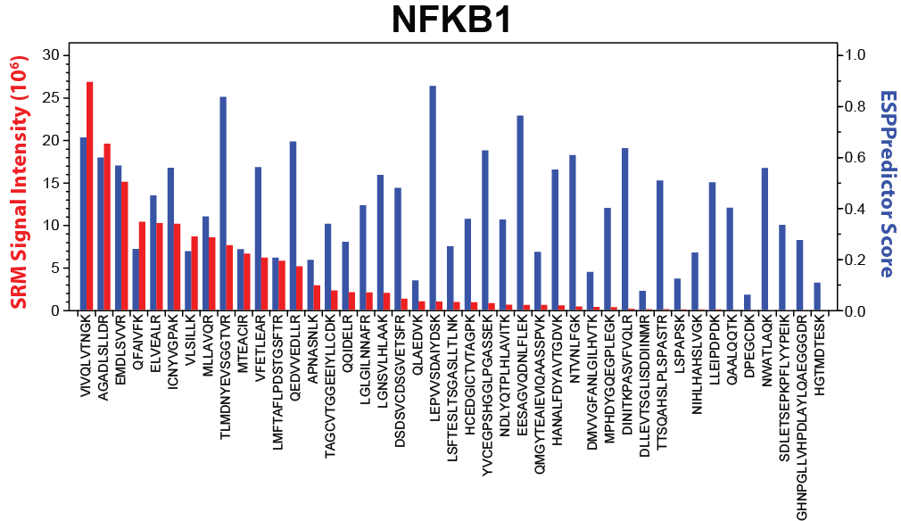
Relationship with other ranking systems
Proteins show an average Spearman correlation of 0.47 (range -0.45 to 0.85)

Slide 13
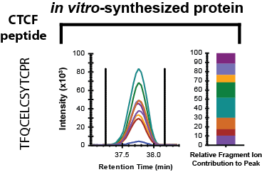
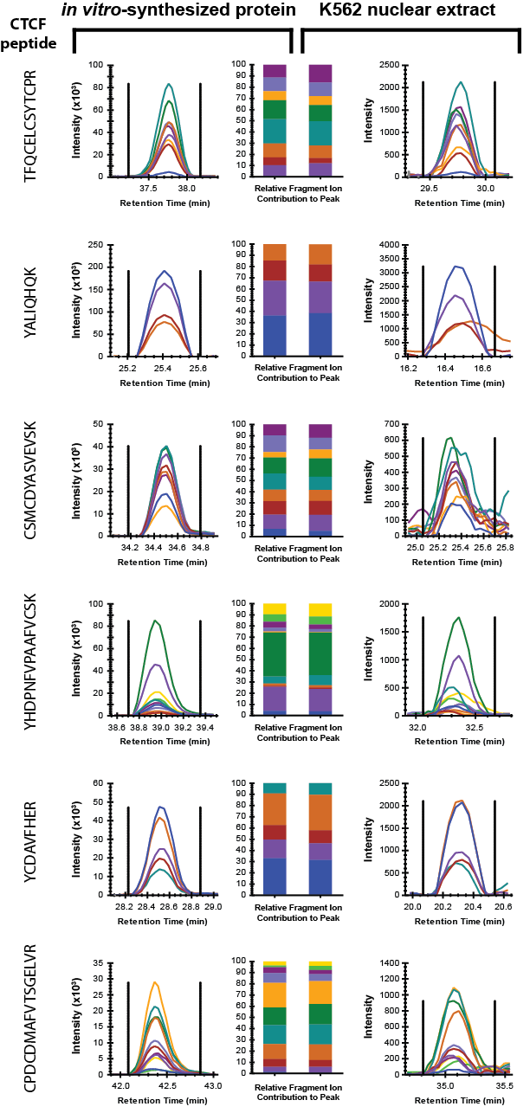
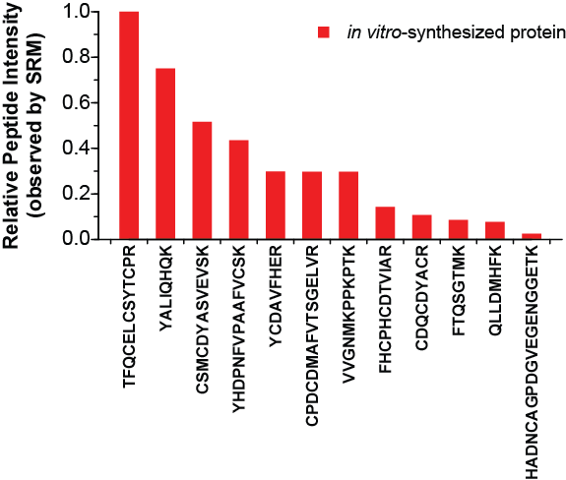
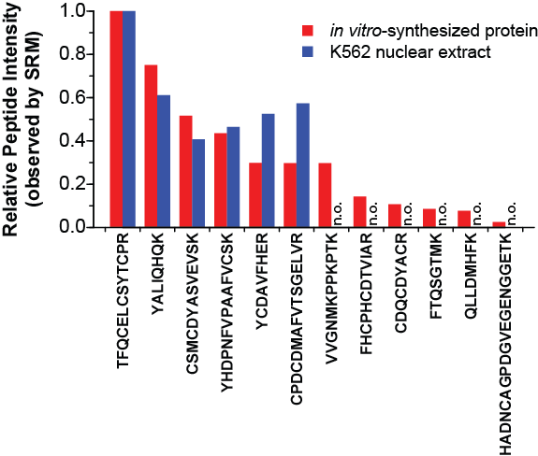
Identifying CTCF peptides in vivo
CTCF

Slide 14
Part III
Compartmentalization of human TFs within the nucleus

Slide 15
Compartmentalization of the nuclear proteome
Nuclear structures:
Heterochromatin
Euchromatin
Nucleoli
Splicing factories
…
Transcription factors (TFs) must find their binding sites and recruit appropriate co-regulators

Slide 16
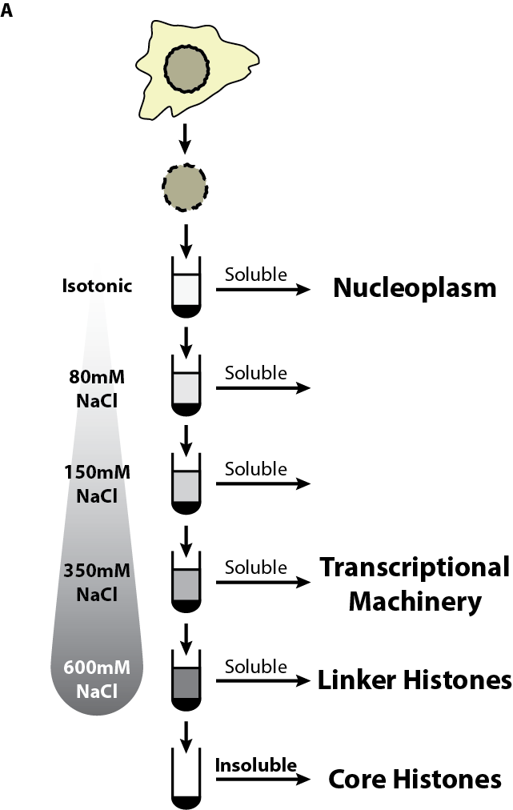
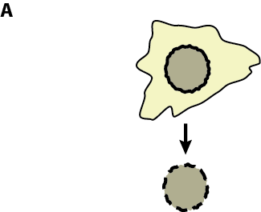
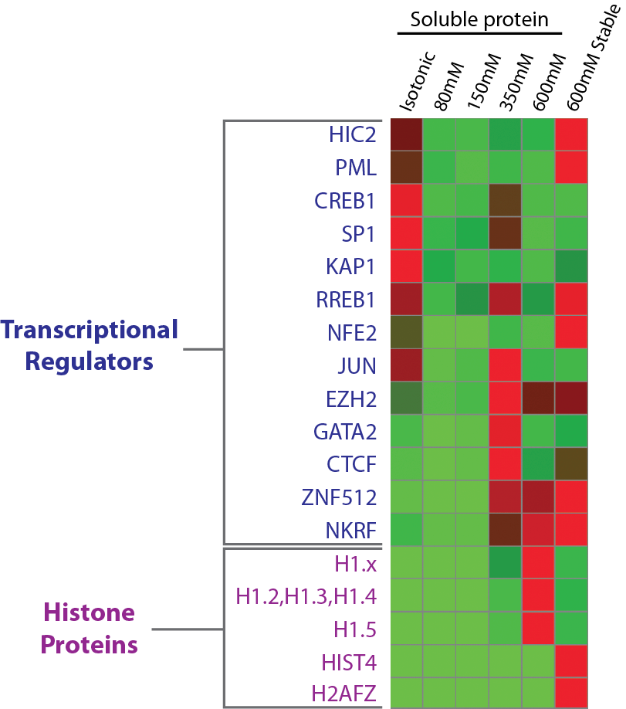
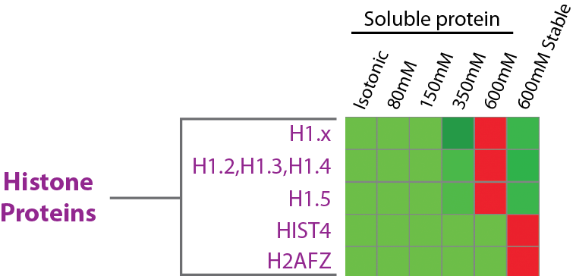

Distribution of TFs across nuclear chromatin
Measure protein abundance using targeted proteomics
Quantification of the compartmentalization ~100 TFs in K562 nuclei (WP256)

Slide 17
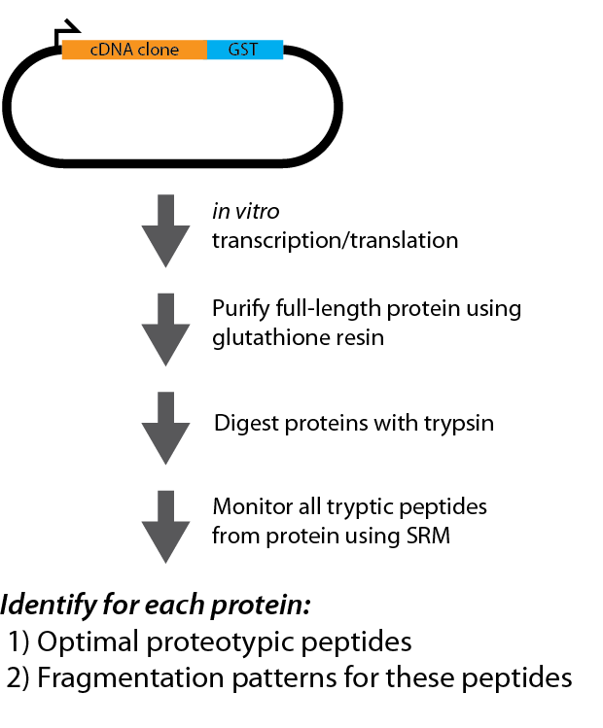

Summary
High-throughput empirical generation of SRM methods
Compartmentalization of
human TFs within the nucleus

Slide 18
Acknowledgments
Proteomics
Michael MacCoss (UW)
Brendan MacLean (UW)
Kristen Lee (UW)
Priska von Haller (UWPR)
Daniela Tomazela (UW)
Michael Bereman (UW)
Eric Hommema (Thermo)
John Rogers (Thermo)
Posters to see!
WP407 – Panorama: A repository of targeted proteomics assays for Skyline
WP256 – Functional assortment of human transcription factors into defined chromatin niches
Chromatin Biology
John Stamatoyannopoulos (UW)
Hao Wang (UW)
Matt Maurano (UW)
Funding
University of Washington's Proteomics Resource (UWPR)
Thermo Scientific Pierce Human In Vitro Translation Research Grant
NIDDK F30 fellowship

