Slide 1


Pinpointing phosphorylation sites
using
Selected Reaction Monitoring
and Skyline
Christina Ludwig
group of Ruedi Aebersold, ETH Zürich

Slide 2

The challenge of phospho-site assignment
Peptides
Phospho-peptides
MS/MS spectra
MS/MS spectra
S
T*
R
S
T
S
S
R
A
A
G
A
G
A
AS*GS*T*AR
phospho-peptide identification
ASGSTAR
peptide identification
ASGST*AR
phospho-site assignment
1

Slide 3
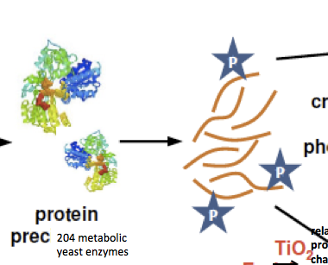
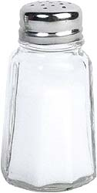


The case study: Phosphorylation changes upon osmotic shock
before
osmotic
shock
after
osmotic
shock
204 metabolic
yeast enzymes
phospho-enrichment
(TiO₂)
yeast cell cultures
steady-state
protein
extraction
digestion
(trypsin)
2

Slide 4
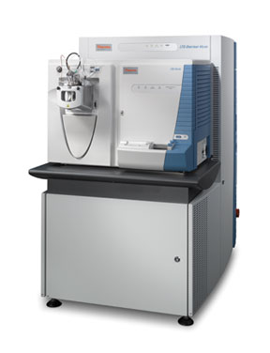
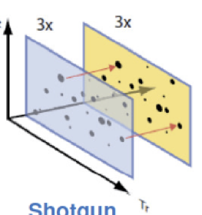
The case study: Phosphorylation changes upon osmotic shock
Pinpointing phosphorylation sites using SRM
Determination of phosphorylation stoichiometries
phosphorylation results table
phospho-peptide sequence | before osmotic shock | after osmotic shock | ratio
YGGHS[p]MSDPGTTYR | 367889 | 90293 | 0.25
KGS[p]MADVPK | 562301 | 574839 | 1.02
SASAVS[p]LPAK | 305 | 3992 | 13.1
…
shotgun
LC-MS/MS
(LTQ-Orbi)
label-free quantification
3

Slide 5


Ambiguities and missing values in discovery-driven data sets
Gpd2 = Glycerol-3-phosphate dehydrogenase 2
Peptide sequence | phospho-site | PepP probability | before osmotic shock A | before osmotic shock B | before osmotic shock C | after osmotic shock A | after osmotic shock B | after osmotic shock C | ratio | Ttest
S[p]DSAVSIVHLK | [S70] | 0.9881 | 0 | 4567890 | 355678 | 432123 | 0 | 0 | 0.18 | #DIV/0!
SDS[p]AVSIVHLK | [S72] | 0.9999 | 5320300 | 4670960 | 4236830 | 0 | 1042920 | 1154030 | 0.23 | 3.0E-03
SDSAVS[p]IVHLK | [S75] | 0.9961 | 1915980 | 1574980 | 1120860 | 510526 | 1309220 | 0 | 0.59 | 2.3E-01
S[p]DSAVS[p]IVHLK | [S70],[S75] | 0.9788 | 834567 | 0 | 590897 | 0 | 890753 | 0 | 1.25 | #DIV/0!
SDS[p]AVS[p]IVHLK | [S72],[S75] | 0.9888 | 966789 | 1056789 | 997654 | 0 | 780864 | 697650 | 0.73 | 1.0E-02
Gpd1 = Glycerol-3-phosphate dehydrogenase 1
Peptide sequence | phospho-site | PepP probability | before osmotic shock A | before osmotic shock B | before osmotic shock C | after osmotic shock A | after osmotic shock B | after osmotic shock C | ratio | Ttest
SS[p]SSVSLK | [S23] | 0.9671 | 0 | 0 | 789098 | 0 | 987539 | 0 | 1.25 | #DIV/0!
SSS[p]SVSLK | [S24] | 0.9979 | 6086840 | 5087770 | 4586845 | 0 | 22236600 | 18536600 | 3.88 | 2.0E-03
SSSS[p]VSLK | [S25] | 0.9995 | 2345001 | 0 | 2678960 | 5754910 | 4796671 | 5196380 | 2.09 | 5.5E-03
SSSSVS[p]LK | [S27] | 0.9889 | 2377960 | 227652 | 2146060 | 2806640 | 0 | 2502570 | 1.68 | 3.1E-01
SSS[p]SVS[p]LK | [S24],[S27] | 0.9991 | 6744910 | 5888620 | 4656130 | 20481500 | 16751200 | 12117300 | 2.85 | 1.3E-02
Are all identified phospho-sites truly occurring in the sample?
Do the obtained quantitative results reflect true biological changes?
Targeted phospho-proteomics using SRM and Skyline ←
4

Slide 6
(Phospho)-SRM workflow carried out in Skyline
(phospho)-
peptide
selection
transition
selection
SRM
measurement
crude synthetic heavy
phospho-peptides
(JPT technologies)
Gpd1
Gpd2
peptide sequence | phospho-site
S[p]SSSVSLK | [S22]
SS[p]SSVSLK | [S23]
SSS[p]SVSLK | [S24]
SSSS[p]VSLK | [S25]
SSSSVS[p]LK | [S27]
peptide sequence | phospho-site
S[p]DSAVSIVHLK | [S70]
SDS[p]AVSIVHLK | [S72]
SDSAVS[p]IVHLK | [S75]
5

Slide 7
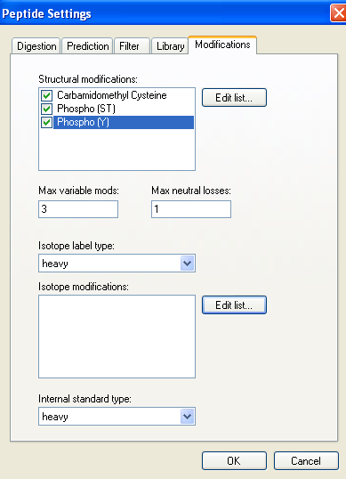
(phospho)-
peptide
selection
Getting phospho-peptides into Skyline
6

Slide 8
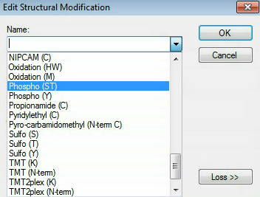
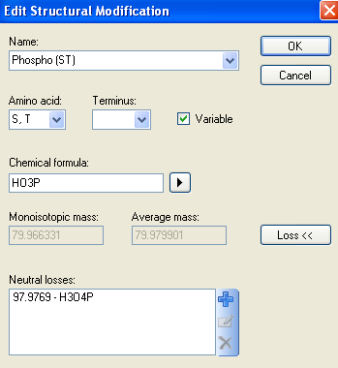
(phospho)-
peptide
selection
Getting phospho-peptides into Skyline
All Uniprot modifications available
7

Slide 9
(Phospho)-SRM workflow carried out in Skyline
(phospho)-
peptide
selection
transition
selection
SRM
measurement
automatic selection of
the y-ion and b-ion series (> 300 Da)
using the transition filter settings
in Skyline
shared transitions
unique transitions
peptide sequence | phospho- site | precursor m/z | y10 b1 [m/z] | y9 b2 [m/z] | y8 b3 [m/z] | y7 b4 [m/z] | y6 b5 [m/z] | y5 b6 [m/z] | y4 b7 [m/z] | y3 b8 [m/z] | y2 b9 [m/z] | y1 b10 [m/z]
S[p]DSAVSIVHLK | [S70] | 622.31 | 1076.62 - | 961.59 - | 874.56 370.06 | 803.52 441.1 | 704.45 540.17 | 617.42 627.20 | 504.27 740.29 | 405.27 839.35 | - 976.41 | - 1089.50
SDS[p]AVSIVHLK | [S72] | 622.31 | 1156.59 - | 1041.56 - | 874.56 370.06 | 803.52 441.1 | 704.45 540.17 | 617.42 627.20 | 504.27 740.29 | 405.27 839.35 | - 976.41 | - 1089.50
SDSAVS[p]IVHLK | [S75] | 622.31 | 1156.59 - | 1041.56 - | 954.53 290.10 | 883.49 361.14 | 784.42 460.20 | 617.42 627.20 | 504.27 740.29 | 405.27 839.35 | - 976.41 | - 1089.50
8

Slide 10
(Phospho)-SRM workflow carried out in Skyline
(phospho)-
peptide
selection
transition
selection
SRM
measurement
→ of synthetic peptides
9

Slide 11
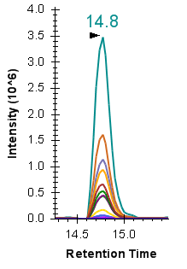
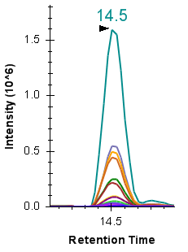
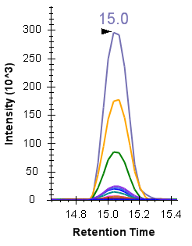
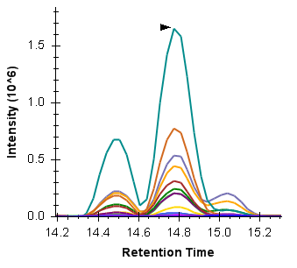

Targeting of synthetic phospho-peptides for Gpd2
SRM
measurement
individual measurements of synthetic peptides
peptide mixture
[S70]
[S72]
[S75]
[S70], 14.6 min
[S72],
14.3 min
[S75],
14.9 min
all phospho-peptide forms
are separable
in retention time
10

Slide 12
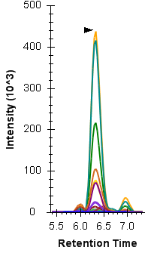
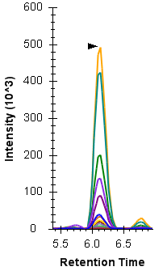
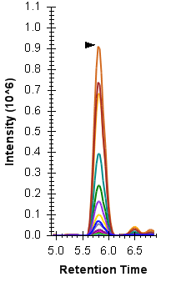
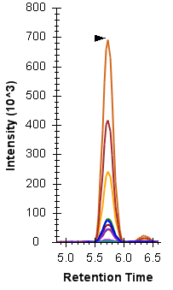
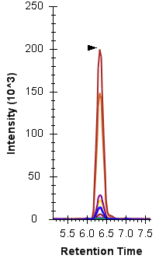
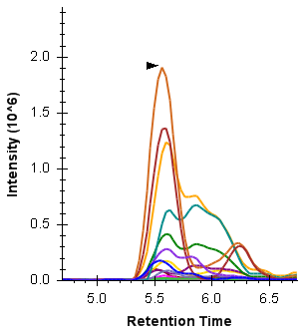
Targeting of synthetic phospho-peptides for Gpd1
SRM
measurement
[S22]
[S23]
[S24]
[S25]
[S27]
individual
measurements
of synthetic
phospho-peptides
[S24],[S25], 5.6 min
[S23], 5.8 min
peptide mixture
[S22], 6.0 min
phospho-peptide forms [S24] and [S25] are not separable
in retention time.
Other peptide forms are strongly overlapping but distinguishable.
[S27], 6.3 min
11

Slide 13
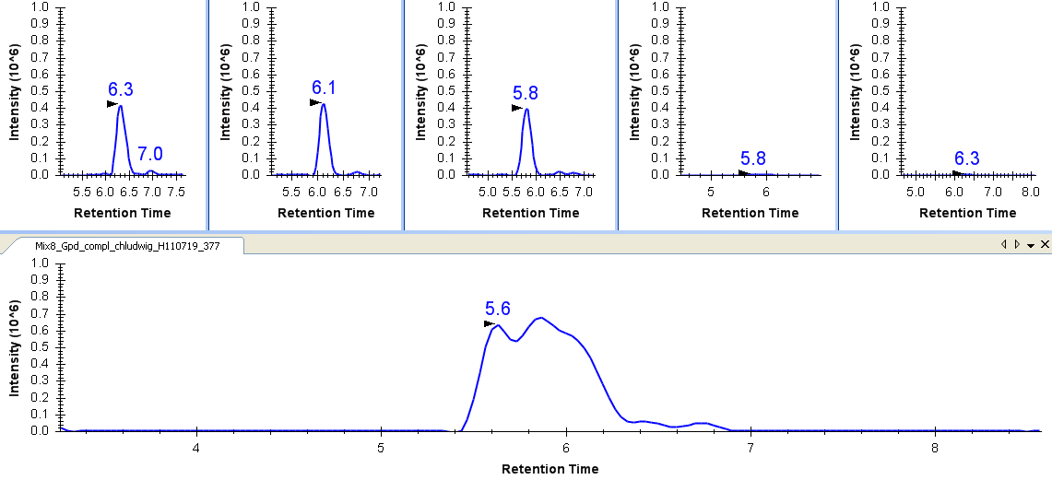
Discrimination of [S24] [S25] despite co-elution
SRM
measurement
peptide sequence | phospho-site | precursor m/z | y7 [m/z] | y6 [m/z] | y5 [m/z] | y4 [m/z] | y3 [m/z] | rt [min]
S[p]SSSVSLK | [S22] | 437.70 | 707.40 | 628.38 | 541.34 | 454.31 | 355.24 | 6.0
SS[p]SSVSLK | [S23] | 437.70 | 795.37 | 628.38 | 541.34 | 454.31 | 355.24 | 5.8
SSS[p]SVSLK | [S24] | 437.70 | 795.37 | 708.43 | 541.34 | 454.31 | 355.24 | 5.6
SSSS[p]VSLK | [S25] | 437.70 | 795.37 | 708.43 | 621.31 | 454.31 | 355.24 | 5.6
SSSSVS[p]LK | [S27] | 437.70 | 795.37 | 708.43 | 621.31 | 534.28 | 435.21 | 6.3
[S22]
[S23]
[S24]
[S25]
[S27]
y5 541.34
[S24]
[S23]
[S22]
12

Slide 14
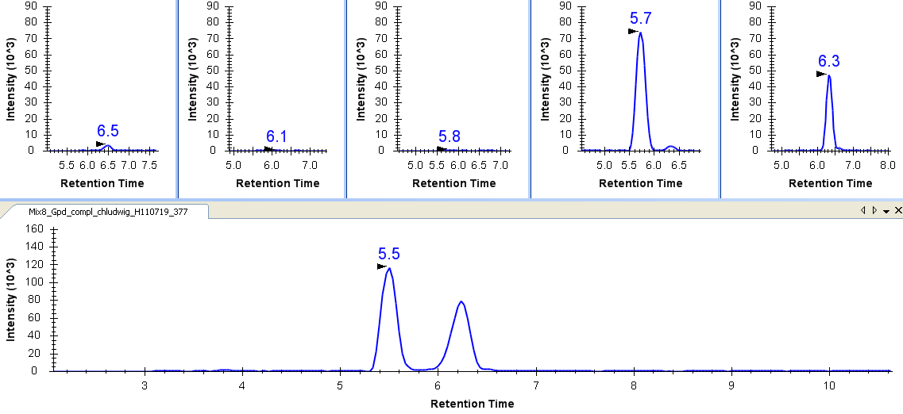
Discrimination of [S24] [S25] despite co-elution
SRM
measurement
peptide sequence | phospho-site | precursor m/z | y7 [m/z] | y6 [m/z] | y5 [m/z] | y4 [m/z] | y3 [m/z] | rt [min]
S[p]SSSVSLK | [S22] | 437.70 | 707.40 | 628.38 | 541.34 | 454.31 | 355.24 | 6.0
SS[p]SSVSLK | [S23] | 437.70 | 795.37 | 628.38 | 541.34 | 454.31 | 355.24 | 5.8
SSS[p]SVSLK | [S24] | 437.70 | 795.37 | 708.43 | 541.34 | 454.31 | 355.24 | 5.6
SSSS[p]VSLK | [S25] | 437.70 | 795.37 | 708.43 | 621.31 | 454.31 | 355.24 | 5.6
SSSSVS[p]LK | [S27] | 437.70 | 795.37 | 708.43 | 621.31 | 534.28 | 435.21 | 6.3
[S22]
[S23]
[S24]
[S25]
[S27]
y5 621.31
[S25]
[S27]
13

Slide 15
Retention time information is important for pinpointing phospho-sites
Phospho-peptide: XXX[S4]X[S6]X[S8]XX
[S4]
[S6]
[S8]
intensity
retention time
retention time
retention time
separable in retention time
co-eluting
[S4]
[S6]
[S8]
[S4]
[S6]
[S8]
X
Y
Z
X
X
X
transitions usable for identification and quantification
[S4]
[S6]
[S8]
[S4]
[S6]
[S8]
not specifically
identifiable and
quantifiable
X
Y
Z
X
X
14
9

Slide 16

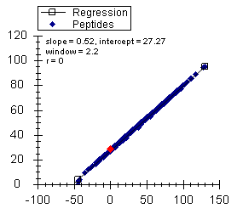
The “iRT” concept implemented into Skyline
The problem:
The solution:
Accurately measured empirical retention times are dependent on the setup of the currently used chromatographic system
Usage of a set of calibration peptides to normalize all peptide retention times to a dimensionless “iRT value”
14.8 min
calibration
peptides
accurate RT
14.5 min
15.1 min
iRT
Consequence in practice:
retention times need to be determined over and over again
Consequence in practice:
once an iRT value is determined, the respective peptide can be scheduled and identified on any LC system
Escher C. et al., Proteomics, 2012, 12, 1111-1121
Monday AM, Poster 624, Escher C. et al.
15
9

Slide 17

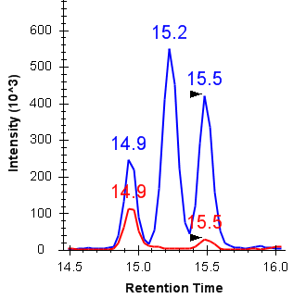
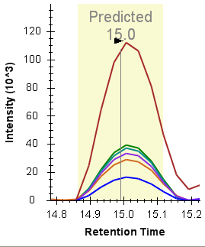
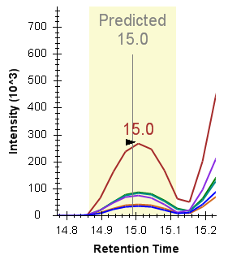
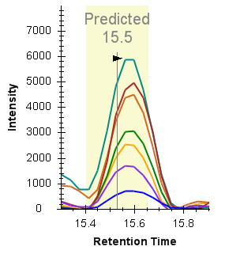
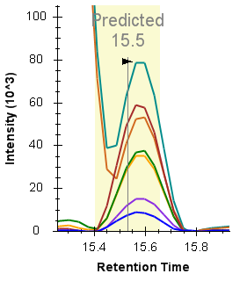
Quantification of endogenous phospho-peptides – Gpd2
phospho-enriched
yeast total cell extract
synthetic,
isotopically-labeled
phospho-peptides
endogenous (light)
synthetic (heavy)
[S72]
[S75]
[S70]
light
heavy
light
heavy
[S72]
[S75]
16

Slide 18
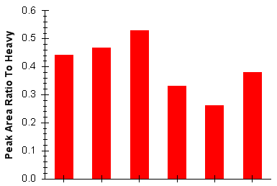
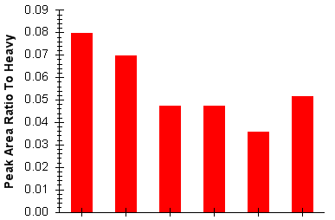
Quantification of endogenous phospho-peptides – Gpd2
phospho-enriched
yeast total cell extract
synthetic,
isotopically-labeled
phospho-peptides
endogenous (light)
[S72]
[S75]
synthetic (heavy)
[S70]
ratio light/heavy
ratio light/heavy
[S72]
[S75]
before
30 min after
before
30 min after
osmotic shock
osmotic shock
1.5-fold down-regulation
(t-test p-value = 0.01)
1.7-fold down-regulation
(t-test p-value = 0.01)
17

Slide 19
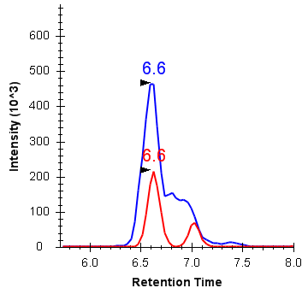
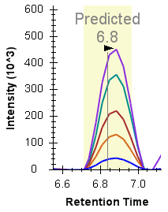
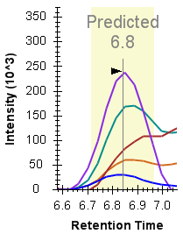
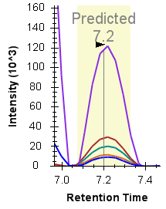
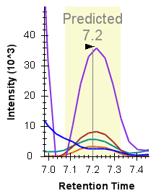
Quantification of endogenous phospho-peptides – Gpd1
phospho-enriched
yeast total cell extract
synthetic,
isotopically-labeled
phospho-peptides
endogenous (light)
synthetic (heavy)
[S24]
[S27]
light
heavy
light
heavy
[S24]
[S25]
[S23]
[S22]
[S27]
18

Slide 20
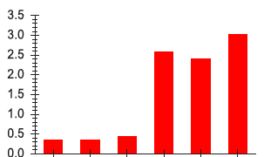
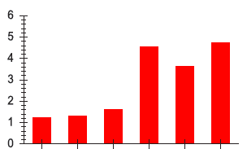
Quantification of endogenous phospho-peptides – Gpd1
phospho-enriched
yeast total cell extract
synthetic,
isotopically-labeled
phospho-peptides
endogenous (light)
synthetic (heavy)
[S24]
[S27]
[S24]
[S25]
ratio light/heavy
ratio light/heavy
[S23]
[S22]
[S27]
before
30 min after
before
30 min after
osmotic shock
osmotic shock
7.2-fold up-regulation
(t-test p-value = 2.1E-4)
3.2-fold up-regulation
(t-test p-value = 2.4E-4)
19

Slide 21
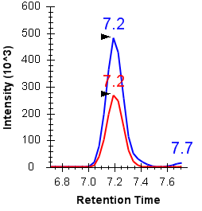
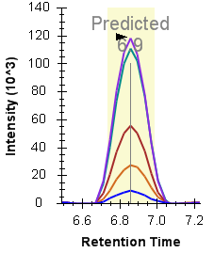
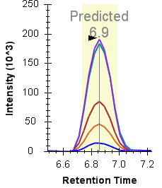
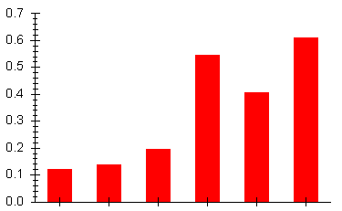
Quantification of a doubly phosphorylated peptide – Gpd1
Quantification of doubly phosphorylated peptide – Gpd1
Spike-in experiment (heavy crude phosphopeptides)
SSS[p]SVS[p]LK [S24,27]
endogenous (light)
[S24,S27]
[S24,S27]
synthetic (heavy)
light
heavy
ratio light/heavy
before
after
osmotic shock
3.5-fold up-regulation
(t-test p-value = 4.4E-4)
20

Slide 22


Take-home messages
Targeted analysis of phosphorylation using SRM provides
quantitative data of high quality, accuracy and reproducibility
Requirement: A priori knowledge
Specific phosphorylation-sites can be pinpointed with high confidence
Requirement: Learn the chromatographic behavior of phospho-peptide forms from synthetic reference peptides
Application of the iRT concept improves acquisition scheduling and peptide identification
Requirement: Consistent use of retention time calibration peptides
21

Slide 23


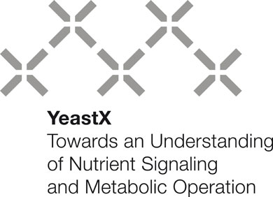
Thank you
Collaborators
Ana Paula Oliveira
Paola Picotti
TSQ-support
Mariette Matondo
Nathalie Selevsek
Ruedi Aebersold and
the whole
Aebersold lab
→ Brendan MacLean
→ Alana Killeen
→ Lukas Reiter
→ Oliver Rinner

Slide 24
Further complications for a phospho-analysis with SRM: Neutral Loss H₃PO₄
1. Loss of H₃PO₄ = -98 Da
example:
y7
O
y7
S D S A V S I V H L K
S D S A V S I V H L K
phosphoserine
serine
y7 backbone
fragmentation &
H₃PO₄ loss
y7 backbone
fragmentation &
H₂O loss on S75
CID MS/MS
-H₃PO₄
CID MS/MS
-H₂O
V S I V H L K
V S I V H L K
transition coordinates
dehydroalanine
dehydroalanine
Q1
622.31
Q3
785.51
Conclusion
For peptides comprising several possibly phosphorylated residues phospho-site assignments based exclusively on H₃PO₄-neutral loss fragment ions can be erroneous,
because their occurrence can also be due to a water-loss of a non-phosphorylated serine residue.

Slide 25
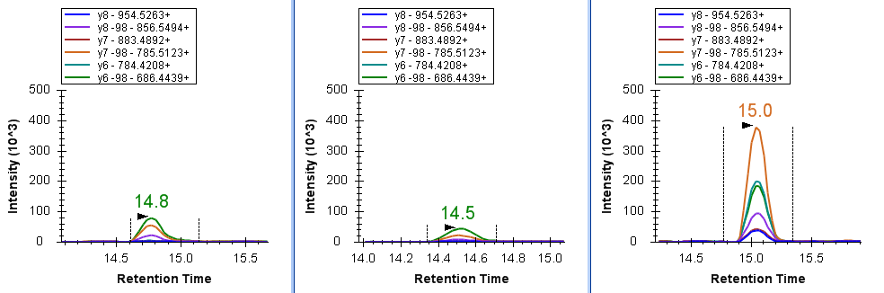
example for H₃PO₄ (-98 Da) phosphate loss interference
peptide sequence | Phos-pho- site | pre-cursor m/z | y10 y10-H₃PO₄ b1 b1-H₃PO₄ [m/z] | y9 y9-H₃PO₄ b2 b2-H₃PO₄ [m/z] | y8 y8-H₃PO₄ b3 b3-H₃PO₄ [m/z] | y7 y7-H₃PO₄ b4 b4-H₃PO₄ [m/z] | y6 y6-H₃PO₄ b5 b5-H₃PO₄ [m/z] | y5 y5-H₃PO₄ b6 b6-H₃PO₄ [m/z] | y4 y4-H₃PO₄ b7 b7-H₃PO₄ [m/z] | y3 y3-H₃PO₄ b8 b8-H₃PO₄ [m/z] | y2 y2-H₃PO₄ b9 b9-H₃PO₄ [m/z] | y1 y1-H₃PO₄ b10 b10-H₃PO₄ [m/z] | rt[min]
S[p]DSAVSIVHLK | [S70] | 622.31 | 1076.62 - - - | 961.59 - - - | 874.56 - 370.06 252.09 | 803.52 - 441.1 343.12 | 704.45 - 540.17 442.19 | 617.42 - 627.20 529.23 | 504.27 - 740.29 642.31 | 405.27 - 839.35 741.38 | - - 976.41 878.44 | - - 1089.50 991.52 | 14.6
SDS[p]AVSIVHLK | [S72] | 622.31 | 1156.59 1058.61 - - | 1041.56 943.53 - - | 874.56 - 370.06 252.09 | 803.52 - 441.1 343.12 | 704.45 - 540.17 442.19 | 617.42 - 627.20 529.23 | 504.27 - 740.29 642.31 | 405.27 - 839.35 741.38 | - - 976.41 878.44 | - - 1089.50 991.52 | 14.3
SDSAVS[p]IVHLK | [S75] | 622.31 | 1156.59 1058.61 - - | 1041.56 943.53 - - | 954.53 856.55 290.10 - | 883.49 785.51 361.14 - | 784.42 686.44 460.20 - | 617.42 - 627.20 529.23 | 504.27 - 740.29 642.31 | 405.27 - 839.35 741.38 | - - 976.41 878.44 | - - 1089.50 991.52 | 14.9
[S70]
[S72]
[S75]
16

Slide 26
Further complications for a phospho-analysis with SRM: Neutral Loss HPO₃
2. Loss of HPO₃ = -80 Da
example:
O
y7
y7
S D S A V S I V H L K
S D S A V S I V H L K
phosphoserine
y7 backbone
fragmentation
y7 backbone
fragmentation &
HPO₃ loss on S75
CID MS/MS
-HPO₃
V S I V H L K
V S I V H L K
transition coordinates
serine
Q1
622.31
Q3
803.52
Conclusion
For peptides comprising several possibly phosphorylated residues phospho-site assignments based exclusively on fragment ions NOT carrying the phosphate group can be erroneous,
because their occurrence can also be due to a neutral loss of HPO₃.
17

Slide 27
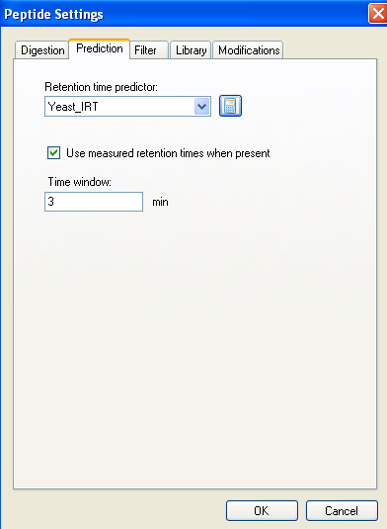
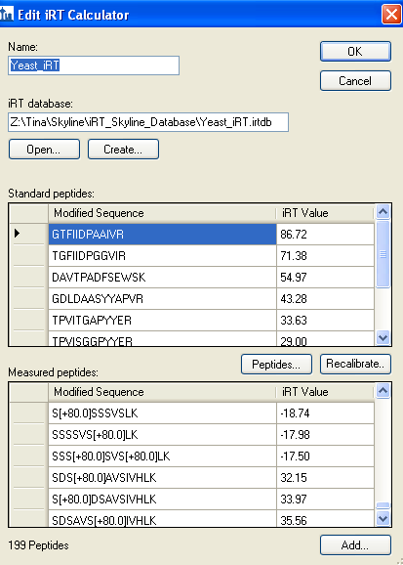
The “iRT” concept implemented into Skyline
17
9

Slide 28
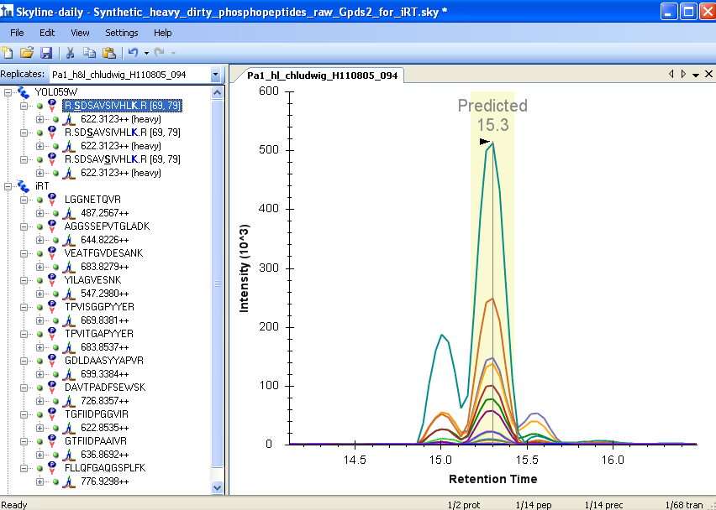
The “iRT” concept implemented into Skyline
18
9

Slide 29
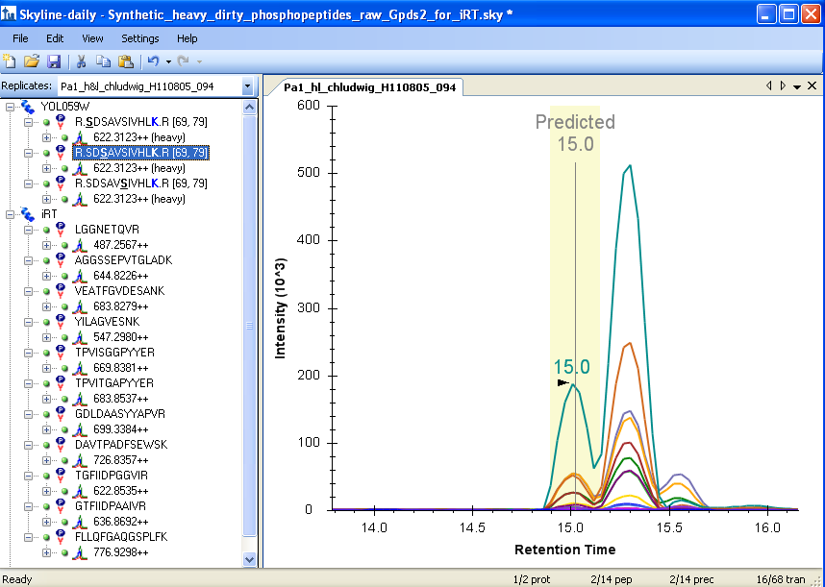
The “iRT” concept implemented into Skyline
19
9

Slide 30
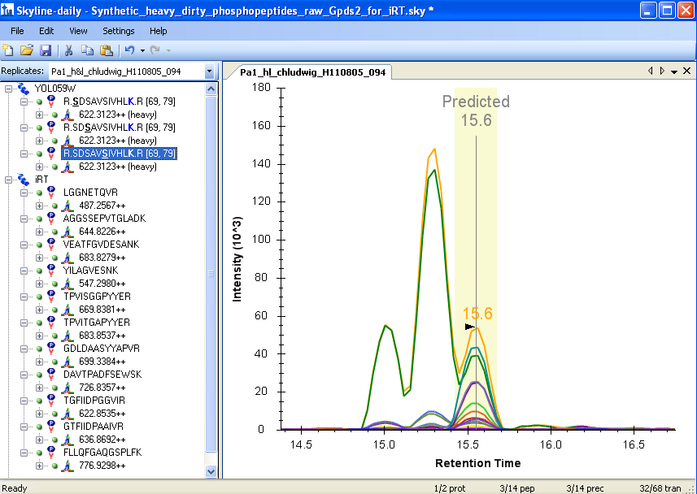
The “iRT” concept implemented into Skyline
20
9

