Slide 1
Effectively Dealing with Transition Selection and Data Analysis for Multiplexed Quantitative SRM-MS Assays across Multiple Vendor Instruments
Susan Abbatiello, Ph.D.
Skyline User’s Meeting
May 20, 2012

Slide 2
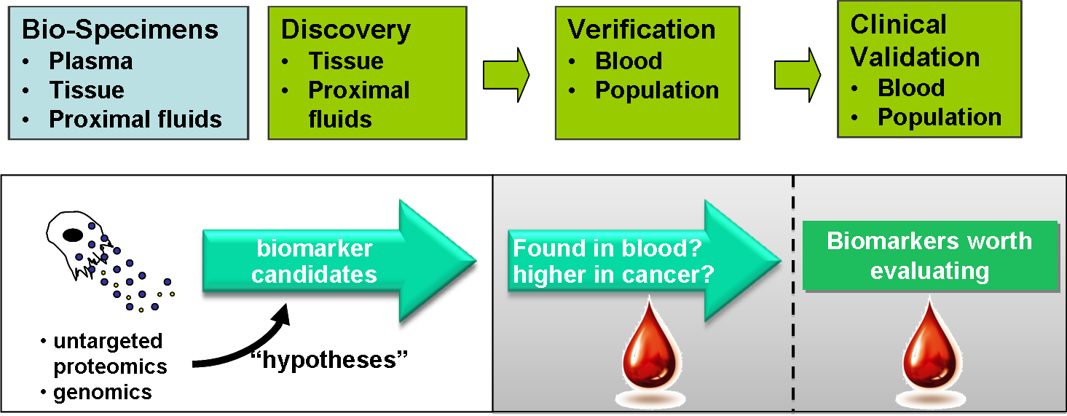
CPTAC – Clinical Proteomic Technologies Assessment for Cancer
NCI established CPTAC October 2006 to Support Biomarker Development
Evaluate and standardize proteomic verification platforms for analysis of cancer-relevant proteomic changes in human clinical specimens.
Notes:
The National Cancer Institute established the CPTC to support biomarker development and rigorously evaluate and improve the individual steps of the “biomarker pipeline” from Bio-Specimen collection to unbiased discovery to biomarker verification. In the process, reagents, protocols, and bioinformatics tools are being generated along with data sets for the proteomic community to utilize to help improve and strengthen the pipeline for biomarker identification and implementation.

Slide 3
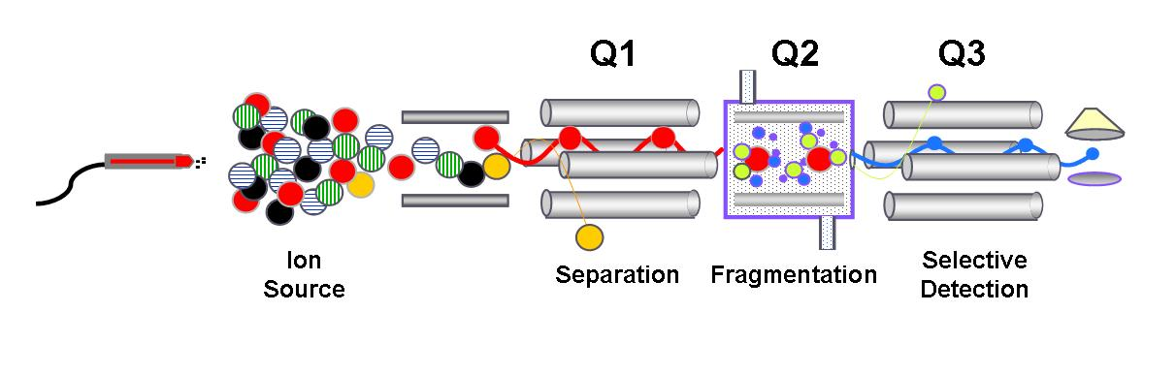
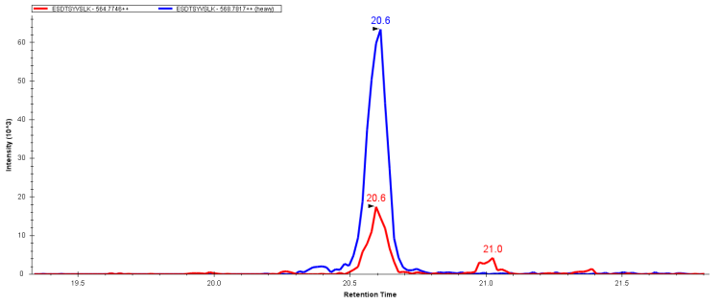
Is SID-MRM-MS Technology Reproducible, Transferrable, and Sensitive? Yes!
– Especially with Skyline!
Candidate Protein
Biomarkers
Spike heavy (¹³C₆)-labeled peptides
Define “Signature peptides”
for candidate biomarkers
Endogenous ¹²C
signature peptides
MRM-MS
Synthesize ¹³C/¹⁵N-labeled versions of signature peptides for use as internal standards
Observed ratio gives precise, relative quantitation across samples
10’s to 100’s peptides can be simultaneously quantified
Ratio ¹³C-peptide to ¹²C-peptide by SID-MRM-MS
Whiteaker, et al, JPR 2007……………….
Keshishian et al, MCP, 2007 and 2009….
Hoofnagle et al, Clin. Chem. 2008……….
Addona et al, Nat. Biotech. 2009…...……
Kuhn et al, Clin Chem 2009………………
Williams et al, JPR 2009…………………
Ossola et al, Methods Mol. Bio., 2011…..
Selevsek et al, Proteomics, 2011………..
Breast cancer
Cardiovascular markers
Thyroglobulin
Interlab study
IL-33, Troponin I
C-Reactive Protein
Glycated peptides
Urine proteins
¹³C₆-peptide “heavy standard”
¹²C-peptide analyte
Abundance
Time, minutes
Notes:
The approach we use in the Verification Working group for precise relative quantitatioin of candidate protein biomarkers is isotope dilution-multiple reaction monitoring MS. As a very brief review, once the protein candidate biomarker is identified, we select unique, proteotypic “signature peptides” for each one and synthesize them in 13C-labeled versions that function as internal standards. These peptides only differ by mass from the endogenous, target peptides and we can use this as a discriminating feature in MRM-MS. We detect at least 3 “transitions”, or fragment ions for each peptide and compare the relative peak areas for each fragment to the internal standard that is spiked in at a known amount. We can then calculate the amount of peptide present in the sample. This ration gives precise, relative quantitation across samples spiked with the same standard and due to the rapid cycle time of the triple quadrupole MS, 10’s to 100’s of peptides can be simultaneously quantified. A good example of this approach in an interesting context was presented Monday by Hasmik Keshishian. (MOD 10:10 am).

Slide 4
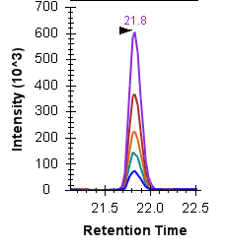
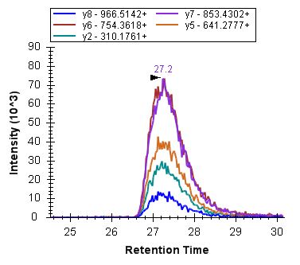
Study 9S: Participants, Platforms, and Objectives
Prior to analyzing complex samples, are LC-MRM-MS systems running in optimal condition?
Establish Instrument Specific Ranges for
Site 52, ABI 4000 QTRAP
Michrom Mix
Site 56, ABI 4000 QTRAP
6 bovine proteins, digested
Site 56A, ABI 5500
RT Variability
Peak Area
Peak Width
Carry over
Column conditioning
Site 56B, Agilent 6460 ChipCube
Site 73, ABI 4000 QTRAP
Site 32, ABI 4000 QTRAP
Site 95, ABI 4000 QTRAP
Site 98, ABI 4000 QTRAP
Site 86, ABI 4000 QTRAP
Site 86A, Waters Xevo
GO
No GO
50 fmol/uL
Site 90, Agilent 6410 ChipCube
Site 65, Thermo Vantage
Site 54, ABI 4000 QTRAP
12 Laboratories
4 MS Vendors
7 MS models
5 LC models
Site 19, ABI 4000 QTRAP
Site 19A, Agilent 6410 ChipCube
Site 20, Thermo TSQ Quantum
Define Pass/Fail Criteria
Notes:
Study 9S was designed to develop a system suitability standard that could be implemented across our multiple sites. One goal was to use a single sample to assess if each LC-MRM-MS platform was operating in optimal conditions prior to the start of a quantitative assay. The 12 laboratories, representing 4 MS vendors and 5 LC models are shown here. An additional goal was to establish what the instrument specific ranges were for a number of chromatographic and mass spectrometric parameters for each of the platforms operating under “normal” conditions. Once this information was determined, we could then apply cut-off criteria or limits to each of these parameters that would allow the instrument operator to look at their data and determine if things were operating within “specs”, resulting in a “GO” or “NO GO” status.

Slide 5

Development of a System Suitability Protocol for Multiple Instrument Platforms
Tools were created to handle workflow and data
Input: DDA Search results
(mzXML, pepXML, etc)
Selection of
22 target
peptides
List of 9 final peptides for evaluation
Output: Spectral Library
Input: Targeted Peptide List
Input: Integrated peaks, report parameters
External
Calculations:
RT Viewer
R Scripts
Output: Vendor Specific MRM Instrument Method
Output: Comprehensive results report
MRM data
acquisition
User
data
analysis
Input: Vendor specific acquisition files
Output: Peak identification and automatic integration
Notes:
Development of the method was facilitated through the use of Skyline, a Targeted Proteomics Environment. More details of the specifics of Skyline and its functions will be presented later today by Brendan MacLean at 3:30pm in this room. Here I will touch upon specific features of the program that helped in the method development, execution and data analysis for this study. First, we began with data-dependent acquisition files on many of the instrument platforms to identify an overlapping set of peptides that could be observed across the 4 platforms. These data were converted to spectral libraries in Skyline and the 22 peptides were manually selected from a larger list and 5 transitions for each peptide were picked in Skyline and manually refined. This target peptide list was then used in Skyline to generate vendor specific MRM transition lists for each platform used in the study. The data were then generated and imported back into Skyline where the extracted ion chromatograms for each peptide and transition were processed and integrated. After some manual inspection, Reports were generated based on required report parameters and the output were .csv files that could be exported uniformly, independent of the vendor platform, for subsequent data analysis by CPTAC bioinformaticians and statisticians.

Slide 6
Problems Can Be Visualized Early:
Peak Area Stability in Skyline
Peak area stability over 10 replicates
Site Z
Peak area CV over 10 replicates
Site Z
Elevated area cv’s for late eluting peptides
before
before
Low peak area
for late eluting peptides
Peak Area (10E6)
0.3
Peak Area CV
after
Improved peak area
for late eluting peptides
after
after
CVs < 0.10
Peak Area (10E6)
Peak Area CV
Notes:
Another example that was not as obvious to us by looking at the raw data is shown here. The top left panel depicts the average peak area (and 1 standard deviation) of 10 replicate injections for each of the 22 peptides. When comparing this data to that from other sites, we noted that the last 4-5 peptides exhibited lower intensity here. A better way to see the effect of this issue is to look at the plot in terms of Peak Area CV (y-axis). Here we see that the early eluting peptides have good, low CVs for peak area for the 10 replicate injections. The last 8 peptides, however, all have CVs that are higher, most above 30%. Again, having the luxury of comparing this to a number of other sites, we knew there was a problem at the end of the gradient. The site did some trouble-shooting on their LC and found that mobile phase B was being delivered at about half the specified flow rate, resulting in very inconsistent peak areas from injection to injection. After re-calibrating the pump, the site re-ran and obtained the data in the bottom panel. Here we see that the peak intensities of the later eluting peptides recovered and the CVs of all peak areas are at or less than 10%. These two ways of viewing the data were developed and implemented into Skyline to facilitate rapid data assessment.

Slide 7
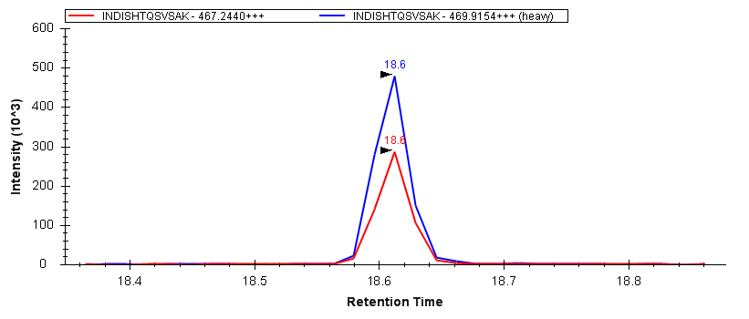
CPTAC VWG Study 9 – Targeting 34 Proteins in
Depleted Plasma, 125 Peptide Targets
unlabeled protein
¹⁵N labeled protein
Trypsin
+
depleted plasma
34 proteins
27 proteins
Goals:
Demonstrate cancer relevancy
Prove feasibility of > 100-plex (34 proteins) assays in plasma
Improve LOD and LOQ by depleting abundant proteins
Demonstrate true quantitative accuracy and evaluate depletion/digestion recovery using heavy labeled proteins
Conduct blinded verification study to assess accuracy, precision and reproducibility across multiple sites and instrument platforms
Evaluate system suitability test in context of this large-scale inter-lab study
34 proteins, 1095 transitions, 9 participating sites, 14 instruments, 4 vendors
¹³C/¹⁵N labeled peptides
Varying Concentrations
Fixed Spike Level
y6
y7
y8
125 peptides
Fixed Spike Level
y6
y7
y8
Figures of Merit (LOD, LOQ)
y6
y7
y8
Recovery from Assay
LC-MRM-MS
Notes:
Goals:
- use of heavy-labeled proteins as internal stnds to assess improvement in accuracy, sensitivity, precision
Improve LOD and LOQ (vs. 1st CPTAC Study) by depleting abundant plasma proteins using Ab columns (Mars14)
Evaluate the effect of plasma depletion on peptide recovery.
Conduct a blind verification study in which accuracy, precision and reproducibility are compared across multiple sites and instrument platforms.
Demonstrate feasibility of > 100-plex (34 proteins) assays in single LC-MRM-MS run.

Slide 8
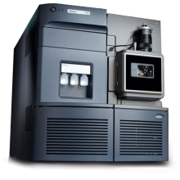
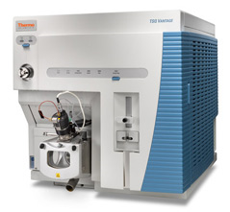
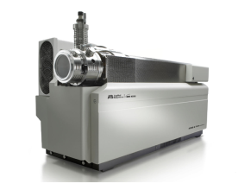
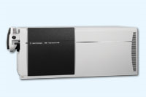
Peptide and Transition Selection is
Streamlined using Skyline
Lys-C/Trypsin
+
Selection of
123 target
peptides
DDA
LC-MS/MS, Database search
Top 5 Product Ions
Spectral Library
Final Transition List
L/H: 750 Transitions
L/H/15N: 1095 Transitions
Selection of best 3 ions
CE Calculation
MRM-MS Data Acquisition
CE publication: B. MacLean et al, 2010, Anal Chem

Slide 9
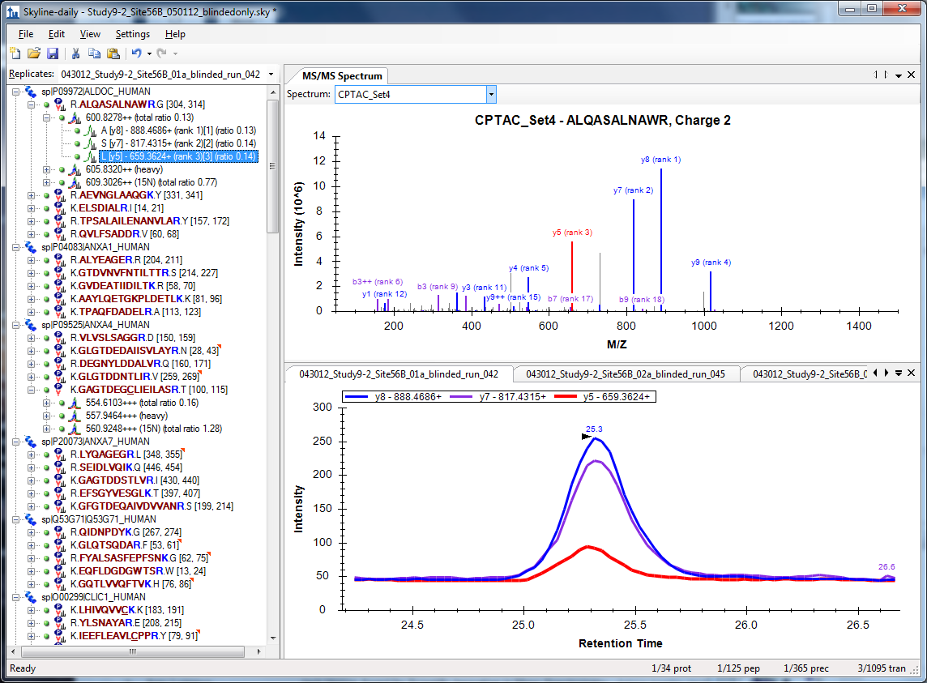
Spectral Libraries Focus Peptide and Transition Selection

Slide 10
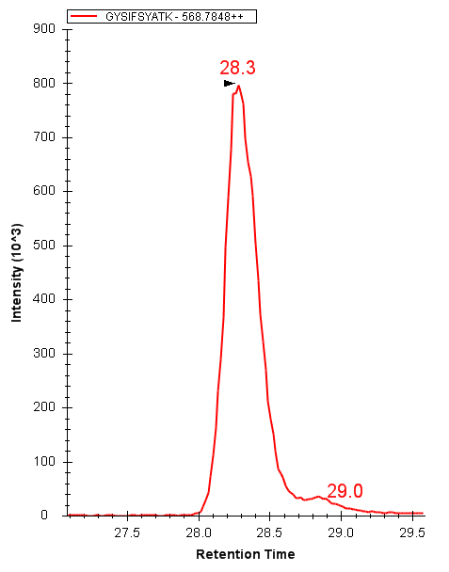
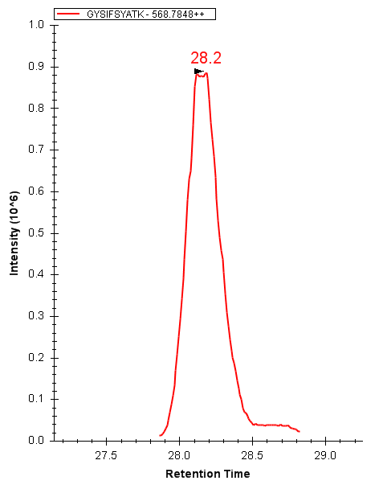
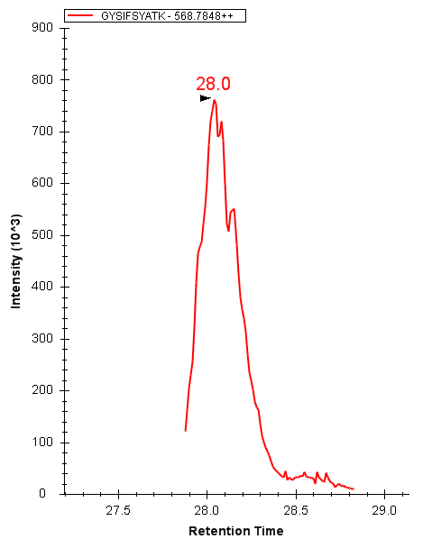
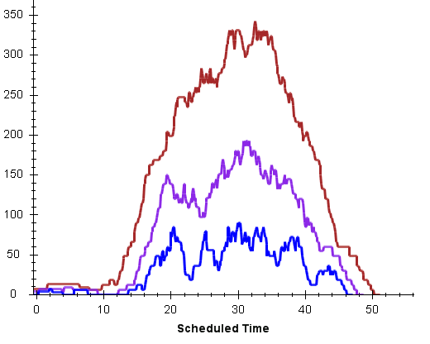
Retention Time Scheduling:
A Necessity for >100 Transitions
Scheduling puts rigorous
demands on RT reproducibility
Peak width and RT drift are often limiting factors
Different peptides shift to various degrees.
28.3 min
28.2 min
28.0 min
Inj. 1
Inj. 2
Inj. 3
Large numbers of transitions require narrow RT windows or longer cycle times
Cycle times may be governed by chromatographic peak width
Skyline helps gauge number of concurrent transitions based on RT window
10 min
325 trs
190 trs
5 min
# Concurrent Transitions
80 trs
2 min
Notes:
In order to target more than 60-80 transitions in one cycle on a TQMS (representing only 10-15 peptide pairs, 3 transitions each), we need to move to MRM-MS methods that use retention time scheduling. This is easier said than done with nano-flow chromatography. Here I show an example of 3 injections made over a span of only 3 hours and you can see the RT for this peptide is creeping forward. When a 1 minute RT window is used to detect this peak, we begin to lose data as the peptide shifts earlier and earlier. Not only do “controllable” factors play a role, such as column age and the connections in your LC plumbing, but so do harder-to-control environmental factors such as ambient temperature. The options are to widen the RT windows just enough to capture enough of the peak and allow for chromatographic shift, or to ask the vendors if there is a better way that may involve real-time feed back for updating retention time windows over the course of an assay.
Peak widths are variable, peak shifting is variable. All depends on # of targets and chromatography.

Slide 11
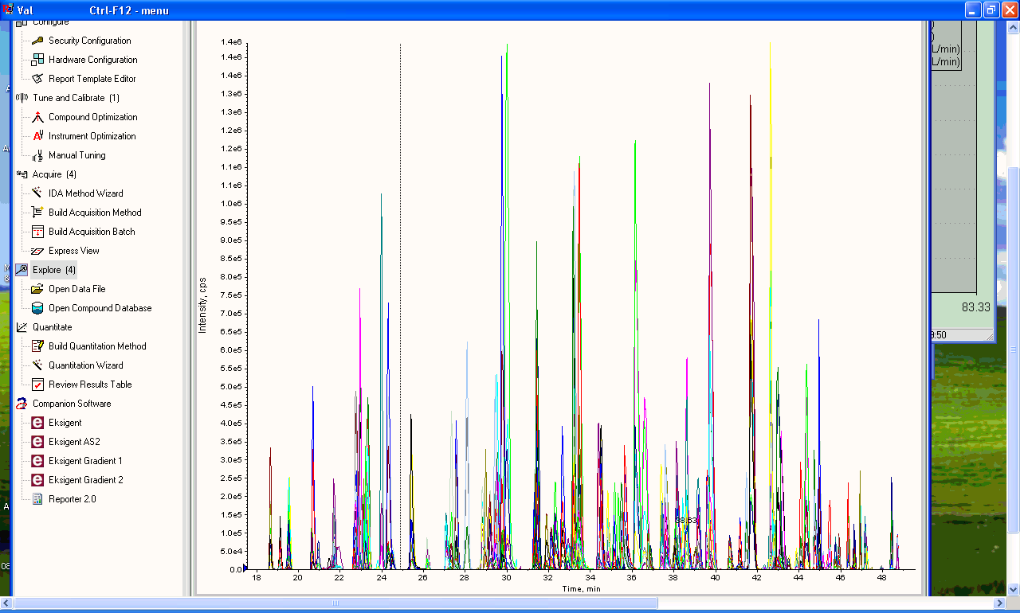
Retention Time Scheduling for 1095 Transitions is Challenging – and Different from System to System
Agilent 6490 ChipCube
AB Sciex 4000 QTrap

Slide 12
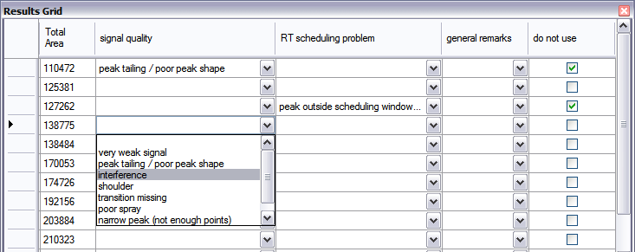
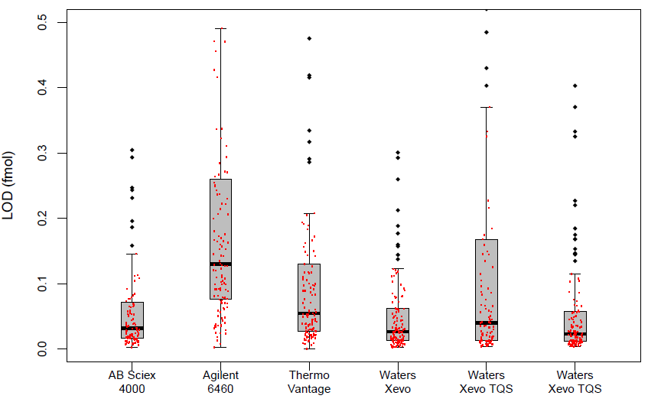
Data Quality Filtering and Custom Annotation by Operators for Data Sets Improves LOD
raw data
custom annotation
Automated version = “AuDIT”
Flags potentially bad transitions
  poor peak shape
  interferences
  missing data
Reduces manual inspection to questionable data
Reduces subjectivity in data analysis
(Abbatiello, Mani et al. Clin. Chem. 2010)
44 amol/uL
23 amol/uL

Slide 13
Automatic Integration as Good as Manual Intervention (but takes less time)
p = 0.6

Slide 14
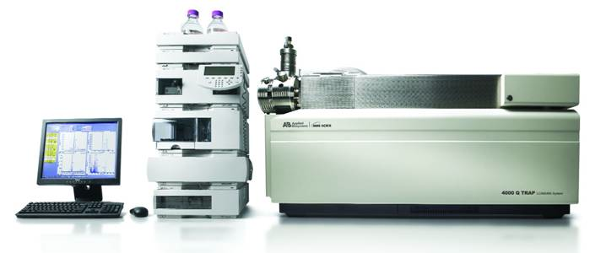
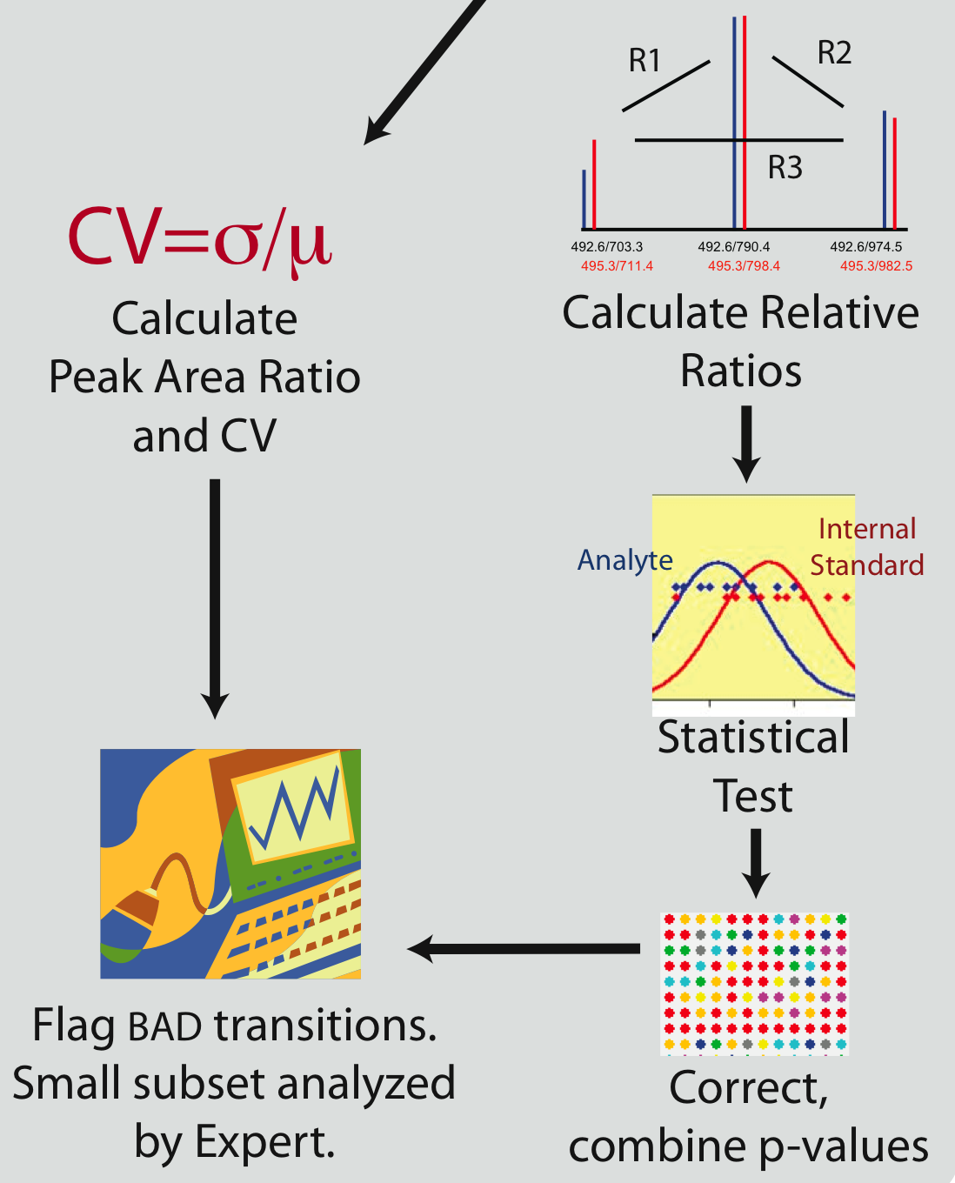
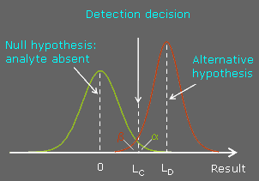


QuaSAR Overview:
Quantitative Statistical Analysis of Reaction Monitoring Results
Pre-process & Filter
Overall Reproducibility
Concentration & sample info
Poster ThP12, #284

Slide 15
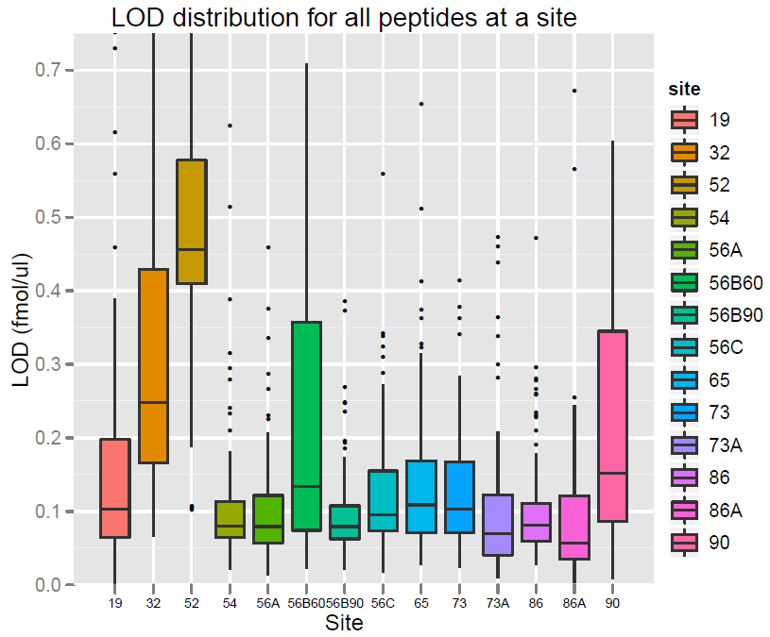
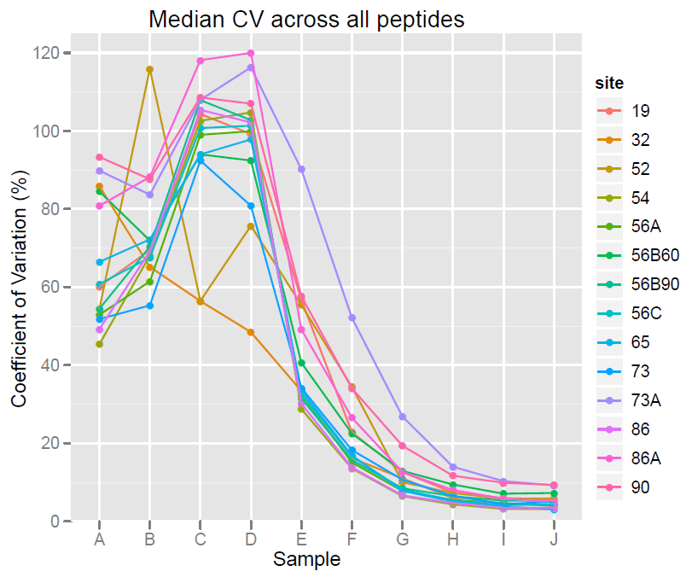
Outcome of CPTAC Study 9 is Promising for the Use of Highly Multiplexed SID-MRM-MS Assays
LOD Distribution for all peptides across Sites, Study 9.1
Median CV at each Concentration,
Study 9.1
1
1
2
2
3
3
4
4
5
5
6
6
7
7
8
8
9
9
10
10
11
11
12
12
13
13
14
14
1
2
3
4
5
6
7
8
9
10
11
12
13
14
0
0.001
0.010
0.018
0.075
0.32
1.3
5.6
24
100
Site Number
Concentration of each peptide
(fmol/μL in 0.5 μg/μL depleted plasma)

Slide 16
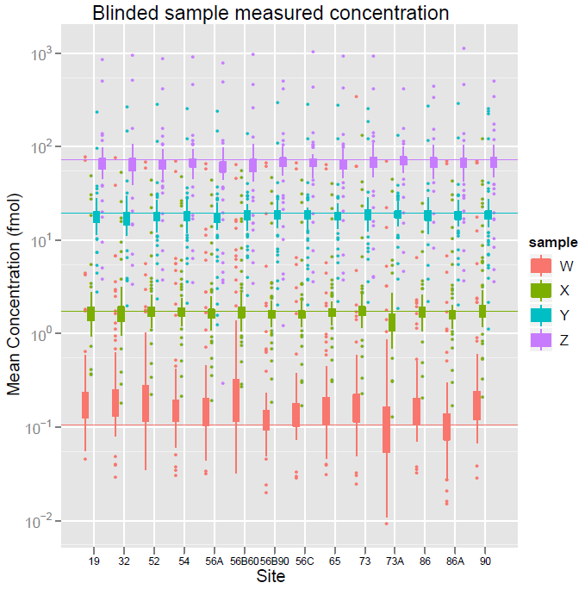
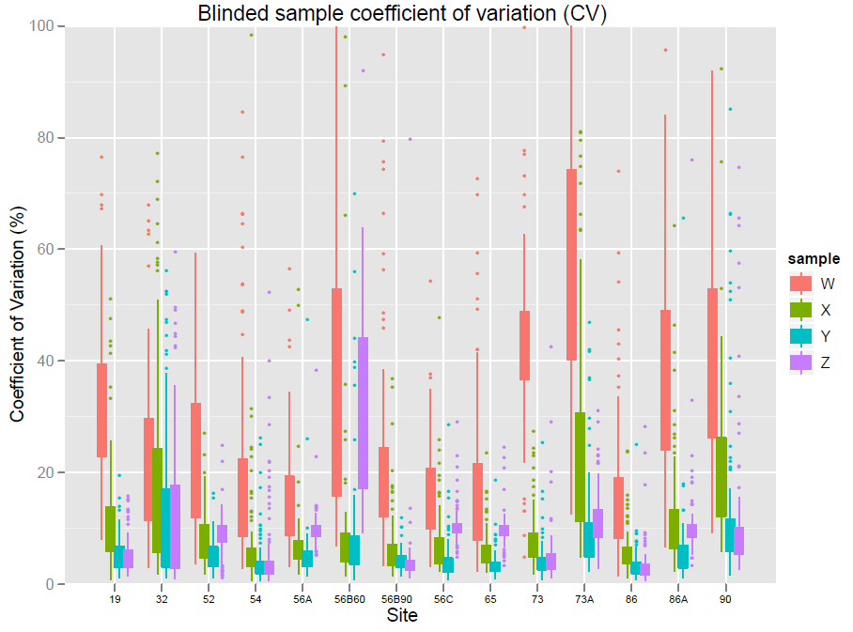
Good Reproducibility and Accuracy is Demonstrated Through Blinded Samples
Blinded Sample Concentration Distribution
Blinded Sample %CV Distribution
Inter-Lab
CV
45%
17%
72 fmol/μL
15%
16%
19 fmol/μL
Mean Determined Concentration (fmol/μL)
1.8 fmol/μL
0.1 fmol/μL
1
2
3
4
5
6
7
8
9
10
1
2
3
4
5
6
7
8
9
10
11
12
13
14
Site
11
12
13
14
Site

Slide 17
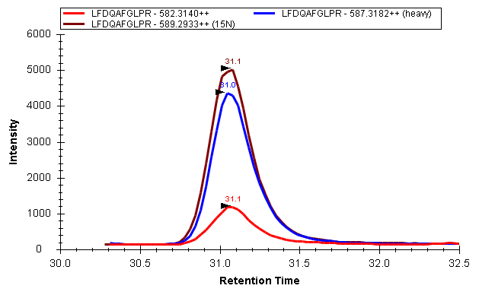
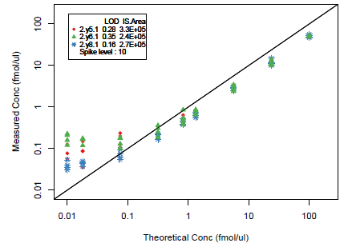
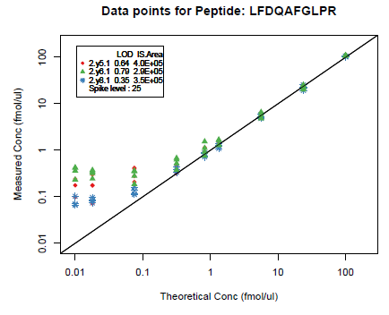
¹⁵N Protein Standards Improve Quantitative Accuracy
¹³C/¹⁵N Peptide Internal Standards
¹⁵N Protein Internal Standards
Peptide Conc_{(13C/15N)}
Light Peak Area
10 fmol
Peptide Conc_{(15N)}
Light Peak Area
25 fmol
=
x
=
x
¹³C/¹⁵N Peak Area
μL
¹⁵N Peak Area
μL
A
B
1.3 fmol/μL concentration point
1.3 fmol/μL concentration point
Transition | % Recovery
y5 | 55
y6 | 57
y8 | 50
Transition | % Recovery
y5 | 110
y6 | 111
y8 | 94

Slide 18
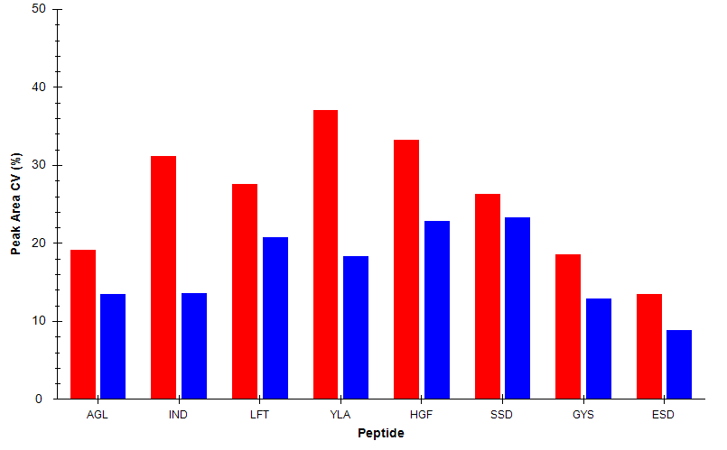
Protein Digestion Controls Help Gauge Assay Variability
Technical and Process Variability Assessed From
Digestion Controls and SIS Peptide Spikes
Process Variability:
Light Peak Area from Protein Digestion Controls
Technical Variability:
¹³C/¹⁵N Peak Area from post-desalt peptide spikes
Peak Area CV(%)
Poster MP01, #004

Slide 19
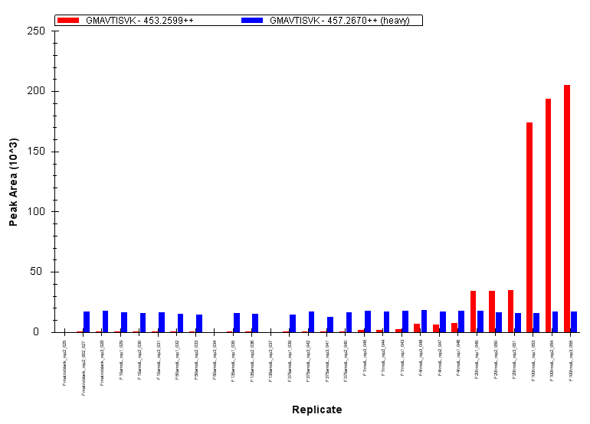
Skyline Facilitates Rapid Data Analysis Through Overview Plots
Peak Area Replicate View, Light and Heavy

Slide 20
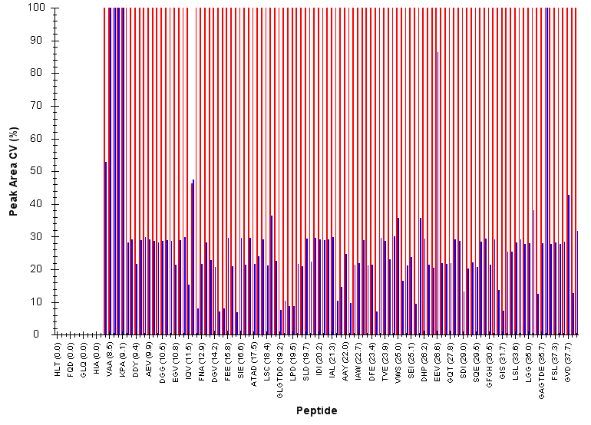
Peak Area CV Plots Provide Quick Assessment of Reproducibility Across a Series of Samples

Slide 21
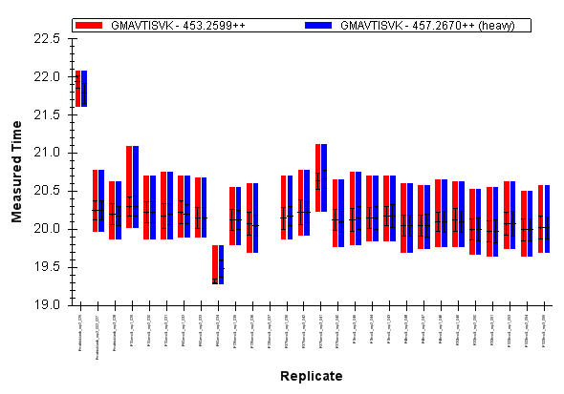
Retention Time Reproducibility Plots Show Trends in Retention Time

Slide 22
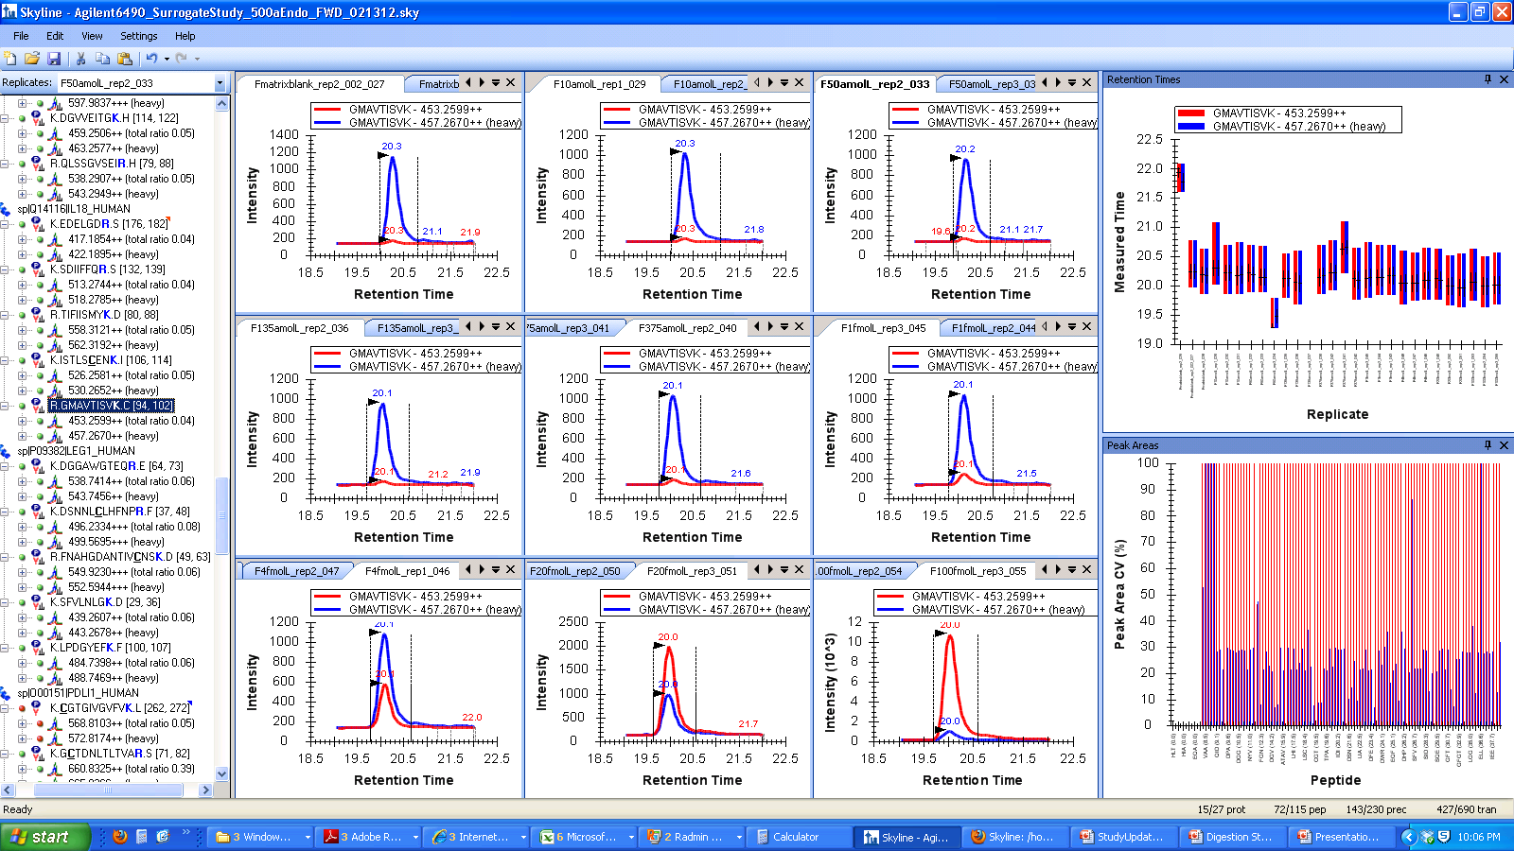
Quick View of All Replicates

Slide 23
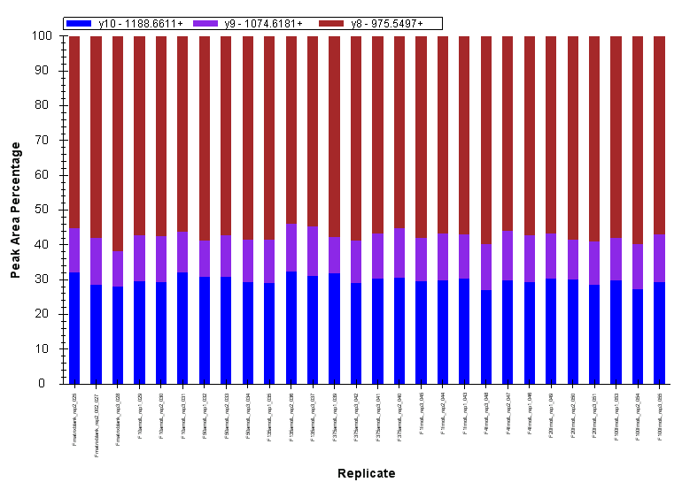
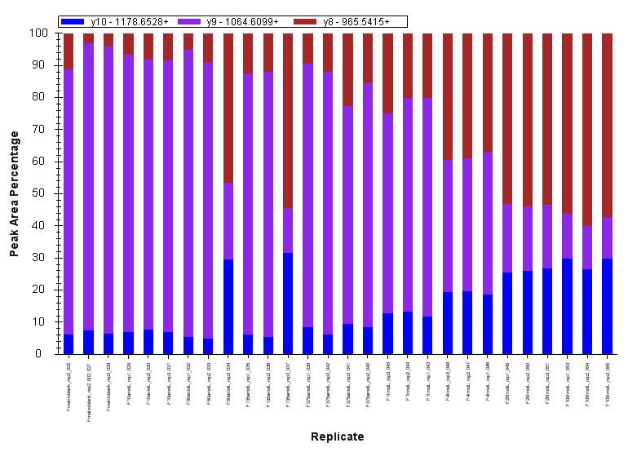
Interference Visualization
Heavy Peptide Transitions
Light Peptide Transitions

Slide 24
Summary
First large-scale interlab study to include 15N protein reagents and >100 peptide targets (>350 peptide forms)
Sensitivity improvement from previous study by using depleted plasma, adjusting the gradient
Transition selection and MS method transfer across 4 instrument platforms facilitated through Skyline
Peak Area and Retention Time views help quickly assess data quality
Customizable reports from Skyline enable down-stream processing, helps remove subjectivity of data evaluation, and increases data analysis throughput
Skyline helps maintain objective processing of data, requiring less manual tweaking
It’s free, it is easy, and it will process your data

Slide 25
CPTAC VWG Participants & Acknowledgements
Broad Institute: Susan Abbatiello,
Terri Addona, Steven A. Carr, Hasmik Keshishian, D.R. Mani, Michael Burgess, James Markell
Buck Institute for Age Research:
Michael P. Cusack, Bradford W. Gibson.
Jason M. Held, Birgit Schilling
Fred Hutchinson Cancer Research Center: Amanda G. Paulovich, Jeffrey R. Whiteaker, Shucha Zhang
Indiana University: Mu Wang, Jong-Won Kim, Jimsan You
Massachusetts General Hospital:
Steven J. Skates
Memorial Sloan-Kettering Cancer Center:
Paul Tempst, Mousumi Ghosh
National Cancer Institute: Emily Boja
Tara Hiltke, Christopher Kinsinger,
Mehdi Mesri, Henry Rodriguez, Robert Rivers
NISS: Xingdong Feng, Nell Sedransk,
Jessie Xia
NIST: Paul Rudnick
New York University: Thomas A. Neubert,
Åsa Wahlander, Sofia Waldemarson, Pawel Sadowski, John Lyssand
Plasma Proteome Institute:
N. Leigh Anderson
Purdue University: Charles Buck, Fred Regnier, Dorota Inerowicz, Vicki Hedrick
University of California, San Francisco:
Simon Allen, Susan J. Fisher, Steven C. Hall,
University of North Carolina: David Ransohof
University of Victoria: Christoph H. Borchers, Angela Jackson, Derek Smith
University of Washington: Michael MacCoss, Brendan MacLean, Daniela Tomazela
Vanderbilt University: Daniel Liebler, Kent Shaddox, Corbin Whitwell, Lisa Zimmerman
Funding: National Cancer Institute

Slide 26
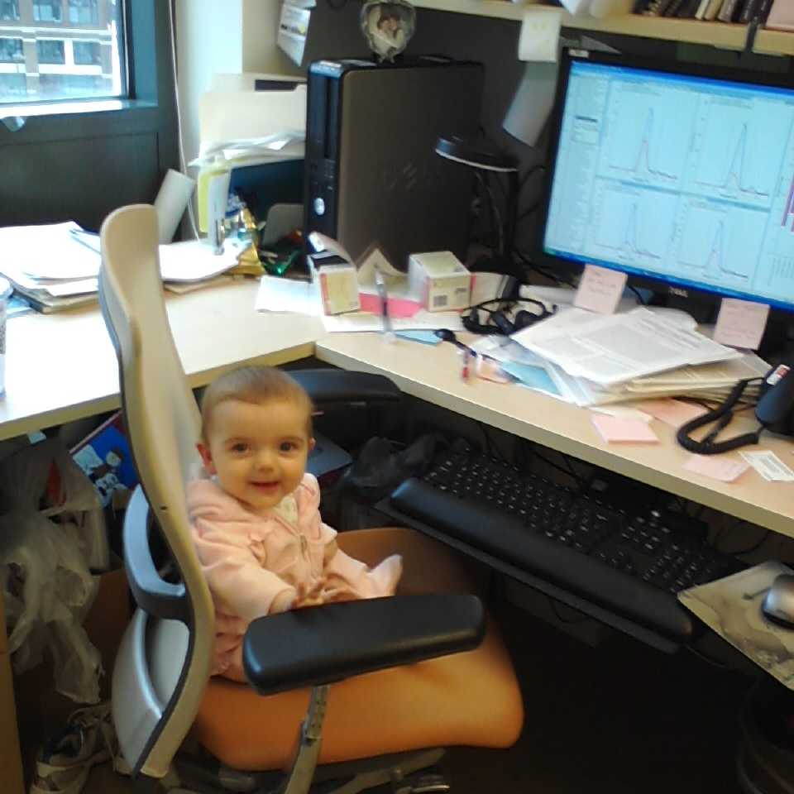
Skyline…
So easy a baby can do it

Slide 27
1000 Q1/Q3 Pairs – AB Sciex 4000 QTRAP
334 precursors:
108 peptides in 3 forms
10 control peptides
Notes:
27
1000 transitions, 334 precursors (108 peptides in 3 forms each: light, 13C/15N labeled, and uniform-15N labeled), plus 10 other peptides (Study 7 peptides, heavy only)

Slide 28
Gradient Optimization will Improve Sensitivity and Data Acquisition

Slide 29
LOD/LOQ Calculations:
How Many Points in the Curve are Needed?
What is the ideal concentration range?
(fmol/µL)
250
113
51
23
10
4.6
2.0
0.9
0.42
0.19
0.09
0.04
0.017
0.008
0.004
0.002
LOD = s_{blank} + t_{0.95} x (σ_{blank} + σ_{low})/√n
Proposed:
LOQ range
LOD
range
Generate preliminary curves (16 pts)
Pick a range and number of points to cover most peptides
Linnet & Kondratovich, (2004) Clin Chem
Keshishian et al, (2009) MCP

Slide 30
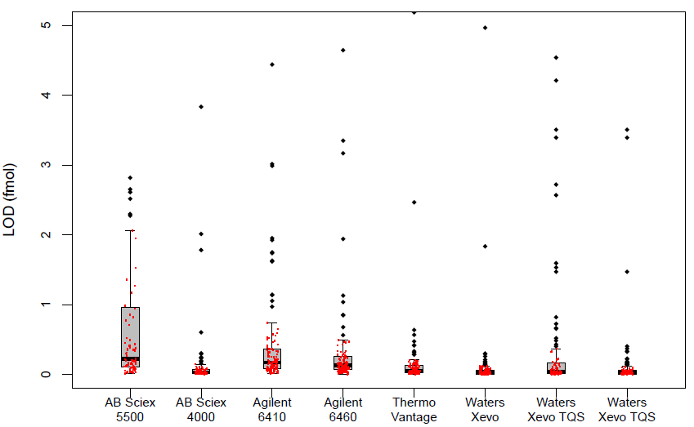
16 Point Curve at Selected CPTAC Sites Shows Good Reproducibility and Sensitivity
Median LOD
(fmol/uL)
0.22
0.032
0.17
0.13
0.055
0.027
0.044
0.023
Outliers
15
16
15
15
15
12
23
19

Slide 31
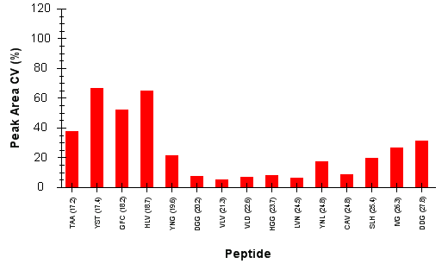
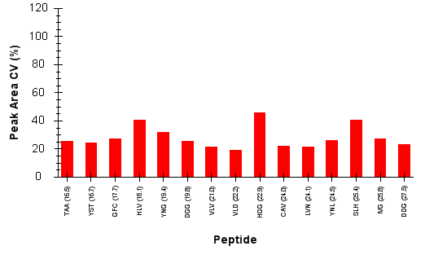
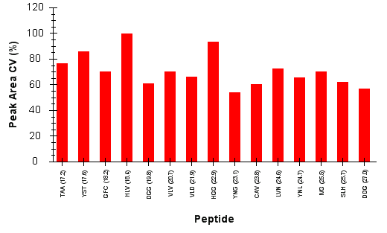
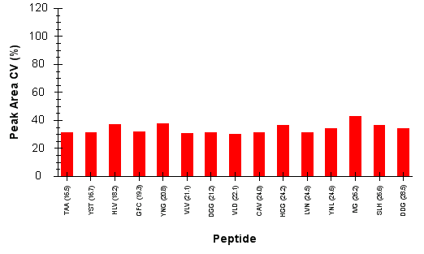
LOD is Highly Dependent Upon System Performance: Chromatography and Ionization
QTRAP 5500
Median LOD: 220 amol
4000 QTRAP
Median LOD: 32 amol
Pre-Assay System Suitability Runs (5)
25% CVs
25% CVs
70% CVs
30% CVs
Throughout Assay System Suitability Runs (24)
Unstable ESI was a major factor in poor detection and reproducibility
System Suitability assessment detects poor system performance

