Slide 1
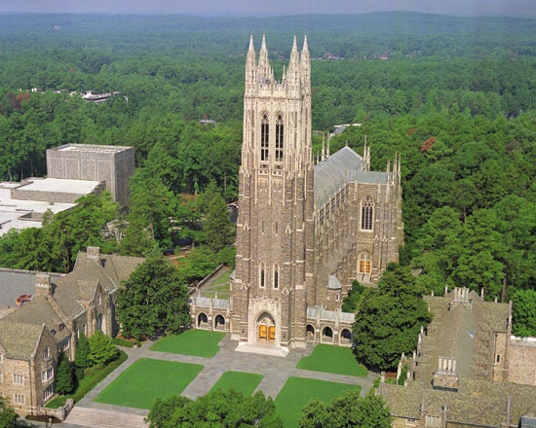
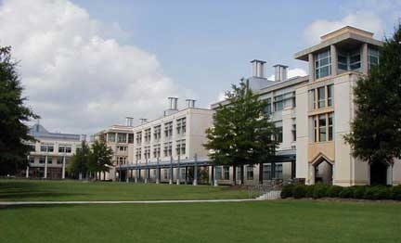
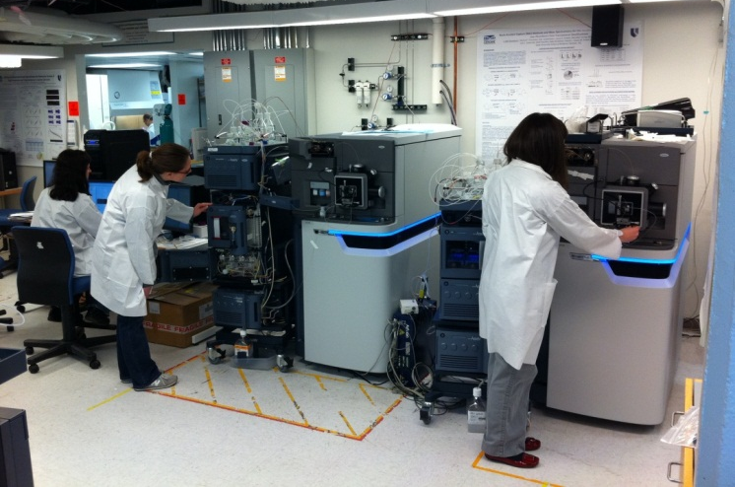


Using Skyline to Monitor Long-Term Performance Metrics of High-Resolution Mass Spectrometers
J. Will Thompson and M. Arthur Moseley
^{Duke Proteomics Core Facility}
Skyline Users Meeting – ASMS 2012

Slide 2
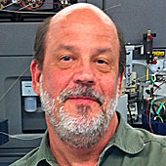
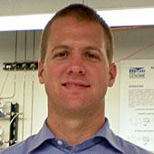
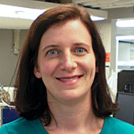
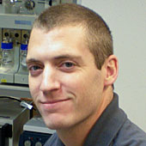


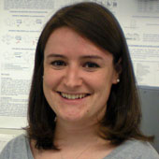
The Duke Proteomics Core Facility
Arthur Moseley, PhD, DPCF Director (2007)
Will Thompson, PhD, Senior Laboratory Administrator (2007)
Laura Dubois, BS, Laboratory Analyst II (2008)
Erik Soderblom, Laboratory Analyst II (2008)
Matt Foster, PhD, Assistant Research Professor - Pulmonology, 20% DPCF (2009)
Meredith Turner, BS, Research Technician II (2010)
Brenna Richardson, PhD, Laboratory Analyst II (2011)

Slide 3
System Suitability: “The process of validating whether your system is acceptable for providing useful analytical data without any bias.”
From the GLP world:
Operational Qualification (OQ): “Establishing confidence that equipment and sub-systems are capable of consistently operating with established limits and tolerances.”
Performance Qualification (PQ): “Demonstrate compliance with all requirements…including tests designed to verify the satisfactory performance of the equipment.”
We know this is important, but how do we go about doing this for a proteomic analysis?

Slide 4
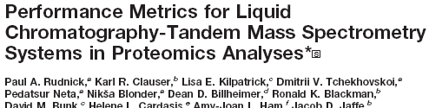
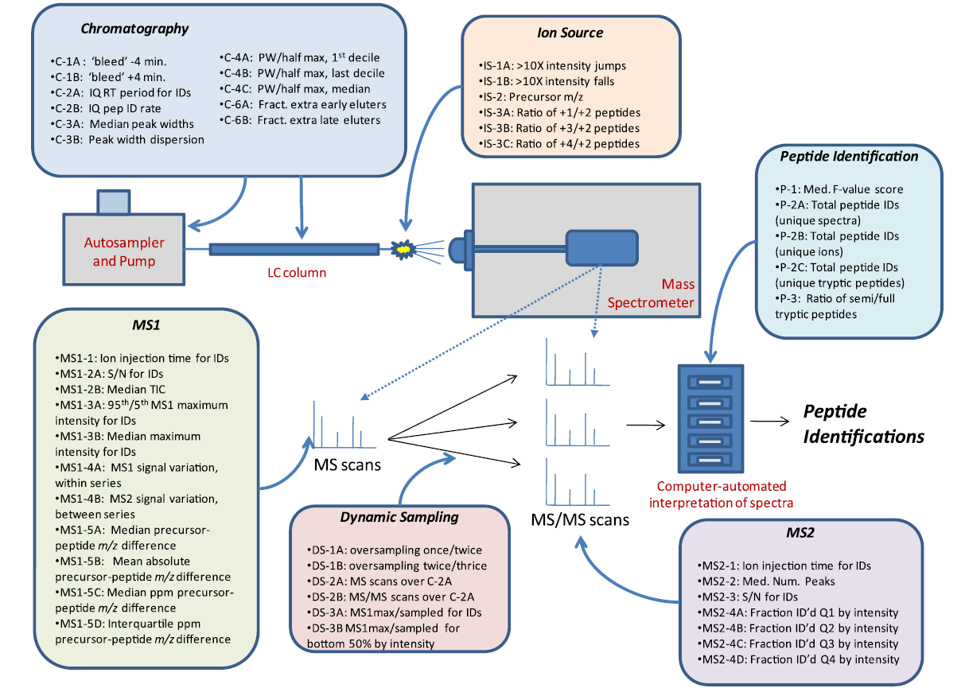
What Metrics are Important?
http://peptide.nist.gov/software/nist_msqc_pipeline/NIST_MSQC_Pipeline.html

Slide 5
What Type of Sample?
Single Peptide? Single Protein? Few Proteins? Lysate?
TIME
COST
CARRYOVER
REAGENT STABILITY
SENSITIVITY
RELEVANCE

Slide 6
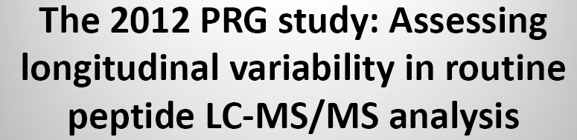
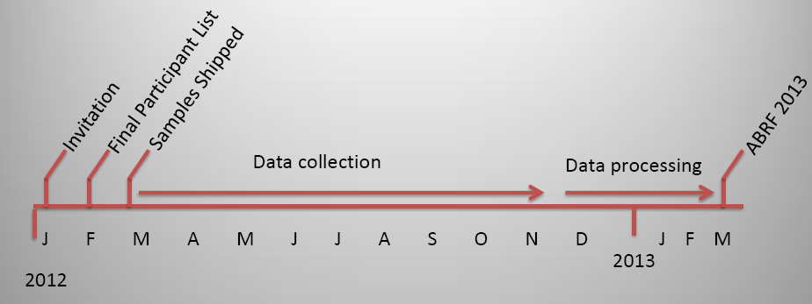
ABRF-Sponsored Longitudinal Variability Study (2012-2013)
http://www.abrf.org/ResearchGroups/Proteomics/Studies/ABRF2012.pdf

Slide 7
So, Just Start Somewhere…
In 2007, the DPCF started using 50 fmol injections of yeast alcohol dehydrogenase (Waters MassPrep)
Primary check was mass accuracy and sequence coverage, using database search results
In May 2011 the DPCF started using Skyline to analyze and track SS data from our QToF instruments using a Full Scan MS2 method targeting 7 analytes

Slide 8
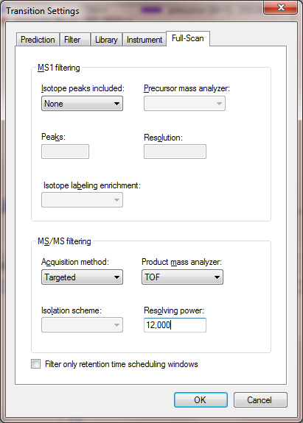
Skyline Setup for Full Scan MS/MS Analysis
https://skyline.gs.washington.edu/labkey/wiki/home/software/Skyline/page.view?name=tutorial_targeted_msms

Slide 9
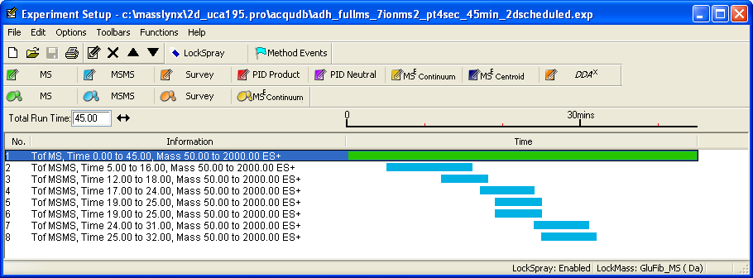
Targeted MS/MS (Pseudo-MRM) Method on a QToF

Slide 10
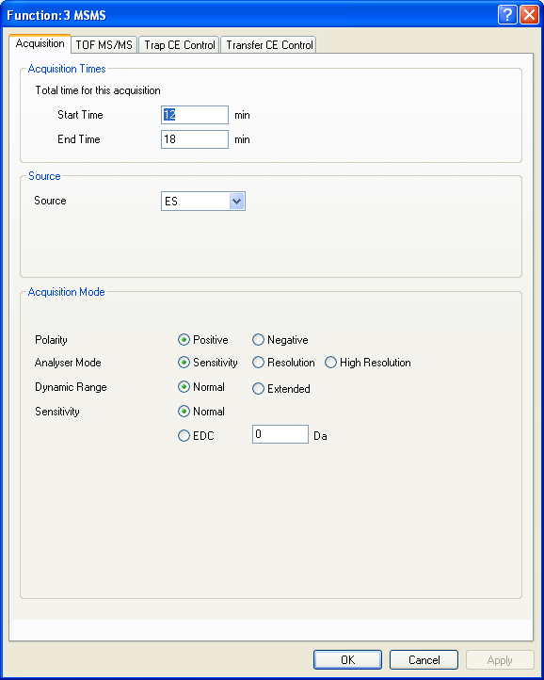
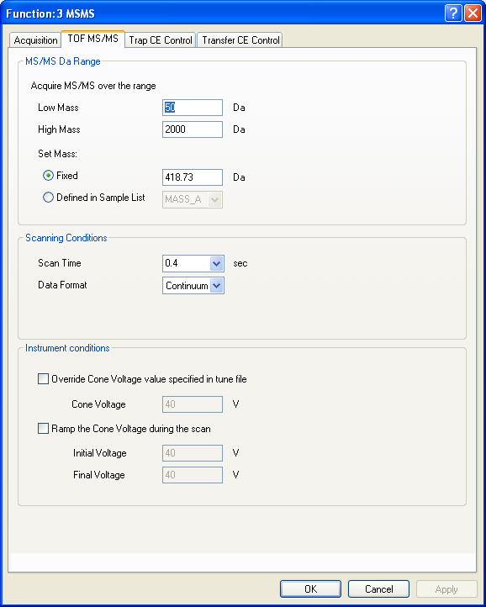
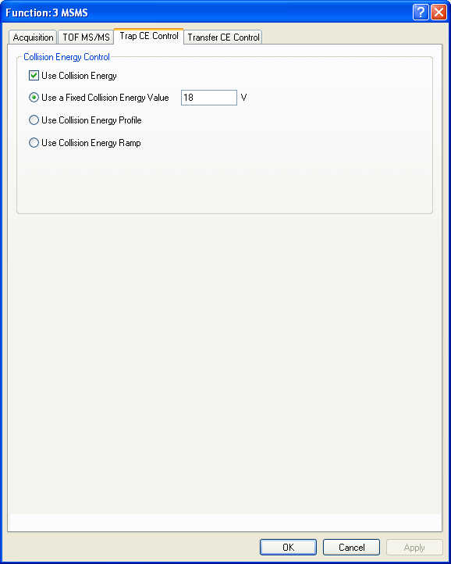
Acquisition Method Details, Continued…

Slide 11
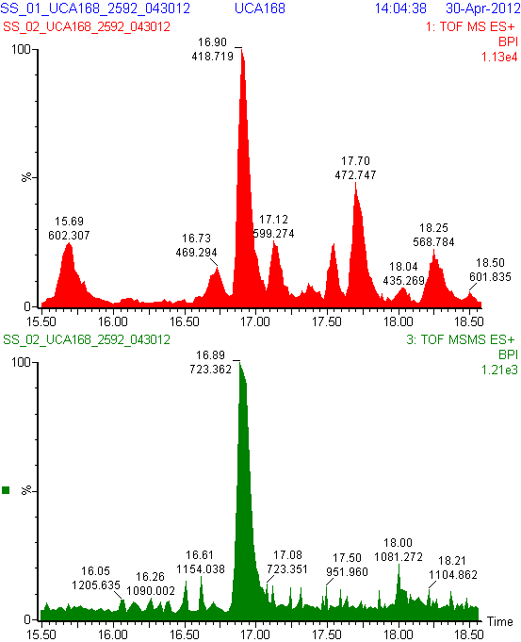
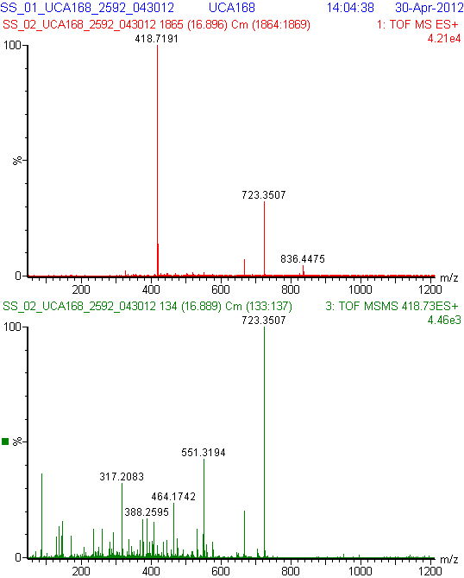
Example Raw Data 50 fmol ADH1_YEAST digest, Synapt G2 HDMS

Slide 12
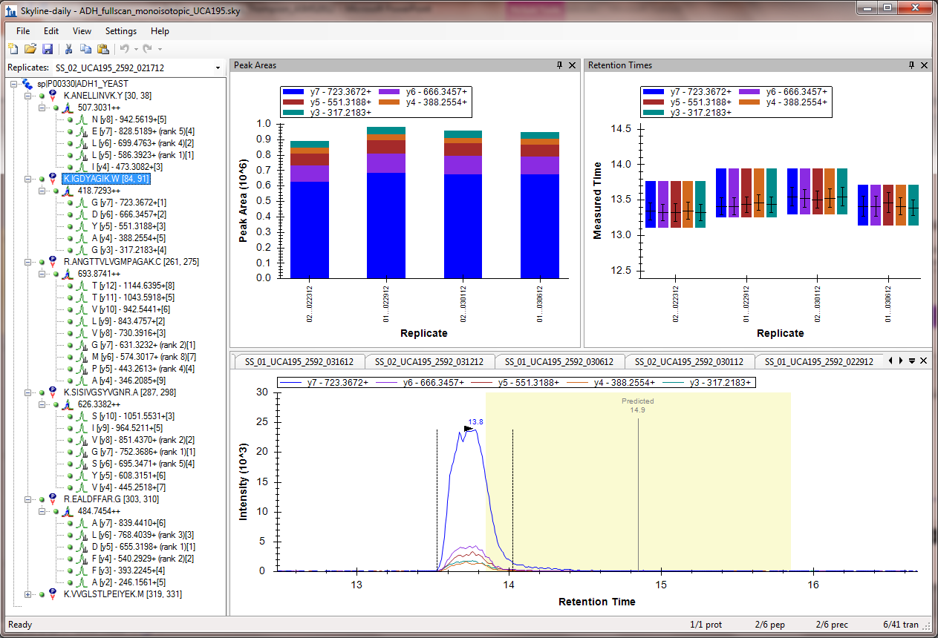
Skyline Customizable View

Slide 13
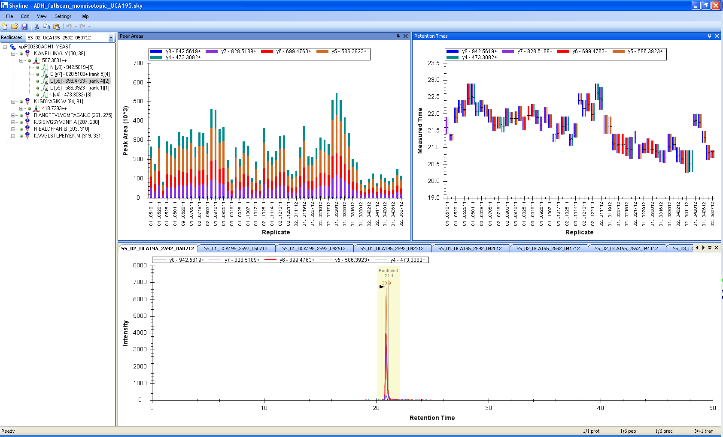
Longitudinal Measurements over 1 Year

Slide 14
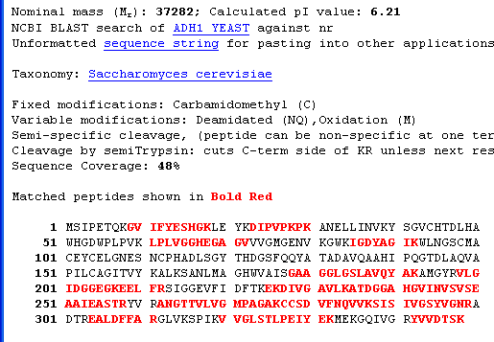
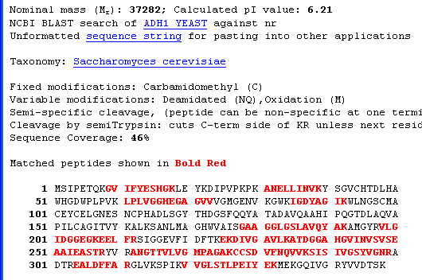

Peak Intensity versus Sequence Coverage

Slide 15
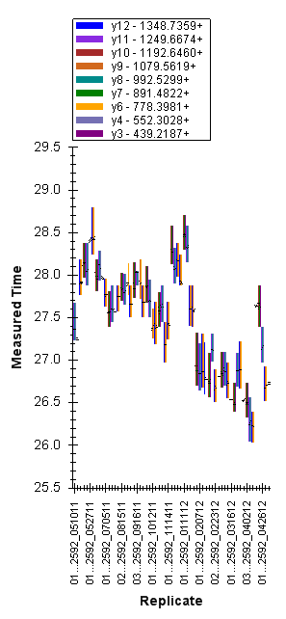
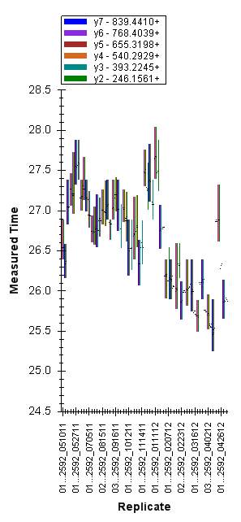
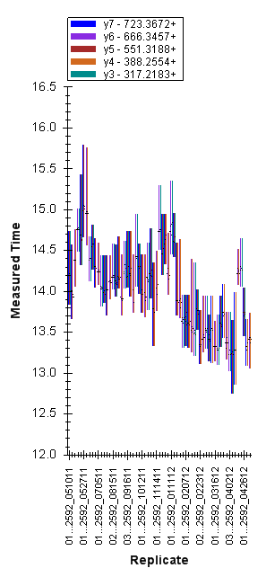
LC Retention Time Consistency

Slide 16
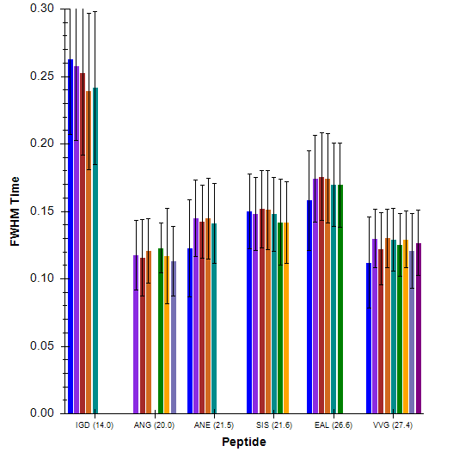
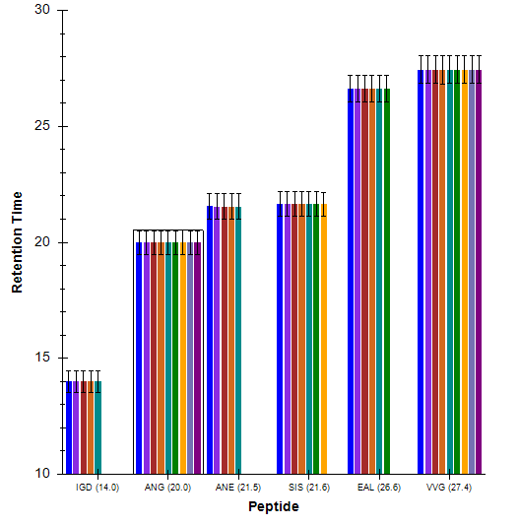
Other Chromatography Metrics
Average Peak Widths (with CV)
Average Retention Time (with CV)

Slide 17
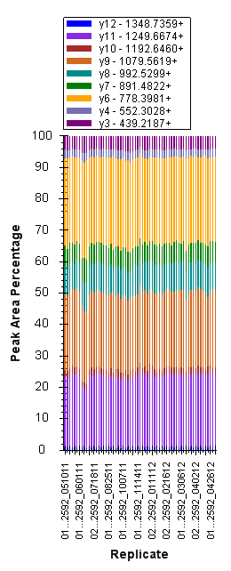
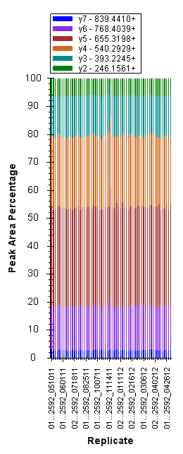
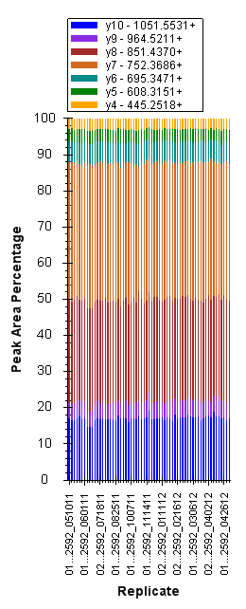
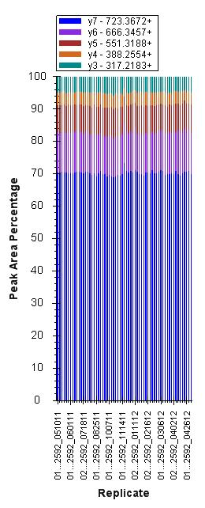
MS/MS Fragmentation Consistency

Slide 18
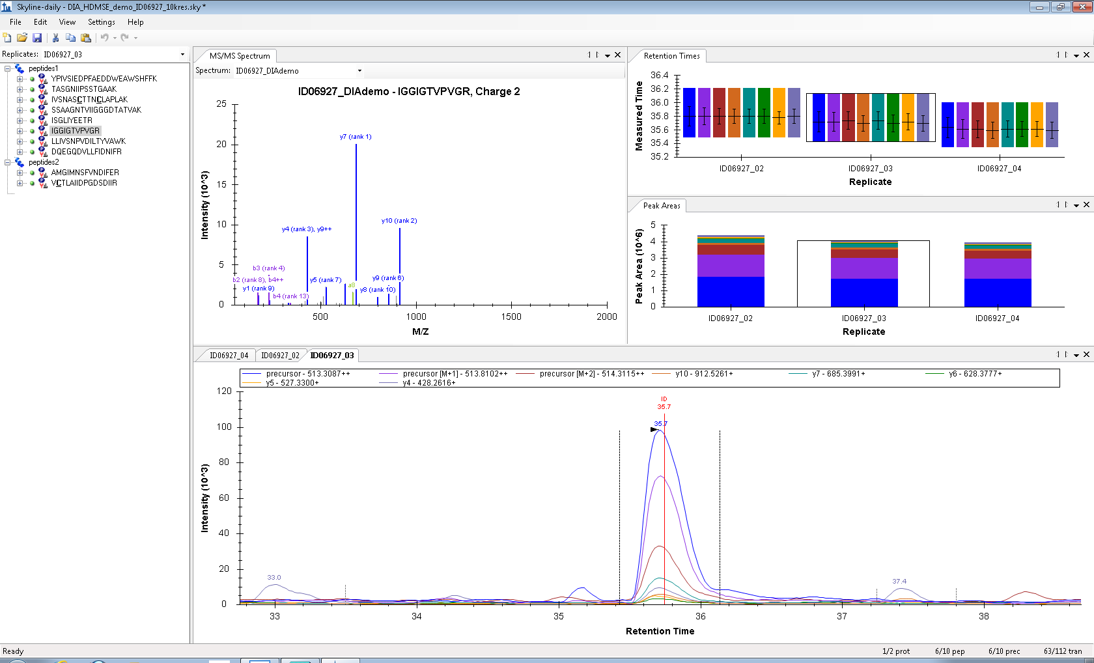
Example of Precursor and Product Ion Extraction in Skyline, Ion Mobility-Data Independent Acquisition

Slide 19
Summarization
Skyline provides a fast, efficient way to gain many system suitability metrics from most MS raw data formats
Thermo, Waters, AB/Sciex, and Agilent
Easy to visualize performance over time, with data at the individual peptide or aggregate level
Can utilize Full Scan MS1, MS/MS, MRM, or DIA approaches for system suitability
Ability to set/visualize “thresholds” for performance metrics once they are established would be a plus

