Slide 1
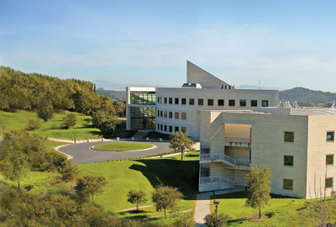

Platform Independent and Label-free Quantitation of Protein Acetylation and Phosphorylation using MS1 Extracted Ion Chromatograms in Skyline
NH₃⁺
acetyl
transferases
HNCOCH₃
deacetylases
Birgit Schilling
Buck Institute for Research on Aging
OH
OPO₃H⁻
kinases
phosphatase
Workshop ASMS 2012

Slide 2
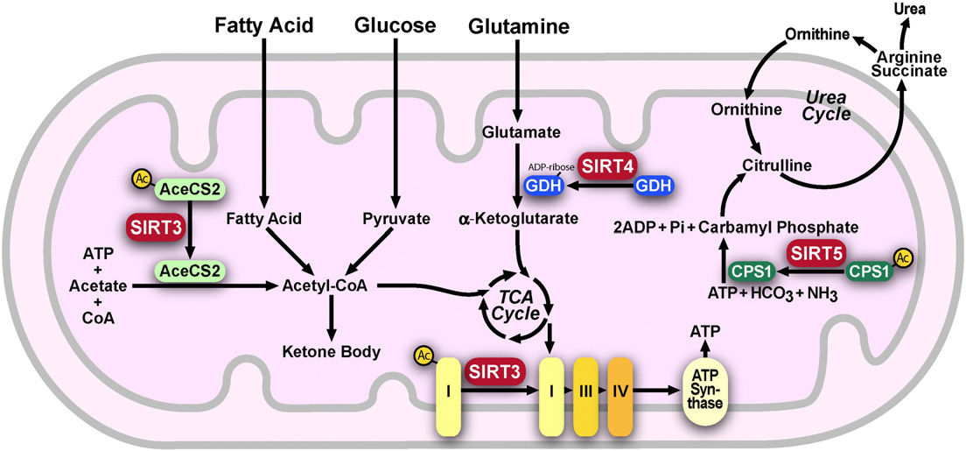
Mitochondrial Sirtuins and Metabolic Regulation
Type 2 Diabetes
Metabolic syndromes
High/low-fat diet
Aging
Neurodegenerative diseases?
MOH, 9:30 am : M. Rardin et al. “Quantitation of the Mitochondrial Lysine Acetylome
in SIRT3 Knockout Animals using MS1 Filtering in Skyline.”
Notes:
KO mice of SIRT3 in skeletal muscle show insulin resistance; KO mice of SIRT3 in liver show metabolic syndromes; high fat diet mice show that the level of SIRT3 is going down in muscle.

Slide 3
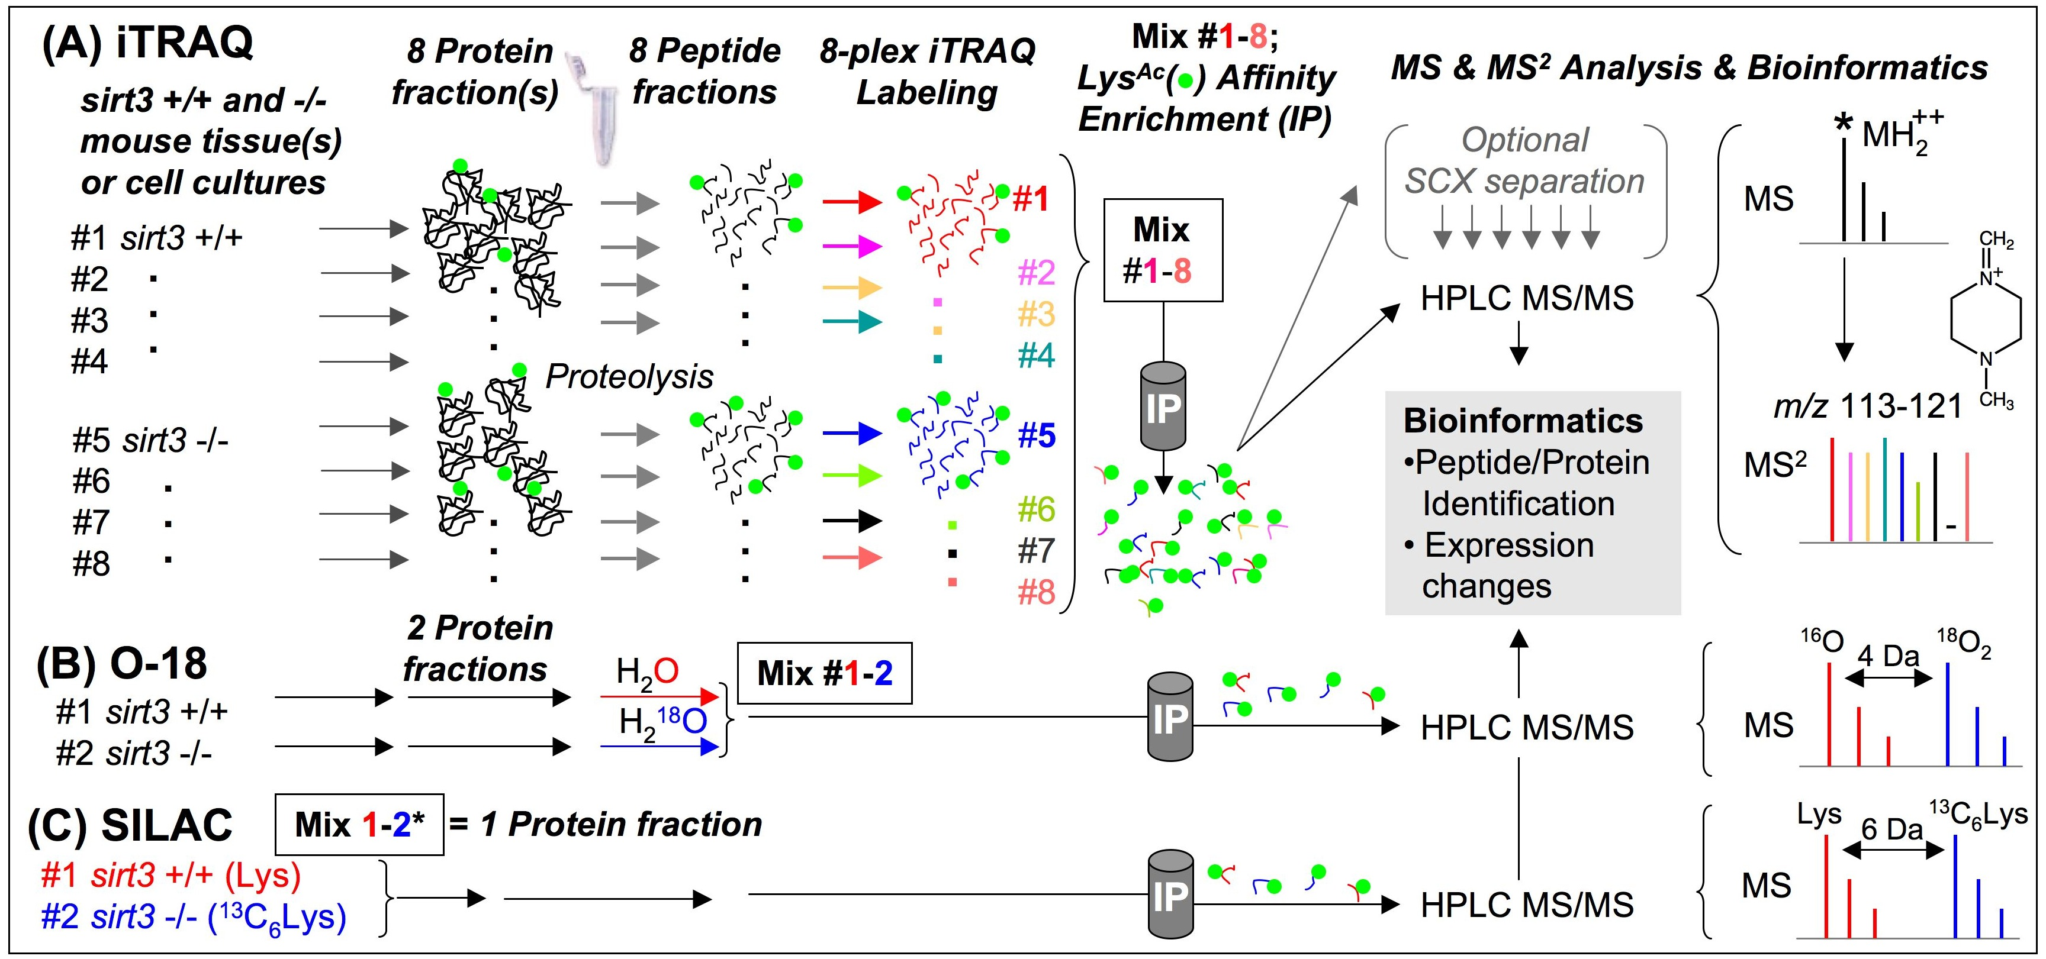
Designing a Quantitative Discovery Immunoaffinity-based ‘Acetylproteome’ Workflow
(D) Label-free Quantitation. Spectral counting, SuperHirn, MaxQuant, MultiQuant,…
#1 sirt3 +/+
#2 sirt3 -/-
#3
#4
etc..
IP
HPLC MS/MS
HPLC MS/MS
HPLC MS/MS
HPLC MS/MS
?
IP

Slide 4
Label-free, quantitative full scan filtering workflows in Skyline
MacLean et al., ASMS 2011 Poster:
“Skyline: Targeted Proteomics with Extracted Ion Chromatograms from Full-Scan Mass Spectra”
Buck Institute Workflows:
Using an AB SCIEX TripleTOF™ 5600 System to identify and quantitate posttranslationally modified peptides.
Ion chromatogram extraction (XICs) from MS1 scans that were acquired as part of data dependent acquisitions (DDA).
Skyline MS1 Filtering
Schilling et al., ASMS 2012, Tuesday TP03 Poster 081

Slide 5
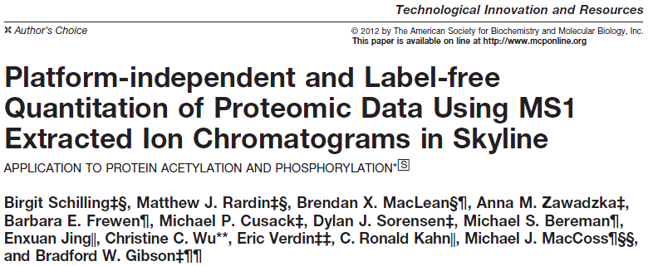
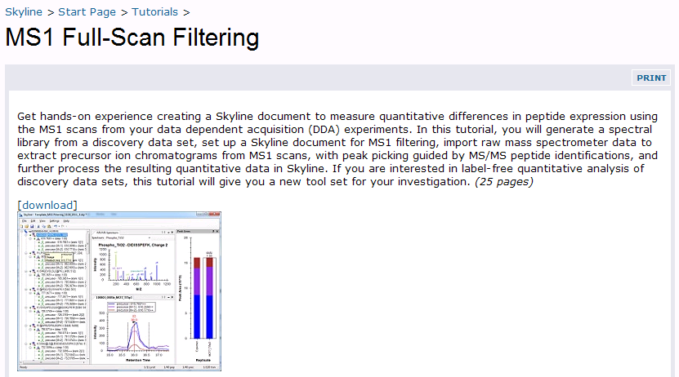

MCP, May 2012
Tutorial
(http://proteome.gs.washington.edu/software/Skyline/tutorials/ms1filtering.html)
Page 202–214

Slide 6
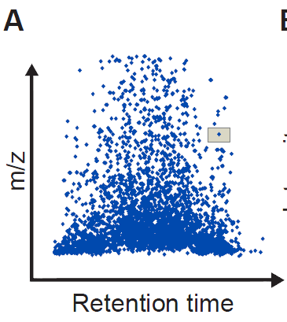
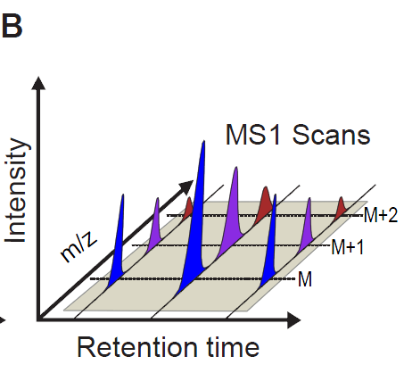
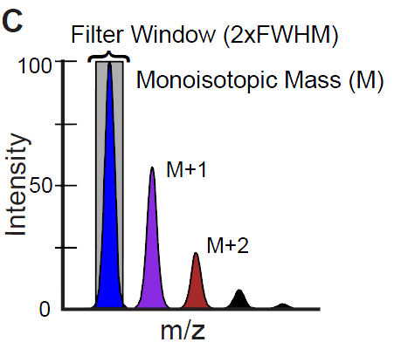
Skyline MS1 Filtering
A quantitative tool for discovery proteomics experiments
Follow a few peptide analytes to >3000 peptides
Label-free
Post analysis design
Skyline interface and tools
MS platform/manufacturer independent (QqTOF, FT and ITs)*
MacLean et al., ASMS abstract 2011
Schilling et al., MCP, 11, 2012, 202-214.
Notes:
Filter window is determined by resolution input (not actual instrument resolution)
6

Slide 7
Proteomic Data Flow in Skyline MS1 Filtering
Samples
(1, 2, 3,… N)
Mass Spectrometer
Raw data:
Peptide Search Engine(s)
(Mascot, Protein Pilot, X!Tandem, etc.)
MS1 Scans
File import
MS/MS Scans
Skyline – ‘BiblioSpec’
Skyline – ‘ProteoWizard’
Skyline – ‘Spectral Library’
Skyline – ‘Full Scan Filter’ Module
Import fasta/proteome files
XIC, automatic integration
MS/MS directed peak picking
‘automatic and manual’
automatic generation of Skyline ‘Peptide Tree’
Peptide Ion Chromatograms
ID annotations
expected isotope distrib.
irank
idotp
Skyline – ‘Visual Tools’
assess data quality and adjust peak integration
Skyline – ‘Custom Reports’
Statistical Processing
Notes:
New Figure 2. Proteomic data flow using MS1 Filtering indicating new or revised Skyline modules (shown in boxes).
7

Slide 8
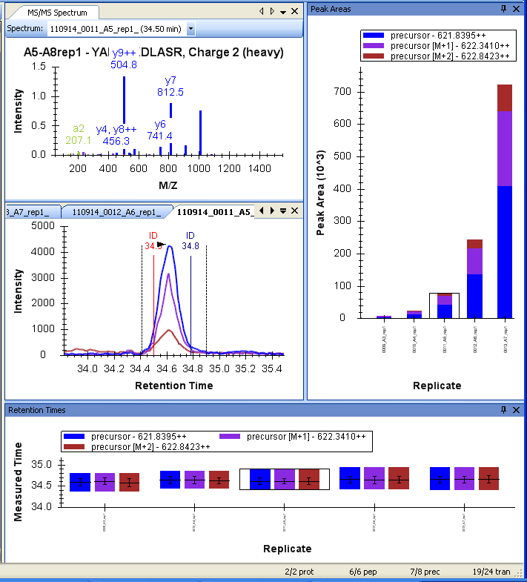
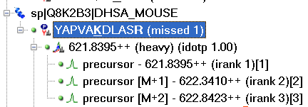
Skyline interface for MS1 filtering data
3
5) M, M+1,M+2 precursor peak areas
5
3) MS/MS spectra and ID
1
1) Peptide ‘tree’ with precursors
irank
idotp
2
2) RT and ID
correlation; peak boundaries set for integration
*
*
A3
A4
A5
A6
A7
4
4) RT variation among peptides and replicates for each precursor isotope (M, M+1, M+2)
*
A3
A4
A5
A6
A7
Notes:
(c) Can set new peak boundaries; Irank = is ranking of most abundant to least abundant isotope; Idotp = score of correlation to theoretical distribution
5600 mass accuracy / Eksigent Ultra RT stability

Slide 9
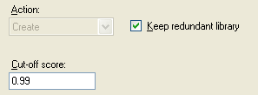
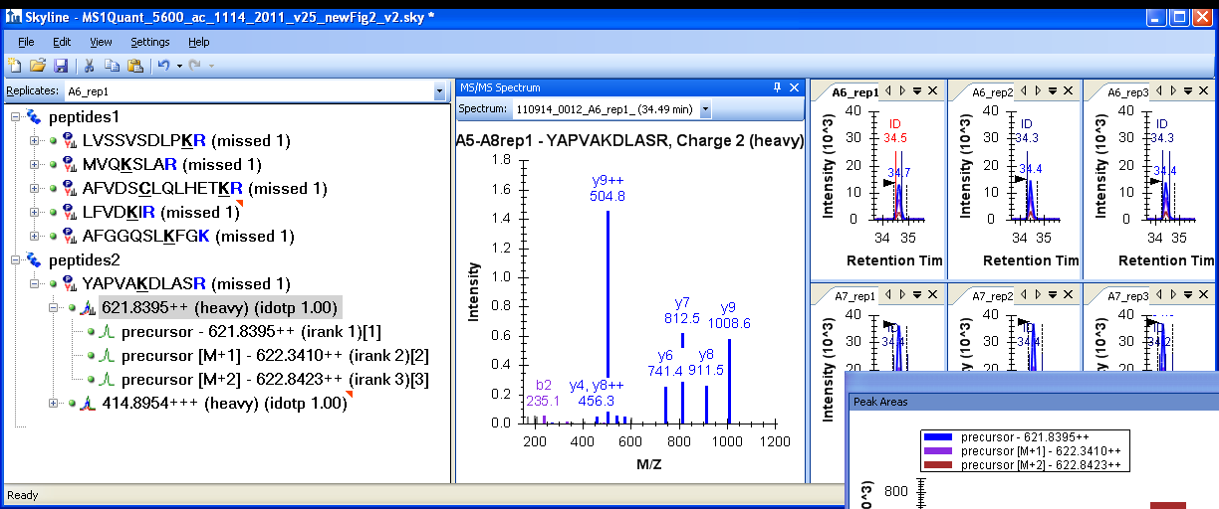
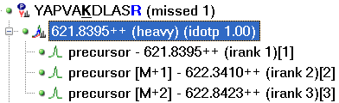
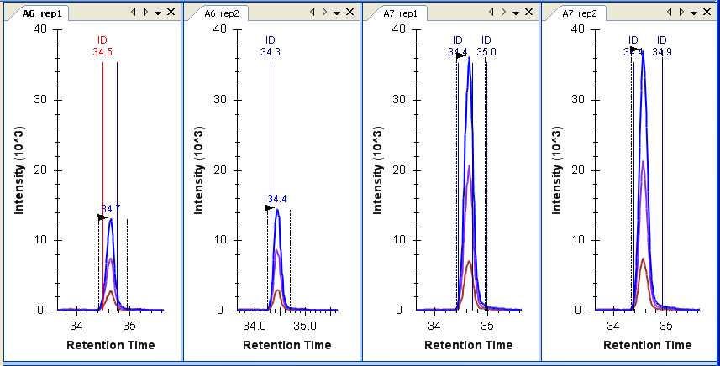
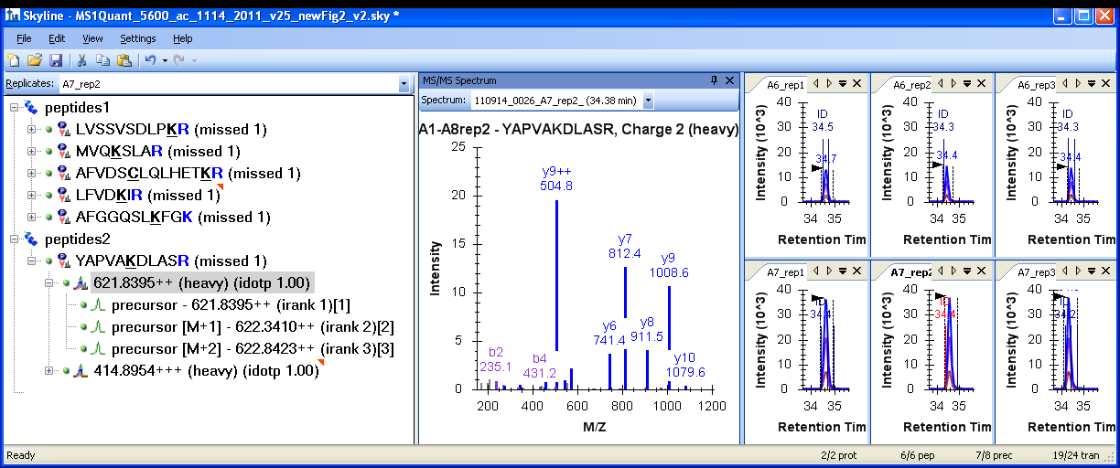
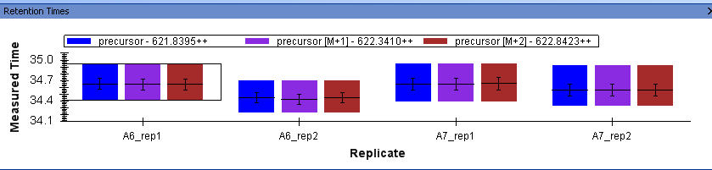
MS/MS (ID) directed Peak Picking for Skyline MS1 Filtering
MS/MS from redundant spectral libraries
A
precursor M 621.8395++
precursor M+1 622.3410++
precursor M+2 622.8423++
S1_R1
*
B
S1_R1
S1_R2
S2_R1
S2_R2
*
**
S2_R2
**
C
S1_R1
S1_R2
S2_R1
S2_R2
Notes:
9

Slide 10
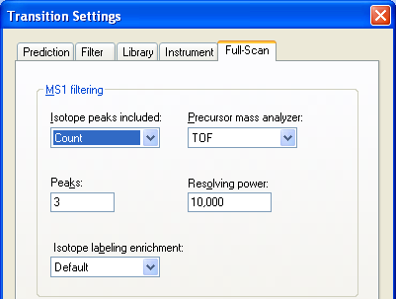
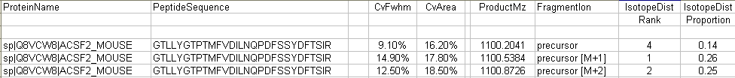
Advantage of quantitating multiple precursor isotopes, M, M+1, M+2
A
B
Measured MS1 Peak Isotope distribution
GTLLYGTPTMFVDILNQPDFSSYDFTSIR 3+
1100.54 (3)
1100.87 (3)
m/z=1100.20
1101.21 (3)
Relative abundance
*1100.20 (3)
1101.54 (3)
m/z
C
D
Observed peak area CV over 9 replicates
GTLLYGTPTMFVDILNQPDFSSYDFTSIR

Slide 11
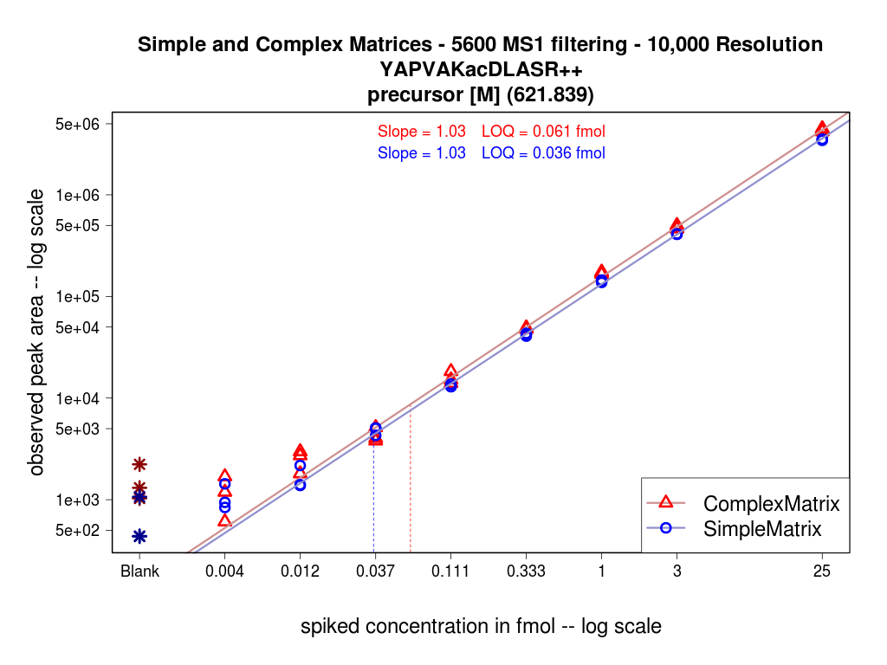
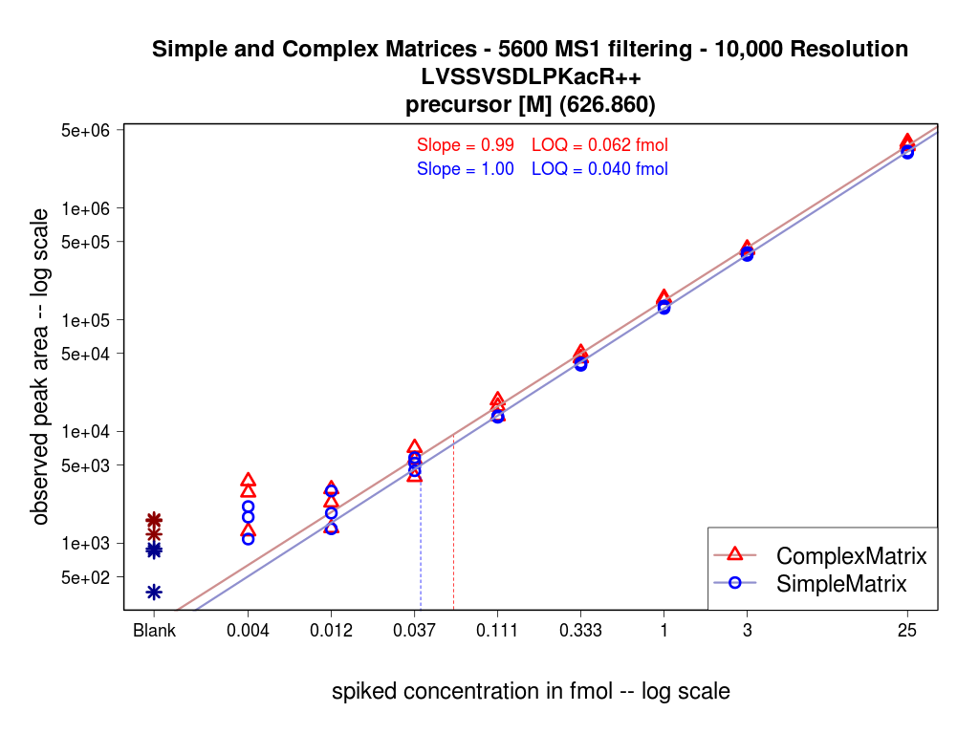
MS1 Filtering Standard Concentration Curves for Lys-Ac Peptides
LOQ = 0.061 fmol (complex matrix)
1xe6
LOQ = 0.036 fmol (simple matrix)
YAPVAKacDLASR⁺⁺
1xe5
TripleTOF 5600
observed peak area (log)
6 peptide mix at 4 amol to 50 fmol
Both simple and complex matrices
Triplicate analysis +/- background matrices
1xe4
1xe3
blank
0.004
0.012
0.037
0.111
0.333
1
3
25
fmol (log scale)
LOQ = 0.062 fmol (complex matrix)
1xe6
LOQ = 0.040 fmol (simple matrix)
1xe5
LVSSVSDLPKacR⁺⁺
observed peak area (log)
1xe4
regression slopes:
1.03 & 1.03 for YAP
0.99 & 1.00 for LVS
1xe3
blank
0.004
0.012
0.037
0.111
0.333
1
3
25
fmol (log scale)
Notes:
5600 data, 10,000 resolution
Complex is mito proteins (500 ng on column)
Simple 6 protein mix
11

Slide 12
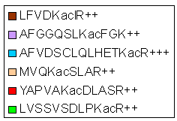
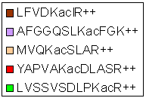
Reproducibility for MS1 Scan Filtering
Complex matrix, ABSCIEX TripleTOF 5600
Simple matrix, ABSCIEX TripleTOF 5600
Peak Area CV in % (3 repl.)
Peak Area CV in % (3 repl.)
30%
30%
20%
20%
100
310 matrix peptides; MS1 (precursor M)
80
Peak Area CV # Peptides
0 - 20%
264
85% with CV<20%
60
20 - 30%
33
Peak Area CV in % (9 repl.)
30 - 40%
13
40
30% CV
20
20% CV
350
550
m/z
750
950
1150
Notes:
560O TripleTOF data
Complex matrix –mitochondrial extract
Simple matrix – 6 protein mix, Michrom
Top 3 replicatesea, composite bottom is 9 replicates (now have done 27 replicates)
12

Slide 13
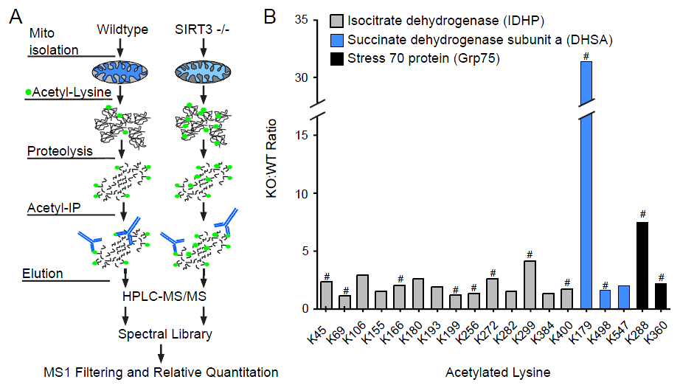
Identification of SIRT3 Substrates in Mouse Mitochondria
Example, Skeletal muscle
31x
7.2x
4.2x
Rardin et al., MS1 Quantitation of >2,000 acetyllysine peptides
Notes:
Sketetal muscle QSTAR data
ICDH published on (some sites)
Stress70, mostly new except for K179 upregulated in caloric restriction
SDHa – activity changes, but no sites given
13

Slide 14
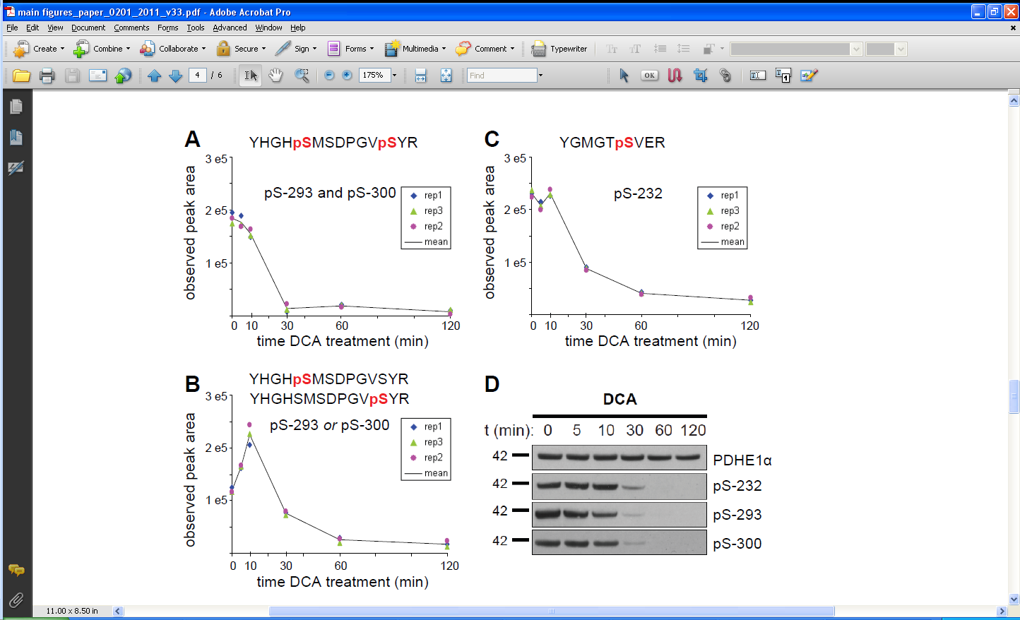
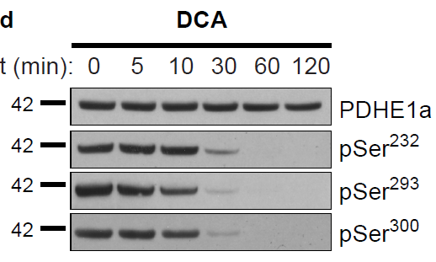
Mouse Mitochondrial Liver– DCA treatment (Kinase inhibitor)
MS1 Filtering for 3 phosphopeptides, Pyruvate DehydrogenaseE1α, 0-120 min
Western blot for comparison
PDHE1α
pSer-232
pSer-293
pSer-300
DCA: dichloroacetate (pyruvate analog, inhibitor)

Slide 15
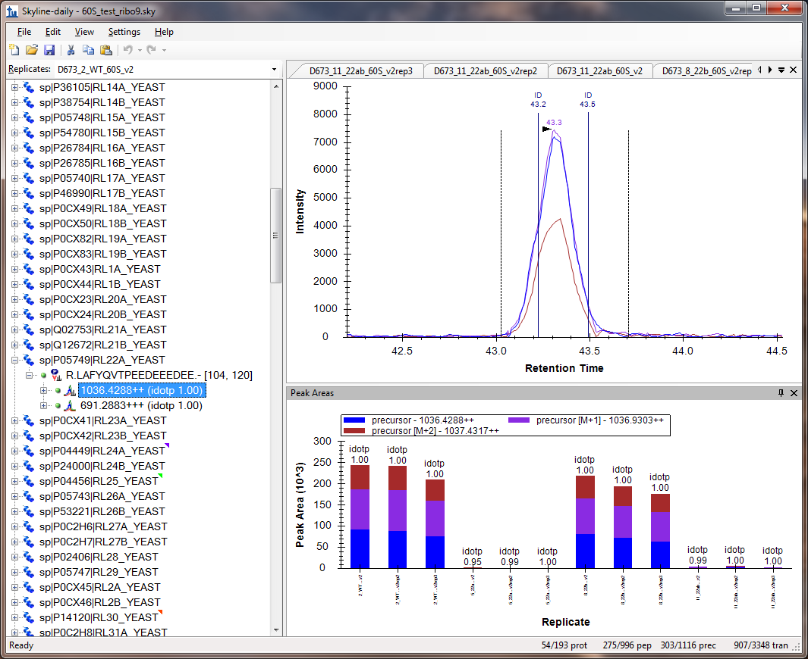
Polysome Changes - High Throughput MS1 Filtering
Spectral libraries are generated for 40S, 60S, and 80S yeast polysome fractions
WT
RL22a-/-
RL22b-/-
RL22ab-/-
yeast strains
MS1 Filtering to comprehensively quantitate ribosomal proteins, ‘RL’ and ‘RS’ proteins (including paralogs) in the polysome fractions.
Subunit changes ?
Complex composition changes ?
Protein RL22a quantitated
(in 4 different yeast strains)
22b-/-
22b-/-
22ab-/-
22ab-/-
22ab-/-
22b-/-
22ab-/-
22b-/-
WT
22b-/-
WT
WT
WT
22a-/-
22a-/-
22a-/-
22a-/-
22a-/-

Slide 16
Greatly improved Raw File Import Speed (64 bit) and Memory Allocation
Example: yeast polysomal proteins and interacting proteins
MS1 Filtering for 2309 peptides, each M, M+1, M=2; total of 7191 “transitions”
Import of 12x TripleTOF 5600 wiff files (90 minute gradient)
Comparison of Skyline file import speed with different computer systems
32 bit, 2 core, 1 proc. 3.16 GHz, 3.3 GB RAM 276 min
64 bit, 4 cores, 1 proc. 3.30 GHz, 8.0 GB RAM 113 min
64 bit, 8 cores, 2 proc. 2.67 GHz, 12.0 GB RAM 99 min
Advantage of file import with scheduled time window (Δ 2 min) around peaks
32 bit, 2 core 78 min
64 bit, 4 cores 29 min
64 bit, 8 cores 20 min
Scheduled File Import Advantages:
reduced import time
greatly reduced Skyline file size (8.6 GB vs 0.08 GB)
easier follow-up peak processing
Skyline daily version 1.2.1.3628

Slide 17
Scheduled File Import during MS1 Filtering using RT from prepicked peaks
R.LAFYQVTPEEDEEEDEE.-
Replicate 1:
Import of chromatogram 0-80 min
R.LAFYQVTPEEDEEEDEE.-
Replicate 2:
Scheduled import with
2 min window around peaks

Slide 18


Integration of Skyline MS1 Filtering into Laboratory Workflows / Pipelines
Discovery Mass Spectrometry
data dependent data set
MS1 spectra
MS/MS spectra
(data dependent)
Peptide
Identifications
Generation of a
Spectral Library in Skyline
MS/MS-directed
MS1 peak-picking
MS1 Filtering in Skyline
MRM transition
selection
quantitative information
from Discovery Experiment
Candidate Lists for Follow-up
LC-MRM-MS assays
(Verification)

Slide 19
MS1 full scan Filtering - Conclusion and Future Outlook
Platform and Vendor Independent
Open Source, continuous development and improvements (Skyline Team)
Easy label-free quantitation, particularly good for PTM peptide quantitation
Taking advantage of existing Skyline graphical displays and QC features
High throughput quantitative screening of discovery workflow experiments
Easy integration of MS1 Filtering results with follow-up MRM experiments
Combination of MS1 Filtering with Skyline iRT features
Retention Time (RT) alignment, also when no MS/MS was sampled

Slide 20




Acknowledgments
B.W. Gibson, M.J. Rardin, M.P. Cusack, A. Zawadzka, D. Sorensen, S. Danielson, Monique O’Leary, Brian Kennedy – Buck Institute
B. MacLean, M.S. Bereman, C. Wu, B. Frewen, M.J. MacCoss – Univ. Washington
E. Jing, R. C. Kahn – Harvard
E. Verdin – Gladstone
P. Drake, S. Fisher – UCSF
C. Hunter, S. Seymour – AB SCIEX
J. Cottrell – Matrix Science
NIH, NCI (CPTAC)

Slide 22
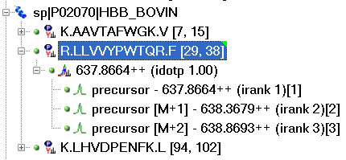
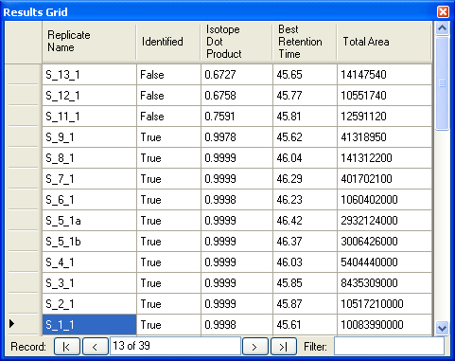
Skyline MS1 Filtering specific parameters and Utilizing Grid View
A
B
Skyline Results Grid View
(LTQ FT-ICR-MS platform)
idotp deviation
from “1”
All parameters such as
irank, observed rank
idotp, isotope distribution %
underlying MS/MS signal for MS1 peak?
can be exported to Skyline custom reports
Notes:
Supplemental Figure S3. Isotope Dot Product
The isotope dot product (idotp) provides a measure to assess precursor isotope distribution and its correlation between expected and observed pattern with optimal matching resulting in an idotp value of “1”. Idotp can be displayed in either A peak area replicate views or B “results grid” views. Large deviations of idotp from 1 indicate unreliable isotope patterns, possible misidentifications, excessive noise and signal below detection limit, or interferences. B, Results Grid column “Identified” indicates (with a True/False option) if an MS/MS spectrum was identified for this precursor per each replicate.

