Slide 1

Multiplexed Data Independent Acquisition for Comparative Proteomics
Jarrett Egertson
MacCoss Lab
Department of Genome Sciences
University of Washington
5/20/2012

Slide 2
Current Technology for Comparative Proteomics
Targeted:
  How much does protein X increase/decrease?
  For a small target list (<100 peptides)
  Often requires extra steps
    Retention time scheduling
    Peptide transition refinement
Discovery:
  What proteins are changing in abundance?
  For ~1,000 - 5,000 semi-randomly selected peptides
  Data is not collected on the majority of peptides!

Slide 3
Many Peptides Are Missed By Data Dependent Acquisition
~25,000 – 50,000 Peptides
Detected in MS
~1,000 – 5,000 Peptides Assigned Sequence Determined By MS/MS
Notes:
Usually 1,000 – 5,000 peptides identified by MS/MS
Usually ~25,000 – 50,000 MS features detected
2-20% of Features Annotated
BUT Usually only ~70% overlap in annotated features between runs

Slide 4
Data Independent Acquisition (DIA) to Increase Sequence Coverage
40 10 m/z-wide windows = 400 m/z
500
m/z
900
Scan 1
Scan 2
Venable JD et. al. Nature Methods 2004.
Notes:
Usually 1,000 – 5,000 peptides identified by MS/MS
Usually ~25,000 – 50,000 MS features detected
2-20% of Features Annotated
BUT Usually only ~70% overlap in annotated features between runs

Slide 5
Data Independent Acquisition (DIA) to Increase Sequence Coverage
40 10 m/z-wide windows = 400 m/z
500
m/z
900
Scan 1
Scan 2
Scan 3
Scan 4
Scan 5
Scan 6
Scan 7
…
Scan 40
Scan 41
Notes:
Usually 1,000 – 5,000 peptides identified by MS/MS
Usually ~25,000 – 50,000 MS features detected
2-20% of Features Annotated
BUT Usually only ~70% overlap in annotated features between runs

Slide 6
Data Independent Acquisition (DIA) to Increase Sequence Coverage
40 10 m/z-wide windows = 400 m/z
500
m/z
900
Retention Time
Notes:
Usually 1,000 – 5,000 peptides identified by MS/MS
Usually ~25,000 – 50,000 MS features detected
2-20% of Features Annotated
BUT Usually only ~70% overlap in annotated features between runs

Slide 7
Targeted-Style Analysis
LGLVGGSTIDIK⁺⁺ (586.85)
LVGGSTIDIK⁺
(1002.58)
3.5
VGGSTIDIK⁺
(889.50)
3.0
GGSTIDIK⁺
(790.43)
GSTIDIK⁺
(676.39)
2.5
STIDIK⁺
(589.36)
TIDIK⁺
(488.31)
Intensity x 10⁻⁶
2.0
IDIK⁺
(375.22)
1.5
1.0
0.5
0.0
48
49
50
51
52
Retention Time
Notes:
Usually 1,000 – 5,000 peptides identified by MS/MS
Usually ~25,000 – 50,000 MS features detected
2-20% of Features Annotated
BUT Usually only ~70% overlap in annotated features between runs

Slide 8
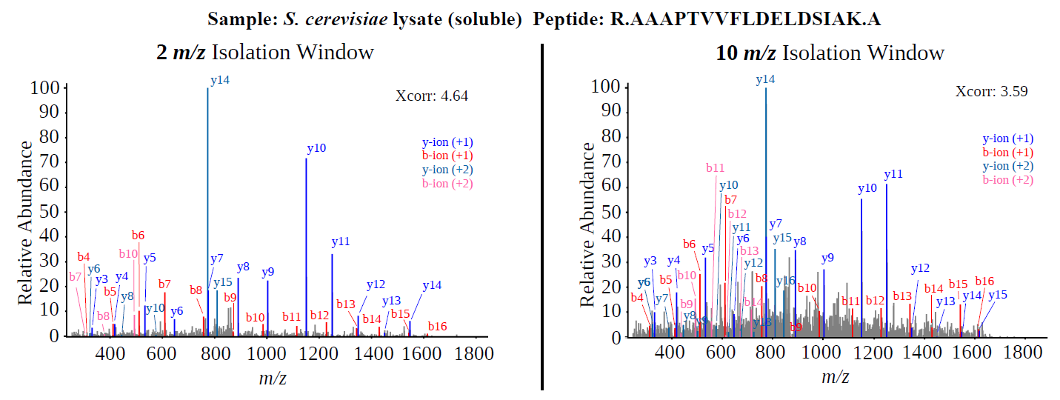
DIA Lacks the Specificity of DDA
2 m/z
10 m/z
Notes:
10 m/z windows 400 – 800 m/z assuming 10 hz scan frequency

Slide 9
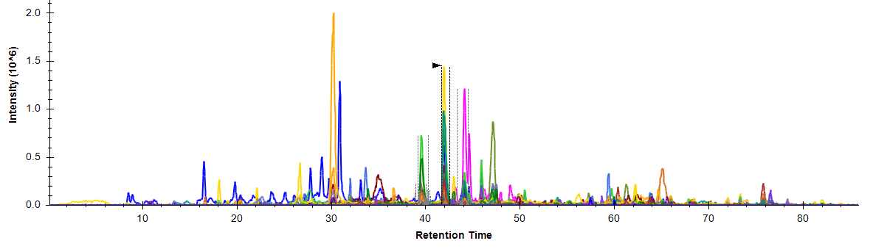
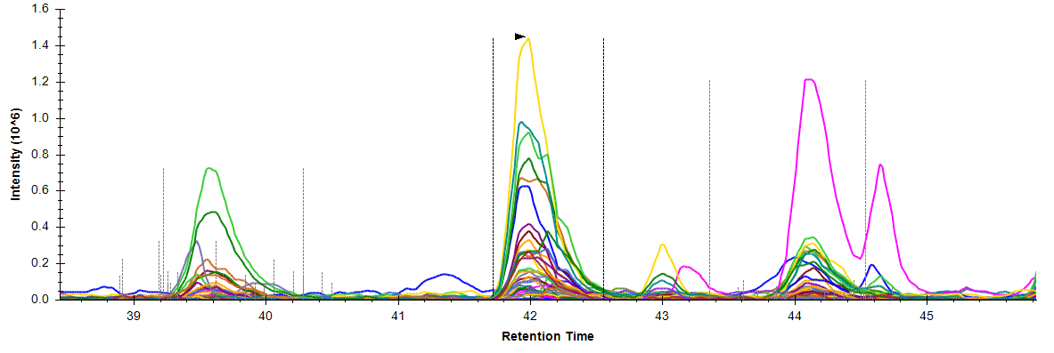
DIA Interference/Low Specificity
FEIELLSLDDDSIVNHEQDLPK S. cerevisiae lysate (soluble) 10 m/z wide window DIA (Q-Exactive)
Notes:
Usually 1,000 – 5,000 peptides identified by MS/MS
Usually ~25,000 – 50,000 MS features detected
2-20% of Features Annotated
BUT Usually only ~70% overlap in annotated features between runs

Slide 10
Multiplexed DIA
100 4 m/z-wide windows = 400 m/z
500
m/z
900
Scan 1
Notes:
Bottom: DIA: 10 m/z wide windows 400 -800 10 hz scan speed
Top: MSX 5 x 2 m/z windows per scan 400 – 800 m/z 10 hz scan speed

Slide 11
Multiplexed DIA
100 4 m/z-wide windows = 400 m/z
500
m/z
900
Scan 1
Notes:
Bottom: DIA: 10 m/z wide windows 400 -800 10 hz scan speed
Top: MSX 5 x 2 m/z windows per scan 400 – 800 m/z 10 hz scan speed

Slide 12
Multiplexed DIA
100 4 m/z-wide windows = 400 m/z
500
m/z
900
Scan 1
Scan 2
Notes:
Bottom: DIA: 10 m/z wide windows 400 -800 10 hz scan speed
Top: MSX 5 x 2 m/z windows per scan 400 – 800 m/z 10 hz scan speed

Slide 13
Multiplexed DIA
100 4 m/z-wide windows = 400 m/z
500
m/z
900
Scan 1
Scan 2
Notes:
Bottom: DIA: 10 m/z wide windows 400 -800 10 hz scan speed
Top: MSX 5 x 2 m/z windows per scan 400 – 800 m/z 10 hz scan speed

Slide 14
Multiplexed DIA
100 4 m/z-wide windows = 400 m/z
500
m/z
900
Scan 1
Scan 2
Scan 3
Notes:
Bottom: DIA: 10 m/z wide windows 400 -800 10 hz scan speed
Top: MSX 5 x 2 m/z windows per scan 400 – 800 m/z 10 hz scan speed

Slide 15
Multiplexed DIA
100 4 m/z-wide windows = 400 m/z
500
m/z
900
Scan 1
Scan 2
Scan 3
. . .
Scan 20
Notes:
Bottom: DIA: 10 m/z wide windows 400 -800 10 hz scan speed
Top: MSX 5 x 2 m/z windows per scan 400 – 800 m/z 10 hz scan speed

Slide 16
Multiplexed DIA
100 4 m/z-wide windows = 400 m/z
500
m/z
900
Scan 1
Scan 2
Scan 3
. . .
Scan 20
Notes:
Bottom: DIA: 10 m/z wide windows 400 -800 10 hz scan speed
Top: MSX 5 x 2 m/z windows per scan 400 – 800 m/z 10 hz scan speed

Slide 17
Multiplexed DIA
100 4 m/z-wide windows = 400 m/z
500
m/z
900
Scan 1
Scan 2
Scan 3
. . .
Scan 20
Notes:
Bottom: DIA: 10 m/z wide windows 400 -800 10 hz scan speed
Top: MSX 5 x 2 m/z windows per scan 400 – 800 m/z 10 hz scan speed

Slide 18
Multiplexed DIA
100 4 m/z-wide windows = 400 m/z
500
m/z
900
Scan 1
Scan 2
Scan 3
. . .
Scan 20
Scan 21
Notes:
Bottom: DIA: 10 m/z wide windows 400 -800 10 hz scan speed
Top: MSX 5 x 2 m/z windows per scan 400 – 800 m/z 10 hz scan speed

Slide 19
Multiplexed DIA
100 4 m/z-wide windows = 400 m/z
500
m/z
900
Scan 1
Scan 2
Scan 3
. . .
Scan 20
Scan 21
Notes:
Bottom: DIA: 10 m/z wide windows 400 -800 10 hz scan speed
Top: MSX 5 x 2 m/z windows per scan 400 – 800 m/z 10 hz scan speed

Slide 20
Multiplexed DIA
100 4 m/z-wide windows = 400 m/z
500
m/z
900
Scan 1
Scan 2
Scan 3
. . .
Scan 20
Scan 21
Notes:
Bottom: DIA: 10 m/z wide windows 400 -800 10 hz scan speed
Top: MSX 5 x 2 m/z windows per scan 400 – 800 m/z 10 hz scan speed

Slide 21
Multiplexed DIA
100 4 m/z-wide windows = 400 m/z
500
m/z
900
Scan 1
Scan 2
Scan 3
. . .
Scan 20
Scan 21
Notes:
Bottom: DIA: 10 m/z wide windows 400 -800 10 hz scan speed
Top: MSX 5 x 2 m/z windows per scan 400 – 800 m/z 10 hz scan speed

Slide 22
Demultiplexing
Intensity
m/z

Slide 23
Demultiplexing
Intensity
m/z

Slide 24
Demultiplexing
Isolation Windows
1
7
28
81
84
Intensity
m/z
Notes:
Bottom: DIA: 10 m/z wide windows 400 -800 10 hz scan speed
Top: MSX 5 x 2 m/z windows per scan 400 – 800 m/z 10 hz scan speed

Slide 25
Demultiplexing
Isolation Windows
1
Intensity
m/z
Notes:
Bottom: DIA: 10 m/z wide windows 400 -800 10 hz scan speed
Top: MSX 5 x 2 m/z windows per scan 400 – 800 m/z 10 hz scan speed

Slide 26
Demultiplexing
Isolation Windows
1
7
28
81
84
Intensity(100) = I1 + I7 + I28 + I81 + I84
Intensity
m/z
Notes:
Bottom: DIA: 10 m/z wide windows 400 -800 10 hz scan speed
Top: MSX 5 x 2 m/z windows per scan 400 – 800 m/z 10 hz scan speed

Slide 27
Demultiplexing
Isolation Windows
3
10
74
75
92
Intensity(99) = I3 + I10 + I74 + I75 + I92
Intensity
m/z
Notes:
Bottom: DIA: 10 m/z wide windows 400 -800 10 hz scan speed
Top: MSX 5 x 2 m/z windows per scan 400 – 800 m/z 10 hz scan speed

Slide 28
Demultiplexing
Intensity(99) = I3 + I10 + I74 + I75 + I92
Intensity(100) = I1 + I7 + I28 + I81 + I84
10 Unknowns
Intensity
m/z
Notes:
Bottom: DIA: 10 m/z wide windows 400 -800 10 hz scan speed
Top: MSX 5 x 2 m/z windows per scan 400 – 800 m/z 10 hz scan speed

Slide 29
Demultiplexing
Intensity(99) = I3 + I10 + I74 + I75 + I92
Intensity(100) = I1 + I7 + I28 + I81 + I84
2
Knowns
10 Unknowns
Intensity
m/z
Notes:
Bottom: DIA: 10 m/z wide windows 400 -800 10 hz scan speed
Top: MSX 5 x 2 m/z windows per scan 400 – 800 m/z 10 hz scan speed

Slide 30
Demultiplexing
Intensity(50) = I3 + I11 + I34 + I35 + I90
…
…
100 Scans
5 Duty
Cycles
~15 seconds
Intensity(99) = I3 + I10 + I74 + I75 + I92
Intensity(100) = I1 + I7 + I28 + I81 + I84
…
…
Intensity(150) = I17 + I44 + I52 + I55 + I99
100 knowns
100 unknowns
Solve by non-negative least squares optimization
Notes:
Bottom: DIA: 10 m/z wide windows 400 -800 10 hz scan speed
Top: MSX 5 x 2 m/z windows per scan 400 – 800 m/z 10 hz scan speed

Slide 31
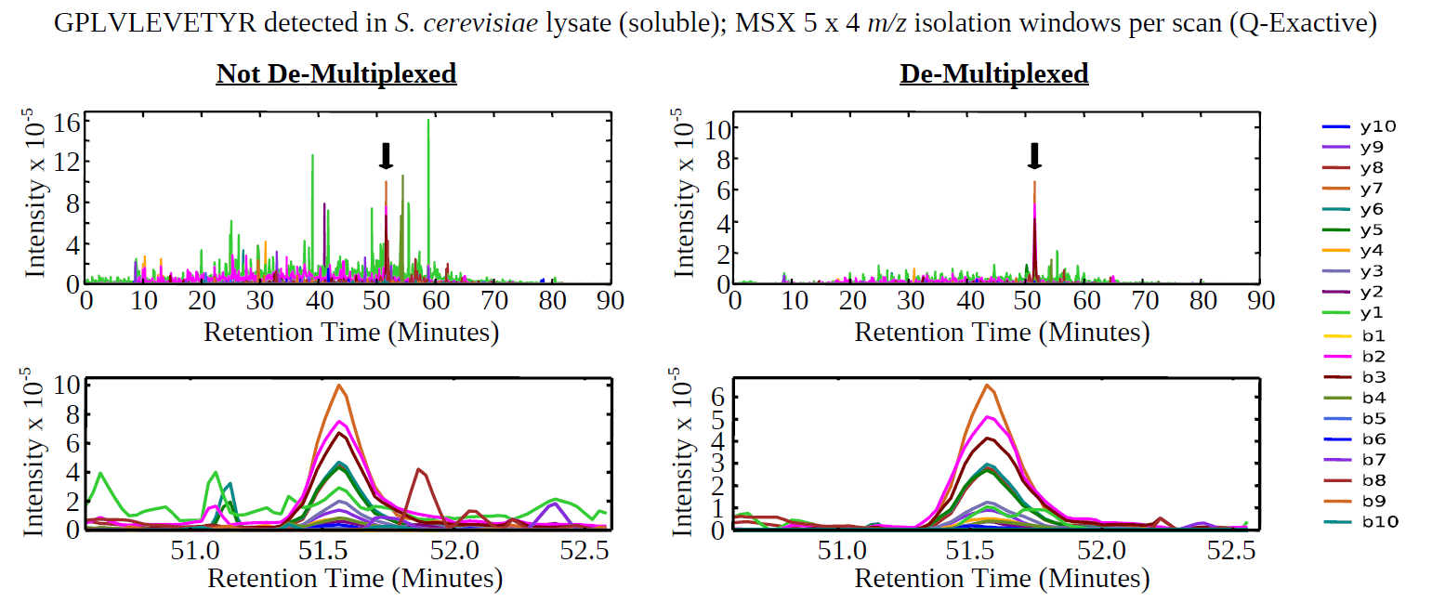
Demultiplexing

Slide 32
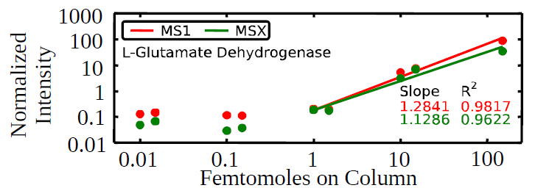
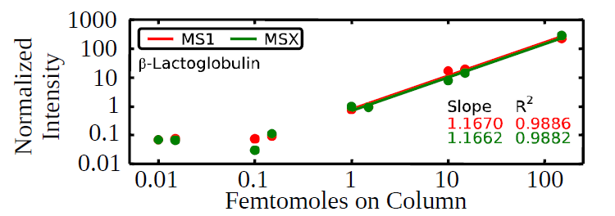
Sensitivity Similar to MS1 Quantification
Bovine proteins spiked into S. cerevisiae lysate (soluble fraction)

Slide 33
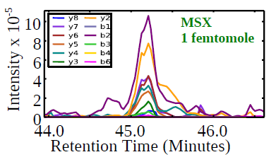
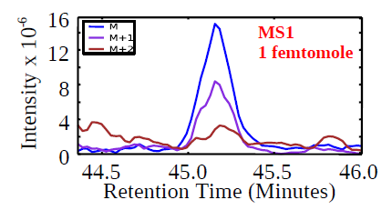
Sensitivity Similar to MS1 Quantification
Bovine proteins spiked into S. cerevisiae lysate (soluble fraction)

Slide 34
Conclusions
DIA data can be multiplexed by mixing precursors prior to fragment ion analysis
MSX de-multiplexing and isolation list export will be included in Skyline v1.3 (http://skyline.maccosslab.org)
A firmware patch is needed to implement this method on the Q-Exactive
  Markus Kellmann (markus.kellmann@thermofisher.com)

Slide 35
Acknowledgments
University of Washington
MacCoss Lab
Gennifer Merrihew
Brendan MacLean
Don Marsh
Other
Ying S. Ting
Nathan Basisty
Thermo Fisher Scientific
Andreas Kuehn
Jesse Canterbury
Markus Kellmann
Vlad Zabrouskov
Wu Lab (University of Pittsburgh)
Nicholas Bateman
Scott Goulding
Sarah Moore
Julie Weisz
Funded by the
National Institutes of Health
Individual F31 fellowship -- F31 AG037265
Yeast Resource Center -- P41 GM103533

