Slide 1
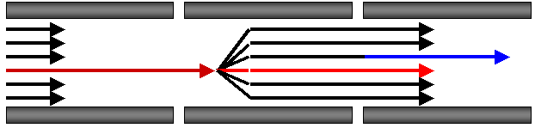

Targeted Proteomics Environment
Status of the Skyline open-source software project four years after its inception
Brendan MacLean
Notes:
Add CPTC and NCI logos to title page?

Slide 2
One Year
2011
NCI funding ending in August
Thursday poster at ASMS
Broke ankle (twice)
Hard drive died
2012
Great new funding
User meeting!
New developers
Progress on multiple fronts

Slide 3







This Meeting
Mike: 20-40 people, under $1000
Sponsors
150+ people registered!

Slide 4
User Community After 4 Years
570 registered users
4 new papers in May
Platform Independent and Label-free Quantitation of Proteomic Data using MS1 Extracted Ion Chromatograms in Skyline – Mol. Cel. Prot.
Label-Free Quantitation of Protein Modifications by Pseudo-Selected Reaction Monitoring with Internal Reference Peptides – J. Prot. Res.
Using iRT, a Normalized Retention Time for More Targeted Measurement of Peptides - Proteomics
The Development of Selected Reaction Monitoring Methods for Targeted Proteomics via Empirical Refinement - Proteomics
25 abstracts at ASMS mention Skyline
75 citations of original paper (after 2 ½ years)
30 in 2012

Slide 5
Software Development After 4 Years
Strong professional development team
Grad student contributions
Jarrett Egertson
Undergraduate internship program
Shannon Joyner – Carnegie Melon University
Daniel Broudy – Harvard University
Growing outside contributions
Matthew Chambers – Tabb Lab – Vanderbilt
Lucia Espona Pernas – Aebersold Lab – ETH
David Cox – AB SCIEX
Kevin Crowell – PNNL

Slide 6
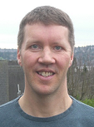
Brendan MacLean
Lead developer and architect
20+ years of professional software development
Big companies (Microsoft & BEA)
Small companies (Westside & LabKey)
Academia (Fred Hutchinson & U. of Washington)
9 years of proteomics
Focus
Experimental structure
All things Skyline…

Slide 7
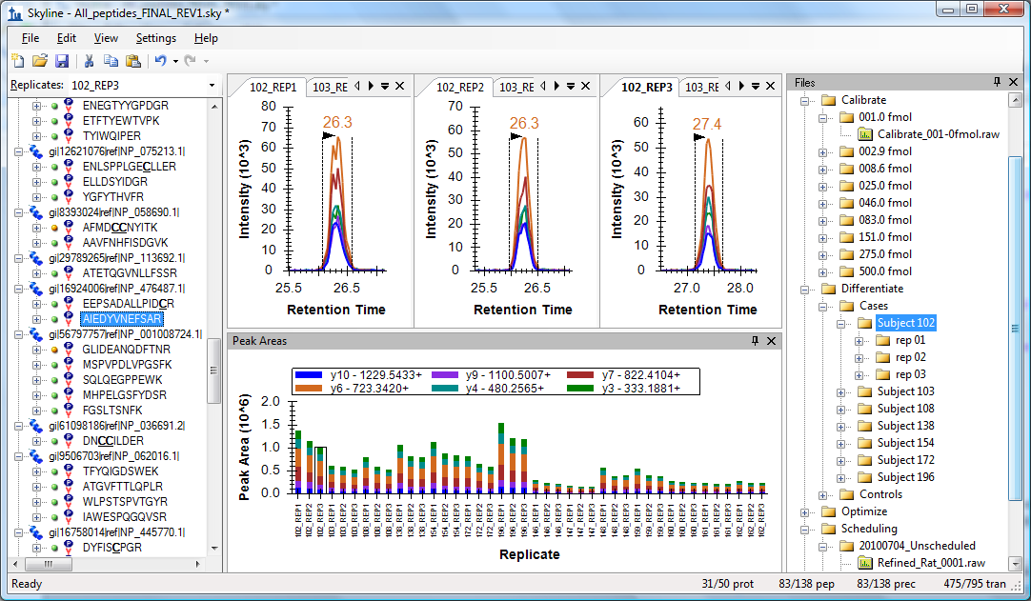
Skyline File View

Slide 8
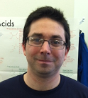

Nick Shulman
17 years of professional software development
5 years at Microsoft & 12 years with Brendan
Creator of
Custom reports & Results grid
Custom annotations
Background proteomes
Topograph – protein turnover
Focus – Peak Integration
Retention time alignment for MS1 filtering
mProphet algorithm
Nick Shulman – Wednesday AM – WP 423

Slide 9
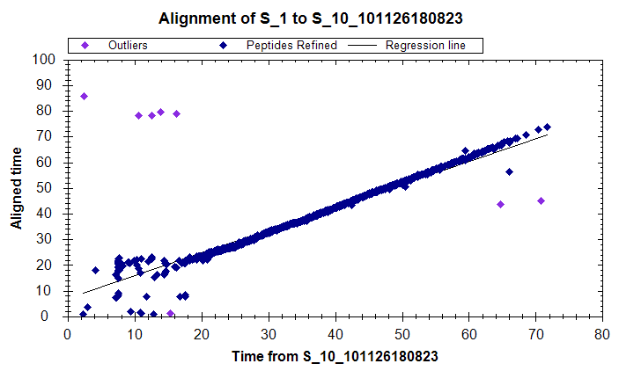
MS1 Filtering Retention Time Alignment
Aligning by linear regression of MS/MS peptide IDs

Slide 10
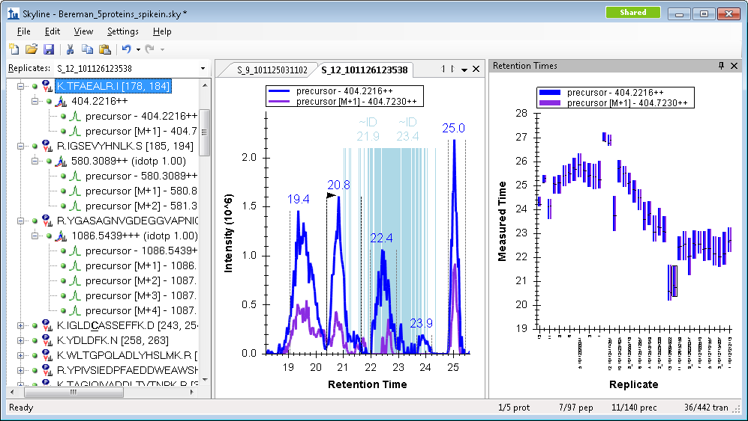
MS1 Filtering Retention Time Alignment

Slide 11
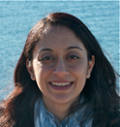

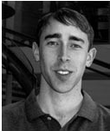
Vagisha Sharma
6 years of professional software development
All in proteomics
4 years on proteomics repositories
Focus
In collaboration with Josh Eckels at LabKey Software
WP 407 - Vagisha Sharma
A private repository of targeted proteomics assays for Skyline

Slide 12
Panorama Peptide Details View

Slide 13

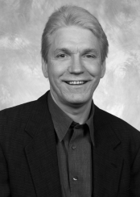
Don Marsh
35 years of professional software development
Big companies – Apple and Microsoft
Medium – Tagilent and Stride Micro
Co-founder of two start-up companies, one acquired by Microsoft
Contributed: 64-bit Skyline and DIA Isolation Schemes
Lots of stress testing
Focus
Full-scan filtering
Performance
ESP peptide response prediction
In collaboration with Steve White at Microsoft

Slide 14
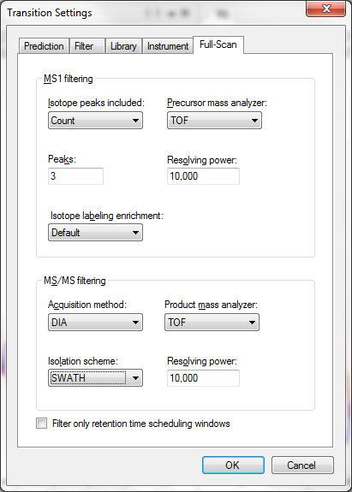
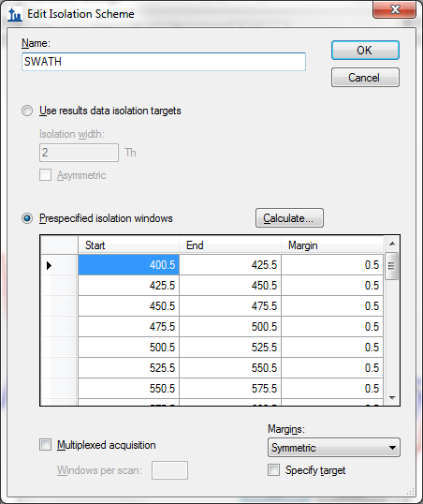
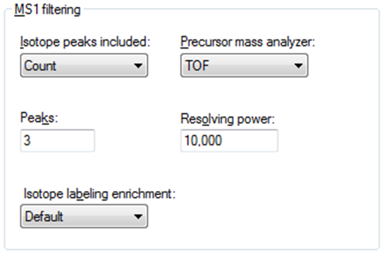
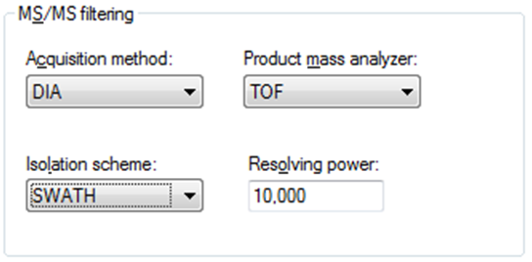
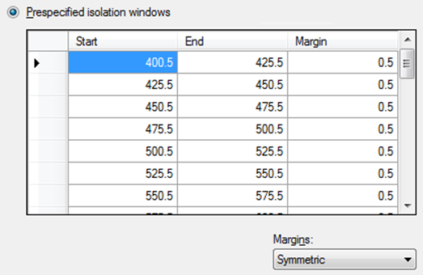
Skyline AB SCIEX SWATH™ Settings (32 x 25 m/z Extraction Windows)
Gillet, L.C. et al. Mol. Cell. Prot. 2012.

Slide 15
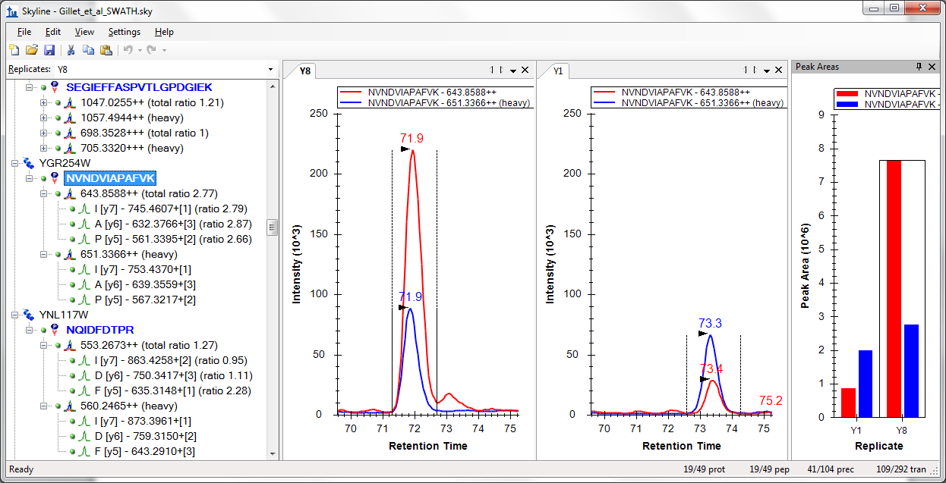
AB SCIEX SWATH™ Data
Gillet, L.C. et al. Mol. Cell. Prot. 2012.

Slide 16
Quantitative Proteomics
Spectrum-based
Spectral counting
Isobaric tags
Chromatography-based
SRM SRM: 220 abstracts, MRM: 390 abstracts
MS1 chromatogram extraction
Targeted MS/MS
Data independent acquisition (DIA) DIA: 9 abstracts, SWATH: 18 abstracts

Slide 17
2010 Support Multiple Instrument Vendors
SRM
Exporting transition lists & native methods
Importing native instrument output files
AB SCIEX
Agilent Technologies
Thermo-Scientific
Waters

Slide 18
2012 Support Multiple Instrument Vendors
Full-Scan
Exporting isolation lists & native methods
Importing native instrument output files
AB SCIEX
Agilent Technologies
Thermo-Scientific
Waters

Slide 19

2012 Support Multiple Instrument Vendors
Full-Scan
Exporting isolation lists & native methods
Importing native instrument output files
AB SCIEX SWATH™
Agilent Technologies DIA
Thermo-Scientific DIA & Multiplexed DIA
Waters MSe™
WOA 10am - Brendan MacLean
Targeted Proteomics Quantitative Analysis of Data Independent Acquisition MS/MS in Skyline

Slide 20
New Full-Scan Features for v1.2 (February)
Integrated display of MS/MS peptide ID spectra in MS1 chromatograms
Peak picking in MS1 chromatograms based on MS/MS peptide ID
Improved memory performance for full-scan chromatogram extraction
New isotope dot-product score on MS1 full-scan filtered peaks, and expected relative isotope abundance in peak area plot and reports
Faster MS/MS library loading
Method export for Thermo and AB SCIEX
Thermo Q Exactive data support

Slide 21
New Features for v1.2 (February)
Command-line interface
More accurate retention time prediction with integrated iRT support
New enhanced Find with Find All
Unexpected error form

Slide 22
New Features for v1.3 (June)
Advanced support for data independent acquisition (DIA)
AB SCIEX SWATH™
Agilent DIA
Thermo Multiplexed DIA
Waters MSe™
64-bit version with higher memory limits
Retention time alignment for MS1 filtering
Auto-detect modifications in Spectral Library Explorer
Decoy peptide and transition generation for FDR based peak picking

Slide 23
New Features for v2.1 (Fall)
Panorama support
Full-scan mass accuracy
Data import performance
Customizable Tools menu
New algorithms
mProphet probability based peak picking
ESP peptide response prediction
Experiment structure with File View
Quantitative statistics
Experiment statistics
Agilent tMRM and Thermo iSRM support

Slide 24
Acknowledgments:
Skyline Team (emeriti)
Eva Baker
John Chilton
Gregory Finney
Barbara Frewen
Mimi Fung
Randall Kern
Alana Killeen
Daniela Tomazela
Broad Institute
Sue Abbatiello
Steve Carr
Jake Jaffe
Duke
Will Thompson
Arthur Moseley
Buck Institute
Birgit Schilling
Matthew Rardin
Brad Gibson
IMSB
Rudolph Aebersold
Ludovic Gillet
Christina Ludwig
Vanderbilt
Matthew Chambers
Amy Ham
Daniel Liebler
AB Sciex
Fadi Abdi
David Cox
Christie Hunter
Brent Lefebvre
Agilent Technologies
Christine Miller
Joe Roark
Pat Perkins
Thermo-Scientific
Markus Kellmann
Andreas Kuehn
Vlad Zabrouskov
Waters
Laurence Firth
James Langridge
Roy Martin
Kieran Neeson
Keith Richards
This work is funded by grants from NIH/NIGMS, NIH/NHGRI, Agilent Technologies and Thermo-Fisher Scientific.

