Slide 1
Effective design of multiplexed quantitative SRM assays with Skyline
Joseph Brown, Ph.D.
Pacific Northwest National Laboratories
Minneapolis, MN; Skyline Workshop; 61st ASMS
Notes:
As the first talk in this series, I’m going to tell you about how we use Skyline in our lab from an introductory perspective that I hope will be useful for researchers who are new to SRM and are thinking about beginning SRM experiments in their lab or currently using SRM but are not taking advantage of Skyline. I will discuss some capabilities in Skyline that we use in our targeted experiments from the initial stages of designing the experiment through to the later stages of analysis. While I believe the our approach is ‘Effective’ as indicated in the title, we are always looking for better ways to be more effective and this is still work in progress.

Slide 2
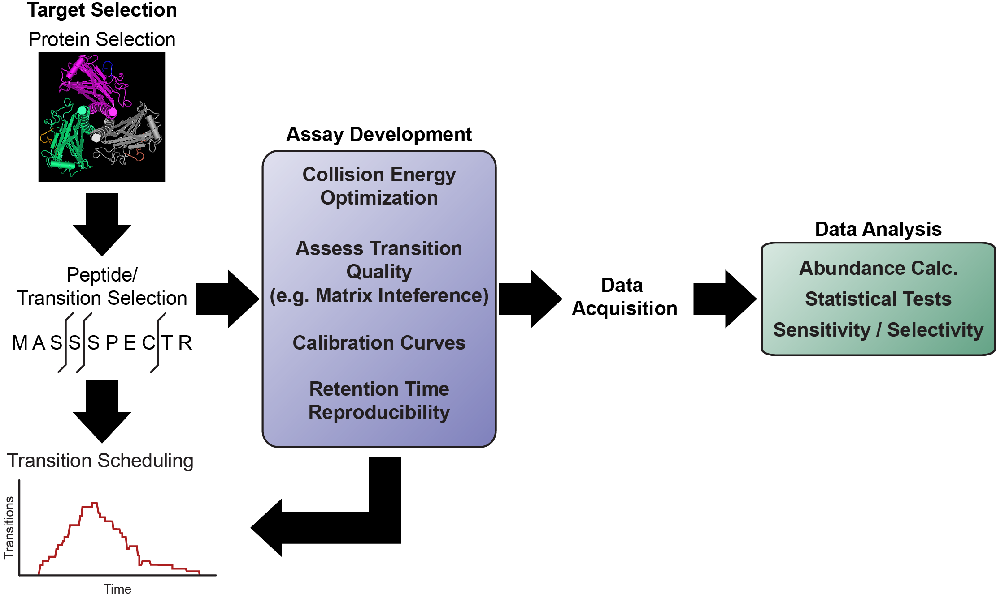
SRM pipeline flowchart
Notes:
Let me just start off with a broad, 30,000 ft view at a generic SRM pipeline or workflow that we’ve setup in our lab. In designing SRM experiments, we always come into an SRM experiment with a list of protein targets, and from this list we need to select the optimal peptides and from those peptides the optimal fragments or transitions to monitor by LC-SRM. We initially cast a relative large net in the selection process (6-7 peptides per protein), and focus in on 2 peptides per protein and 3 transitions per peptide.
SRM provides for multiplexing and in these situations, you need to carefully plan and schedule the transitions you monitor across the entirety of the LC gradient, and I will talk to you about how Skyline can help you with that. Transition scheduling also falls under the umbrella of Assay Development.
I’ll discuss this process in more detail in the next few slides. While these steps could be addressed separately, Skyline helps researchers progress through this pipeline be combining steps that contain overlap. For example, the process of peptide and transition selection also includes transition scheduling, i.e. when to monitor each transition across your LC gradient. This step is very important in multiplexed SRM experiments because the duty cycle of your instrument allows use to only measure a finite number of transitions at any particular time in the gradient.
Collision energy optimization is a step that we explore to increase sensitivity, which is especially important for those low abundance proteins. We also assess the quality of our selected transitions in both buffer and in the sample for potential interference.
When all these parameters have been optimized, we are ready to run the experiment and acquire the data. If care is taken in all the up-front work, that makes the data analysis is

Slide 3
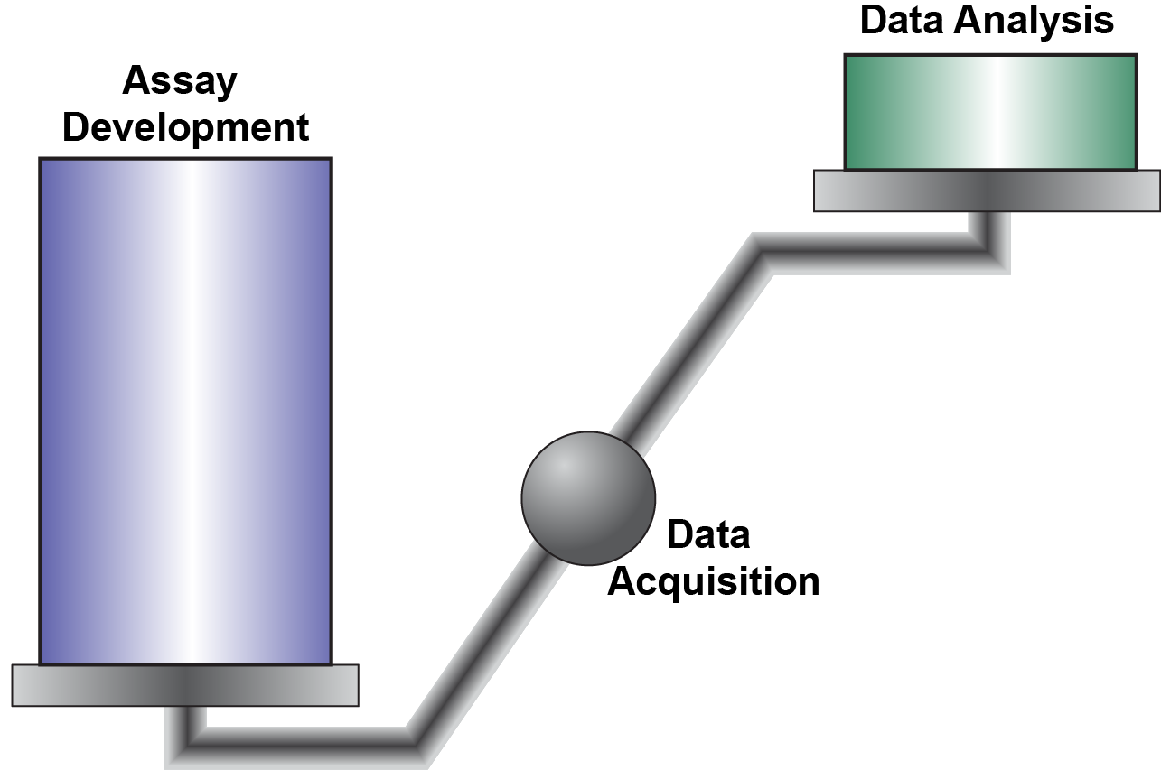
Investing on assay development simplifies data analysis
Notes:
If you think of an SRM experiment as a balance, the data acquisition is the pivot point that separates the assay development from the data analysis.
Spending the time up-front to really optimize your target transitions, will significantly ease the burden of down-stream data analysis and Skyline has really helped us out a lot in the steps involved in the assay development phase.

Slide 4
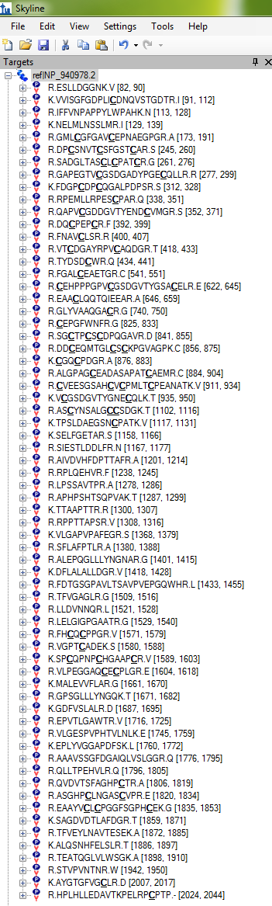
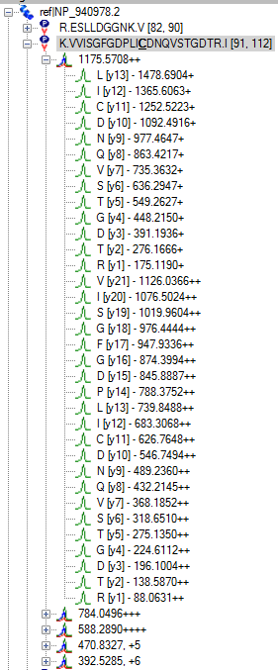
How do you choose the “best” transition, or is an “OK” transition sufficient?
Prior Knowledge
Previous Experiments
Public Databases
NIST
PeptideAtlas
GPM
Prediction Software
SRM Collider
Peptides
Transitions
Notes:
We’ve found the most challenging aspects of SRM development to be in the design phase, choosing the best list of transitions to monitor for each target protein. For any given protein, there are typically a large number of transitions to choose from, so the question is how do you choose the “best” transition to monitor or is an “OK” transition sufficient for your protein target? For low abundant proteins or proteins that are difficult to detect by mass spec, we want to monitor the best transitions and we want to optimize as much as possible on those transitions.
So, having this kind of prior knowledge about the protein is important and facilitates peptide selection, and to some extent, the fragment ions to monitor. We typically select our list of proteins from a previous global-study and we have a large repository to pull from, so this information is available for us, but we also look at public databases such as NIST, PeptideAtlas, and GPM to influence our selection.
We also inspect the peptides by triple quad by MS/MS to
With target proteins identified, in some instances we have observed peptides for these proteins in previous experiments, and in other instances we will have protein targets

Slide 5
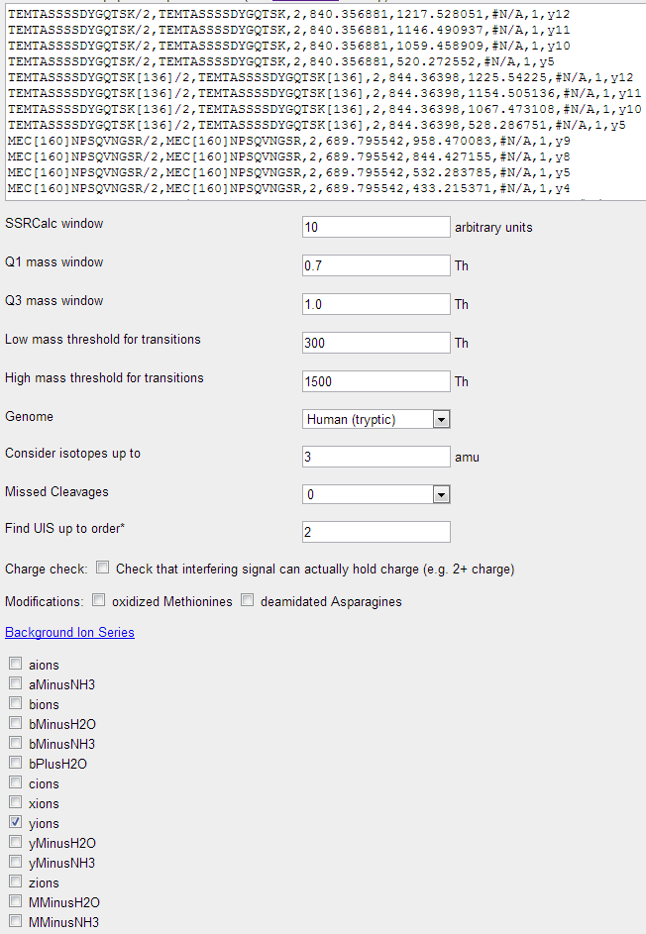
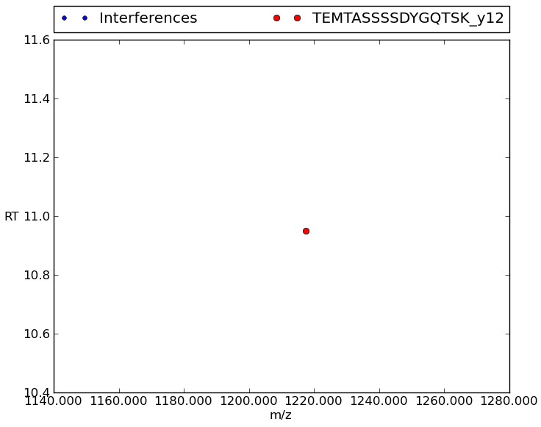
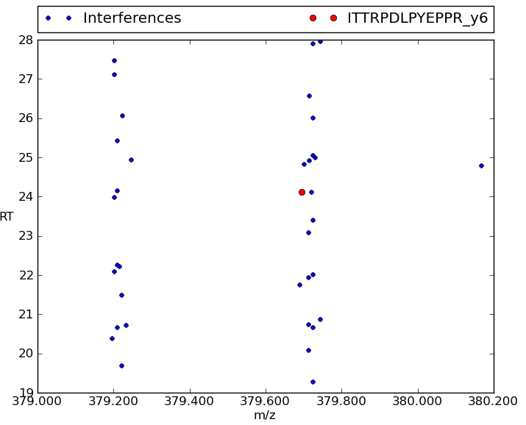
SRM Collider to predict potential matrix interferences
Notes:
Note: check ‘SRM Collider’ or ‘SRMCollider’
Skyline provides a link to SRM Collider webservice, which we’ve found to be helpful in predicting if certain transitions will be affected by interference in a given sample.
automatically formats your transition information and enters it into the SRMCollider input text field.

Slide 6
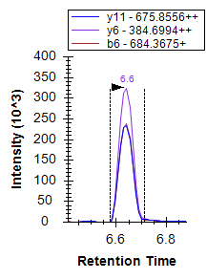
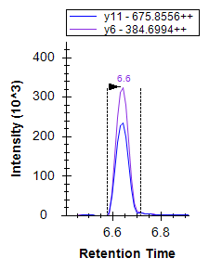
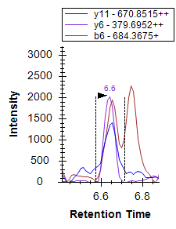
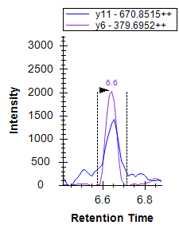
Assessing matrix interference
Heavy
Remove b6-ion
Interfering Peak
Light
Notes:
Here is an example of what matrix interference looks like, in the light b6 transition. To orient you to the slide, we are looking at XICs for 3 transitions corresponding to the heavy peptide variant on top and light variant on bottom. You’ll notice a neighboring peak in the light b6 channel. Because interferences from the matrix can influence your measurements, we remove these transitions in Skyline, which is as easy as selecting the transition and clicking delete. Other transitions can easily be added to substitute for the bad transitions.
Now, you can manually go through and look at each individual peak, or Skyline can package your data up for easy import into QUASAR, which includes a program called AUDIT that uses t-test and covariance in your transition measures to make a “good” or “bad” call for each of your transitions. This is very helpful if your dealing with many transitions, and you want to quickly narrow down on a small set of transitions to inspect visually.

Slide 7
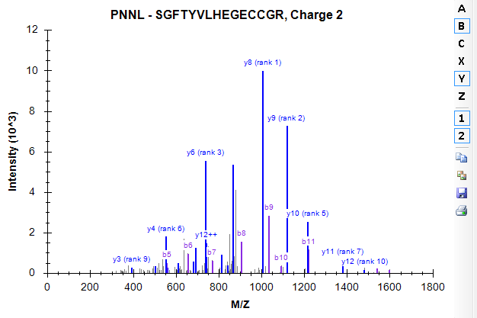
Spectral libraries visualization through Skyline
Notes:
Skyline allows you to easily inspect a representative MS/MS spectrum for your peptide of interest, which can influence our choice of transition to monitor. We typically use Skyline to build a spectral library from our MS/MS search results, and then we can interrogate that library for our target peptide.
We typically look specifically at y-ions, so in this spectrum that I’m showed, we would choose to monitor the y8, y9, and y6 ions for SRM. Y7 is the rank 4 ion, which is colored but not labeled in this particular view. The label will show up as the window is expanded.

Slide 8
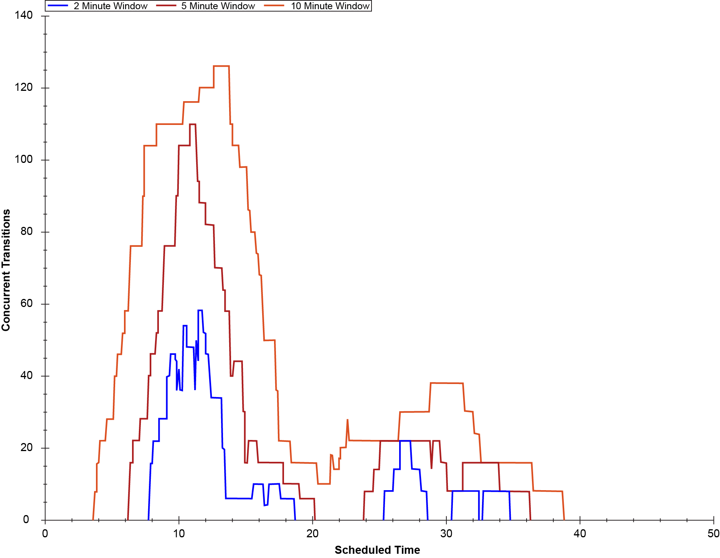
Transition scheduling
Notes:
When selecting transitions to monitor, it is important to consider scheduling. We use Skyline to help us schedule our transitions over the course of the elution gradient, so we don’t monitor too many transitions at any particular time. Skyline plots a transition scheduling histogram so we can see the number of concurrent transitions across the scheduling space and adjust the transition window accordingly. In this plot, Skyline shows the concurrent transitions for 3 windows (2 min in blue, 5 min in red, and 10 min in orange). If you’re color-blind and cannot distinguish between these colors, you can turn these window sizes off and on to select the best window for your experiment. We typically aim for at least 10 sampling points for each transition over the elution peak.

Slide 9
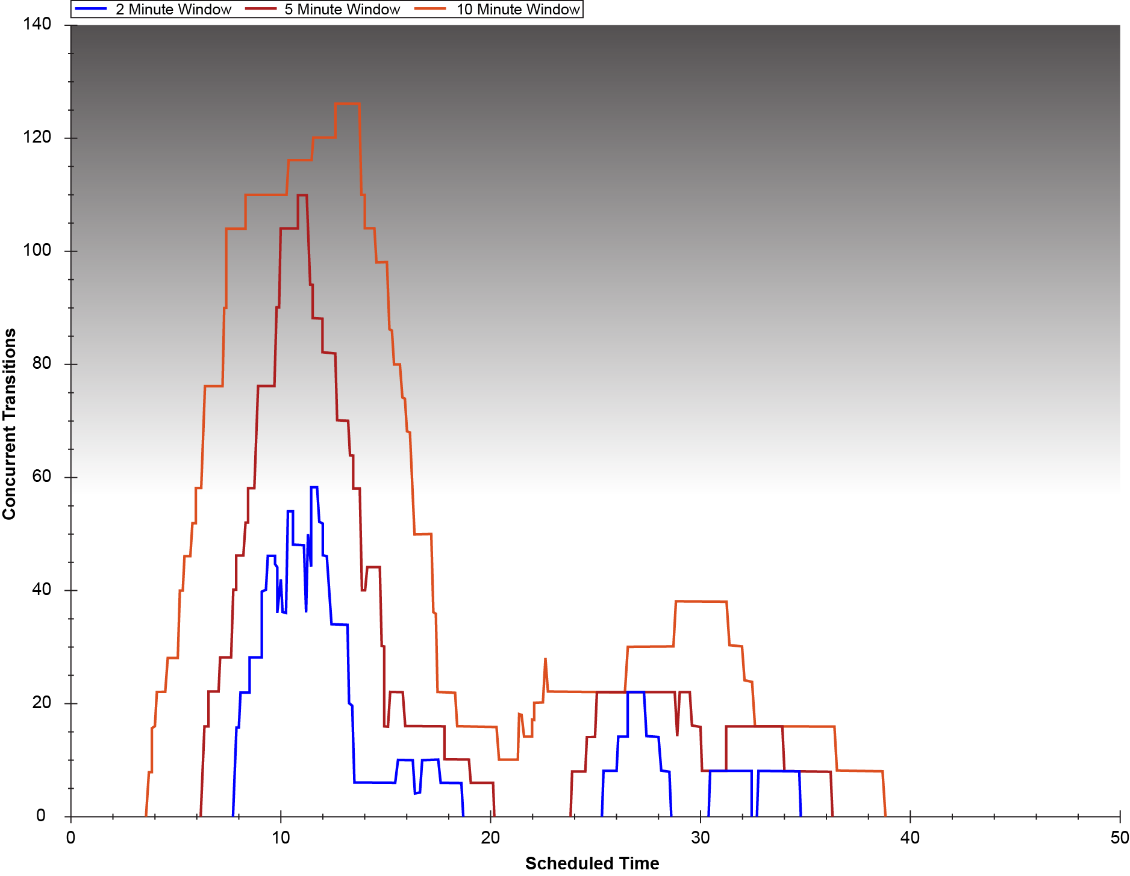
Transition scheduling
Notes:
Which means, we try to schedule no more than 60 concurrent transitions at any particular time, as a general rule of thumb. However, I’ve shaded the upper region with a gradient, because we don’t have a hard-fast cutoff and it really depends on the circumstances and different users have different adjust this up or down to match up with their objective.

Slide 10
Collision energy optimization
Precursor | Product ion | Ramping CE
504.2363 | 613.3043 | 11.3
504.2363 | 613.3043 | 12.3
504.2363 | 613.3043 | 13.3
504.2363 | 613.3043 | 14.3
504.2363 | 613.3043 | 15.3
504.2363 | 613.3043 | 16.3
504.2363 | 613.3043 | 17.3
504.2363 | 613.3043 | 18.3
504.2363 | 613.3043 | 19.3
504.2363 | 613.3043 | 20.3
504.2363 | 613.3043 | 21.3
Precursor | Product ion | Ramping CE
504.2363 | 243.8715 | 11.3
504.2363 | 243.8715 | 12.3
504.2363 | 243.8715 | 13.3
504.2363 | 243.8715 | 14.3
504.2363 | 243.8715 | 15.3
504.2363 | 243.8715 | 16.3
504.2363 | 243.8715 | 17.3
504.2363 | 243.8715 | 18.3
504.2363 | 243.8715 | 19.3
504.2363 | 243.8715 | 20.3
504.2363 | 243.8715 | 21.3
Precursor | Product ion | Ramping CE
504.2363 | 874.3346 | 11.3
504.2363 | 874.3346 | 12.3
504.2363 | 874.3346 | 13.3
504.2363 | 874.3346 | 14.3
504.2363 | 874.3346 | 15.3
504.2363 | 874.3346 | 16.3
504.2363 | 874.3346 | 17.3
504.2363 | 874.3346 | 18.3
504.2363 | 874.3346 | 19.3
504.2363 | 874.3346 | 20.3
504.2363 | 874.3346 | 21.3
-2
-1
-3
0
-3
-4
+1
-4
-2
-1
+2
-5
-5
0
+3
-2
-1
0
+1
-3
+1
+2
+4
+2
+5
-4
+3
-5
+3
+4
+4
+5
A Composite Scan 3 transitions / 11 CEs
Notes:
While we can predict the optimal collision energy for a peptide based on its sequence, we typically use that predicted value as a guidepost to increment around to optimize collision energies for individual transitions. Here I’m showing an example of how we used to manually optimize for 3 transitions (colored red, green, and yellow) of a peptide. We are incrementing around 21.3 V, and we would basically construct a composite scan for the transitions, and select the highest peak for each individual transition.

Slide 11
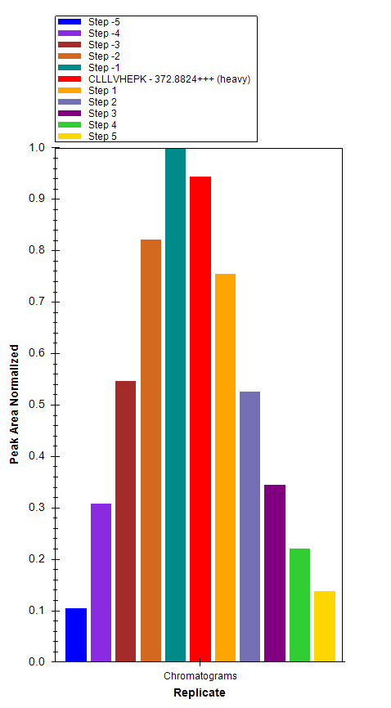
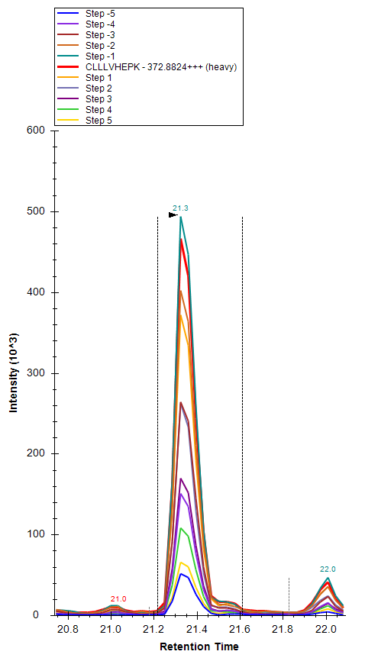
Skyline automates collision energy optimization
Notes:
Skyline provides a workflow to perform the same procedure in an automated way, and make a lot of use of this workflow in our group. Again, Skyline iteratively increments around a predicted optimal CE, allows you to visualize the peak areas for a given transition/CE to select the CE that provides the greatest signal.
Now, I’m going to transition over to applications, and discuss some options that we have explored in our lab for downstream data analysis, such as the hypothesis test.

Slide 12
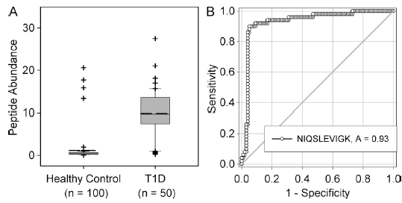
Peptide distinguishes T1D from healthy control
Platelet basic protein abundance in human serum
Zhang et al. 2013 J Exp Med.
Notes:
Here is an example, that was recently published in J Exp Med were Qibin Zhang in our group found a statistically significant increase in a peptide corresponding to platelet basic protein

Slide 13


Increased fractionation with PRISM-SRM facilitates deep-dive approach
High-pressure, high-resolution separations coupled with intelligent selection & multiplexing
On-line monitoring
heavy peptides
3 µm, C18 column
(200 µm i.d. × 50 cm)
Q1
Q2
Q3
Capillary LC (high pH)
QQQ MS
#2
#6
#10
Time (min)
96 well plate
iSelection
Fraction multiplexing
SRM Signal
1.7 µm, C18 column
(75 µm i.d. × 25 cm)
Q1
Q2
Q3
Nano LC (low pH)
QQQ MS
Conventional SRM analysis
Time (min)
Shi et al. 2012 PNAS
Notes:
A common technique used in our lab to dive deeper into the proteome and quantify those very low abundance proteins is PRISM, which stands for high-pressure, high-resolution separations coupled with intelligent selection and multiplexing. This approach uses offline fractionation coupled with online monitoring of ~10% of the sample. The online monitoring is then used to identify the fraction to go back to for further separation and analysis with conventional SRM analysis.

Slide 14
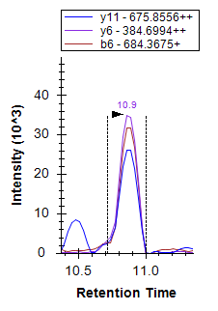
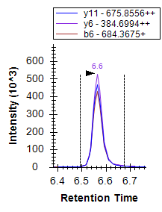
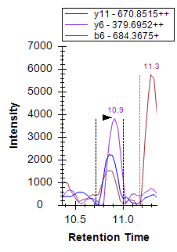
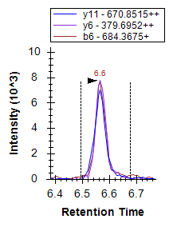
Use Skyline to visualize and inspect fractions
ITTRPDLPYEPPR
Conventional SRM
PRISM-SRM
Increased S/N
Reduced Interference

Slide 15
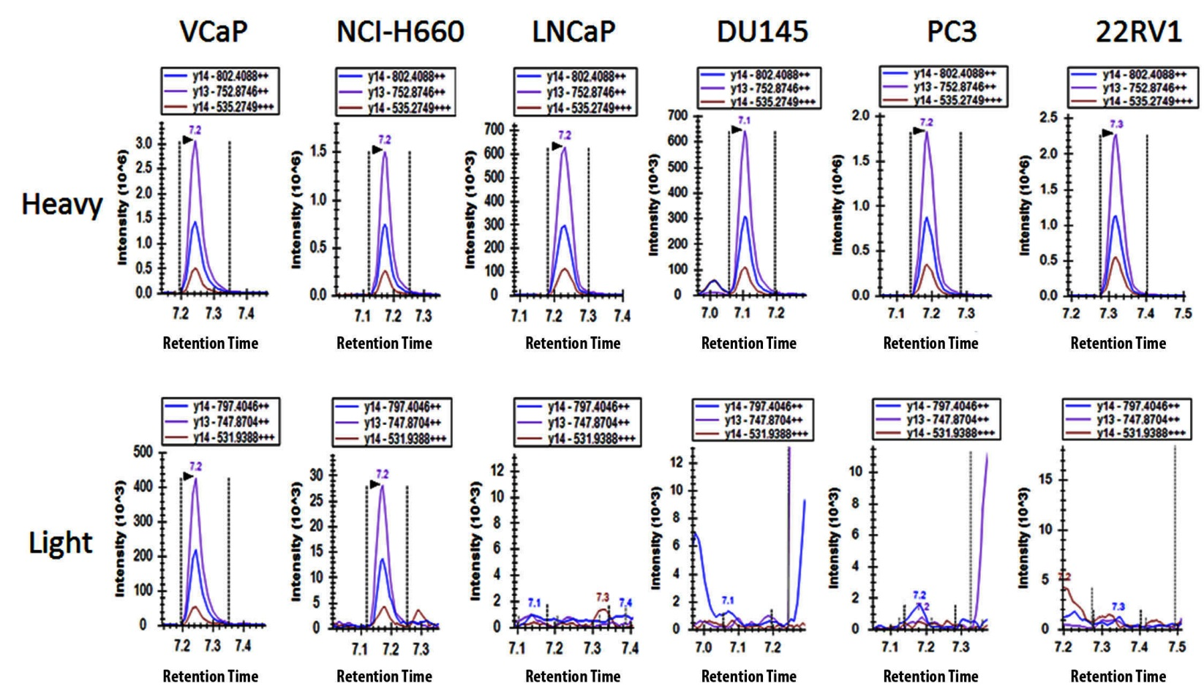
Detection of an ERG peptide in TMPRSS2-ERG positive vs negative prostate cancer cell lines
VIVPADPTLWSTDHVR
(+)
(+)
(-)
(-)
(-)
(-)
N.D.
N.D.
N.D.
N.D.

Slide 16
Acknowledgments
Tao Liu
Weijun Qian
Tujin Shi
Tom Fillmore
Qibin Zhang
Chaochao Wu
Jintang He
Yuqian Gao
Tom Metz
Sam Payne
Gordon Anderson
David Camp
Karin Rodland
Dick Smith

Slide 17
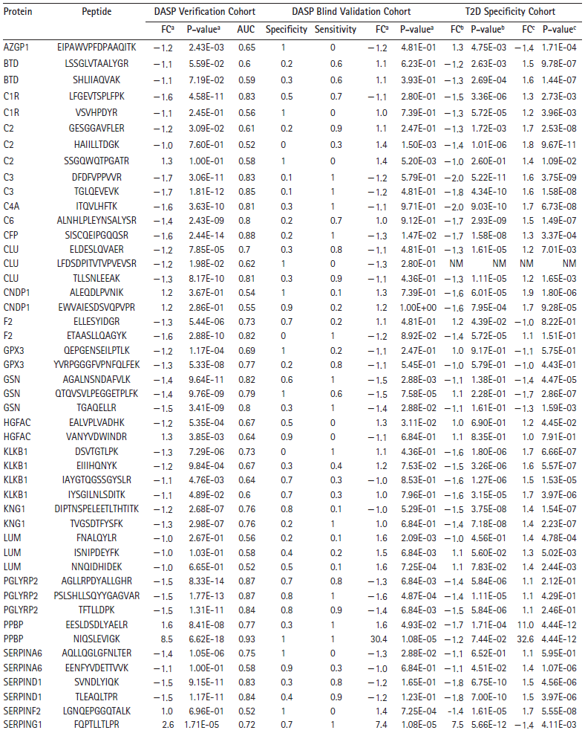
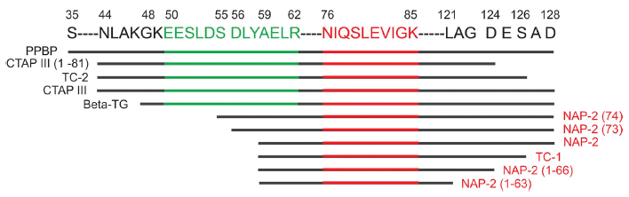
T1D-specific peptide
Pro-platelet basic protein
100 HC, 50 T1D
10 HC, 10 T1D
50 T2D
1.6
8.5
Zhang et al. 2013 J Exp Med.

