Slide 1
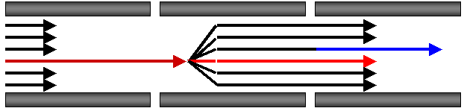

Targeted Proteomics Environment
Status of the Skyline open-source software project five years after its inception
Brendan MacLean
Notes:
Add CPTC and NCI logos to title page?

Slide 2
User Community After 4 Years
560 registered users
150 registered for this meeting
4 new papers in May
Platform Independent and Label-free Quantitation of Proteomic Data using MS1 Extracted Ion Chromatograms in Skyline – Mol. Cel. Prot.
Label-Free Quantitation of Protein Modifications by Pseudo-Selected Reaction Monitoring with Internal Reference Peptides – J. Prot. Res.
Using iRT, a Normalized Retention Time for More Targeted Measurement of Peptides - Proteomics
The Development of Selected Reaction Monitoring Methods for Targeted Proteomics via Empirical Refinement - Proteomics
25 abstracts at ASMS mention Skyline
75 citations of original paper (after 2 ½ years)
30 in 2012

Slide 3
User Community After 5 Years
1000+ registered users
250 registered for this meeting
More papers and press
Targeted proteomics Nature Methods Method of the Year in 2012
MS1 Label-free Quantification Using Ion Intensity Chromatograms in Skyline (Research and Clinical Applications) (book chapter)
Design, Implementation, and Multi-Site Evaluation of a System Suitability Protocol for the Quantitative Assessment of Instrument Performance in LC-MRM-MS - MCP
Viewing the Targeted Proteomics Horizon with Skyline – eProtein feature
37 abstracts at ASMS mention Skyline
200+ citations of original paper

Slide 4
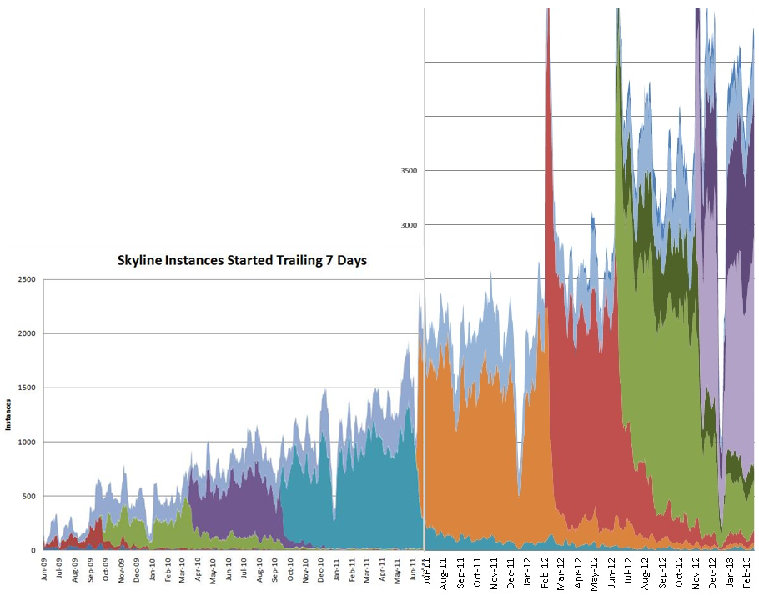
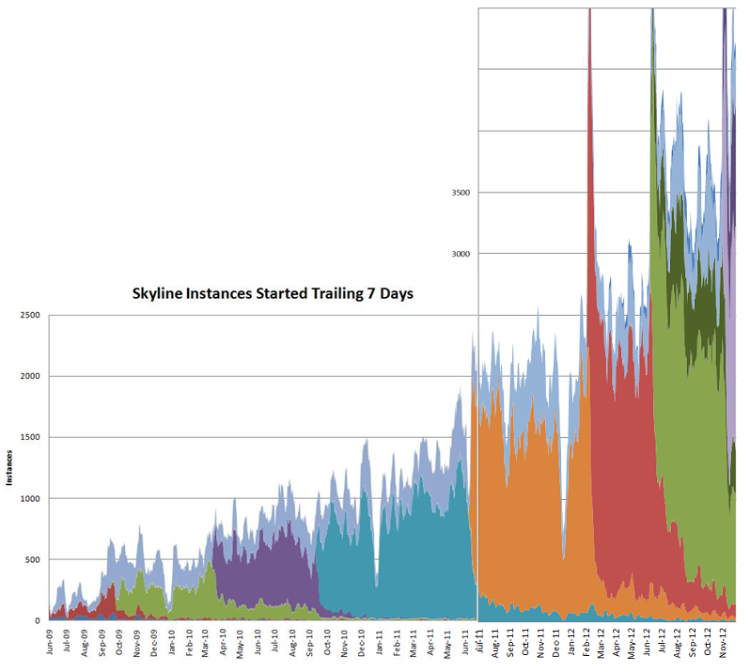
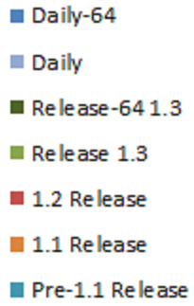
Skyline Use
5000
4500
4000
ASMS
2012
3500
Skyline Instances Started Trailing 7 Days
3000
2500
ASMS
2011
Dev 64 Release
Dev Release
2000
1.3 64 Release
ASMS
2010
1.3 Release
1500
Panorama
2013
Instances
1.2 Release
1000
1.1 Release
500
Pre-1.1 Release
0

Slide 5
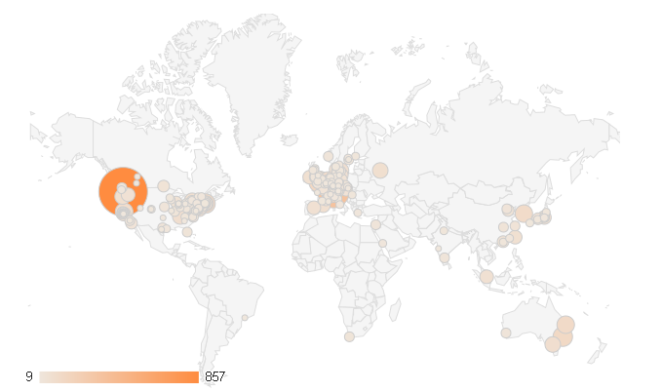
Skyline Web Site Visits (past 3 months)

Slide 6
Learning More
Au PS Workshop, Melbourne (February)
US HUPO Workshop, Baltimore (March)
Skyline User Group Meeting! here (now)
SRM Course, Zurich (July)
Proteomics Course, Cold Springs Harbor (July)
Targeted Quant. Course, Seattle
September 9-14

Slide 7




Instrument Vendor Partnerships

Slide 8

Panorama Partnership Program
2 – 4 labs
Seeking leading edge targeted proteomics infrastructure
Local Panorama server installation
Direct collaboration with Skyline/Panorama team
Full support for 1 year

Slide 9
Prior Knowledge and Consistency
Powerful enough to be used cross-lab / cross experiment
More powerful run-to-run
Relative ion abundance
Spectral and chromatogram libraries
Retention time
iRT
Does ensuring comparable measurements require ID?
Notes:
Confidence in what is being measured

Slide 10
Haptoglobin
LQTEGDGIYTLNSEK

Slide 11
Haptoglobin
LQTEGDGIYTLNSEK
SVVDIGLIK

Slide 12
Mitochondrial 39S ribosomal protein L9
CSSLLWAGAAWLR

Slide 13
Mitochondrial 39S ribosomal protein L9
CSSLLWAGAAWLR
SVVDIGLIK

Slide 14
CSSLLWAGAAWLR
H_159_REP1
D_138_REP3

Slide 15
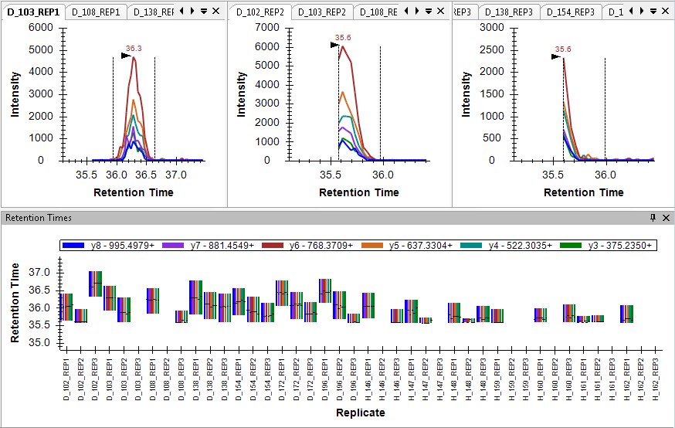
Truncated and Missing Peaks
TGTNLMDFLSR

Slide 16
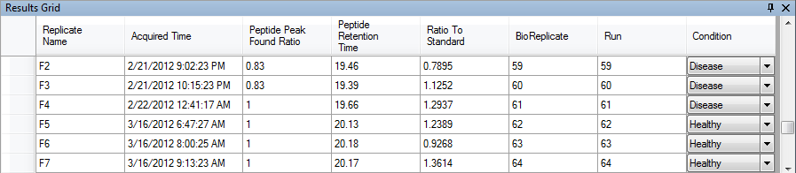
Deciphering the Unexpected
YGQTIRPICLPCTEGTTR
17 to 22-Feb-2012
16 to 17-Mar-2012

Slide 17
Aligned by iRT
YGQTIRPICLPCTEGTTR

Slide 18
Integrating with External Tools
GeneSpring & Skyline Automation Tool (Agilent)
MSstats (Purdue) – Grouped study analysis
QuaSAR (Broad Institute) – Response curves, LOD, LOQ
MS1 Probe (Buck Institute) – MS1 quant. statistics
TP28 – Alexandria D’Souza
SRM Collider (IMSB) – Interference probability calculator

Slide 19
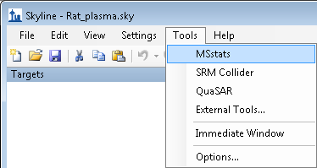
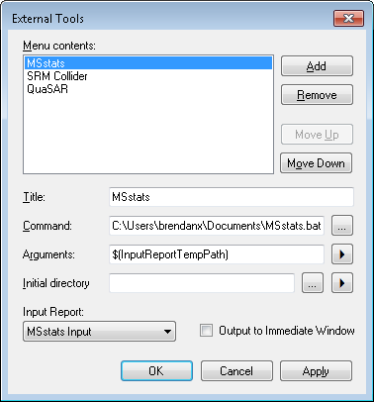
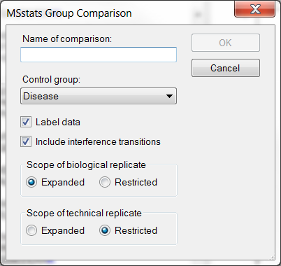
External Tool MSstats

Slide 20
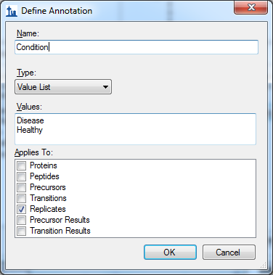
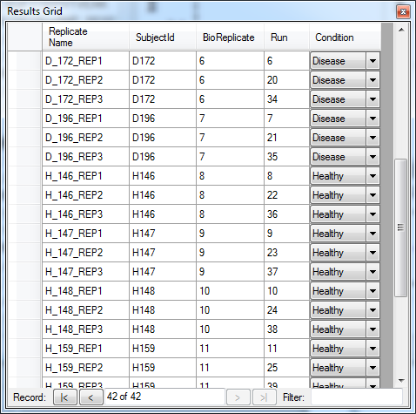
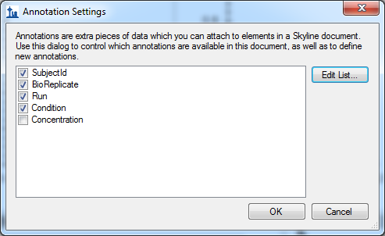
Replicate Annotations
Notes:
Response curves
Protein estimation
Suppression of ionization
Interference

Slide 21
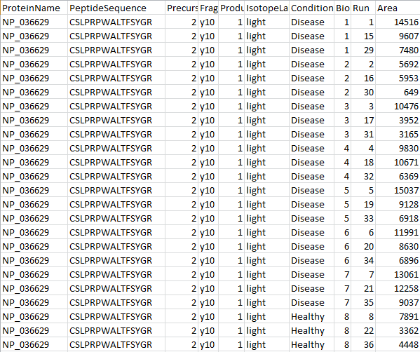
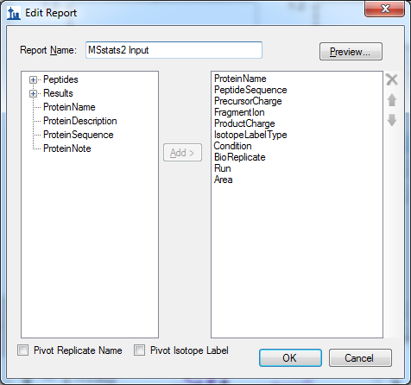
Custom Reports

Slide 22
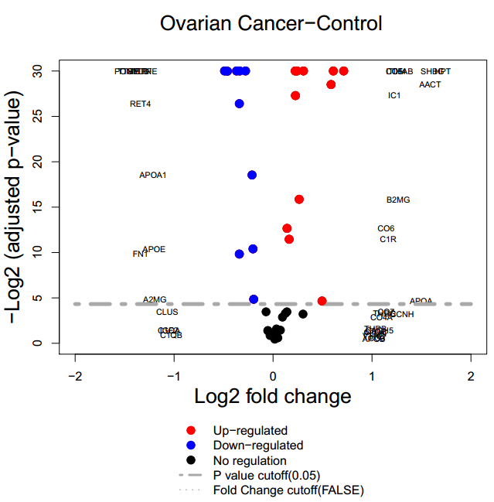
Downstream Analysis with Statistical Tools
Analysis of reports with R – MSstats

Slide 23
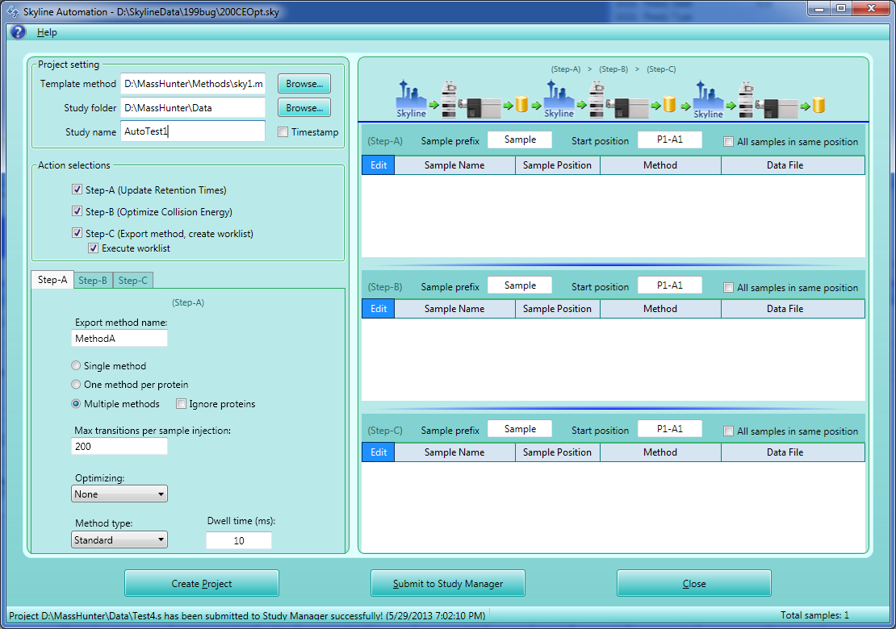
Skyline Automation with SkylineRunner

Slide 24
MS/MS Spectral Library Sources
Global Proteome Machine
NIST
Peptide Atlas
Build your own from peptide search results
Mascot
MaxQuant Andromeda
Morpheus
Myrimatch / IDPicker
OMSSA
PRIDE XML
Protein Pilot
Protein Prospector
Proteome Discoverer (MSF)
Scaffold – mzIdentML / MGF
Spectrum Mill
TPP – pepXML / mzXML files – Peptide Atlas
Waters Mse
X! Tandem

Slide 25
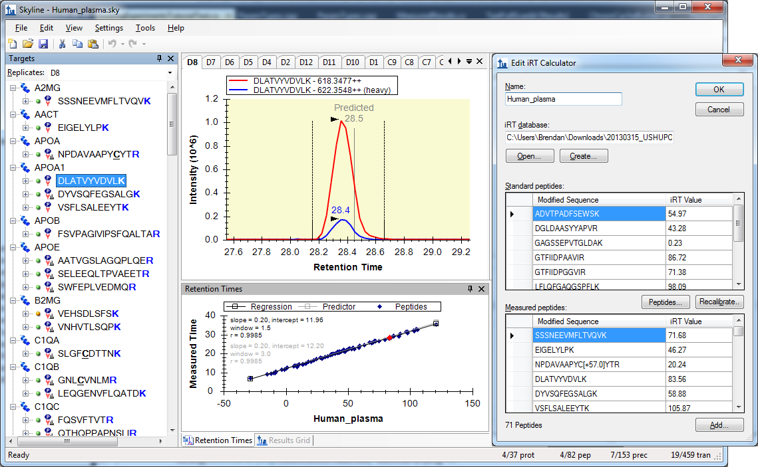
Integrating Great Ideas (iRT)

Slide 26
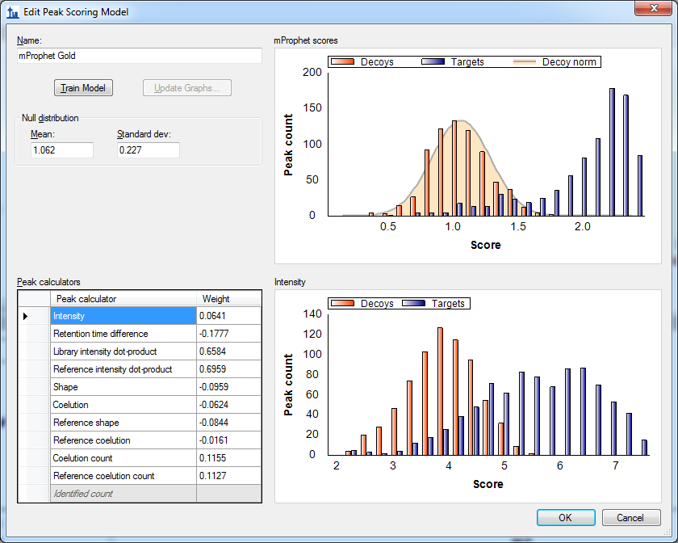
Integrating Great Ideas (mProphet)
TP 499 - MacLean

Slide 27
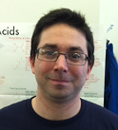
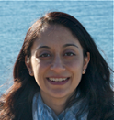

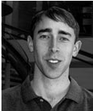
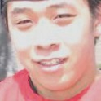
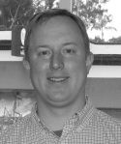
Skyline Team
Nick Shulman
Don Marsh
Kaipo Tamura
Danny Broudy
Trevor Killeen
Vagish Sharma
Josh Eckels
Greg Taylor
Jarrett Egertson
Dario Amodei

Slide 28
Collaborators:
U. of Wa.
Eva Baker
Jarrett Egertson
Jimmy Eng
Andrew Stergachis
Biognosys
Lukas Reiter
Oliver Rinner
Claudia Escher
Broad Institute
Sue Abbatiello
Steve Carr
Jake Jaffe
D. R. Mani
Buck Institute
Birgit Schilling
Matthew Rardin
Brad Gibson
Duke
Will Thompson
Arthur Moseley
IMSB
Rudolph Aebersold
Christina Ludwig
Olga Schubert
Hannes Röst
Lucia Espona Pernas
Purdue
Veavi Chang
Meena Choi
Olga Vitek
Stanford
Dario Amodei
Parag Mallick
Vanderbilt
Matthew Chambers
Daniel Liebler
David Tabb

Slide 29

Instrument Vendor Support
Agilent Technologies
Christine Miller
Juli Salcedo
Shripad Torvi
Yinghang Yang
Bruker
Carsten Baessmann
Marius Kallhardt
Stephanie Kaspar
AB Sciex
David Cox
Christie Hunter
Brent Lefebvre
Thermo-Scientific
Markus Kellmann
Andreas Kuehn
Vlad Zabrouskov
Waters
Laurence Firth
James Langridge
Roy Martin
Kieran Neeson
Keith Richards

