Slide 1

Developing, transferring, sharing, combining, and bridging
global and targeted quantitative methods and data
in a platform-independent manner thanks to Skyline
Christine Carapito
Laboratory of Bio-Organic Mass Spectrometry
CNRS / Strasbourg University
Director: A. Van Dorsselaer
ccarapito@unistra.fr
2nd Skyline User Group Meeting ASMS 2013
June 8th, 2013

Slide 2

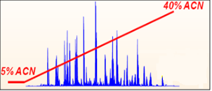

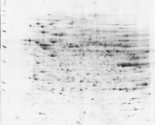

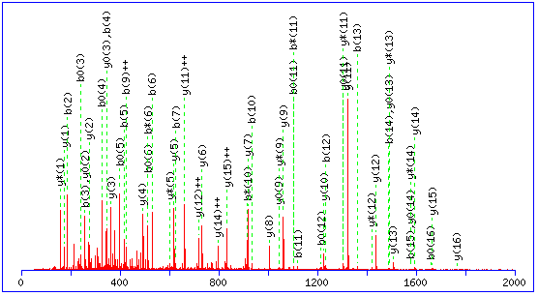


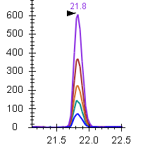
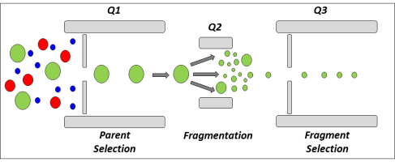

From Global to Targeted Proteomics Approaches
Global, Discovery Proteomics
Shotgun, LC/LC-MSMS approaches
1D-2D Gel Electrophoresis
Qualitative
Quantitative
LC-MS/MS
- Label-free quantification
- Isotopic labeling
- Spectral counting
500-2000 identified proteins
Poorly reproducible, approx. quantitation
From Mueller, L. N., et al., 2008
Proteins of interest
Qualitative
Quantitative
LC-SRM
Targeted Proteomics
QQQ technology
Heavy labeled synthetic standards
10-100 candidate proteins
Precise reproducible, absolute quantitation

Slide 3

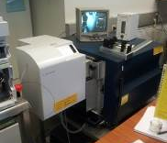
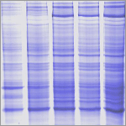
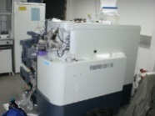
Examples of applications from our lab
Proteome and Metaproteome Analysis of Arsenic-Resistant Bacteria and Bacterial Communities
Collaboration with Bertin P. and Ploetze F., Strasbourg University
Acid mine drainage (AMD) of the Carnoules mine (south of France) characterized by acid waters containing high concentrations of arsenic and iron.
From Global/Discovery Proteomics :
AmaZon ion trap (Bruker Daltonics)
2D gels
Systematic cutting
Sediment analysis:
- Metagenome sequencing of the community
- Metaproteome analysis using the metagenome data
NanoLC-MS/MS
1D gels
In-gel trypsin
digestions
Q-TOF Synapt
(Waters)
Identification of ~900 proteins among which interesting candidate proteins involved in arsenic bioremediation
Carapito C., et al. (2006) Biochimie 88: 595-606
Muller D., et al. (2007) PLoS Genet 3: e53
Weiss S., et al. (2009) Biochimie 91: 192-203
Bruneel O., et al. (2011) Microb Ecol 61: 793-810
Bertin P.N., et al. (2011) ISME J. 5:1735-1747
Halter D., et al. (2011) Res Microbiol 162: 877-887
Halter D., et al. (2012) ISME J. 6: 1391-1402

Slide 4
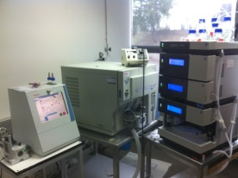
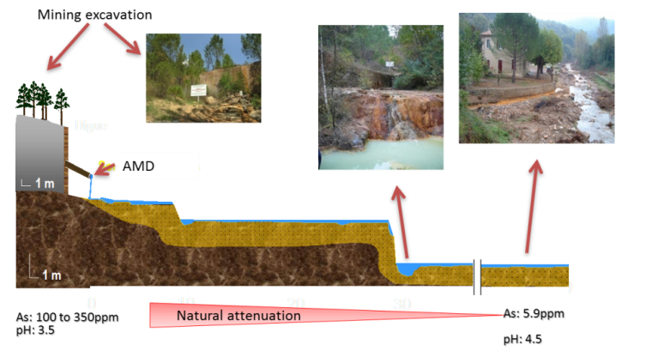
Examples of applications from our lab
Proteome and Metaproteome Analysis of Arsenic-Resistant Bacteria and Bacterial Communities
Collaboration with Bertin P. and Ploetze F., Strasbourg University
Acid mine drainage (AMD) of the Carnoules mine (south of France) characterized by acid waters containing high concentrations of arsenic and iron.
To Targeted Proteomics :
TSQ Vantage QQQ
(Thermo Scientific)
Liquid digestion
heavy labeled peptides
LC-SRM analysis
Sediment analysis:
- Metagenome sequencing of the community
- Metaproteome analysis using the metagenome data
LC-SRM assay for accurate quantification of targeted proteins in sediments over the watercourse and seasons.
Carapito C., et al. (2006) Biochimie 88: 595-606
Muller D., et al. (2007) PLoS Genet 3: e53
Weiss S., et al. (2009) Biochimie 91: 192-203
Bruneel O., et al. (2011) Microb Ecol 61: 793-810
Bertin P.N., et al. (2011) ISME J. 5:1735-1747
Halter D., et al. (2011) Res Microbiol 162: 877-887
Halter D., et al. (2012) ISME J. 6: 1391-1402

Slide 5
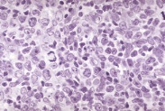
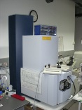
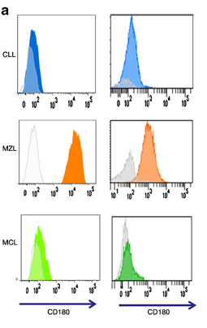
Examples of applications from our lab
B-cells lymphoma biomarker discovery
Sarah Lennon, Christine Carapito, Laurent Miguet, Luc Fornecker, Laurent Mauvieux, Alain Van Dorsselaer, Sarah Cianferani
Collaboration with Institute of Hematology and Immunology, Strasbourg University
From Global/Discovery Proteomics :
B-cell Lymphoma: Blood disease characterized by a proliferation of B lymphocytes
Q-TOF MaXis
(Bruker Daltonics)
1D SDS-PAGE
Systematic cutting
Differential
Spectral counting analysis
NanoLC-MS/MS
In-gel trypsin
digestions
Q-TOF Synapt
(Waters)
Blood cells
Microparticles induction
Membrane proteins enriched fraction
Identification of 2 robust candidate biomarkers:
CD148 and CD180
Validated by flow cytometry
(on 1 epitope) on > 500 samples
Miguet L. et al., (2006) Proteomics 6: 153-171
Miguet L. et al., (2007) Subcell Biochem 43: 21-34
Miguet L. et al., (2009) J Proteome Res 8: 3346-3354
Miguet L. et al., (2013) Leukemia Epub ahead of print

Slide 6
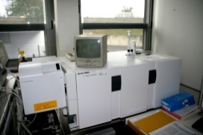
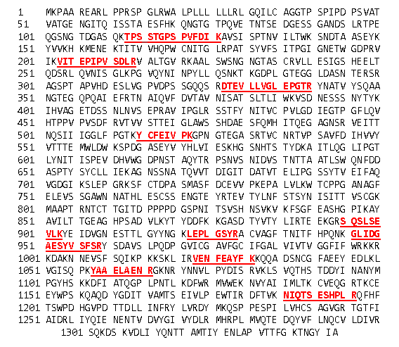
Examples of applications from our lab
B-cells lymphoma biomarker discovery
Sarah Lennon, Christine Carapito, Laurent Miguet, Luc Fornecker, Laurent Mauvieux, Alain Van Dorsselaer, Sarah Cianferani
Collaboration with Institute of Hematology and Immunology, Strasbourg University
B-cell Lymphoma: Blood disease characterized by a proliferation of B lymphocytes
To Targeted Proteomics :
6410 QQQ
(Agilent Technologies)
Blood cells lysate
Liquid digestion
heavy labeled peptides
LC-SRM analysis
Microparticles induction
Membrane proteins enriched fraction
LC-SRM assay for absolute quantification of targeted proteins, following at least 10 peptides per protein (versus 1 epitope)
Blood cells
Sequence coverage
of CD148 (Q12913)
Miguet L. et al., (2006) Proteomics 6: 153-171
Miguet L. et al., (2007) Subcell Biochem 43: 21-34
Miguet L. et al., (2009) J Proteome Res 8: 3346-3354
Miguet L. et al., (2013) Leukemia Epub ahead of print

Slide 7

Targeted quantitative proteomics workflow using SRM-MS
1. List of proteins of interest
2. Proteotypic peptides for proteins of interest
3. Transitions selection and optimisation
4. SRM analysis
5. Quantitative data interpretation

Slide 8
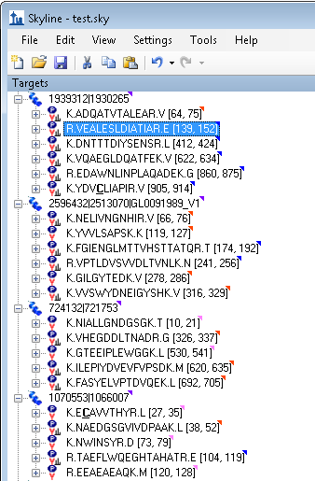
Targeted quantitative proteomics workflow using SRM-MS
Previous global/discovery proteomics experiments
+
Additionnal hypotheses, Biological observations or litterature/data mining, …
1. List of proteins of interest
2. Proteotypic peptides for proteins of interest
Upload of targeted proteins
(.fasta file)
3. Transitions selection and optimisation
4. SRM analysis
5. Quantitative data interpretation

Slide 9


Targeted quantitative proteomics workflow using SRM-MS
1. List of proteins of interest
Useful functionalities to identify best flyers and unique peptides :
Building of Peptide Spectral Libraries generated from global proteomics data
nanoLC-MSMS data
2. Proteotypic peptides for proteins of interest
Interpretation using 2 search engines
3. Transitions selection and optimisation
Mascot searches
OMSSA* searches
MSDA in-house developed interface
http://www.matrixscience.com
https://msda.unistra.fr/
4. SRM analysis
Identification
Validation (FDR control)
5. Quantitative data interpretation
.mzIdentML import into Skyline
* Geer, LY et al. J Proteome Res 2004

Slide 10
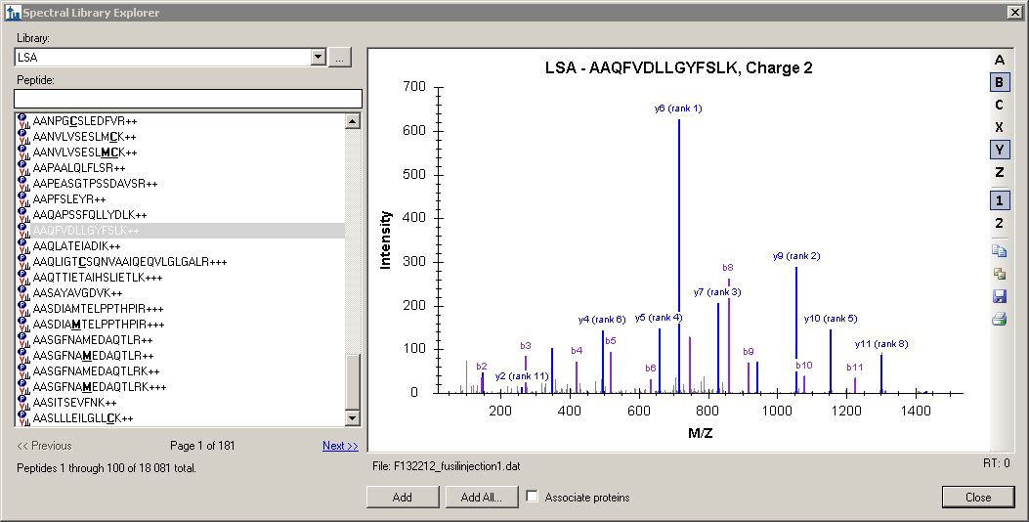
Targeted quantitative proteomics workflow using SRM-MS
1. List of proteins of interest
Useful functionalities to identify best flyers and unique peptides :
Building of Peptide Spectral Libraries generated from global proteomics data
2. Proteotypic peptides for proteins of interest
Spectral Library Explorer
3. Transitions selection and optimisation
4. SRM analysis
5. Quantitative data interpretation

Slide 11
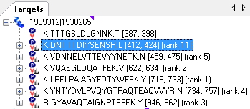
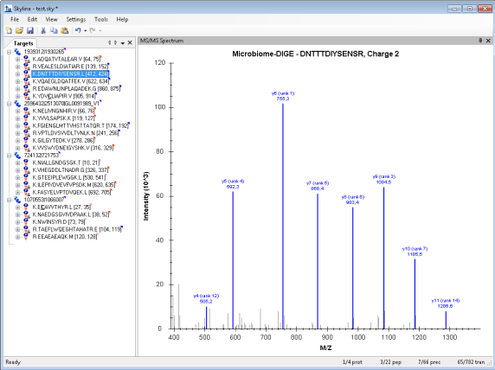
Targeted quantitative proteomics workflow using SRM-MS
1. List of proteins of interest
Useful functionalities to identify best flyers and unique peptides :
Building of Peptide Spectral Libraries generated from global proteomics data
2. Proteotypic peptides for proteins of interest
3. Transitions selection and optimisation
4. SRM analysis
Among all possible peptides of the proteins of interest, several have already been seen in global proteomics experiments and are likely the best candidates
Ranking of peptides added (Expect values, picked intensity, spectrum count)
5. Quantitative data interpretation

Slide 12
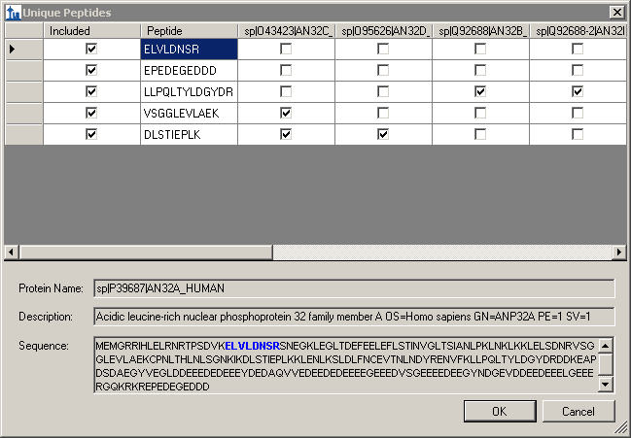
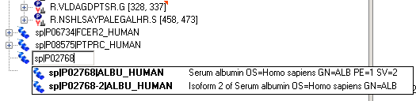
Targeted quantitative proteomics workflow using SRM-MS
1. List of proteins of interest
Useful functionalities to identify best flyers and unique peptides :
Building of Peptide Spectral Libraries generated from global proteomics data
Defining a Background proteome
2. Proteotypic peptides for proteins of interest
Upload a background proteome as a database .fasta file
3. Transitions selection and optimisation
4. SRM analysis
Allows to easily visualise unique / shared peptides (much faster than performing BLAST alignments)
5. Quantitative data interpretation
Especially important for discriminating isoforms that are present/added in the background proteome

Slide 13
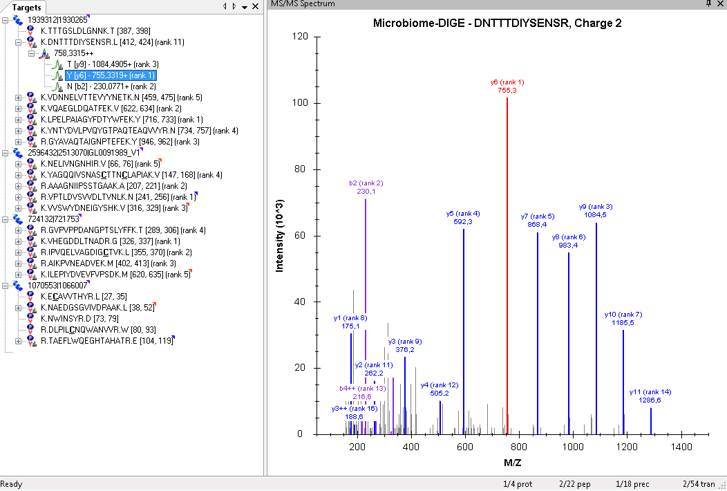
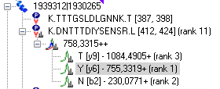
Targeted quantitative proteomics workflow using SRM-MS
1. List of proteins of interest
Useful functionalities to select the best (specific (no interferences) and sensitive) transitions / peptides :
Again Peptide Spectral Libraries
2. Proteotypic peptides for proteins of interest
3. Transitions selection and optimisation
4. SRM analysis
Spectral librairies built on LC-MSMS data acquired on heavy labeled synthetic standard peptides (for yet unseen peptides)
Transition ranking + many adjustable filters
5. Quantitative data interpretation

Slide 14
Targeted quantitative proteomics workflow using SRM-MS
1. List of proteins of interest
Useful functionalities to select the best (specific (no interferences) and sensitive) transitions / peptides :
Again Peptide Spectral Libraries
Collision energy optimisation
2. Proteotypic peptides for proteins of interest
CE -6
CE +2
CE -4
CE +4
CE -2
CE +6
140
GPNLTEISK - 483.8++ (heavy)
120
100
3. Transitions selection and optimisation
80
Area (10 ³)
60
40
20
0
Replicates
4. SRM analysis
Easily possible thanks to :
Automatic collision energy optimisation methods setup with different CE steps
Availability of heavy labeled standard peptides
5. Quantitative data interpretation

Slide 15
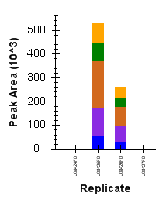
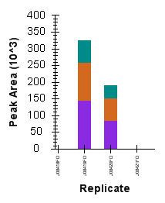
Targeted quantitative proteomics workflow using SRM-MS
1. List of proteins of interest
Useful functionalities to select the best (specific (no interferences) and sensitive) transitions / peptides :
Again Peptide Spectral Libraries
Collision energy optimisation
2. Proteotypic peptides for proteins of interest
VVSQYHELVVQAR
LVLEVAQHLGESTVR
3. Transitions selection and optimisation
4. SRM analysis
After optimisation / Equation prediction
After optimisation / Equation prediction
5. Quantitative data interpretation
Increased sensitivity for specific peptides

Slide 16
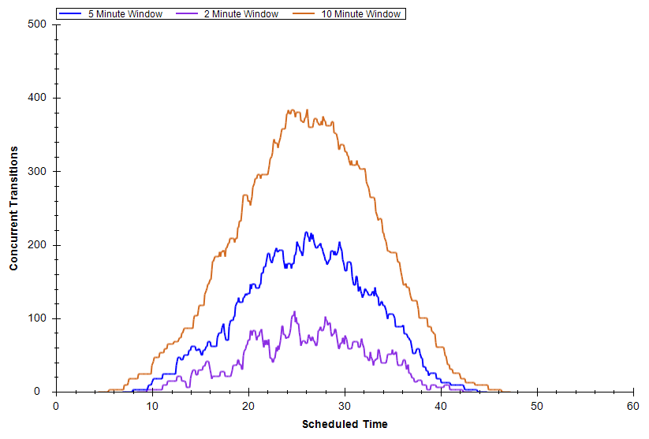
Targeted quantitative proteomics workflow using SRM-MS
1. List of proteins of interest
Useful functionalities to setup up the acquisition methods:
Vendor specific method export from a generic Skyline file
2. Retention time scheduling et retention time prediction tools
Time scheduling is challenging but mandatory for multiplexing!
2. Proteotypic peptides for proteins of interest
- Requires precisely controlled chromatography
- Retention times need to be highly reproducibility
- Peak width and retention time shifts limit the multiplexing.
380 transitions
10 min window
3. Transitions selection and optimisation
220 transitions
5min window
Concurrent transitions
100 transitions
2min window
4. SRM analysis
Scheduled Time
5. Quantitative data interpretation
Use of Retention Time reference (iRT) peptides, spiked in all samples
Escher C, Reiter L, MacLean B, Ossola R, Herzog F, Chilton J, MacCoss M.J, Rinner O Proteomics 2012, 12(8): 1111-1121.

Slide 17
Targeted quantitative proteomics workflow using SRM-MS
Retention time prediction
1. List of proteins of interest
Chromatographic condition A
Chromatographic condition B
%B
%B
Gradient change, Column change,
System change, …
2. Proteotypic peptides for proteins of interest
90min
30min
3. Transitions selection and optimisation
4. SRM analysis
5. Quantitative data interpretation

Slide 18
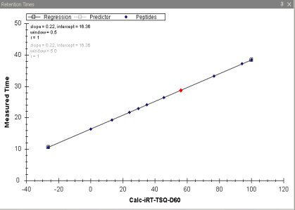
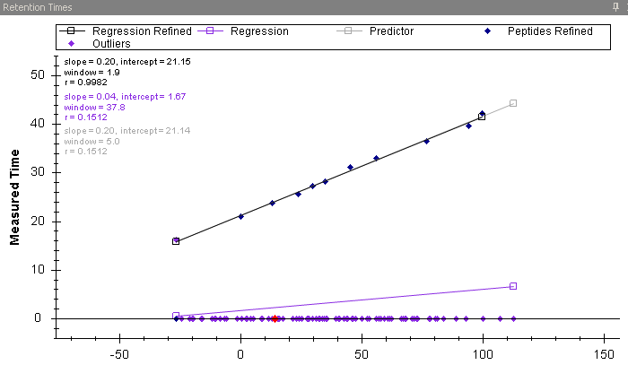
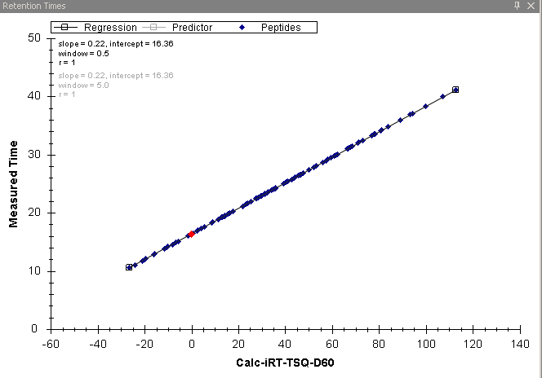
Targeted quantitative proteomics workflow using SRM-MS
Retention time prediction
1. List of proteins of interest
Chromatographic condition A
Chromatographic condition B
%B
%B
2. Proteotypic peptides for proteins of interest
90min
30min
iRT measured in condition A
iRT measured in condition B
Predictor
3. Transitions selection and optimisation
Retention time
iRT-value
Retention time
Calculator
4. SRM analysis
iRT-value
Determination of iRT values for the peptides of interest
Retention time
Export of scheduled SRM method
5. Quantitative data interpretation
iRT-value

Slide 19
Targeted quantitative proteomics workflow using SRM-MS
Retention time prediction
1. List of proteins of interest
Gain of time for determining peptides’ retention times
Less sample consumption
Easy change in chromatography type and scale
(nanoLC microLC LC)
Easy method transfer inside the laboratory and with collaborating laboratories
2. Proteotypic peptides for proteins of interest
3. Transitions selection and optimisation
4. SRM analysis
5. Quantitative data interpretation

Slide 20
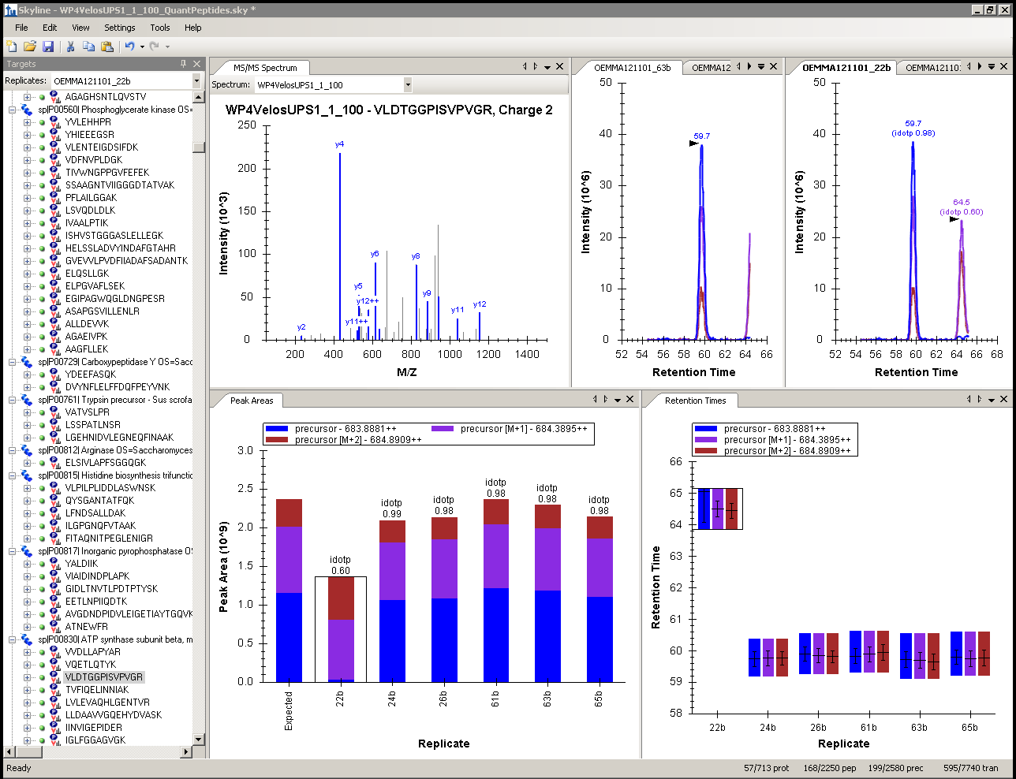
Targeted quantitative proteomics workflow using SRM-MS
1. List of proteins of interest
Useful functionalities for quantitative data interpretation:
All Skyline views
Easy data checking: manual verification is possible, in a fast and efficient way
View of all replicates
Visualisation of interferences
Flexible and rich export templates
2. Proteotypic peptides for proteins of interest
3. Transitions selection and optimisation
4. SRM analysis
5. Quantitative data interpretation

Slide 21
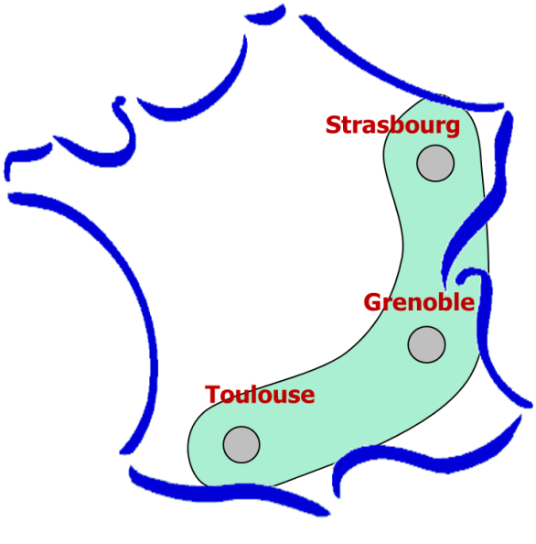
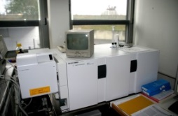
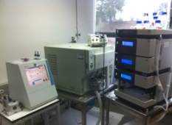
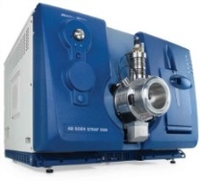
An inter-laboratory performance evaluation standard
48 human proteins (Universal Proteomics Standard UPS1)
spiked into a yeast cell lysate background +
iRT reference peptides
Weekly injections over 6 months:
Data processing/exchange with Skyline!
Definition of a series of criteria to meet for System OK/Not OK:
Signal intensities (Peak areas)
Peak widths
Retention time
Peak distribution
G6410
(Agilent Technologies)
TSQ Vantage (Thermo)
Allows us to check:
Multiplexing capability
(689 transitions)
Signal fluctuations
Retention time variability
Platform comparisons
Robustness over time
Peptide storage over time, …
Q-Trap (ABSciex)
Q-Trap (ABSciex)

Slide 22
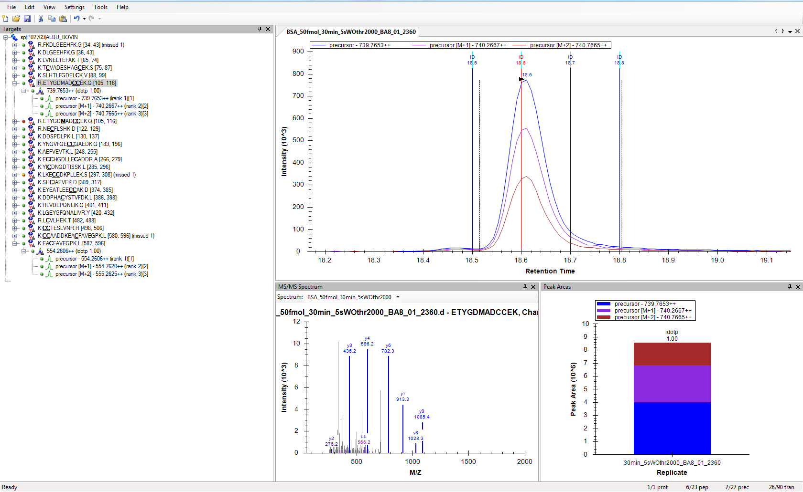

Global/Discovery proteomics approaches with Skyline
MS1- filtering
Q-TOF MaXis and
Q-TOF Compact
(Bruker Daltonics)
Even easier integration of full-scan/discovery results with follow-up targeted experiments !

Slide 23
From Global to Targeted Proteomics Approaches
Global/Discovery Proteomics
Targeted Proteomics
Qualitative
Quantitative
Qualitative
Quantitative
500-2000 identified proteins
Poorly reproducible, approx. quantitation
10-100 candidate proteins
Precise reproducible, absolute quantitation

Slide 24
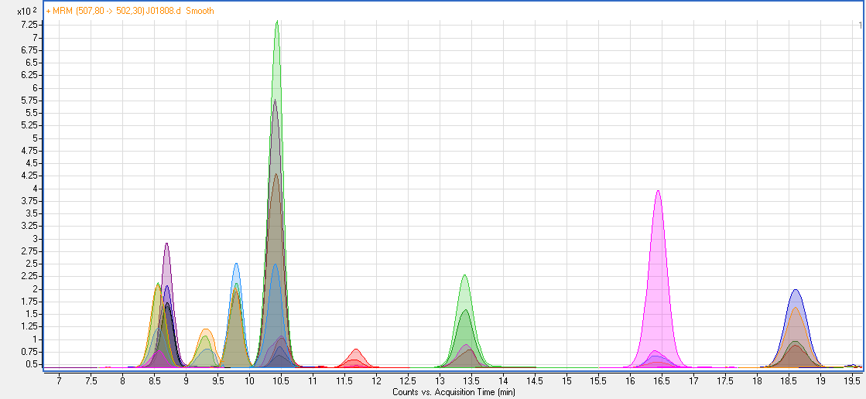
Thanks !
Brendan MacLean and the Skyline team
Van Dorsselaer A.
WP3 of ProFI
Vaca S.
Opsomer A.
Hovasse A.
Lennon S.
Cianferani S.
Plumel M.
Delalande F.
Bertaccini A.
Boeuf A.
WP3 of the French Proteomics Infrastructure (Garin J.) :
-Grenoble : Benama M., Adrait A., Ferro M.
-Strasbourg : Opsomer A., Vaca S., Hovasse A., Schaeffer C., Carapito C.
-Toulouse : Garrigues L., Dalvai F., Stella A., Bousquet M.P., Gonzales A.

