Slide 1
Using Skyline to analyze the SPRG2013-2014 Targeted Proteomics Assay (TPA) standard
Brett S. Phinney, Ph D.
UC Davis Genome Center

Slide 2
What is the ABRF?
ABRF members are from over 300 international core laboratories in academia, government, and industry, in a broad spectrum of biomolecular technologies
The ABRF promotes the research, technology, communication and education
ABRF has Research Groups and Committees, Affiliates and Chapters, annual conferences with educational courses, a quarterly journal, a Newsletter, Research Group publications, and Listserves
The ABRF is unique for providing benchmarking studies by its Research Groups and has efficient mechanisms for networking and sharing

Slide 3
Proteomics Standards Research Group (sPRG) 2013-2014
Christopher Colangelo (Chair) | Yale University
Craig Dufresne | Thermo Fisher Scientific
Alexander R. Ivanov (Ad hoc) | Northeastern University
Toni Koller | Stony Brook University
Brett Phinney (EB Liaison) | University of California, Davis
Kristie Rose | Vanderbilt University
Paul Rudnick | National Institute of Standards and Technology
Brian Searle | Proteome Software
Scott A. Shaffer | University of Massachusetts Medical School
Brendan Maclean | University of Washington SOM
David Hawke | UT M.D. Anderson
Notes:
9 members of the sPRG group in 2013 group.

Slide 4
Study Rationale / Design
Design a comprehensive standard mixture of heavy-labeled tryptic peptides that can be used as internal standards for proteomics applications.
Widely applicable across human, mouse, and rat proteomes.
Proteotypic in nature.
Utility towards both discovery and targeted proteomics applications.

Slide 5
Study Rationale / Benefits
Heavy/light peptide ratios will allow for normalization and evaluation for both inter- and intra- sample comparisons.
System suitability of LC-MS/MS performance including benchmarking and reproducibility of LC peptide elution profiles, evaluation of MS sensitivity and dynamic range.
Provide additional control for longitudinal proteomics studies and can be used in interlaboratory studies.
Peptides can be converted into absolute quantitation standards via cleanup, purification, and amino acid analysis.

Slide 6
Study Design
1000 stable isotope labeled tryptic peptides conserved across Homo sapiens, Mus musculus and Rattus norvegicus.
Peptide mixture will be spiked at fixed concentration to a HEK digest at 3 different dilutions (3 orders of magnitude).
Participants will analyze the samples using LC-MS instrument platform of their choice, report ratios, return the questionnaire and raw data to the sPRG (via study anonymizer or possibly Panorama).
Spectral library will be constructed, data searched, and peptide ratios determined for all data sets.
Comparison of ratios, normalization of data, and peptide retention/elution order will be compared across data sets.

Slide 7
Peptide Selection
Peptides selected via databases at Yale, NIST, Stony Brook
YPED; 115 LC-MS/MS HEK experiments
MASCOT SCORE > identity
BLAST search common to human, mouse, and rat
K or R tryptic cleavage (C-terminal)
6750 peptides, <1% to 67% observed in the samples
Removed peptides with upstream proline to K, R
Removed peptides with upstream KK, RR
Removed peptides with M
Removed peptides w/ miscleavages
1500 peptide candidates to send to JPT Peptide Technologies
JPT selected 1000 peptides for synthesis
Notes:
We want to have only peptides that will cleave easily with limited chance for missed cleavage.

Slide 8
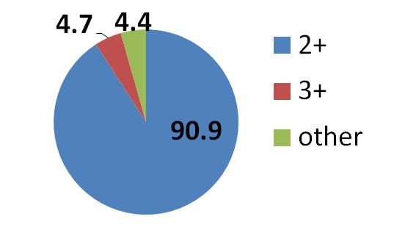
Peptide Selection and Other Criteria
Charge State (NIST)
Dynamic Range (YPED)
observed spectral counts
spectral counts
Peptides Map to 552 proteins
peptide number
# peptides mapping to each protein
Notes:
Other criteria considered observed dynamic range, observed charge state, and number of represented proteins

Slide 9
Peptide Identification in ABRF Labeled Peptide Standard Mix

Slide 10
Using Skyline for AUC analysis
1000 peptides + 5 ug HEK lysate
We decided on AUC analysis as we did not have enough time to develop a scheduled MRM method
Still possible for someone out there to develop a scheduled MRM method if you want
Might be a good test for RT prediction algorithms

Slide 11
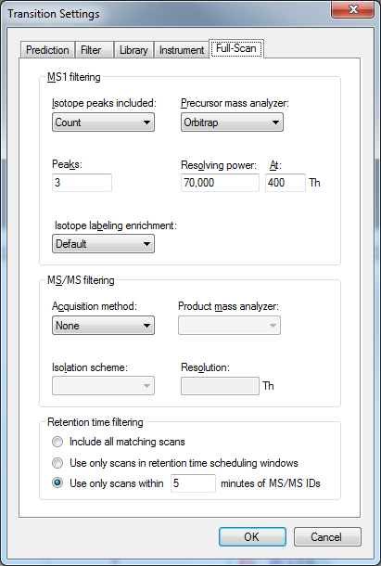
Using Skyline for AUC analysis
1 pmol peptide mix spiked into 5 ug HEK 293 lysate
Set MS1 resolving power at 70K
Q-Exactive Data

Slide 12
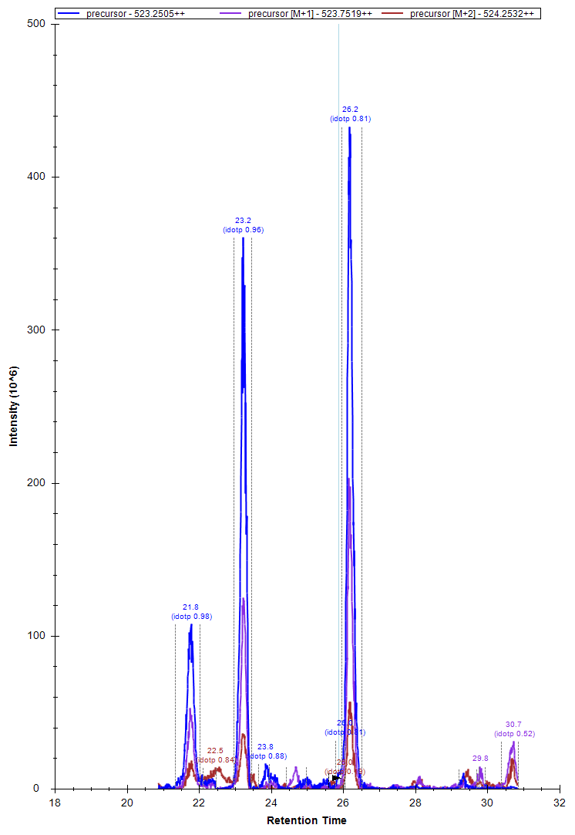
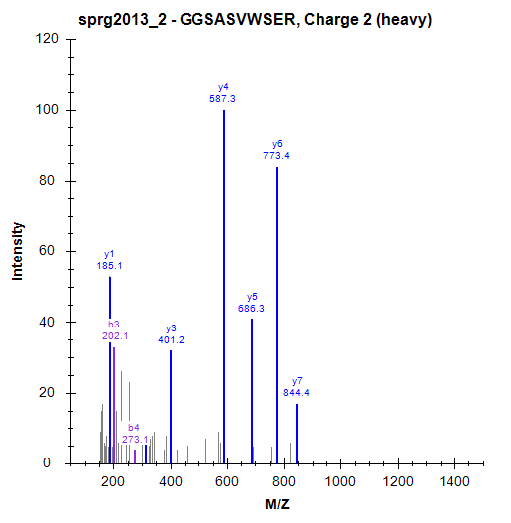
Example Peptide GGSASVWSER (523.2505, 2+)

Slide 13
Example Peptide GGSASVWSER (523.2505, 2+)
Retention Time from Library
Isotope Dot Product
idot = 0.96
Isotope Dot Product
idot = 0.81

Slide 14
Lets look at raw data

Slide 15
XIC 523.25-523.27 m/z

Slide 16
MS Spectra (522-527 m/z) Peak at 23 min
523.25641
A+1 isotope
idotp = 0.96

Slide 17
MS Spectra (522-527 m/z) Peak at 26 minutes
523.25079
Correct isotope
idotp = 0.81

Slide 18
Precautions
Skyline’s Isotope Dot Product (idotp) is actually better for the wrong analyte
This can get a bit tricky when you are analyzing 1000 peptides
Probably best to not rely on just idotp
We have found that getting the RT’s correctly in the library really is critical

Slide 19
Making a library that has proper RT’s
This has been very finicky in our hands
Some workflows work, some don’t
Different combinations of software all seem to affect this
Peak List generator (mzML…mzXML….)
Searching software (x!tandem, Mascot...)
Meta file has to have the same name as the raw data file (except for the extension)

Slide 20
Generating libraries with correct RT’s (our workflow)
Generate mzML using proteome discoverer
Combine all peptides into an artificial protein
Search with x!tandem (turning on the skyline option!)
Rename the x!tandem output files to extension *.xtan.xml
Make Library in skyline

Slide 21
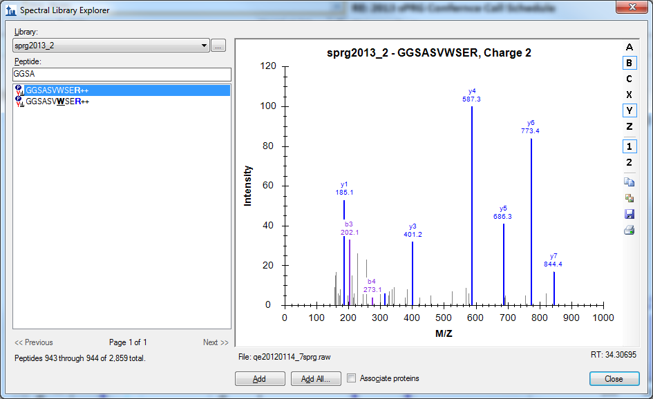
Correct library
RT
File Name

Slide 22
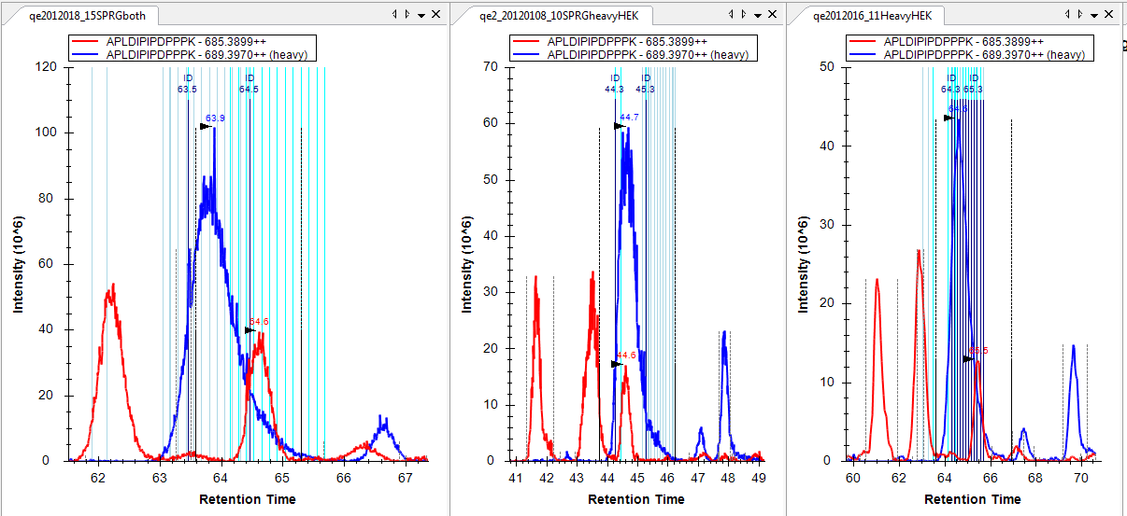
HEK lysate Non-Co-eluting labeled peptides??

Slide 23
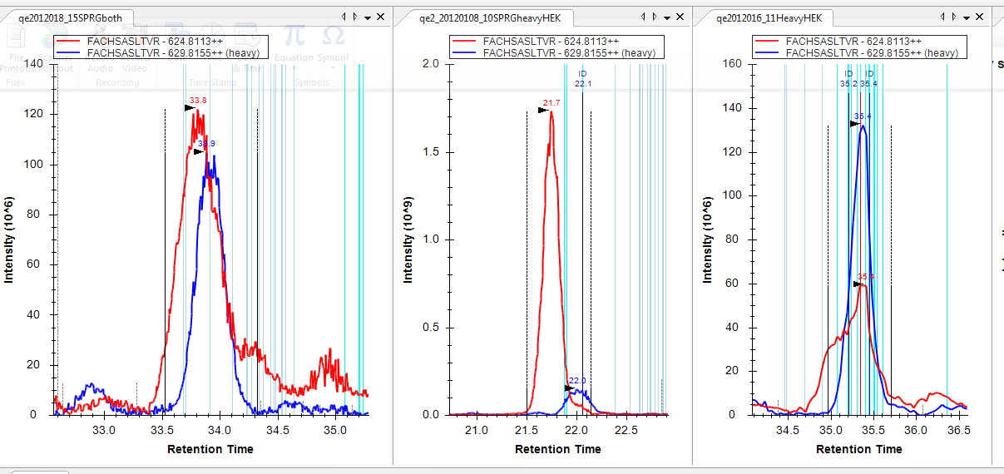
More non co-eluting pairs

Slide 24
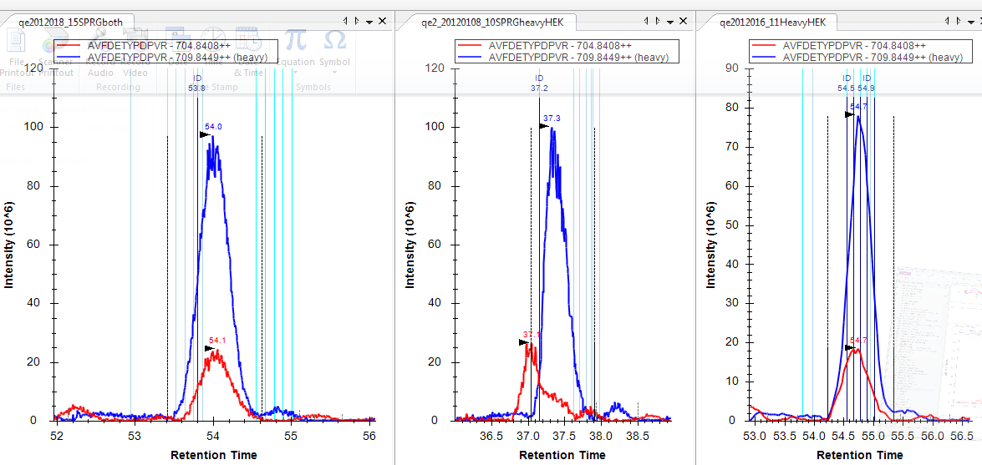
And more

Slide 25
Lets look at this one

Slide 26
MS spectra very complex

Slide 27
Very complex
Heavy Peptide
Light Peptide?

Slide 28
Light HEK peptide?
m/z =704.83911
Thero m/z =704.8408
Delta = 2.39 ppm

Slide 29
MS/MS spectra
None Acquired for light peptide
Is this the correct light peptide?
Probably not
Next steps
Need to acquire with an isolation list or a MRM or Data Independent method??? Maybe use a much longer gradient or LC-LC-MS/MS

Slide 30
Skyline analysis
Can take a lot of analysis time to go over 1000 peptides in skyline in full scan mode
Need to consider adding additional data metrics to reduce need to manually check each integration
Figuring out if the light peptide of a heavy/light pair is real or interference is a real problem. Especially the more complex your data is.
sPRG sample is probably too complex to analyze by Full scan in one 2 hour LC-MS/MS run

Slide 31
Conclusions
Progress has been made for the 1st year in development of an innovative proteomics standard.
Study sample is designed to represent proteins spanning three orders of magnitude in concentration.
1,000 isotope labeled peptides were synthesized and analyzed. Greater than 99% of the peptides were identified during the validation runs.
In peptide dilution experiments, the majority of peptides behaved as expected with a linear response; however, a few peptides had a non-linear response.
The peptides were spiked into a HEK digest and showed minimal variation in both retention time and peak area.
The sPRG is hopeful that the designed formulation will become a valuable resource in various mass spectrometry-based proteomic applications, including quantitative and differential protein profiling, interlaboratory studies, as well as general LC-MS/MS benchmarking.

Slide 32
How to Get a sample
E-mail
sprg2013@googlegroups.com
Samples are limited so be certain you can analyze the sample if you ask for one.

Slide 33
Acknowledgments
SPRG
Current Membership
Dr. Christopher Colangelo (Chair) - Yale University Dr. Craig P. Dufresne - Thermo Fisher Scientific Dr. Alexander R. Ivanov - Northeastern University Dr. Antonius Koller - Stony Brook University Brendan MacLean - University of Washington Dr. Kristie L. Rose - Vanderbilt University Medical Center Dr. Paul A Rudnick - NIST Brian C. Searle - Proteome Software Inc. Dr. Scott A. Shaffer - University of Massachusetts Medical School Dr. Brett S Phinney (EB Liaison) - Proteomics Core UC Davis Genome Center Dr. David Hawke – MD Anderson Caner Center

Slide 34
Acknowledgments part 2
JPT Peptide
ABRF (funding) www.abrf.org
Dr. Rich Eigenheer UC Davis (UC Davis Data)

