Slide 1
MS1 and MS2 crosstalk in label free quantitation of mass spectrometry data independent acquisitions
528.18⁺⁺⁺ m/z
568.98⁺⁺ m/z
MS1
678.34⁺⁺ m/z
MS2/SWATH
June 9th, 2013
Matthew J. Rardin

Slide 2
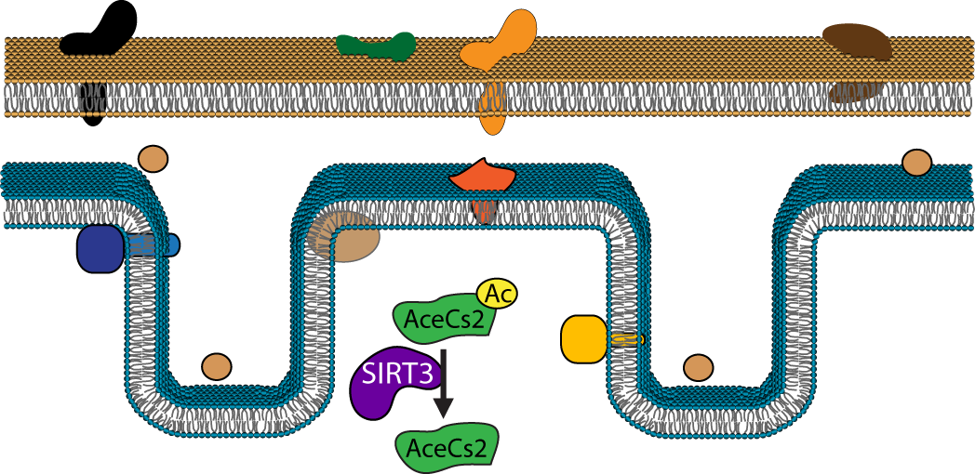
SIRT3 regulated mitochondrial lysine acetylation
Cytosol
OM
IMS
IM
Matrix
Type 2 Diabetes
Metabolic syndromes
High/low-fat diet
Aging
Cancer
PNAS 2013 110 (16), 6601-6606.

Slide 3
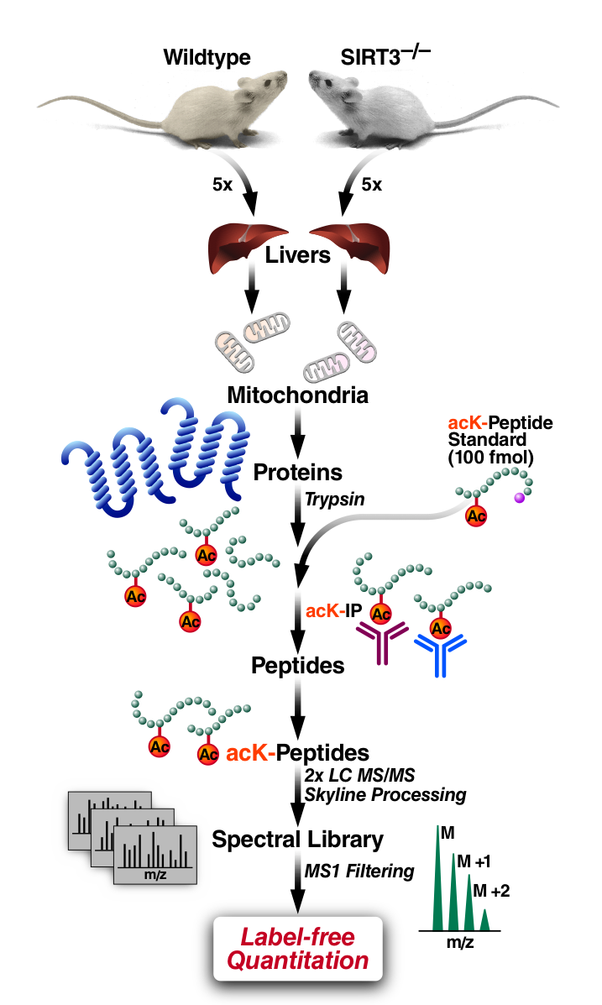
Strategy for identification and quantitation of the SIRT3 regulated
acetylome in mouse liver mitochondria
Mitochondria were purified from 5WT and 5KO mice by differential centrifugation and normalized to total protein
Perform a trypsin digest with two replicates per mitochondrial sample to control for process variability
Spike-in acetyl standard LVSSVSDLP(acK)R as a sample process loading control
Two polyclonal antibody combination for enrichment of lysine acetylated peptides
Two injection replicates per sample were ran on the Triple TOF 5600
Label free “relative” quantitation using MS1 Filtering
Published spectral library information in Panorama
PNAS 2013 110 (16), 6601-6606.

Slide 4
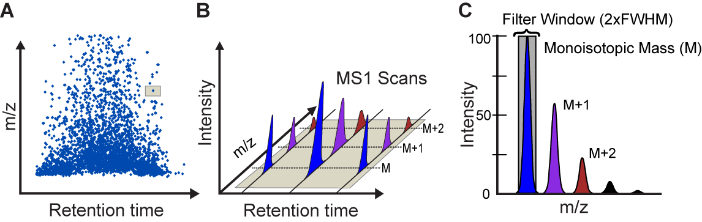
Skyline MS1 Filtering
A quantitative tool for discovery proteomics experiments
Follow a few peptide analytes to >3000 peptides
Label-free
Skyline interface and tools
MS platform/manufacturer independent (QqTOF, FT and ITs)*
Samples (1, 2, 3,… N)
Mass Spectrometer
Peptide Search Engine(s)
Redundant Spectral Library
Peptide Ion Chromatograms (raw data)
Peak Integration
Relative Quantitation
Mol Cell Proteomics 2012 11: 202-214.

Slide 5
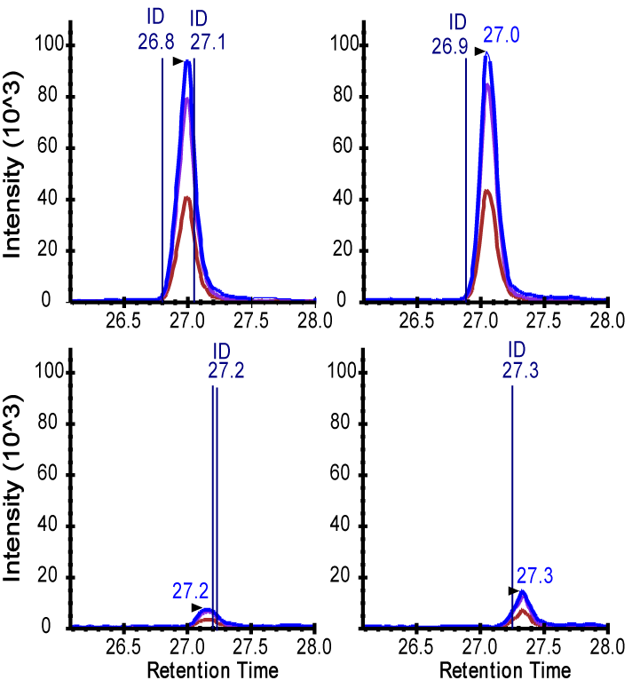
Label free quantitation using MS1 Filtering in Skyline
Peak Integration of the peptide ELQHHVK^{Ac}SVTAPYK⁺⁺⁺
KO1
KO2
WT1
WT2
PNAS 2013 110 (16), 6601-6606.

Slide 6
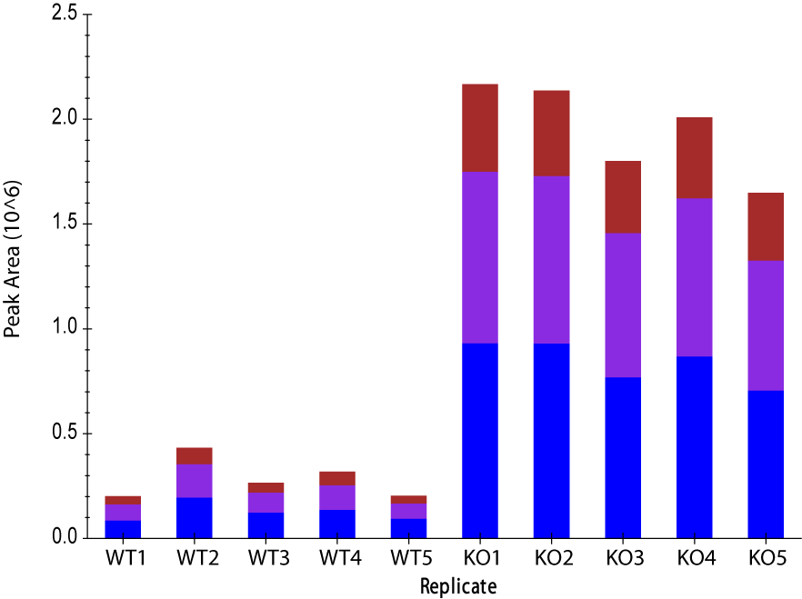
Peak area replicates of ACSM1 K534
Peak Integration
Peak Area Replicate View
KO1
KO2
M+2
M+1
WT1
WT2
M
PNAS 2013 110 (16), 6601-6606.

Slide 7
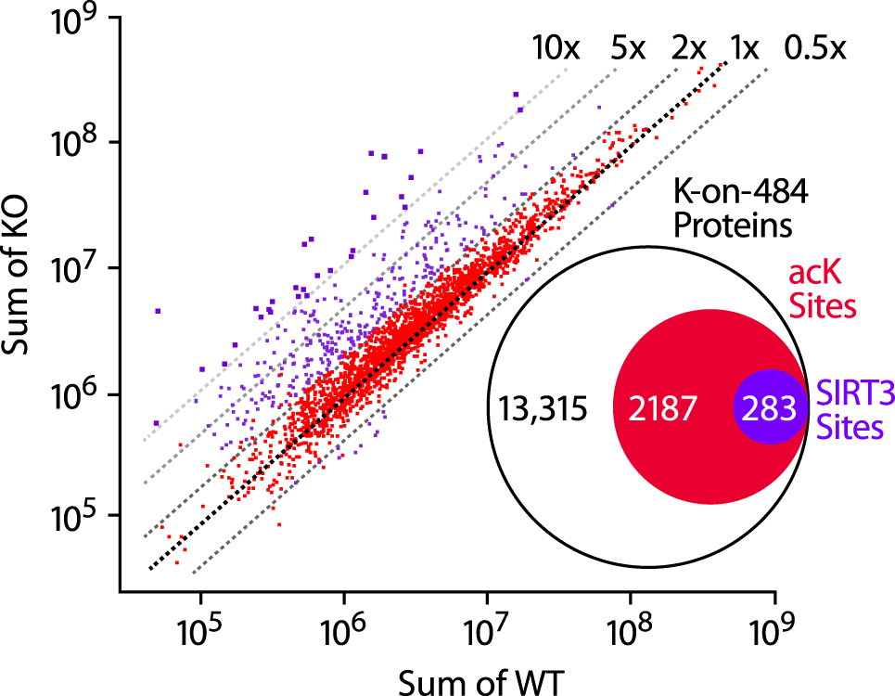
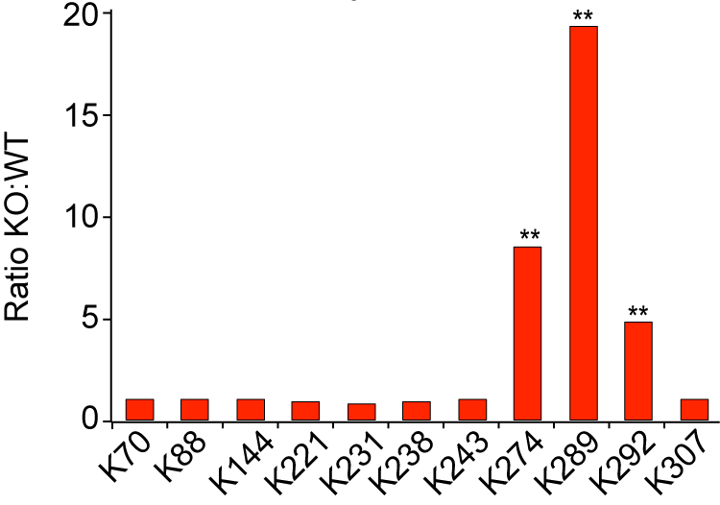
Label free quantitation of K^{Ac} peptides in SIRT3-/-
Quantitation of 2017 K^{Ac} sites
Coefficient of variation of the
peptide standard was 26% across 40 replicates
Peptide area is normalized to spiked-in peptide standard
Identified 266 sites on 136 proteins with greater than 2-fold increase in SIRT3-/- (p-value<0.01)
Majority of sites were unchanged in the KO
Quantitation of peptides from mitochondrial lysates showed no significant increase in protein expression
A
>2x & p-value < 0.01
<2x or p-value > 0.01
B
OTC – Urea cycle
PNAS 2013 110 (16), 6601-6606.

Slide 8
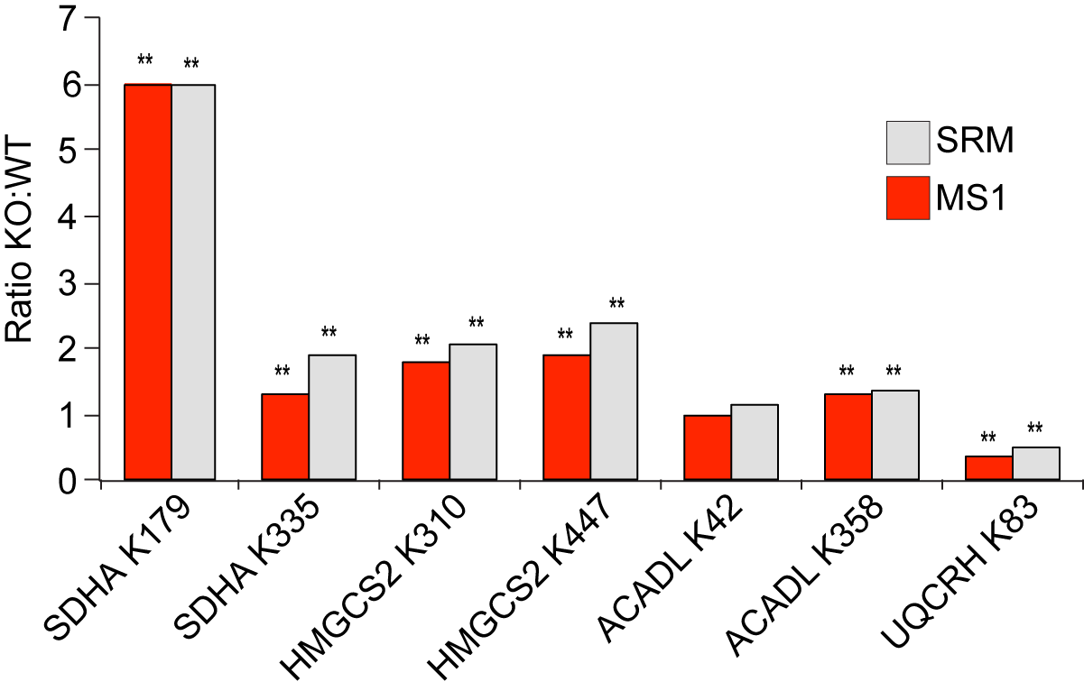
Targeted quantitation of acetyl peptides by Selected Reaction Monitoring (SRM) mass spectrometry
Data collected on a 5500 QTRAP
Spiked in 25 fmol of a heavy labeled synthetic peptide corresponding to peptides of interest
SRM demonstrates similar results to MS1 Filtering
p-value < 0.05*, 0.01**
PNAS 2013 110 (16), 6601-6606.

Slide 9
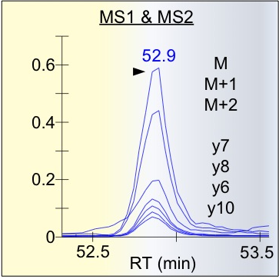
Data Independent Acquisition (DIA) on a Triple TOF 5600

Slide 10
Adding MS1 quantitation to a DIA
MS2 (SWATH) acquisition
What is the relationship between MS1 and MS2 quantitation in a DIA acquisition?
-MS1 scan is acquired between each SWATH cycle
Is there value in combining MS1 analysis to SWATH MS2 data?
Are there cases when one method (MS1 or MS2) provides more accurate data than other When is one data set compromised?

Slide 11
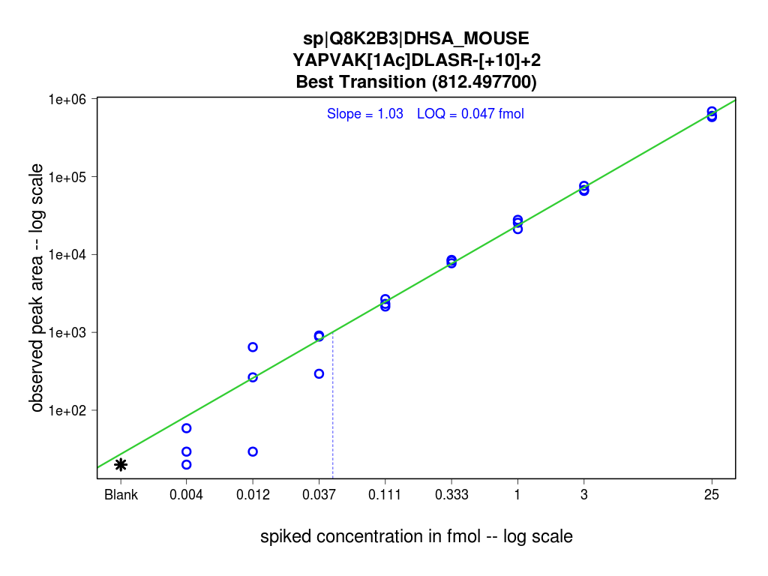
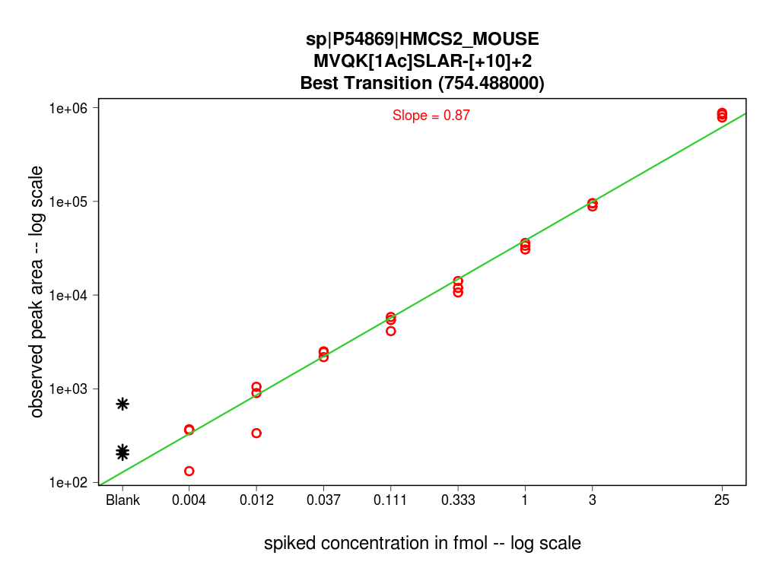
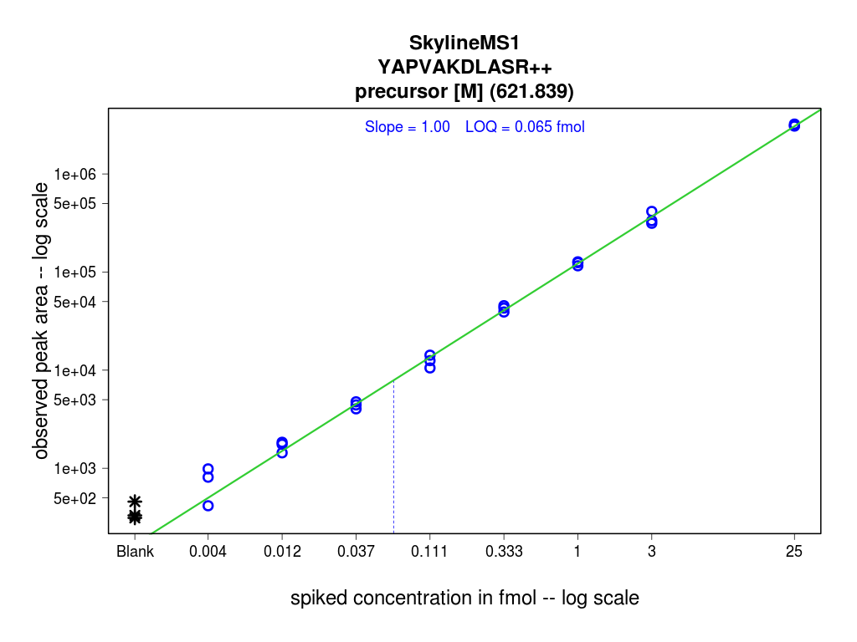
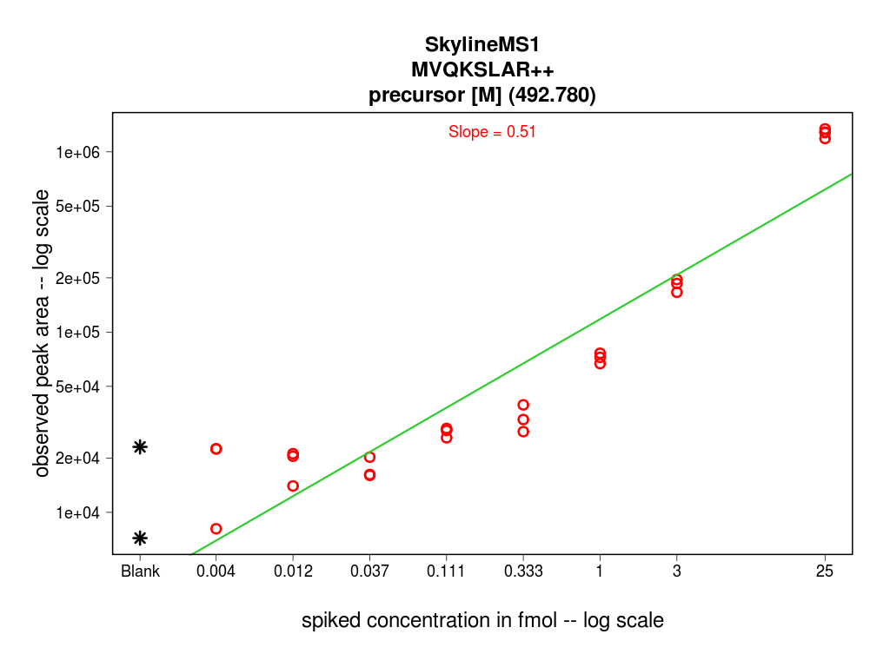
MS1 Filtering vs SWATH in Simple and Complex Matrix
Std. Concentration Curve 4 amol – 25 fmol
A
Simple Matrix - 25fmol β-gal
B
Complex Matrix – 300 ng digest
SWATH - YAPVAK_{Ac}DLASR
SWATH - MVQK_{Ac}SLAR
Slope 1.03
Slope 0.87
MS1 - YAPVAK_{Ac}DLASR
MS1 - MVQK_{Ac}SLAR
Slope 1.0
Slope 0.51

Slide 12
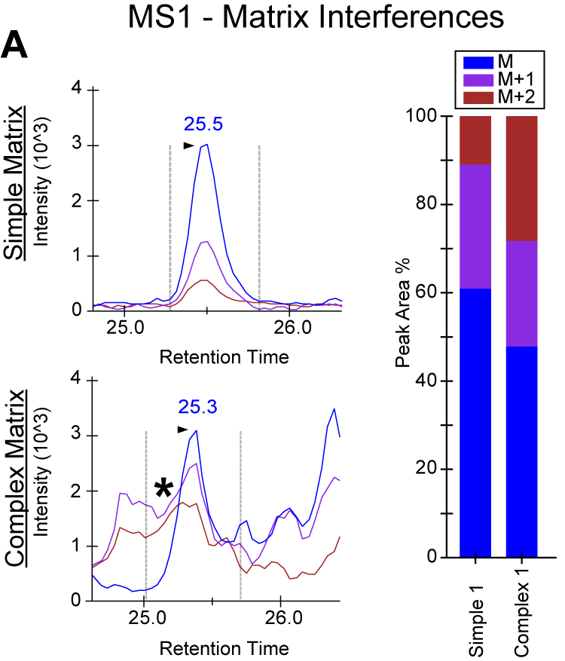
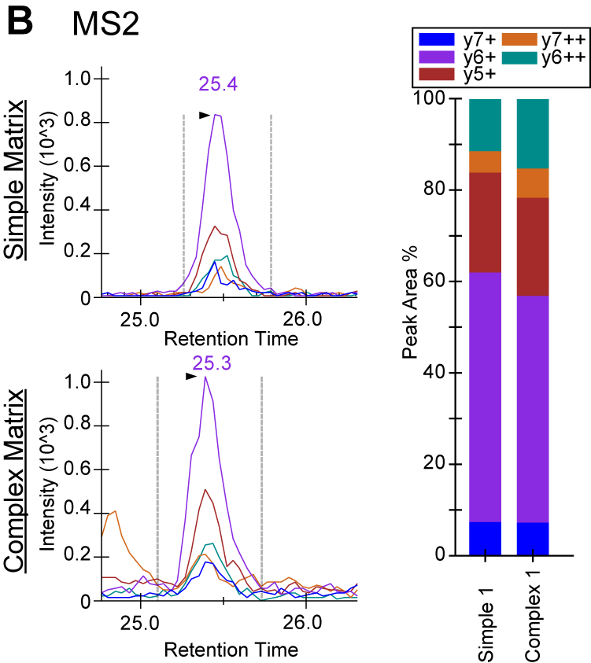
Inferences increase in the MS1 Signal with sample complexity
*
*
Simple Matrix – 25 fmol β−gal
Complex Matrix – 300 ng protein digest
* - Interference

Slide 13
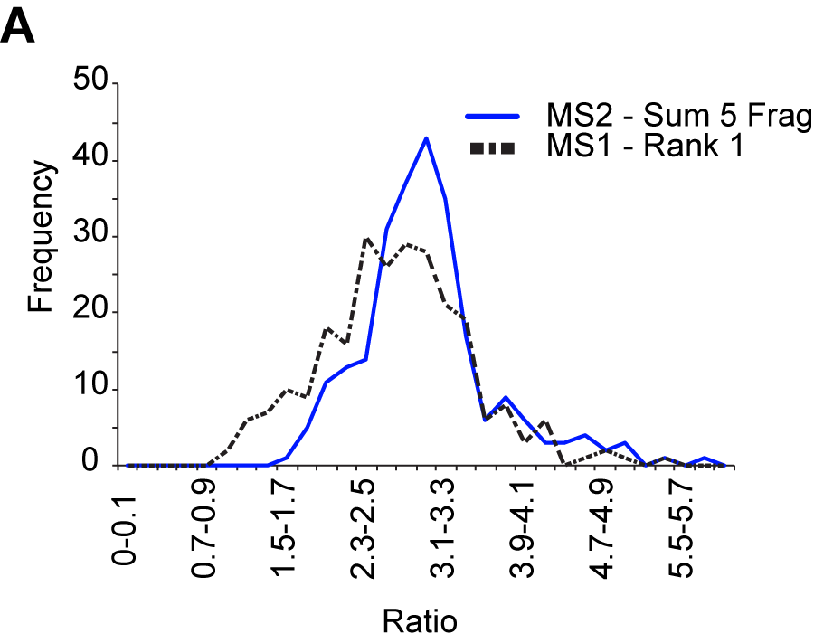
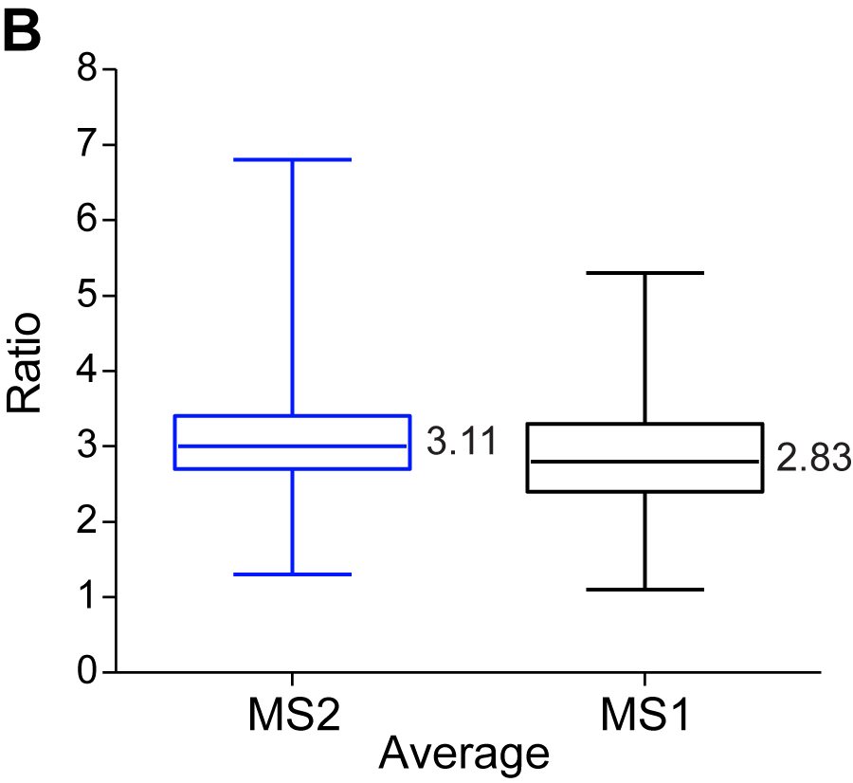
Quantitative comparison of 250 peptides at a fixed ratio using MS1 and SWATH
6 technical replicates were acquired using either 100ng or 300ng of a protein digest
The frequency of the peptide ratios in MS2 was tighter than MS1
The average ratio in the MS2 was closer to the actual ratio; 3.11 vs 2.83 in the MS1 Filtering
Sum of fragment ions in MS2 dramatically improves the distribution of ratios and p-values
SWATH performed better then MS1 Filtering, but not as dramatically as we expected

Slide 14
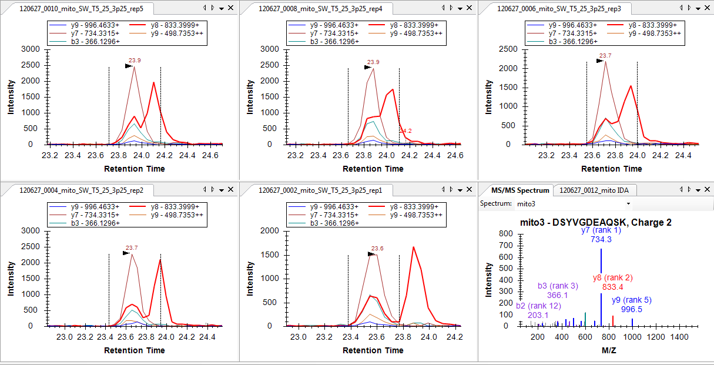
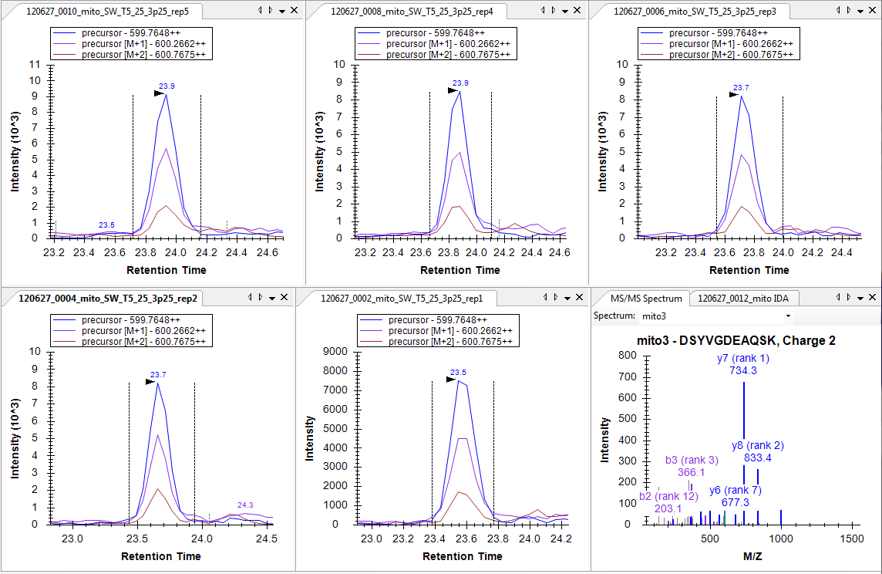
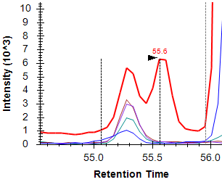
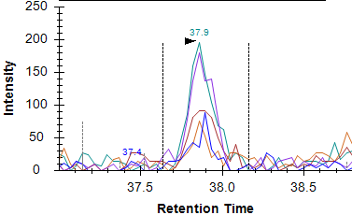
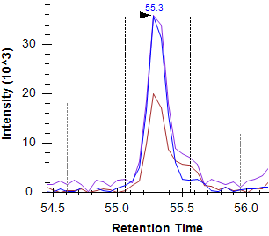
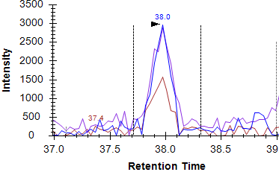
Inferences in the MS2 Signal
A.
Dynamic Interference
y8-interference
SWATH MS2
expected
rep1
rep2
rep3
MS1
expected
rep1
rep2
rep3
B.
Stable Interference
C.
Weak MS2 signal
SWATH MS2
y6-interference
SWATH MS2
expected
rep1
expected
rep1
MS1
MS1
expected
rep1
expected
rep1

Slide 15
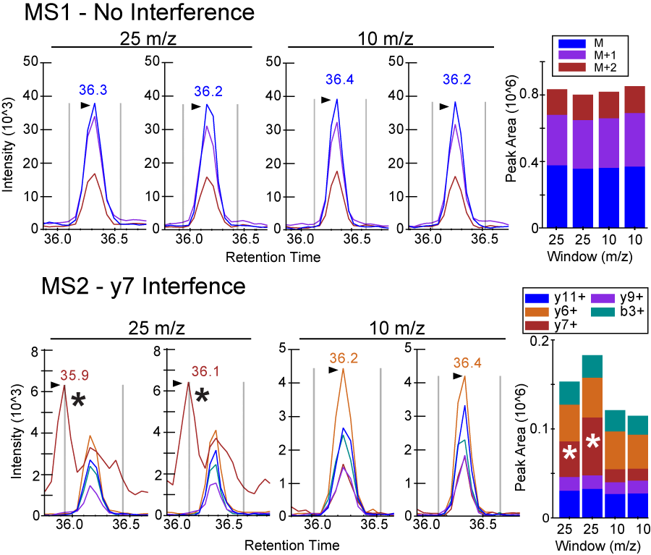
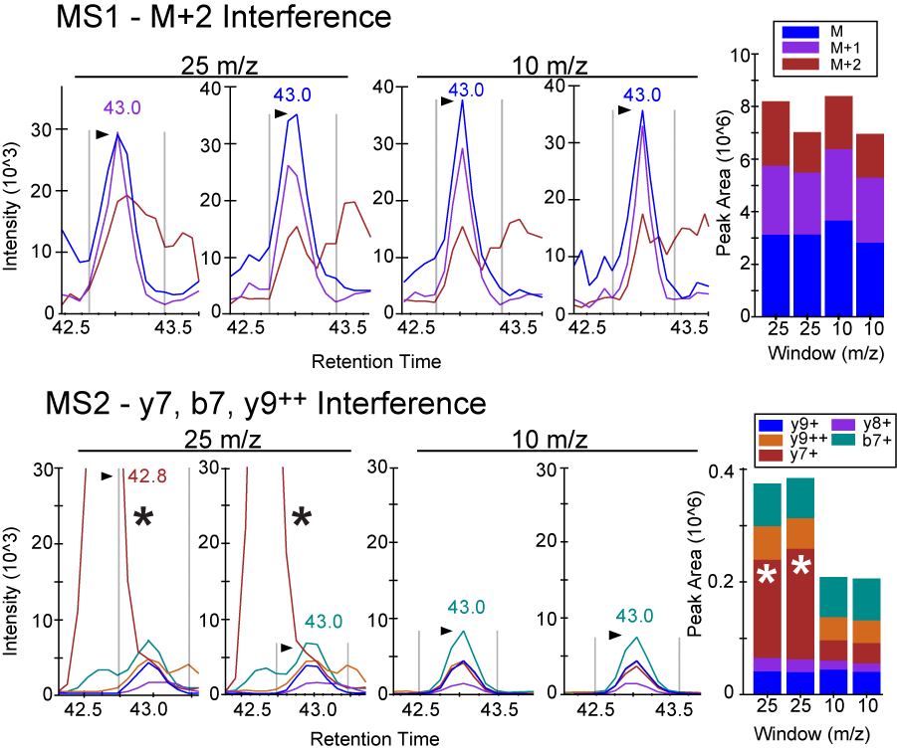
Reducing interferences in the MS2 scan during a SWATH DIA
SWATH 25 m/z
MS1 scan – 250 msec
MS2 scan – 125 msec
SWATH 10 m/z
MS1 scan – 250 msec
MS2 scan – 50 msec

Slide 16
SUMMARY
During a SWATH DIA the MS1 scan is still acquired on the Triple TOF 5600.
In Skyline, both the MS1 and MS2 scans can be extracted and used for quantification of peptide analytes
In a simple matrix the MS1 scan appears to have greater sensitivity then the MS2 scan. However in more complex samples the MS2 scan outperforms the MS1 scan.
The MS1 scan provides useful information and can be used as a secondary quantitation strategy
Use of both scans allow for screening and identifying various types of interferences
Reduction of the SWATH window in a complex sample reduces interferences without loss of sensitivity in the MS2 scan

Slide 17
Acknowledgements
Laboratory of Bradford W. Gibson
Birgit Schilling – MOA 3:50pm
MS1 Filtering for quantifying lysine acetylation in E. coli.
Alexandria D’Souza – TP521
External tool development in Skyline
Jason Held – WP555
Quantifying cysteine oxidation using MS1 Filtering and SWATH
Anna Zawadzka – THOD 8:50am
Breast cancer biomarker study using MS1 Filtering
M
M+1
M+2
y7
y6
y8
y5
b5
b4
University of Washington
Michael J. MacCoss
Brendan MacLean

