Slide 1
Discovery to Targets for a Phosphoproteomic Signature Assay: One-stop shopping in Skyline
Jake Jaffe
Skyline Users Meeting
June 2013

Slide 2
Idea: Phosphosignaling is coordinated!
Phosphosignaling is likely coordinated
Kinase-substrate relationships tend to be 1-to-many
A priori expectation of coordinate regulation of sites
Don’t need to monitor every phosphosite
Can we identify a few that we can reliably monitor?
Go wide instead of deep

Slide 3
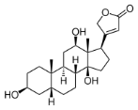

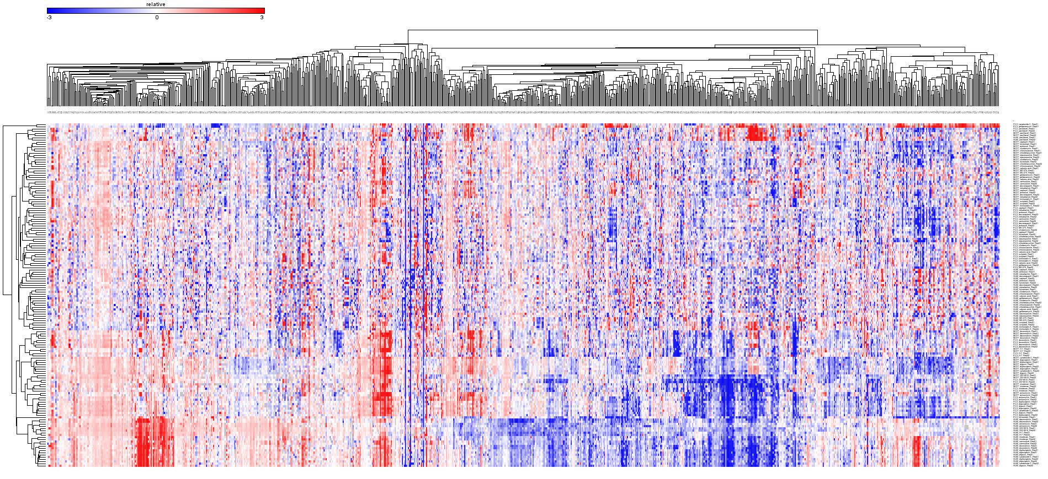
Control DMSO
MCF7
‘Light’ Cells
26
drugs
2
repeats
Tx 1
PC3
X
X
=
‘Medium’ Cells
Tx 2
HL60
‘Heavy’ Cells
Sites
Treatments/Cell lines
Largest systematic set of perturbations with phosphoproteomics readout in existence
Over 10,000 phosphosites observed
Over 1,200 sites present in >75% of all experiments
Jinal Patel, Xiaodong Lu

Slide 4
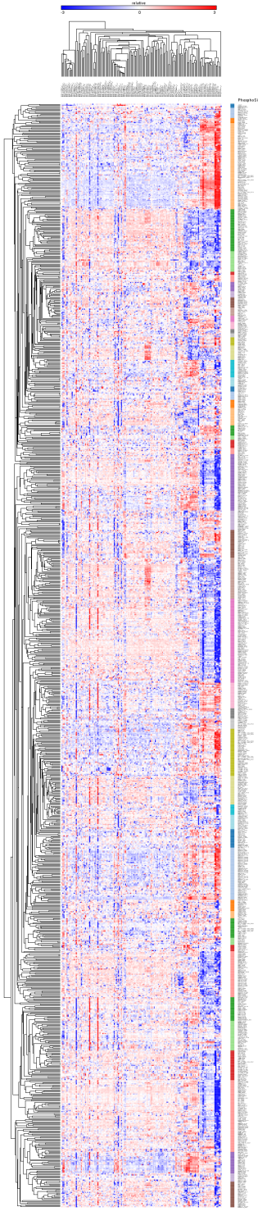
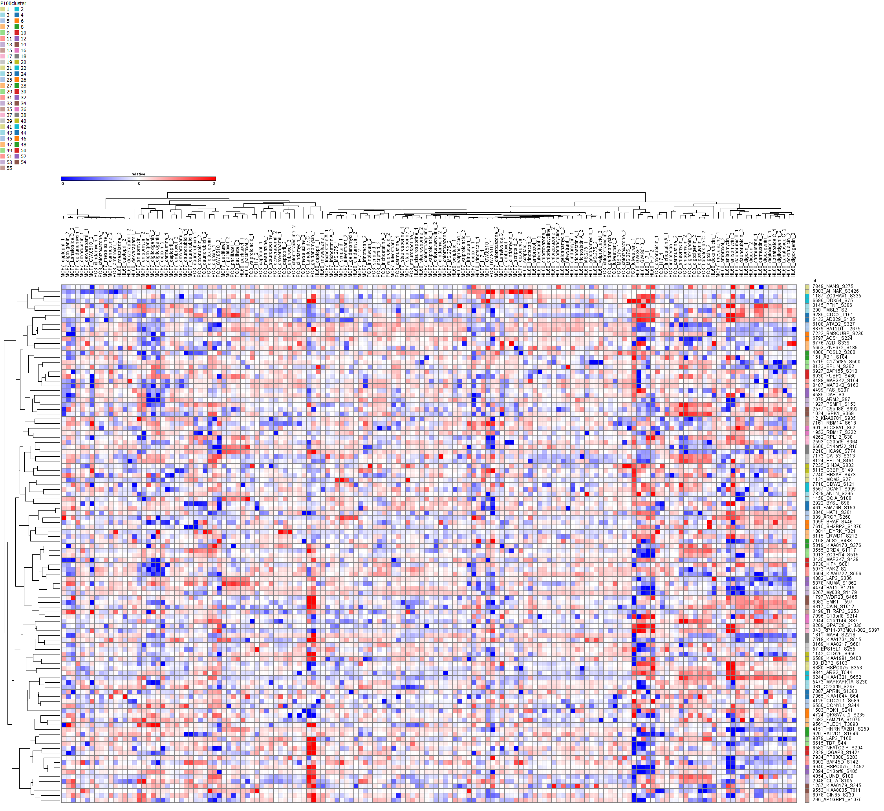
Dimensionality reduction: >1000 to 55 with 2x probe redundancy
Roger Hu

Slide 5
Now for the hard part… Building the P100 Assay

Slide 6
Optimal Phosphosite Quant Requires Multiple Inputs
Level of phosphopeptide
Picked “best” representative peptides from each cluster
Observability, site localization, etc.
Level of non-phosphophorylated cognate
Picked based on above
Level of a non-involved peptide
Control for protein level
Gleaned from all in-house MaxQuant data

Slide 7
Assay Optimization Strategy
Identify and order peptides
Configure Skyline document
Sequence identities
Spectra libraries
Characterize peptides
QC + establish RT properties
Refine spectral libraries
Configure final assay

Slide 8
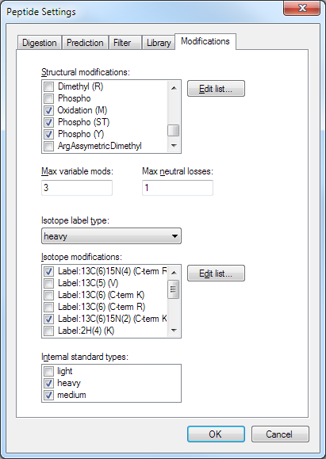
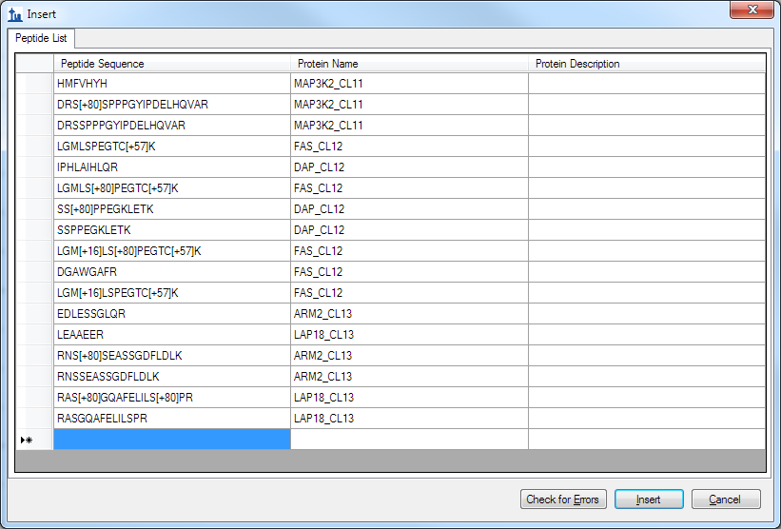
Step 1: Get Sequences into Skyline
Peptide shorthand makes it easy to insert modified sequences
Make sure modifications are present in document!

Slide 9
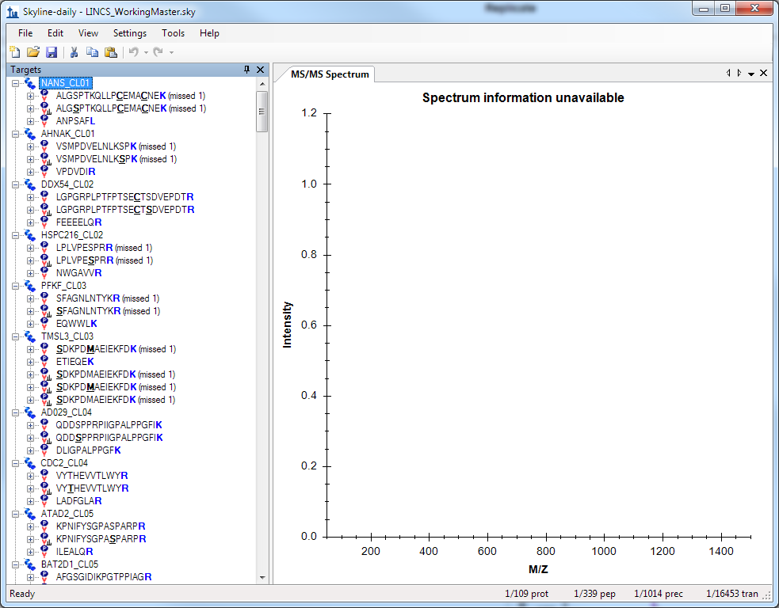
Entire assay document configured in one fell swoop

Slide 10


Discovery and Targeted Platforms are Different
X
MaxQuant
Used for all discovery data processing
Performed all SILAC quantification
MEGA result file
MS/MS table (txt)
2.8 GB
Skyline
Targeted proteomics environment of choice
Now supports MaxQuant / Andromeda formats

Slide 11
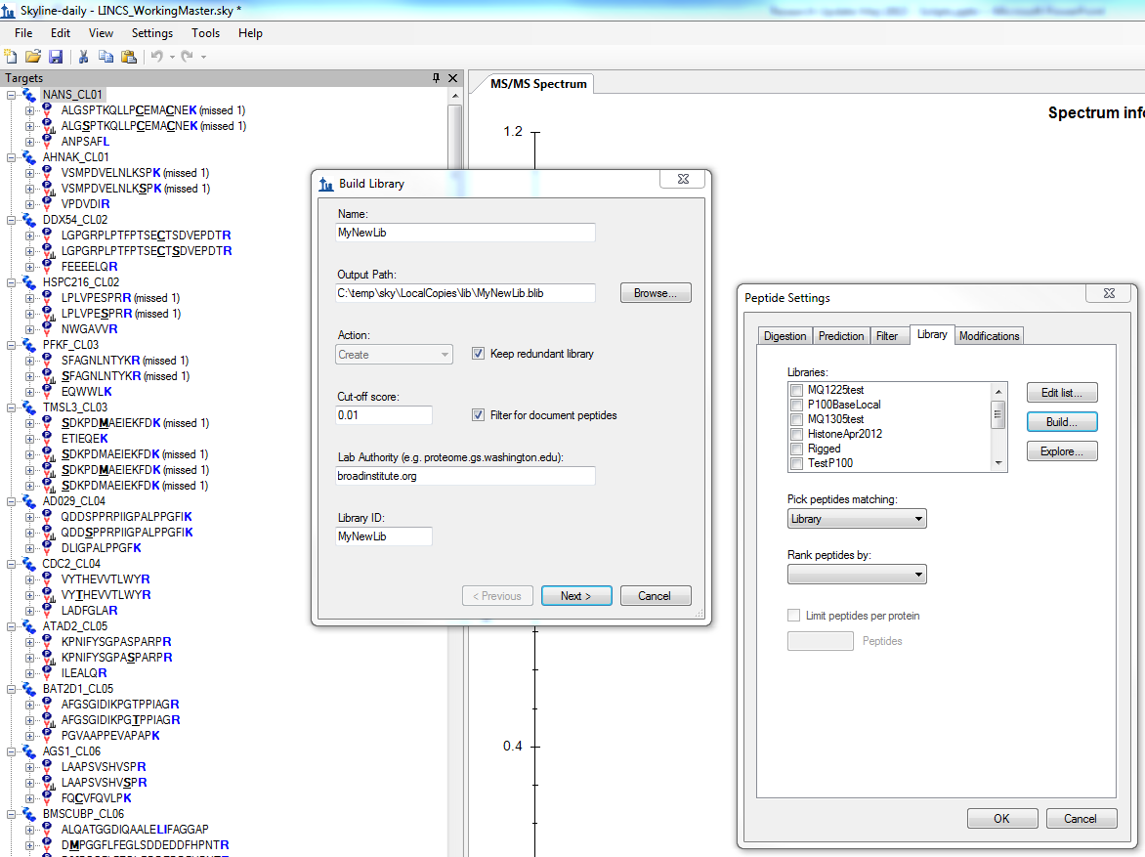
Skyline Spectral Library Building

Slide 12
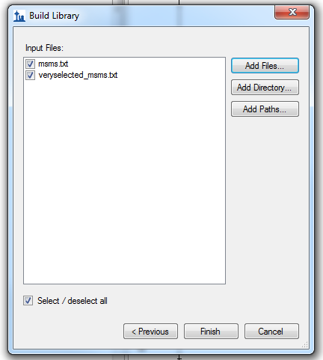
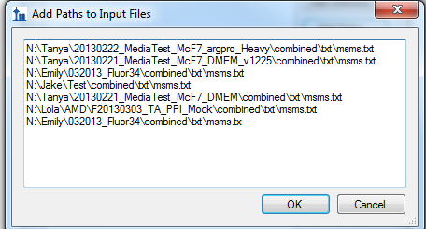
Easily done even when data are distributed

Slide 13
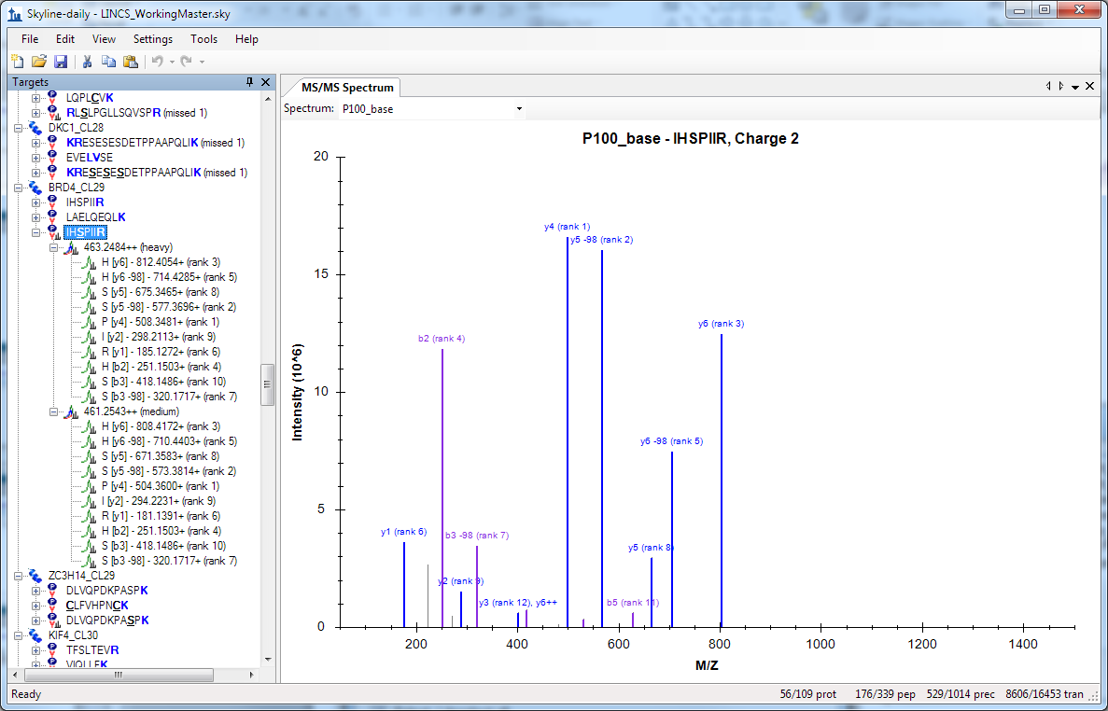
Instant Focused Spectral Library from > 2.8Gb Raw Spectra

Slide 14
Peptide QC and RT Establishment
Run mixtures of peptides conforming to analysis clusters
QExactive MS
Inclusion lists pulled from Skyline doc
Unscheduled…but fully targeted
Full-scan hi-res MS enables proof positive ID
Allows comparison to library as a whole spectrum
Mass accuracy increases confidence
Can observe potential interferents when porting to triple quad

Slide 15
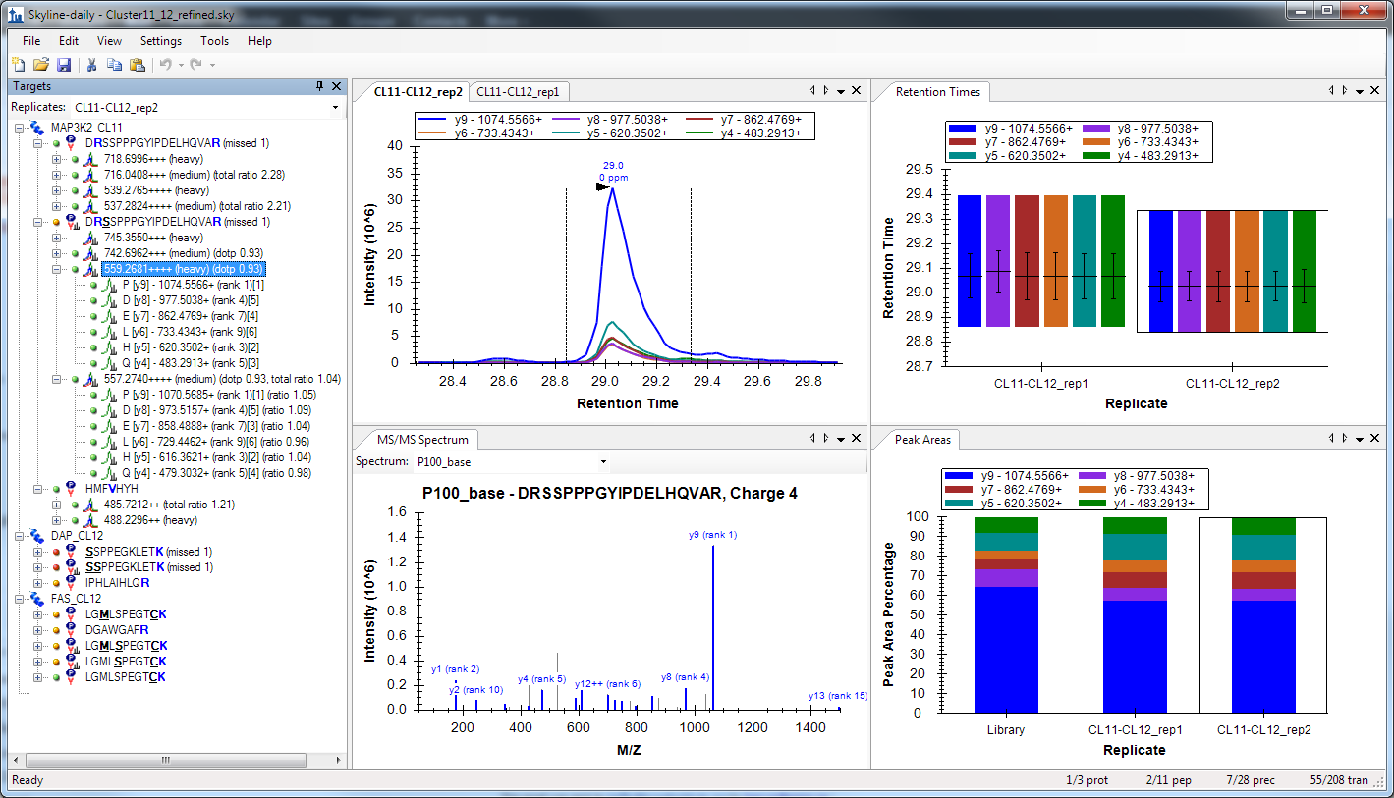
Full-scan QC allows for proof-positive refinement

Slide 16
Assay Optimization Strategy Revisited
Identify and order peptides
Configure Skyline document
Sequence identities
Spectra libraries
Characterize peptides
QC + establish RT properties
Will later use iRT strategy for assay scheduling
Refine spectral libraries
Configure final assay

Slide 17

Distribution of the assay with Panorama
All of our work will be available to other labs
To implement the assay at multiple sites
Ensure data analysis consistency
Clearing house of assay data
Communication with other project data infrastructures

Slide 18
Conclusions
Skyline has contributed immensely to rapid configuration of our assay:
Easy sequence import – even for modified peptides
Easy spectral library creation based on discovery data
Helpful in validation of synthetic peptides
Sets groundwork for scheduling targeted assays
Makes assay portable
Panorama extension will make assay distributable
Feedback / support cycle of Skyline development can drive projects in real time

Slide 19
Acknowledgements
LINCS Program and Program Officers
U01 CA164186-01/Jaffe
MacCoss Lab, Univ. of Washington
Mike MacCoss – co-PI
Brendan MacLean
Kaipo Tamura
Vagisha Sharma
Broad Institute Proteomics Platform
Jinal Patel
Susan Abbatiello
Lindsay Pino
Philipp Mertins
Steve Carr
Broad Institute LINCS Centers
Todd Golub
Aravind Subramanian
Xiaodong Lu
Roger Hu

