Slide 1
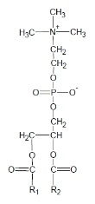

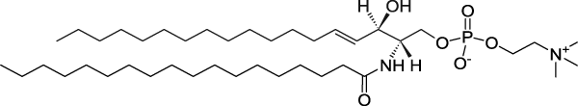
Using Skyline for Targeted Lipidomics
User's Group Meeting
June 9, 2013
Hari Nair, PhD
Andy Hoofnagle, MD PhD
University of Washington

Slide 2
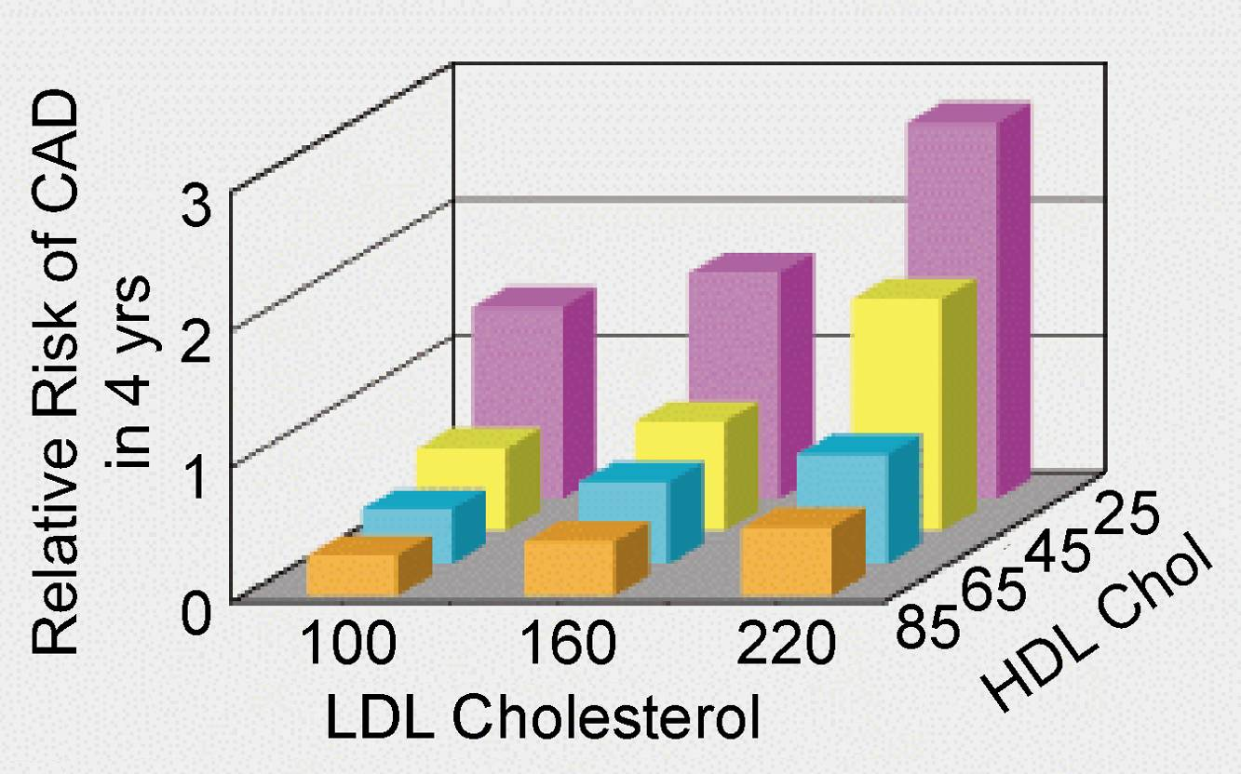
HDL is the Good Cholesterol
The Framingham Heart Study
Castelli, Can J Cardiol, 1988

Slide 3
HDL Cholesterol is Not the Whole Story
Torcetrapib (ILLUMINATE)
60% increase in HDL cholesterol
40% increase in poor outcomes
Dalcetrapib (dal-OUTCOMES)
35% increase in HDL cholesterol
No improvement in outcomes
Niacin (AIM-HIGH)
30% increase in HDL cholesterol
Twice as many strokes
Three HDL-C raising studies terminated early

Slide 4
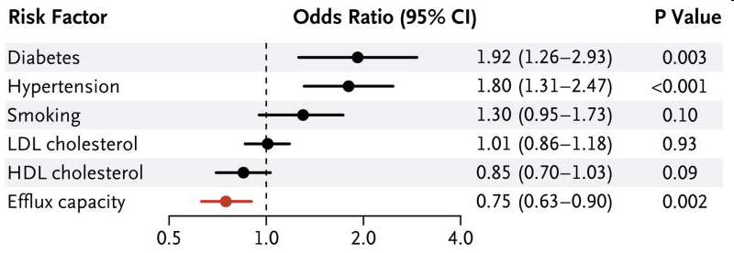
HDL Does More than Just Carry Lipids Functional Assays of HDL
Particles remove lipids from lipid-laden macrophages
HDL activity in vitro is predictive of coronary artery disease
Khera, NEJM, 2011

Slide 5
The HDL Proteome is Vast
CETP
LCAT
ApoC-I
PLTP
ApoM
ApoC-II
ApoC-III
SERF2
ApoF
AGT
SERF1
ApoE
ApoC-IV
Lipid Metabolism
PON3
Proteinase
Inhibitor
ApoD
SAA4
ApoL-1
SAA2
ApoA-II
SAA1
Clusterin
ApoA-I
AHSG
HRP
SERA1
AMP
ApoA-IV
ApoH
PON1
KNG1
Complement
Regulation
C3
Acute Phase Response
C4A
C4B
ORM2
HPX
C9
TTR
TF
FGA
ITIH4
RBP4
VTN
Vaisar, JCI, 2007

Slide 6
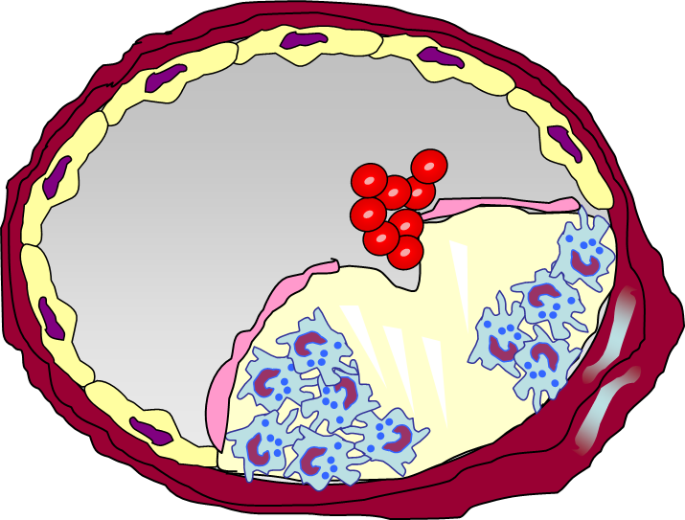
Thrombotic Occlusion of Coronary Artery
Enzymatic Weakening of the Fibrous Cap
Platelet and Coagulation Activation at the Lipid Core
Acute Coronary Syndrome and Sudden Death
Proteolysis
Complement Activation

Slide 7
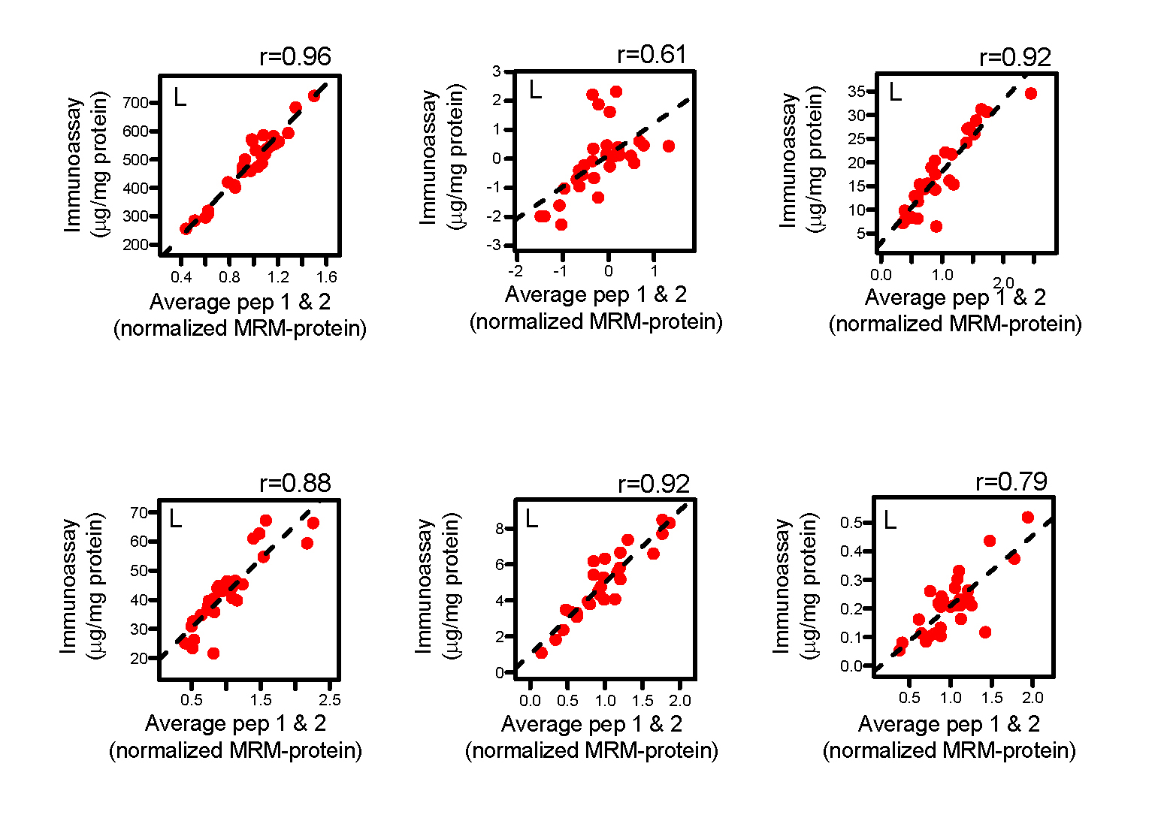
Targeted Proteomics for HDL
Internal Standard Protein
apoA-I
apoB
apoC-II
apoC-III
apoE
apoJ
Hoofnagle, ClinChem, 2012

Slide 8
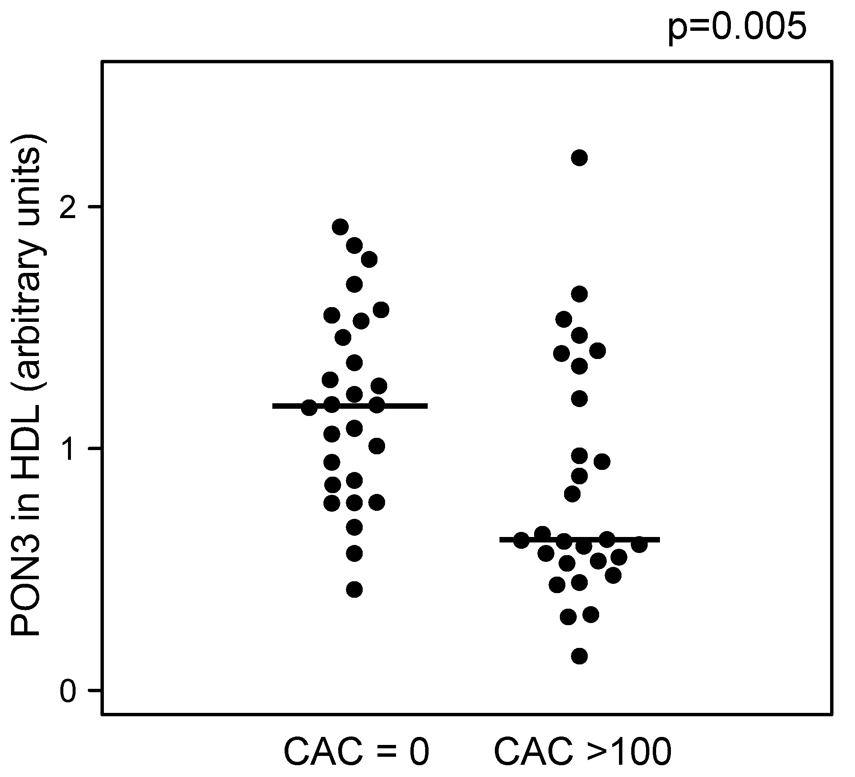
Paraoxonase 3 is Depleted in Patients with Type 1 Diabetes and Artery Calcification

Slide 9
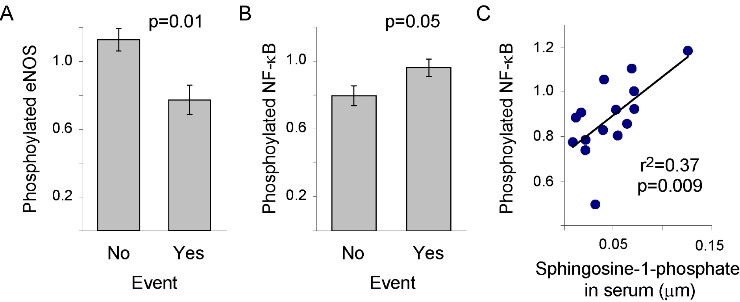
Endothelial Cell Function
Implicating HDL Lipids

Slide 10
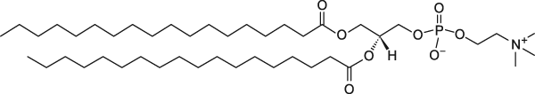
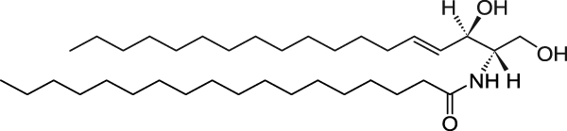
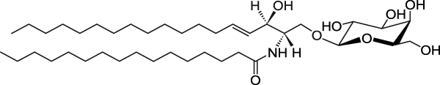
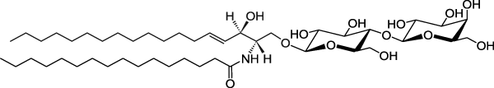
Thinking Beyond Cholesterol Phospholipids and sphingolipids
Phosphotidylcholine
Sphingomyelin
Ceramide
Glucosylceramide
Lactosylceramide

Slide 11
Common Fragment Ions
Common Head Group
Fragment (m/z)
Phosphotidylcholine
184
Sphingomyelin
Ceramide
Common Backbone
Fragment (m/z)
Glucosylceramide
264
Lactosylceramide

Slide 12
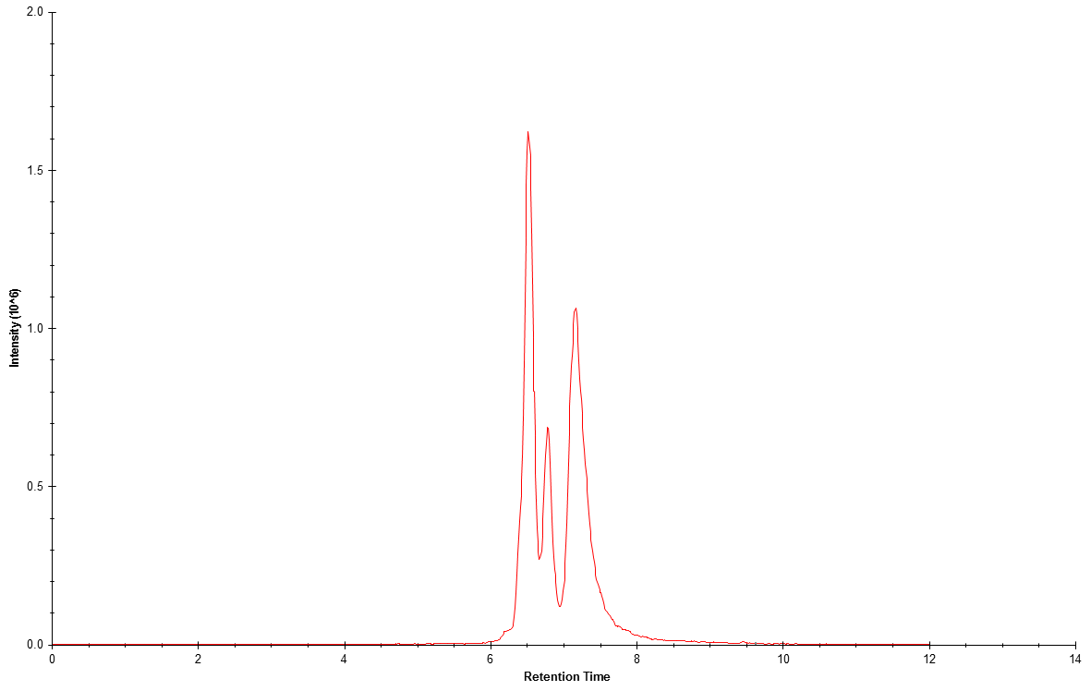
Typical Chromatogram
2.0
1.5
Intensity (cps x10⁴)
1.0
0.5
4
6
8
10
Time (minutes)

Slide 13
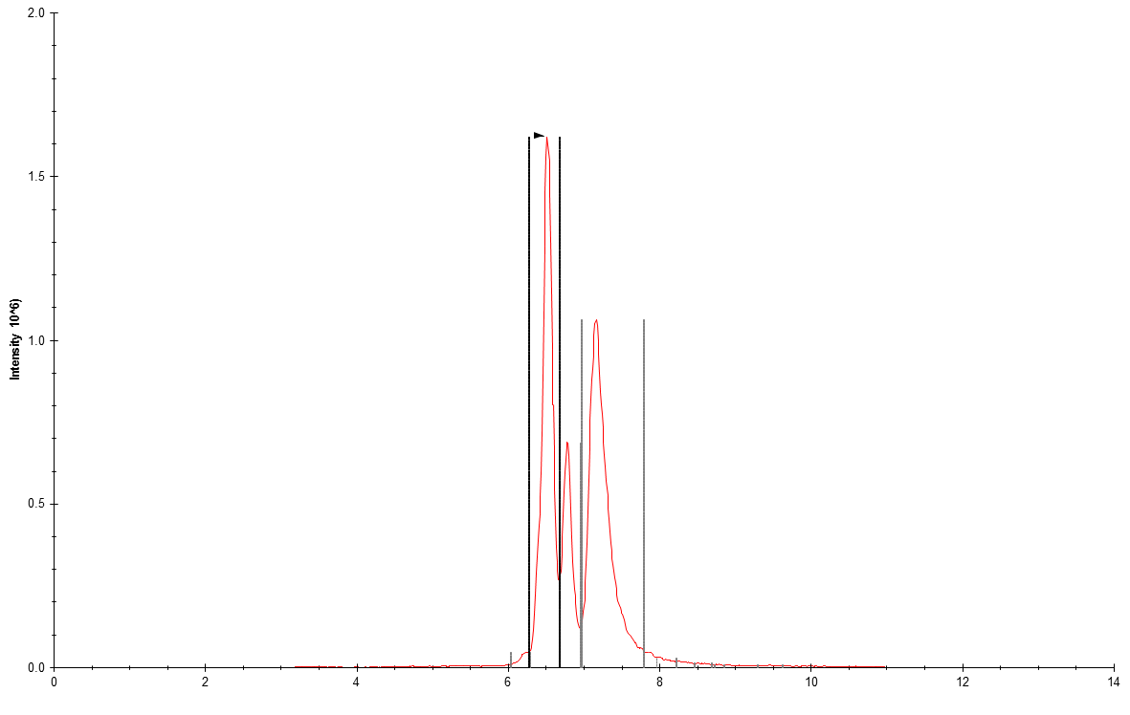
Biological Complexity
2.0
dehydro SM20
PC
1.5
SM20
Intensity (cps x10⁴)
1.0
0.5
4
6
8
10
Time (minutes)

Slide 14
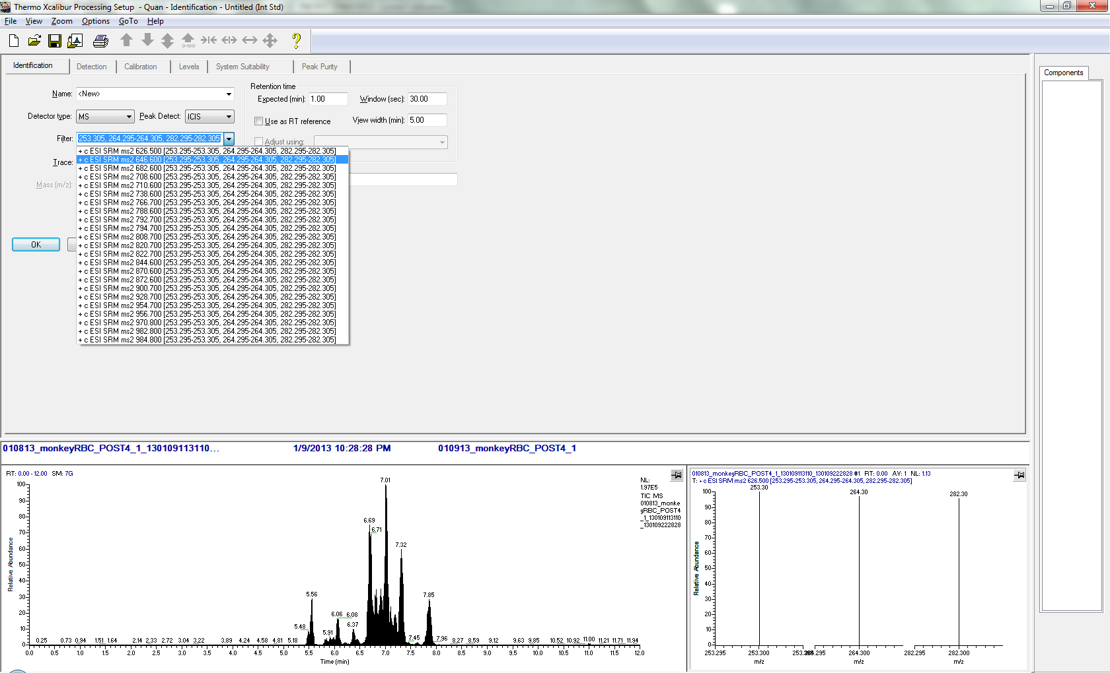
Step 1: Design Data Processing Method
Assign transitions

Slide 15
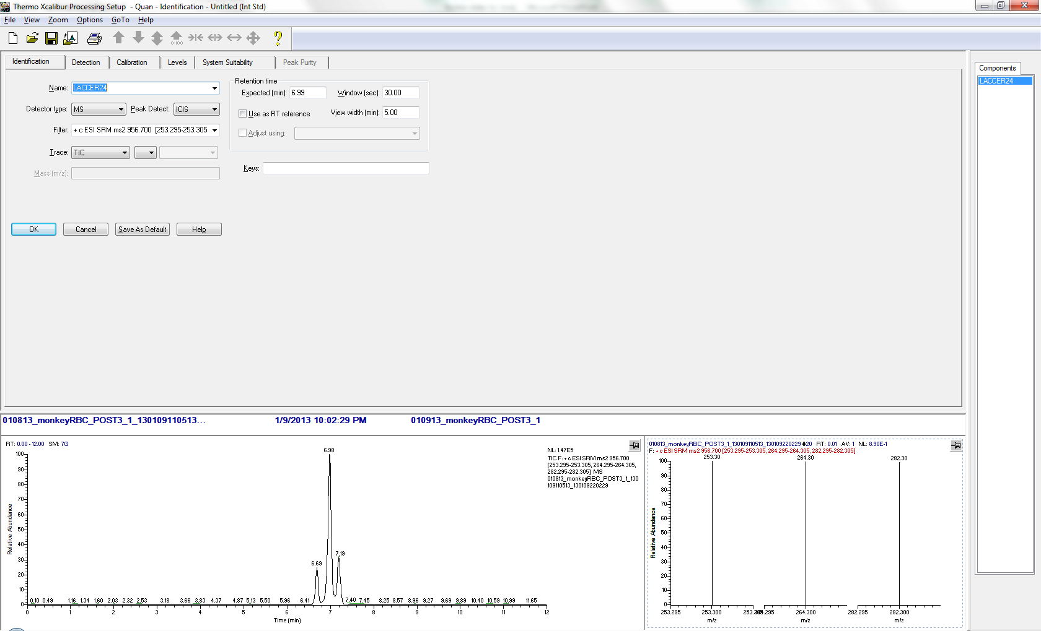
Step 2: Design Data Processing Method
Set RT and Integration window

Slide 16
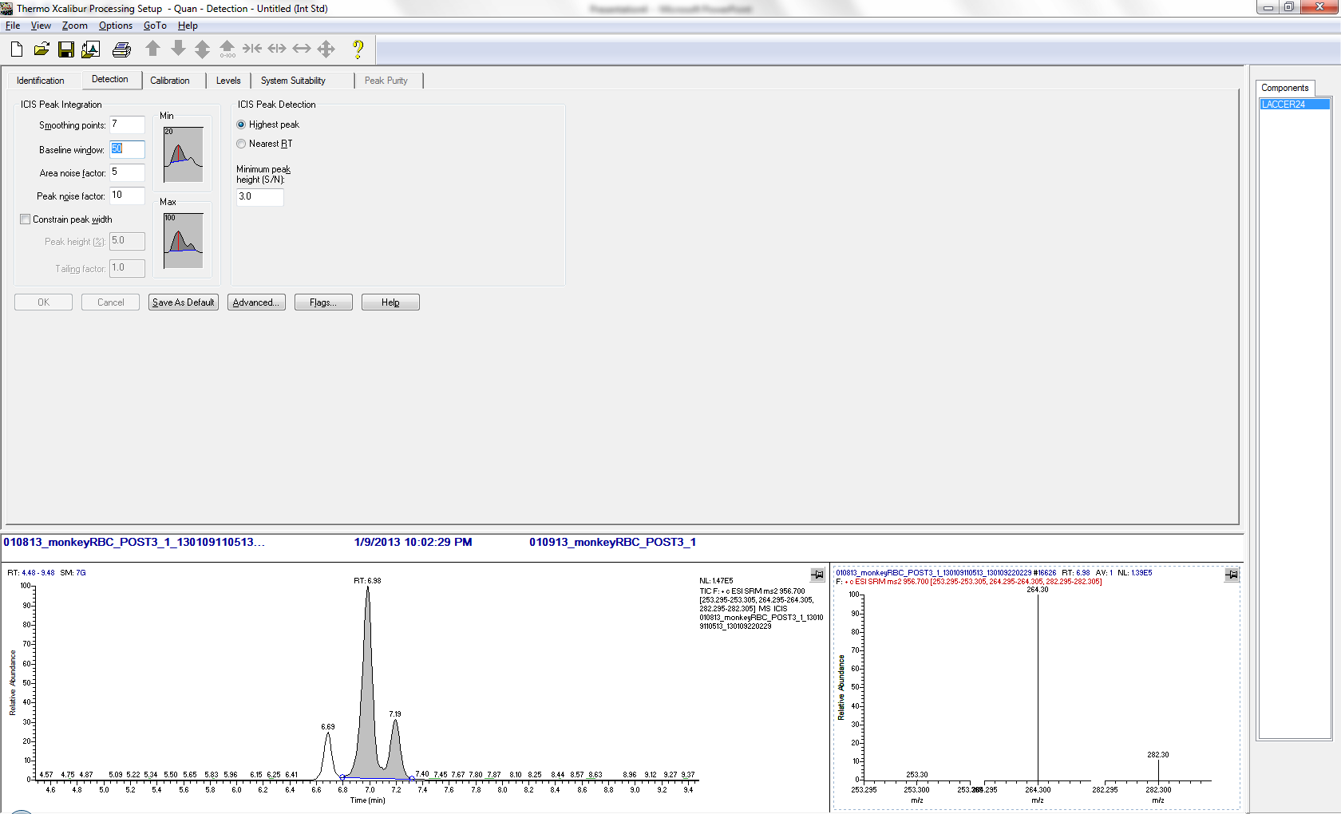
Step 3: Design Data Processing Method
Assign smoothing parameters

Slide 17
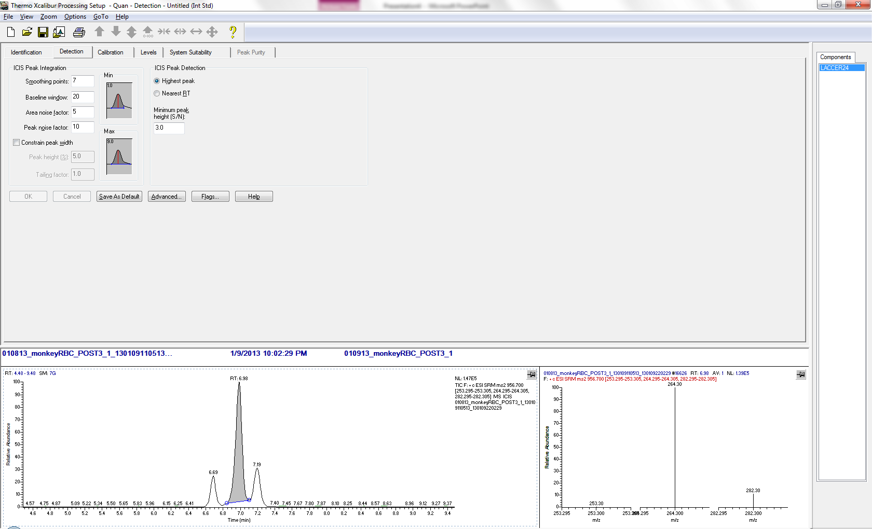
Step 4: Design Data Processing Method
Manually pick peak

Slide 18
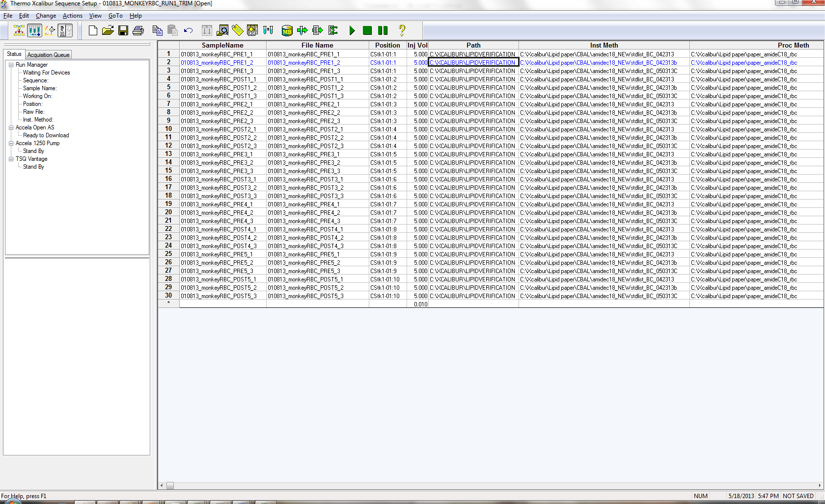
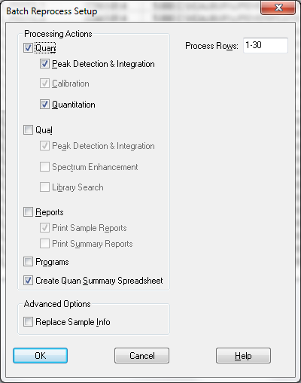
Step 5: Process the Data
Method 1
Method 2
Method 3

Slide 19
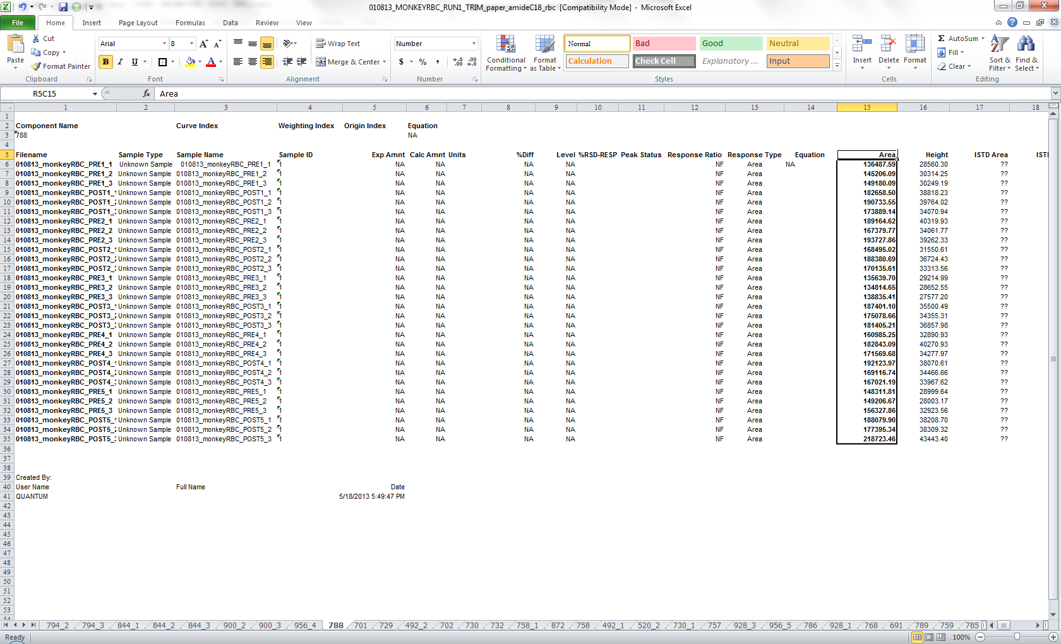
Step 5: Export the Data
An Excel spreadsheet with a single transition per tab

Slide 20
Step 6: Manual Integration & Re-process
Identify samples with wrong retention time, etc.
Fix processing parameters, reprocess
There are 100 tabs here!

Slide 21
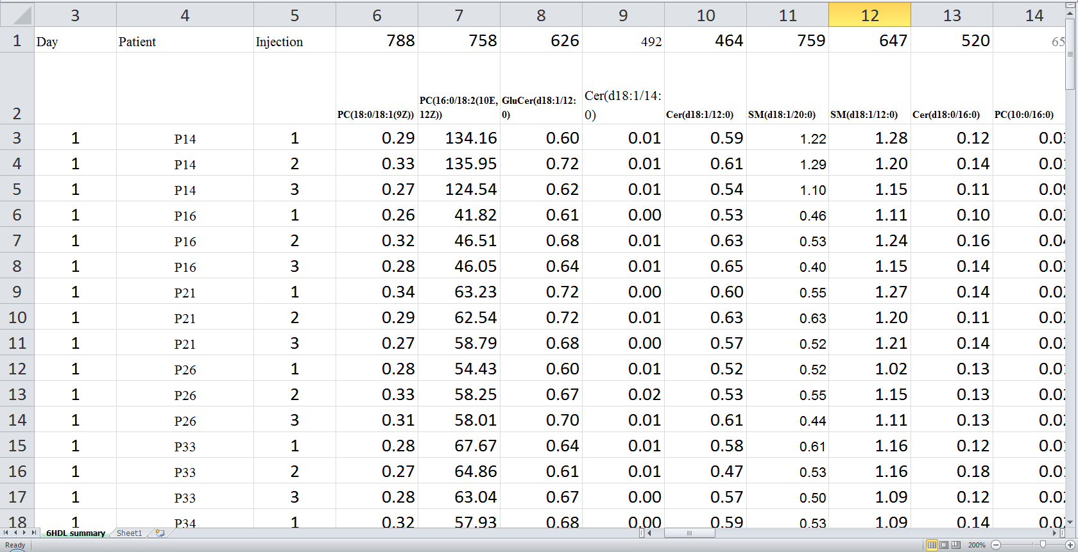
Step 7: Compile Data: A Single Spreadsheet

Slide 22
Workflow Complexity
Three different LC-MS runs
Create a processing method for each transition
Using a previously acquired data file:
Assign RT, peak width, smoothing parameters.
Process data using this processing method
Adjust processing parameters as needed
Export data:
One worksheet in Excel per transition
Random order of worksheets in Excel
Compile data into a single file
Perform QC:
Manually ensure proper integration (retention time, peak shape)
Export data
Perform QC
Lather, Rinse, Repeat...

Slide 23
Possible Solution: Skyline
Easy to manipulate large data sets
Chromatographic alignment
Automated peak integration
Simple report configuration
Simple data export

Slide 24
Possible Solution: Skyline
Tricking Skyline
Set one amino acid to be the fragment for the class of lipids
Set another amino acid to add up to the right precursor mass
Pretend the two amino acids are a peptide

Slide 25
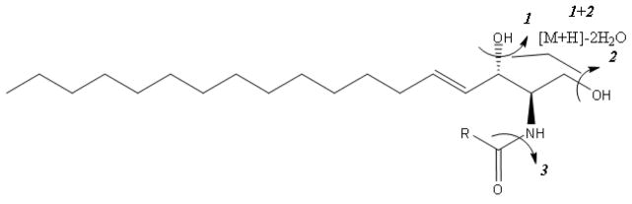
Inventing Amino Acids: The Constant Part
Modified Glycine
Chemical Formula
M+H⁺
264
C₁₅H₂₄
Ceramides (CER, GluCer, LacCer)
Phosphatidylcholine (PC)
184
C₁₀H₄
Sphingomyelins (SM)

Slide 26
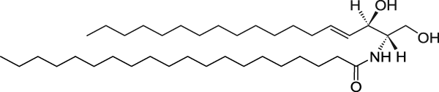
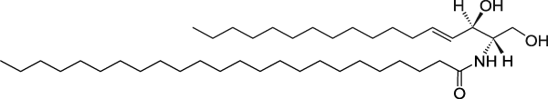

Inventing Amino Acids: The Variable Part
Modified Alanine
Chemical Formula
M+H⁺
C18 Ceramide (d18:1/18:0)
548
C₁₃H₁₃
C20 Ceramide (d18:1/20:0)
576
C₂₀H₁₃
C22 Ceramide (d18:1/22:0)
604
C₁₇H₂₁

Slide 27
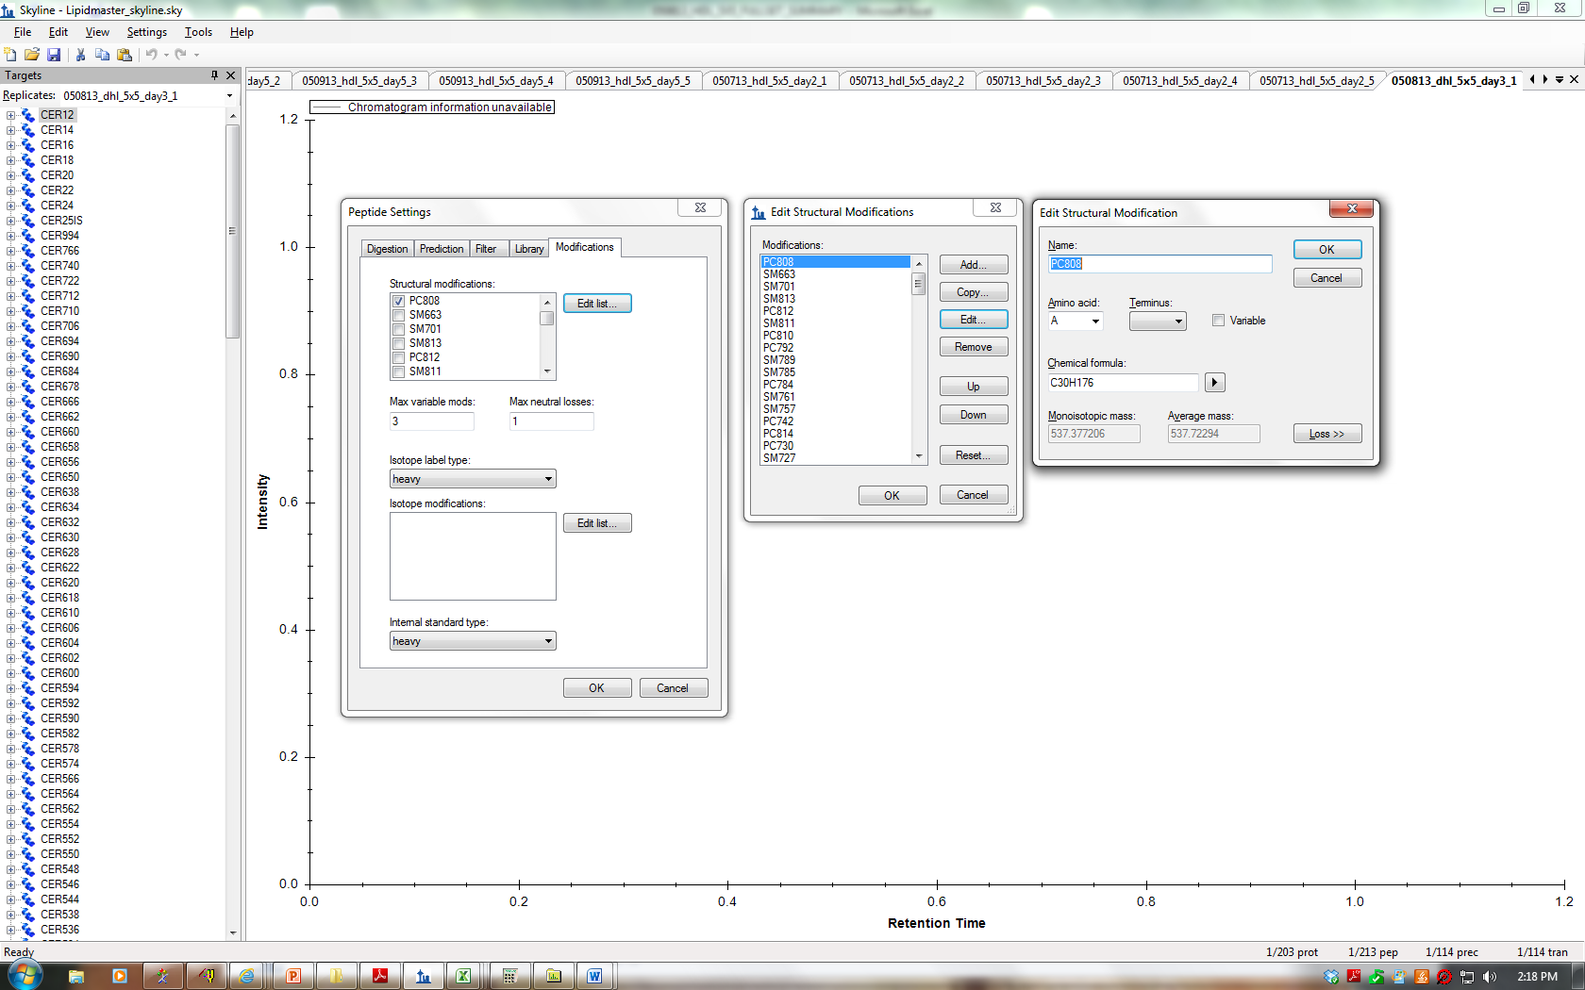
Step 1: Invent Modified Amino Acids

Slide 28
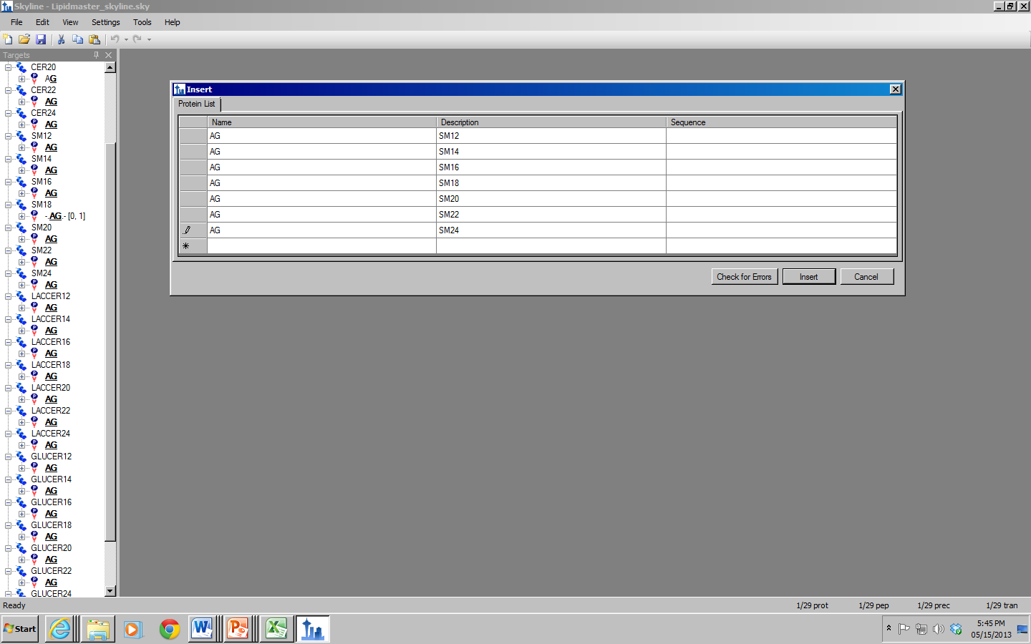
Step 2: Invent New "Proteins" and "Peptides"

Slide 29
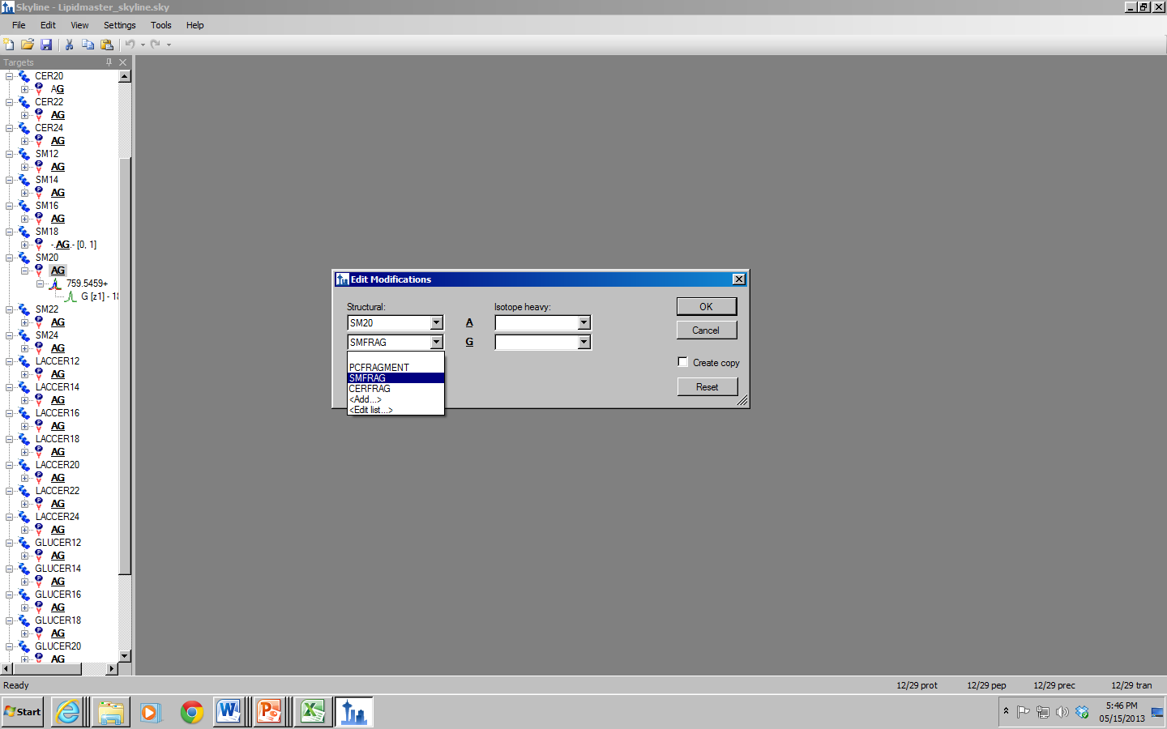
Step 3: Modify the Amino Acids on the "Peptides"

Slide 30
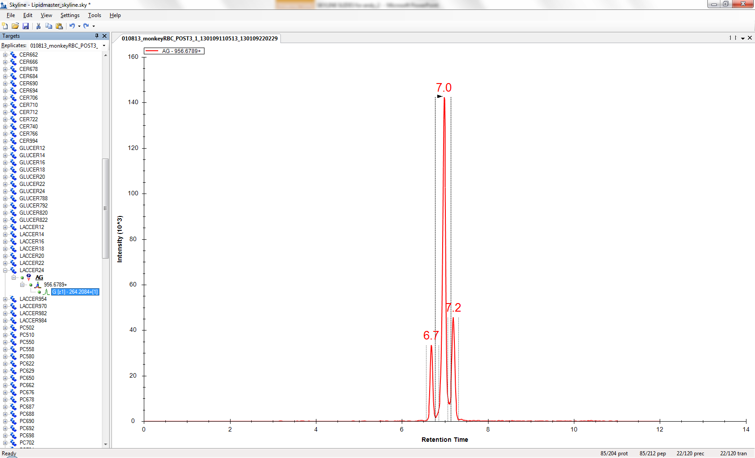
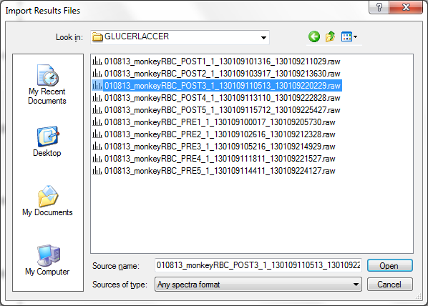
Step 4: Import Data

Slide 31
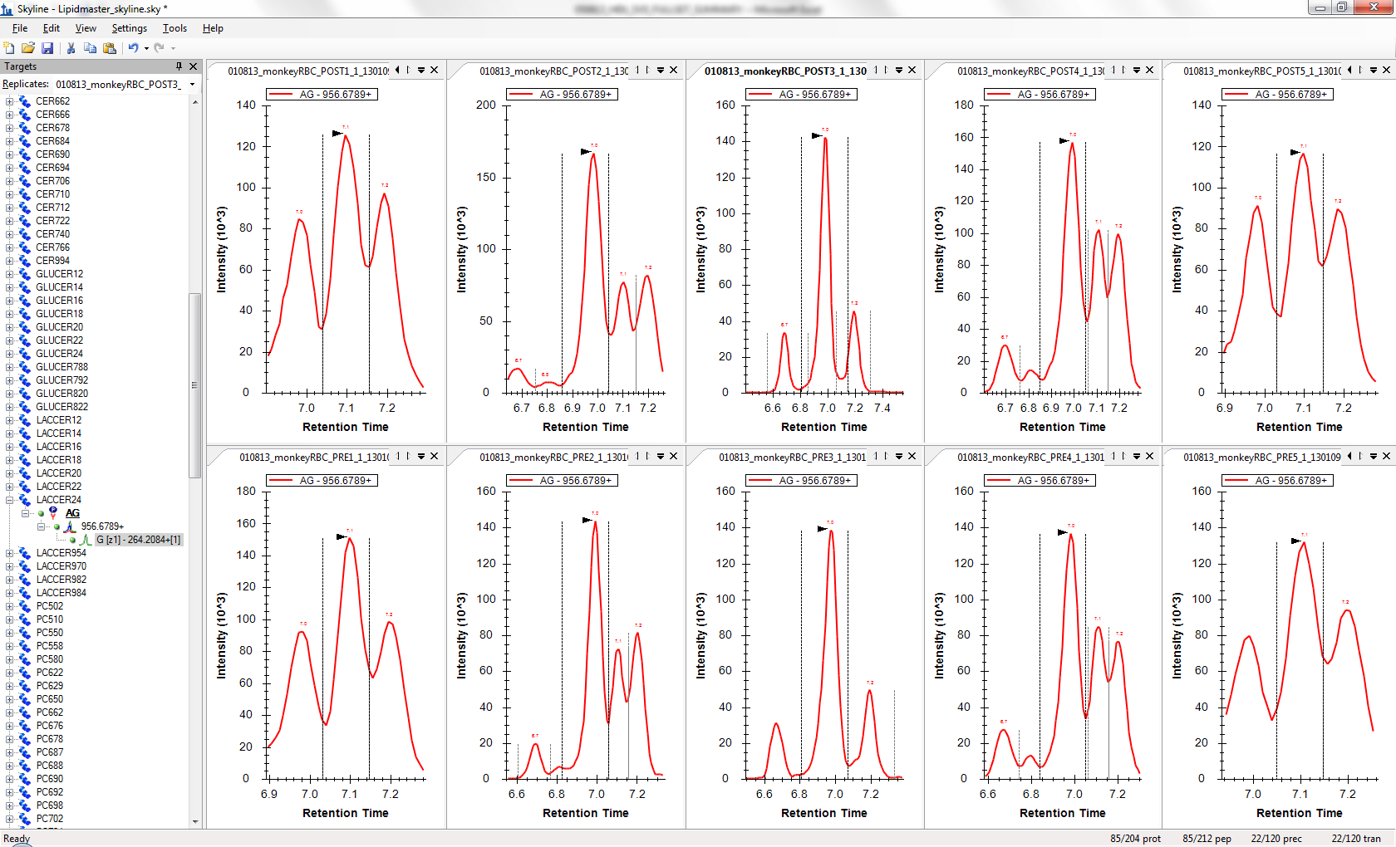
Step 5: Manually Pick Peaks if Needed

Slide 32
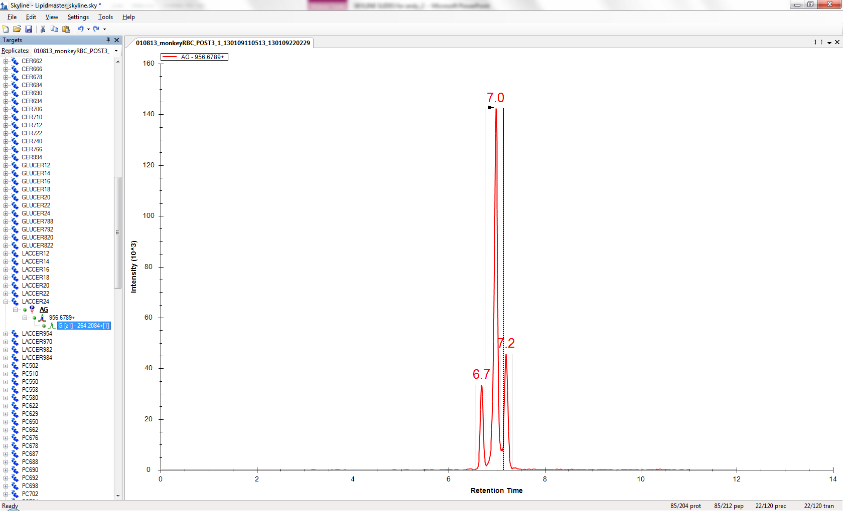
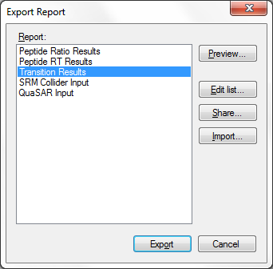
Step 6: Export the Data

Slide 33
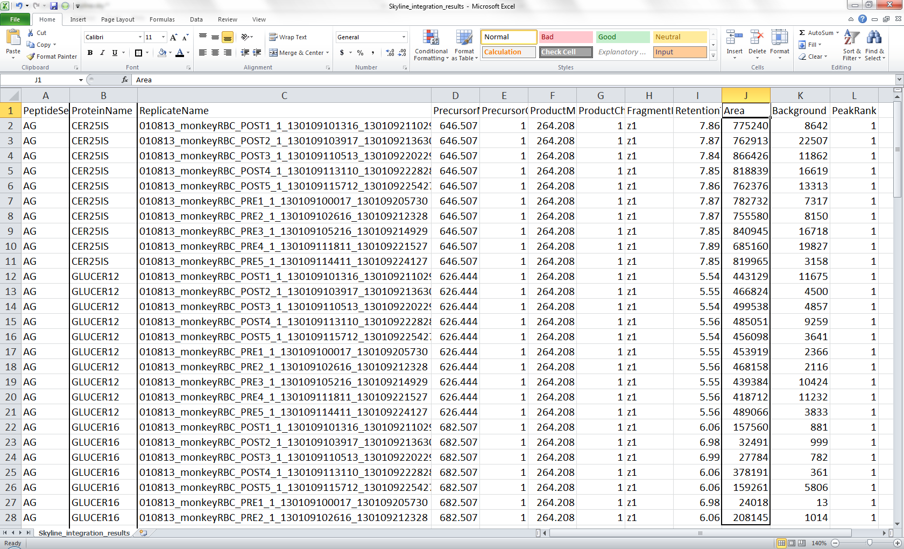
A Deliverable: One Tab on One Spreadsheet

Slide 34
An Experiment: The Data First
How long would you be willing to spend to get this amount of data?
Vendor Software: 15 hours, Skyline: 4 hours
Actively collaborating with the author of the software: Priceless

