Slide 1
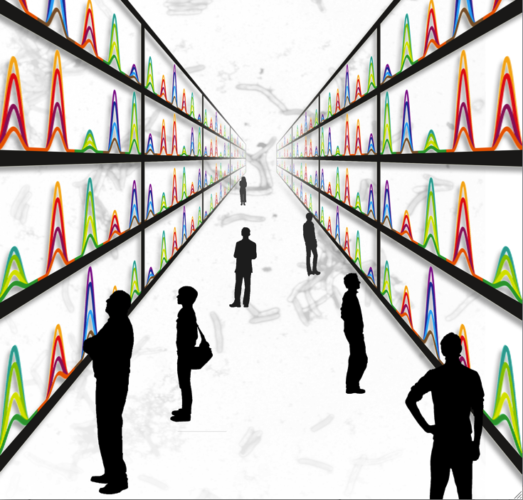

The Mtb Proteome Library:
Development and application of assays for targeted MS analysis of the complete proteome of Mycobacterium tuberculosis by SRM and SWATH-MS
Olga Schubert
Group of Prof. Ruedi Aebersold
ETH Zurich
Skyline User Meeting 2013 Minneapolis

Slide 2
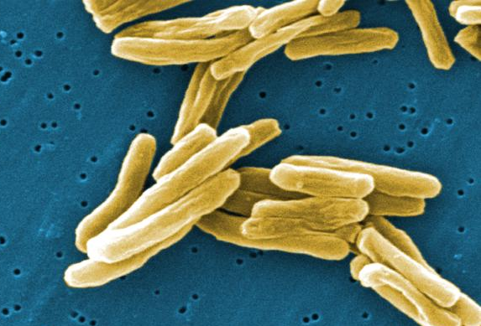
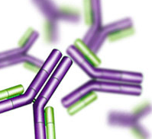
Mycobacterium tuberculosis (Mtb)
Mycobacterium tuberculosis is the causative agent of Tuberculosis (TB)
One third of the world’s population latently infected with Mtb
1.7 million deaths from TB each year
More efficient treatments urgently needed
Limited availability of techniques to measure proteins with high sensitivity, selectivity and reproducibility
  Traditional approach: Antibodies
Aim
To generate a resource of validated assays for the sensitive detection and accurate quantification of every protein of Mycobacterium tuberculosis, even in complex backgrounds.
Only for few targets, high cost, low throughput

Slide 3
The Mtb Proteome Library contains SRM assays for the entire proteome of Mtb
Schubert et al. Cell Host & Microbe 2013
The Mtb Proteome Library: A Resource of Assays to Quantify the Complete Proteome of Mycobacterium tuberculosis.

Slide 4
Definition of the MS-accessible
Mtb proteome by discovery MS
Extensive fractionation and shotgun MS on Orbitrap XL
Isoelectric focusing (off-gel electrophoresis)
3074 proteins (77%)
100% corresponds to the 4,012 annotated ORFs in Mtb
(TubercuList v2.3)
RNA-seq data: Arnvig et al., PLoS Pathogens 2011

Slide 5
Generation of SRM assays
using crude synthetic peptides
3894 proteins (97%)
17,463 crude synthetic peptides (JPT) measured in pools of ~100 on a Qtrap 4000 in SRM-triggered MS2 mode

Slide 6
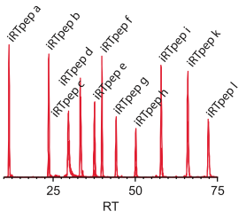
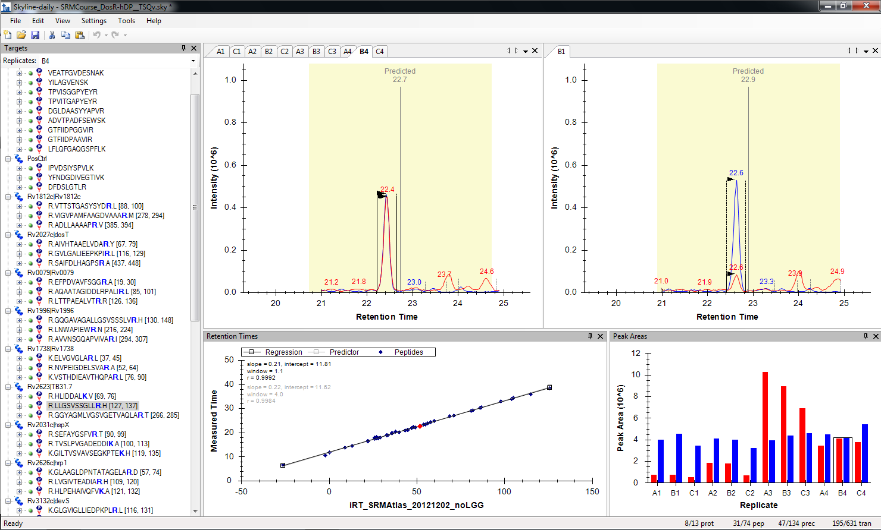
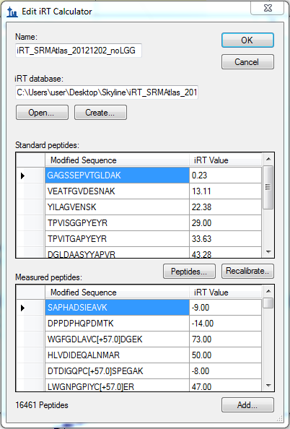

Increasing SRM/SWATH assay specificity and throughput by using iRTs and scheduled SRM
iRT peptides spiked into each sample allow to determine a chromatography-independent retention time (iRT) for each peptide.
Escher et al., Proteomics 2012, Using iRT, a normalized retention time for more targeted measurement of peptides

Slide 7
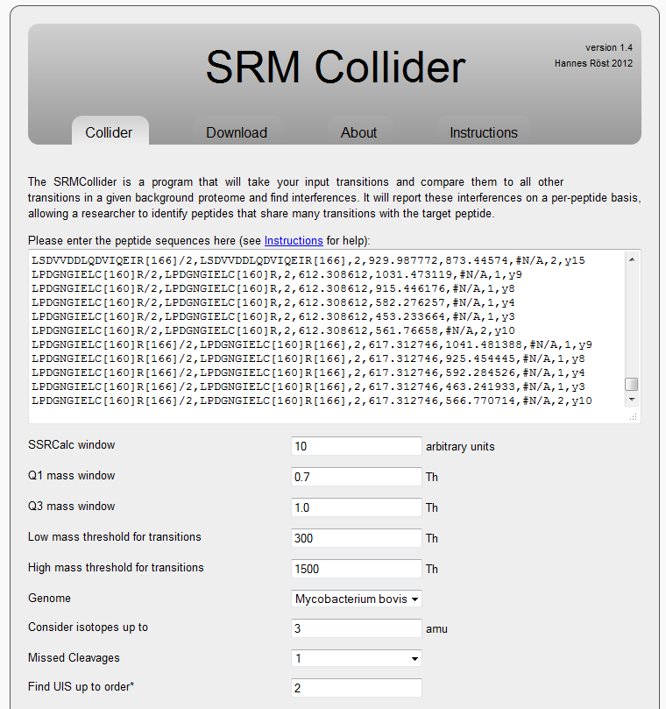
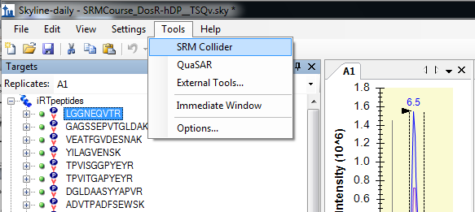
Theoretical assessment of SRM assay
specificity using the SRMCollider
Röst et al., MCP 2012, A computational tool to detect and avoid redundancy in selected reaction monitoring
Notes:
Prediction of transition specificity
Unique ion signatures were calculated as described by Röst and colleagues (Röst et al., 2012). Theoretical precursor ions were generated using trypsin for proteolysis, CAM as fixed modification, and charge states 2+ and 3+ for parent ions and considered up to three 13C isotopic peaks (+0, +1, +2, +3 amu). For each of those precursor ions the complete set of y and b fragment ions was generated. The Mtb dataset gave rise to 74,921 tryptic peptides, 599,872 precursors, and 17,447,648 transitions. The human dataset gave rise to 677,150 tryptic peptides, 5,417,200 precursors, and 117,151,632 transitions. For each precursor in the Mtb Proteome Library the best n ions were selected, where n is in the range of 1 to 6. We then determined all transitions of the background proteome that were within a Q1 and Q3 tolerance of ± 0.35 m/z, as well as within a certain retention time tolerance for scheduled measurements (± 5 SSRCalc arbitrary units corresponding to approximately ± 2.5 min on a 30-min gradient) (Krokhin, 2006). The minimal number of transitions necessary to uniquely identify a precursor species was defined as the minimal n for which no other precursor existed in the background whose ions contained all n query ions.

Slide 8
Validation of the Mtb Proteome Library in unfractionated whole cell lysates by SRM
mProphet analysis
SRM validated Mtb Proteome Library
2884 at 1% FDR
(72% of the Mtb proteome)
2884 proteins (72%)
To validate all these SRM assays, over 200 scheduled SRM runs were needed.
Reiter et al., Nature Methods 2011, mProphet: automated data processing and statistical validation for large-scale SRM experiments
Notes:
SRM on TSQ Vantage; scheduled (±2min on 35 min gradient)
6 transitions per precursor and ~70 precursors/run → >200 runs
11 spiked in iRT peptides and 3 endogenous positive control peptides measured in each run
~500 decoy transition groups measured along with the targets

Slide 9
The Mtb Proteome Library contains SRM assays for the entire proteome of Mtb
3074 (77%) proteins
3894 (97%) proteins
2884 (72%) proteins
Schubert et al. Cell Host & Microbe 2013
The Mtb Proteome Library: A Resource of Assays to Quantify the Complete Proteome of Mycobacterium tuberculosis.

Slide 10
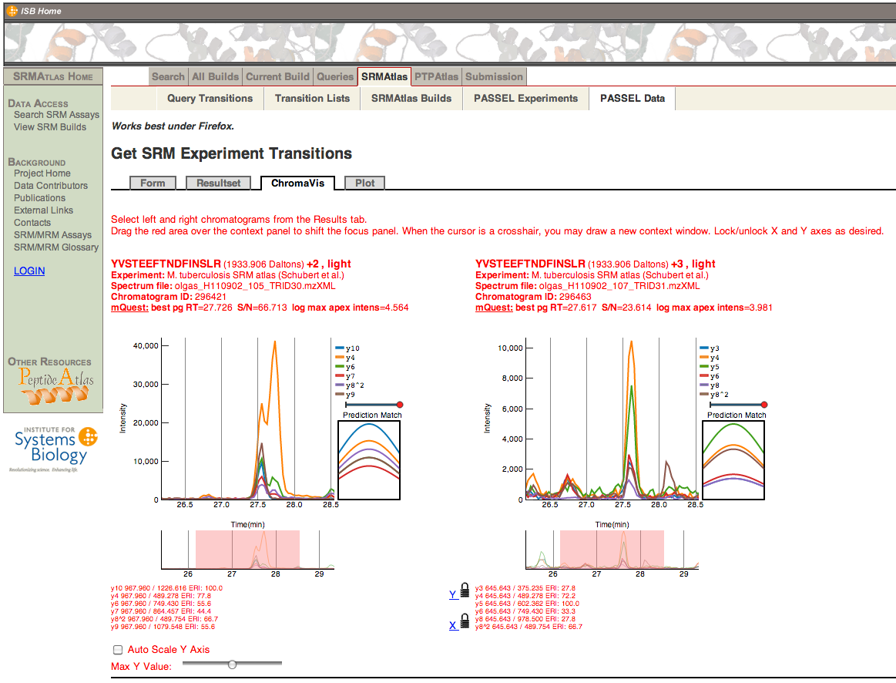
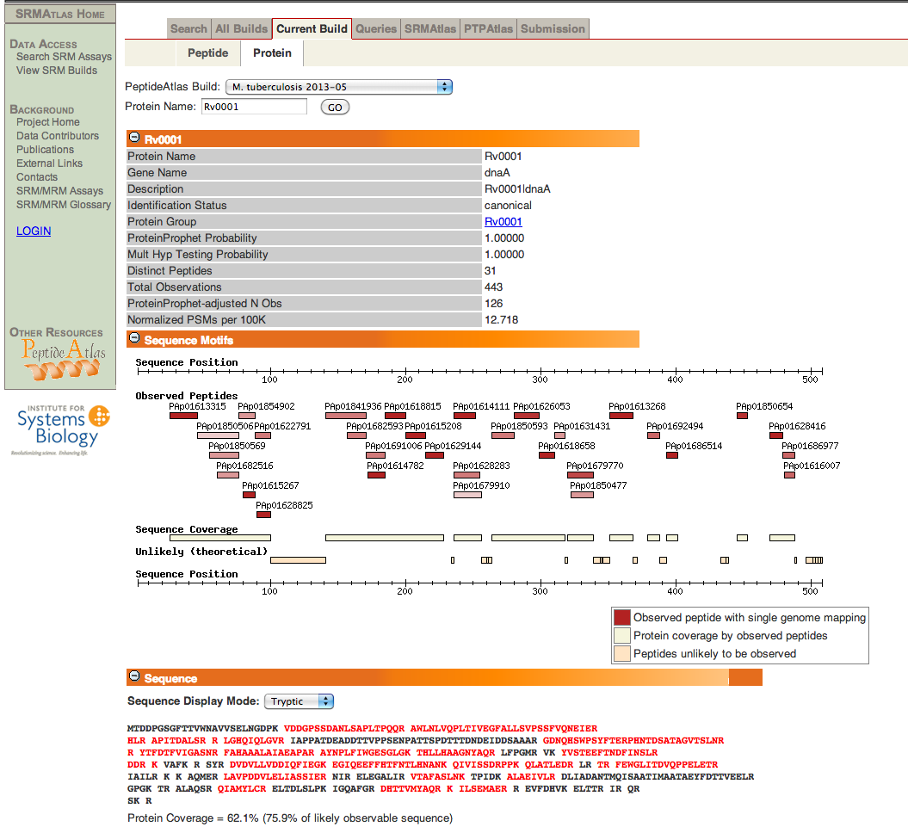
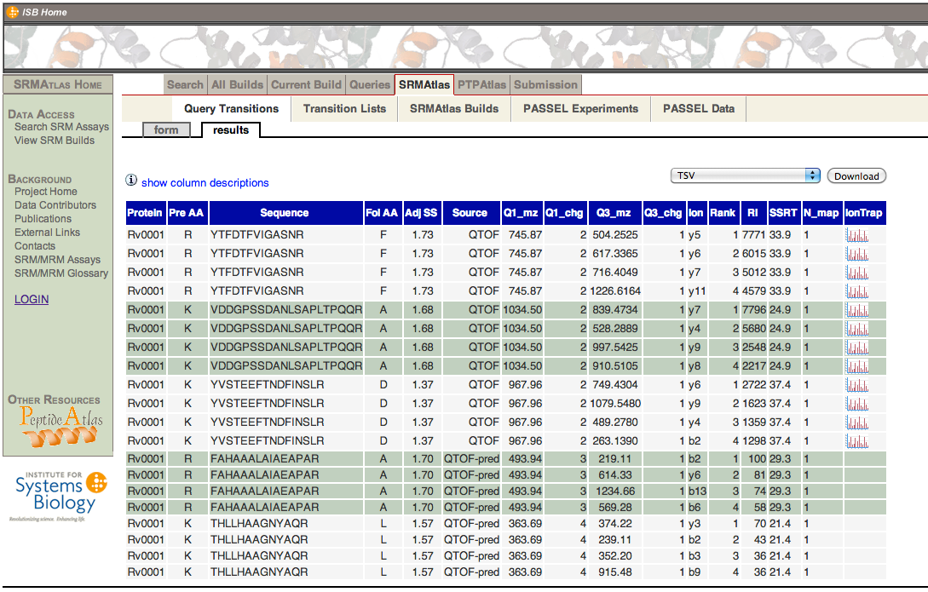
The Mtb Proteome Library is a publicly available resource of MS reference data, SRM assays and their validation
www.PeptideAtlas.org/PASSEL
www.PeptideAtlas.org
www.SRMAtlas.org

Slide 11
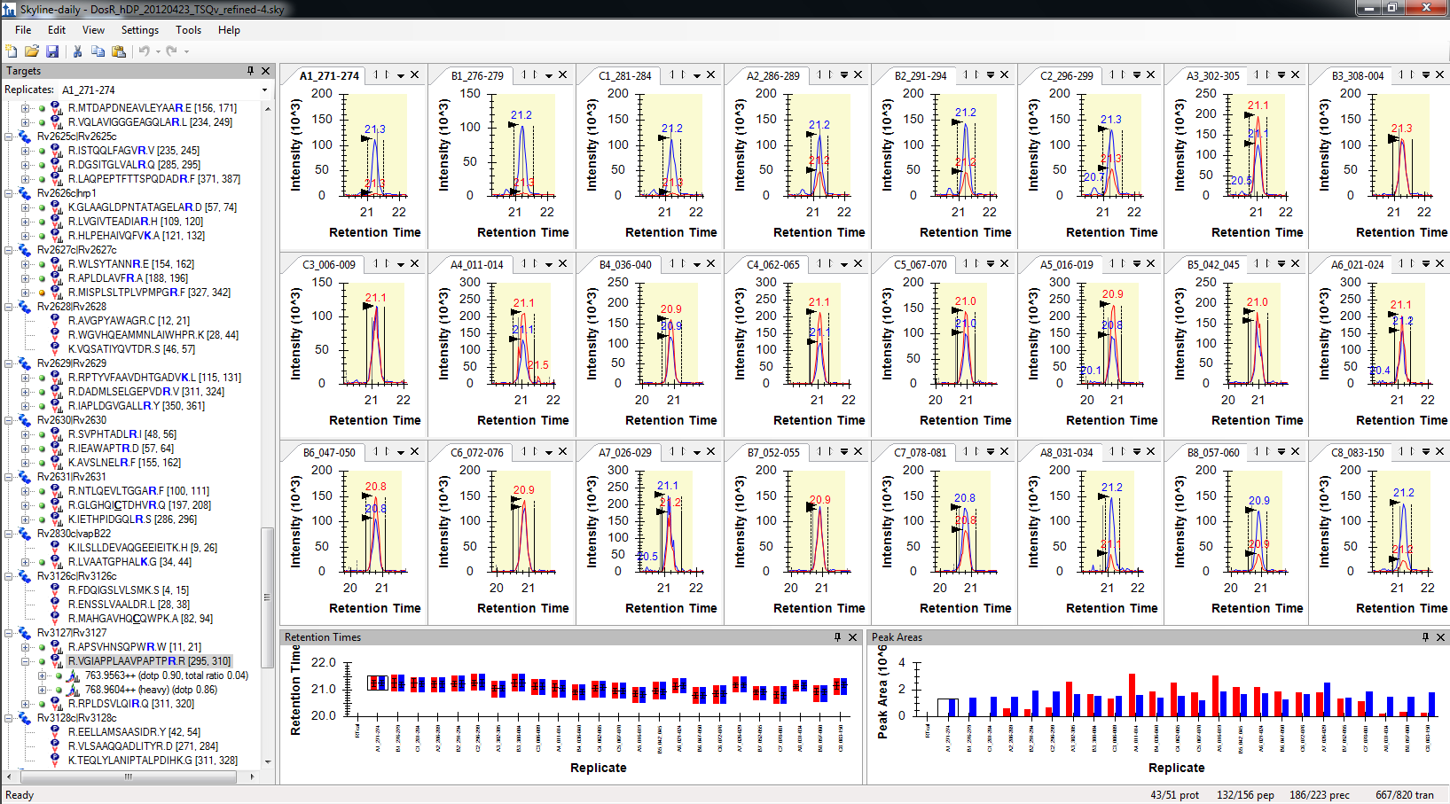
Application of the Mtb Proteome Library to study the dynamics of the DosR regulon of Mtb under hypoxia
Mycobacterium bovis BCG

Slide 12
Application of the Mtb Proteome Library to study the dynamics of the DosR regulon of Mtb under hypoxia

Slide 13
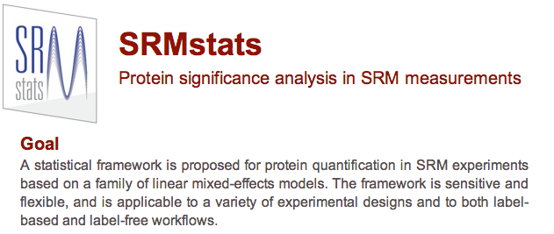
Statistical analysis of SRM data by SRMstats
Chang et al., Mol Cell Proteomics 2012. Protein significance analysis in SRM measurements

Slide 14
Absolute label-free quantification by SRM exploits the linear correlation of the sum of the top transitions of the top peptides per protein and the protein concentration
2195 proteins
Linear correlation established using 34 anchor proteins quantified by AQUA peptides
MS intensity: sum of 2 most intense transitions of the 3 most intense peptides per protein
Ludwig et al., MCP 2011, Estimation of absolute protein quantities of unlabeled samples by SRM

Slide 15
Proteome-wide absolute
abundance estimates for Mtb

Slide 16
SWATH-MS: Data-independent acquisition with targeted data extraction
Targeted mass spectrometric techniques: SRM and SWATH
Gillet et al., MCP 2012, Targeted data extraction of the MS/MS spectra generated by data-independent acquisition: a new concept for consistent and accurate proteome analysis.
Figure by Christina Ludwig

Slide 17
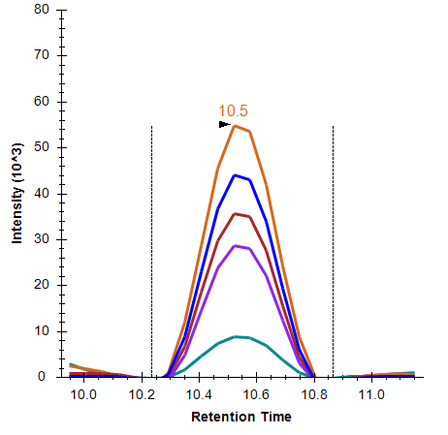
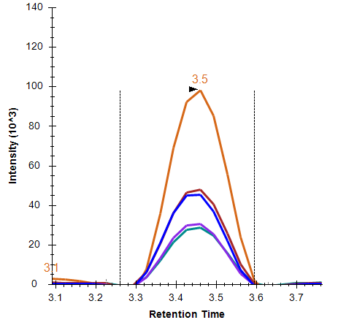
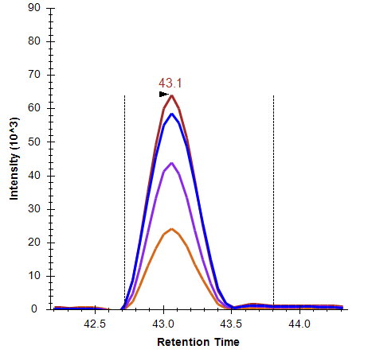
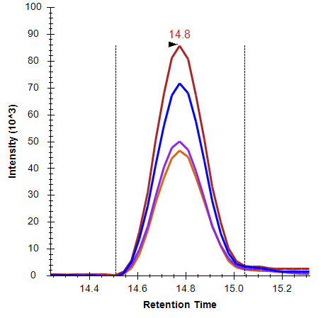
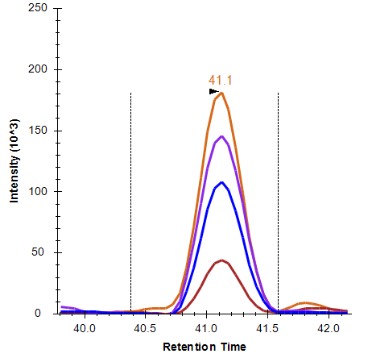
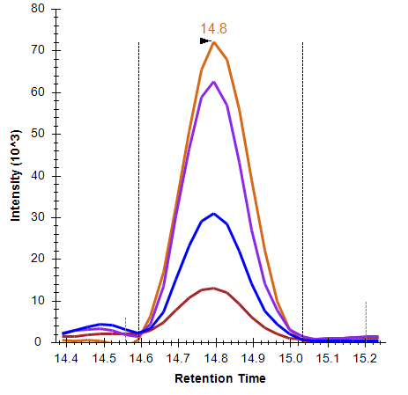
Generation of the Mtb SWATH library
Synthetic peptides
Fractionated lysates
Whole-cell lysates of different stress conditions
SWATH-MS
SRM
TripleTOF shotgun mode
Rv0569 GATIDQPDHR 2+
Search each dataset with Mascot and Sequest
iProphet combination of all datasets
Alignment of runs into a common RT space (iRT)
Consensus spectral library generation with SpectraST
Extraction of the top transitions per precursor
Rv0569 FGAVQSAILHAR 3+
Mtb SWATH library
3931 proteins (98%)
39,479 peptides
Rv1738 ELVGVGLAR 2+

Slide 18
SWATH-MS allows reproducible, high proteome coverage measurements of Mtb in a single run
SWATH-MS
SRM
Rv0569 GATIDQPDHR 2+
Proteome coverage by SWATH-MS
single injection
2683 proteins (67%)
(openSWATH software)
Proteome coverage by SRM
>200 injections
2884 proteins (72%)
(mProphet software)
Rv0569 FGAVQSAILHAR 3+
Rv1738 ELVGVGLAR 2+

Slide 19
Summary
The Mtb Proteome Library is a public resource of SRM assays for the entire proteome of Mtb
  SRM assays generated from crude synthetic peptides and validated in whole cell lysates
  Data analysis with Skyline and supporting tools: iRT peptides, SRMCollider, mProphet, SRMstats
  Data can be browsed on and downloaded from www.SRMAtlas.org, www.PeptideAtlas.org/passel
Application of the Mtb Proteome Library to study the dynamics of the DosR regulon of Mtb under hypoxia
Absolute label-free quantification by SRM exploits the linear correlation of the sum of the top transitions of the top peptides per protein and its absolute concentration.
Expansion of the Mtb Proteome Library for use with SWATH-MS
SWATH-MS allows reproducible, high proteome coverage measurements of Mtb in a single run

Slide 20
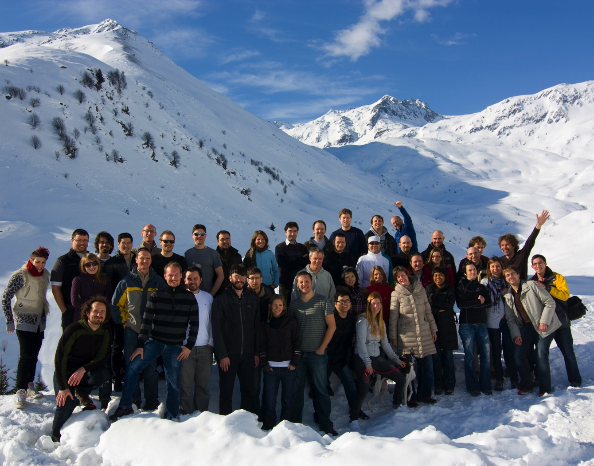

Acknowledgements
ETH Zurich
Prof. Ruedi Aebersold
Christina Ludwig
Jeppe Mouritsen
George Rosenberger
Hannes Röst (Mon 5:45 pm and WP 595, Wed)
Ludovic Gillet (TOD pm, Tue 5:30 pm)
Ben Collins (WP 688, Wed)
Alessio Maiolica, Mariette Matondo
University of Ghana
Dr. Patrick K. Arthur
Max Planck Institute Berlin
Prof. Stefan Kaufmann
Dr. Martin Gengenbacher
ISB Seattle
Prof. Rob Moritz
Dave Campbell
Zhi Sun
Terry Farrah
Samuel Bader (ABSciex, Mon 7 am)
University of Washington
Brendan MacLean (TP 499, Tue)
UBS
Promedica
Foundation
Institute of Molecular Systems Biology

