Slide 1

Application of Data Independent Acquisition Techniques Optimized for Improved Precursor Selectivity
Jarrett D. Egertson, Ph.D.
MacCoss Lab
Department of Genome Sciences
University of Washington
6/8/2013
Notes:
Title Slide should have all authors

Slide 2
Acquisition Methods
Data Independent
Acquisition (DIA)
Targeted
Discovery
Selected Reaction Monitoring (SRM)
Peptide Quantitation
Data Dependent Acquisition (DDA)
Peptide Identification
Notes:
Targeted, Discovery, DIA

Slide 3
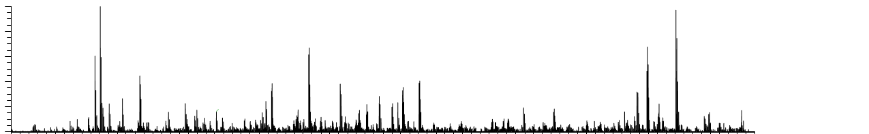
LC–MS/MS: Data Dependent Acquisition
1
2
4
3
5
m/z
MS Scan
MS Scan
Notes:
Add things we’re targeting showing up on the MS1 scan

Slide 4
Data Independent Acquisition (DIA)
20 20 m/z-wide windows = 400 m/z
500
m/z
900
Notes:
Switch to 20, put in some MS1 scans
Usually 1,000 – 5,000 peptides identified by MS/MS
Usually ~25,000 – 50,000 MS features detected
2-20% of Features Annotated
BUT Usually only ~70% overlap in annotated features between runs

Slide 5
Data Independent Acquisition (DIA)
20 20 m/z-wide windows = 400 m/z
500
m/z
900
Scan 1
Notes:
Switch to 20, put in some MS1 scans
Usually 1,000 – 5,000 peptides identified by MS/MS
Usually ~25,000 – 50,000 MS features detected
2-20% of Features Annotated
BUT Usually only ~70% overlap in annotated features between runs

Slide 6
Data Independent Acquisition (DIA)
20 20 m/z-wide windows = 400 m/z
500
m/z
900
Scan 1
Scan 2
Notes:
Switch to 20, put in some MS1 scans
Usually 1,000 – 5,000 peptides identified by MS/MS
Usually ~25,000 – 50,000 MS features detected
2-20% of Features Annotated
BUT Usually only ~70% overlap in annotated features between runs

Slide 7
Data Independent Acquisition (DIA)
20 20 m/z-wide windows = 400 m/z
500
m/z
900
Scan 1
Scan 2
Scan 3
Scan 4
Scan 5
Scan 6
Scan 7
…
Scan 20
Scan 21
Notes:
Switch to 20, put in some MS1 scans
Usually 1,000 – 5,000 peptides identified by MS/MS
Usually ~25,000 – 50,000 MS features detected
2-20% of Features Annotated
BUT Usually only ~70% overlap in annotated features between runs

Slide 8
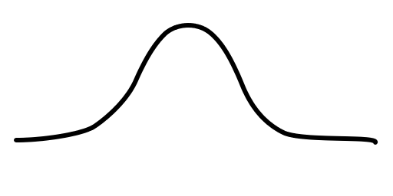
Data Independent Acquisition (DIA)
20 20 m/z-wide windows = 400 m/z
500
m/z
900
MS Scan
~2 seconds
Time
~30 seconds
Notes:
Mention on this slide that skyline has really helped with analyzing MS1 data, not much of a trade off in duty cycle, but quant can be complementary in less complex regions of the sample

Slide 9
Data Independent Acquisition (DIA)
20 20 m/z-wide windows = 400 m/z
500
m/z
900
Time
Notes:
Add in MS1 scans here

Slide 10
Data Independent Acquisition (DIA)
20 20 m/z-wide windows = 400 m/z
500
m/z
900
Time
LGLVGGSTIDIK⁺⁺ (586.85)
Notes:
Add in MS1 scans here

Slide 11
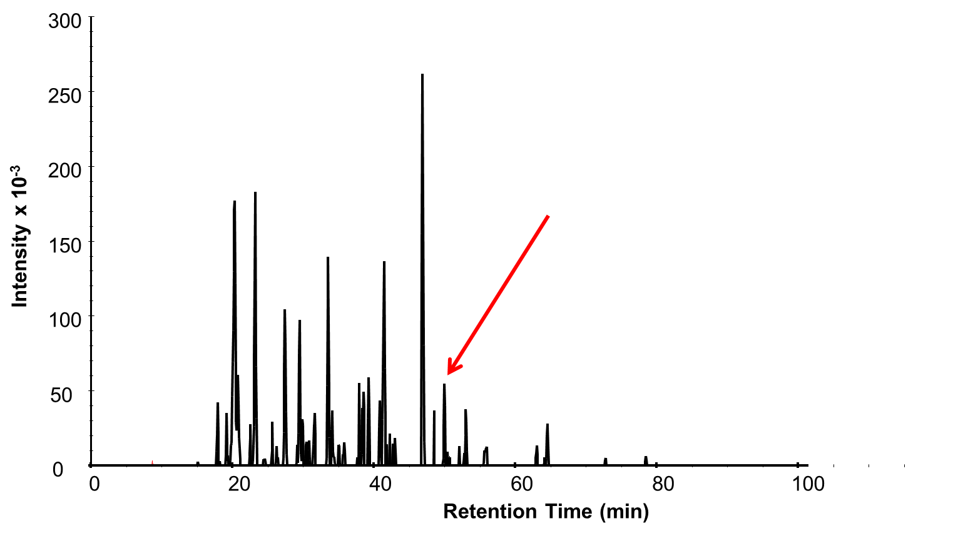
Data Independent Acquisition (DIA)
LGLVGGSTIDIK⁺⁺ (586.85)
LVGGSTIDIK⁺
(1002.58)
VGGSTIDIK⁺
(889.50)
GGSTIDIK⁺
(790.43)
GSTIDIK⁺
(676.39)
STIDIK⁺
(589.36)
TIDIK⁺
(488.31)
IDIK⁺
(375.22)
Notes:
Usually 1,000 – 5,000 peptides identified by MS/MS
Usually ~25,000 – 50,000 MS features detected
2-20% of Features Annotated
BUT Usually only ~70% overlap in annotated features between runs

Slide 12
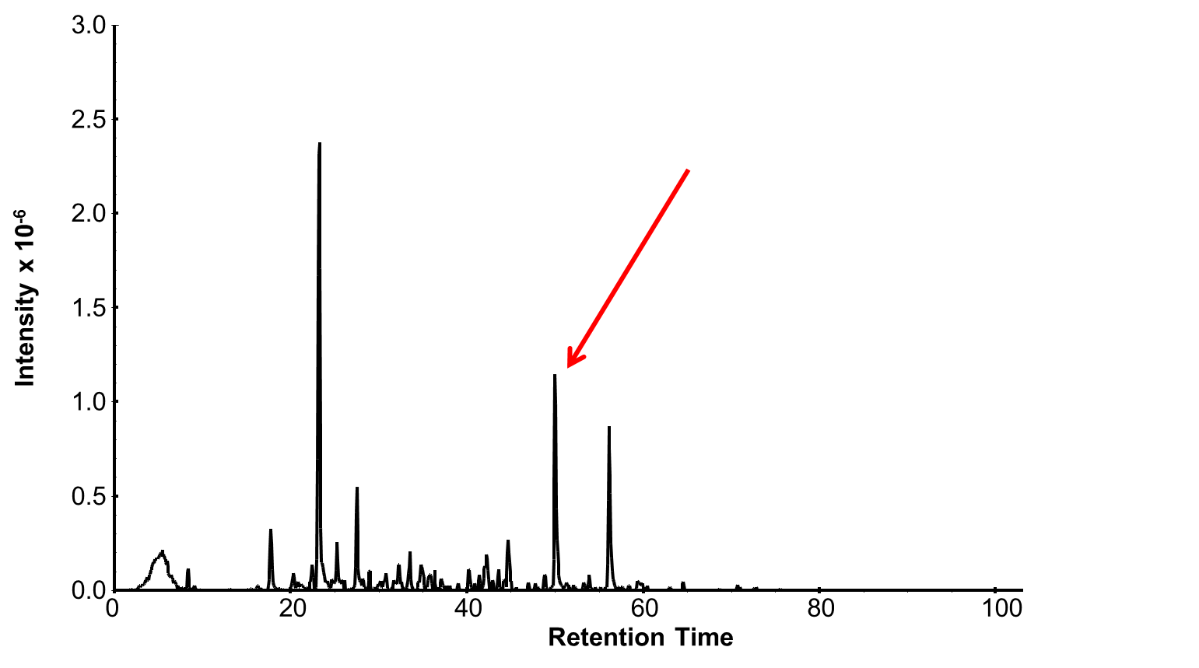
Data Independent Acquisition (DIA)
LGLVGGSTIDIK⁺⁺ (586.85)
LVGGSTIDIK⁺
(1002.58)
VGGSTIDIK⁺
(889.50)
GGSTIDIK⁺
(790.43)
GSTIDIK⁺
(676.39)
STIDIK⁺
(589.36)
TIDIK⁺
(488.31)
IDIK⁺
(375.22)
Notes:
Usually 1,000 – 5,000 peptides identified by MS/MS
Usually ~25,000 – 50,000 MS features detected
2-20% of Features Annotated
BUT Usually only ~70% overlap in annotated features between runs

Slide 13
Data Independent Acquisition (DIA)
LGLVGGSTIDIK⁺⁺ (586.85)
LVGGSTIDIK⁺
(1002.58)
3.5
VGGSTIDIK⁺
(889.50)
3.0
GGSTIDIK⁺
(790.43)
GSTIDIK⁺
(676.39)
2.5
STIDIK⁺
(589.36)
TIDIK⁺
(488.31)
Intensity x 10⁻⁶
2.0
IDIK⁺
(375.22)
1.5
1.0
0.5
0.0
48
49
50
51
52
Retention Time
Notes:
Usually 1,000 – 5,000 peptides identified by MS/MS
Usually ~25,000 – 50,000 MS features detected
2-20% of Features Annotated
BUT Usually only ~70% overlap in annotated features between runs

Slide 14
MS/MS
1.02 femtomoles of Bovine Serum Albumin
(LVNELTEFAK++) in 1.2 ug of S. cerevisiae lysate
Notes:
1.02 femtomoles of serum albumin in 1.2 ug of S. cereivsiae lysate
LVNELTEFAK++
1.02 femtomoles in 1.2 ug of soluble S. cerevisiae lysate
From DIA, can query for any peptide, and get MS/MS targeted like data
-- and also, that quantitation can be better than DDA --
Can use MS/MS or MS for quant, show MS and MS/MS, sometimes there is chemical interference in the MS signal, so MS/MS will be more sensitive

Slide 15
MS
MS/MS
1.02 femtomoles of Bovine Serum Albumin
(LVNELTEFAK++) in 1.2 ug of S. cerevisiae lysate
Notes:
1.02 femtomoles of serum albumin in 1.2 ug of S. cereivsiae lysate
LVNELTEFAK++
1.02 femtomoles in 1.2 ug of soluble S. cerevisiae lysate
From DIA, can query for any peptide, and get MS/MS targeted like data
-- and also, that quantitation can be better than DDA --
Can use MS/MS or MS for quant, show MS and MS/MS, sometimes there is chemical interference in the MS signal, so MS/MS will be more sensitive

Slide 16
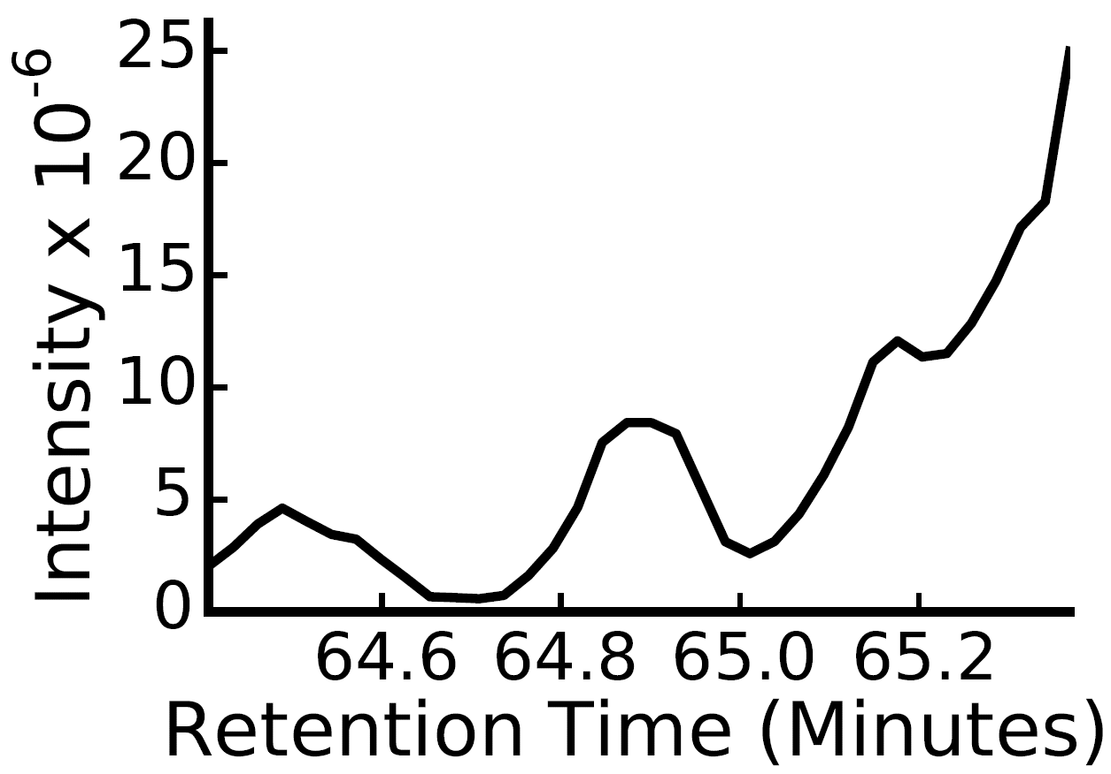
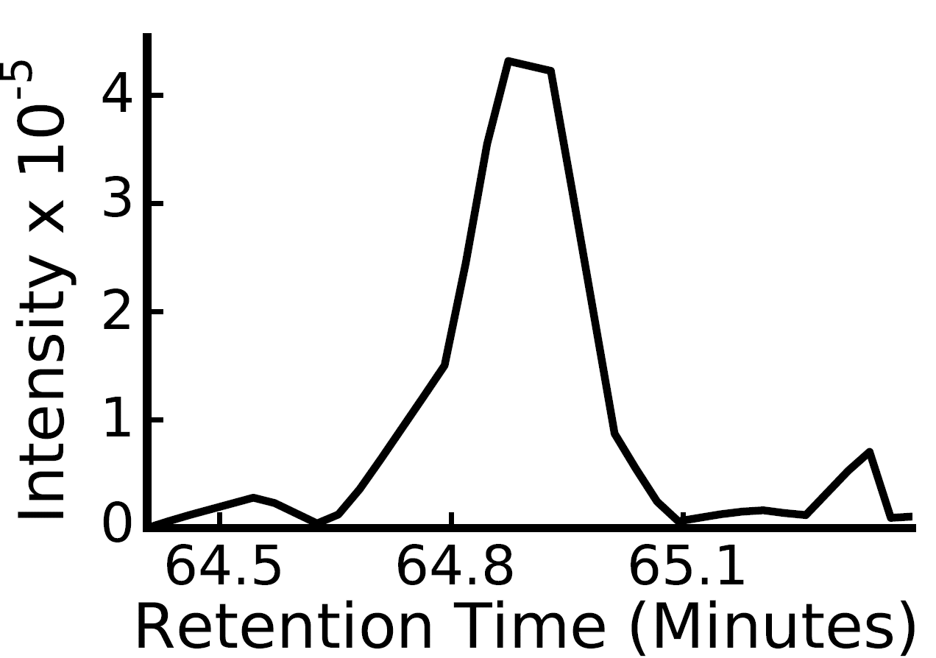
MS
MS/MS
1.02 femtomoles of Bovine Serum Albumin
(LVNELTEFAK++) in 1.2 ug of S. cerevisiae lysate
Notes:
1.02 femtomoles of serum albumin in 1.2 ug of S. cereivsiae lysate
LVNELTEFAK++
1.02 femtomoles in 1.2 ug of soluble S. cerevisiae lysate
From DIA, can query for any peptide, and get MS/MS targeted like data
-- and also, that quantitation can be better than DDA --
Can use MS/MS or MS for quant, show MS and MS/MS, sometimes there is chemical interference in the MS signal, so MS/MS will be more sensitive

Slide 17


Theoretical Benefits of DIA
500 – 900 m/z
Comprehensive Sampling
Reproducibility
Improved Quantitation
MS
MS/MS

Slide 18
Isolation Window Width
DDA
DIA
Vs.
Vs.
2 m/z
10 m/z
20 m/z
Lower precursor selectivity
More peptides co-fragmented
More complex MS/MS spectra
More interference
Notes:
Show the spectrum, and the chromatogram
Even with DDA >30% of the spectra are mixed
Quantitation can be limited by interference, show 10 m/z vs. 20 m/z (from overlap experiment)
Spectrum and chromatogram from loq data on a yeast background peptide

Slide 19
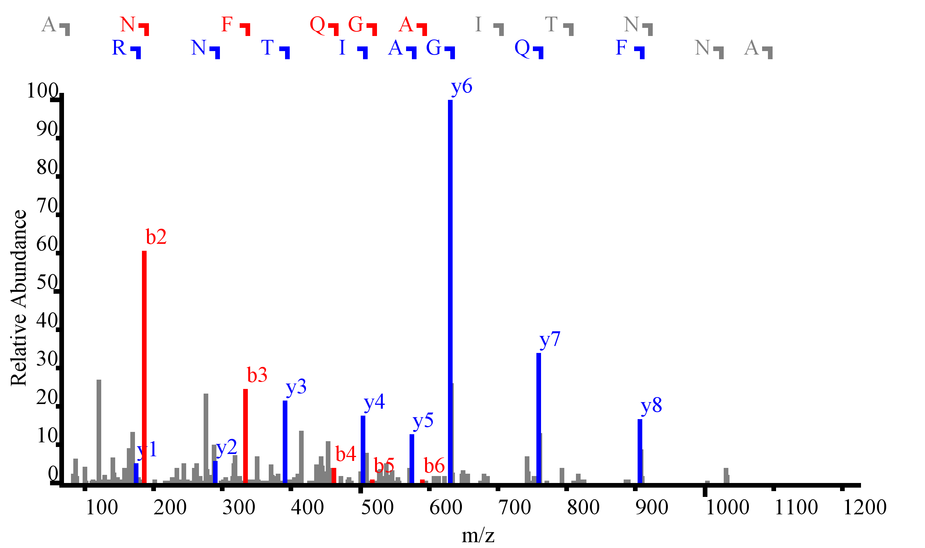
Precursor Selectivity
2 m/z
ANFQGAITNR
Notes:
Show the spectrum, and the chromatogram
Even with DDA >30% of the spectra are mixed
Quantitation can be limited by interference, show 10 m/z vs. 20 m/z (from overlap experiment)
Spectrum and chromatogram from loq data on a yeast background peptide

Slide 20
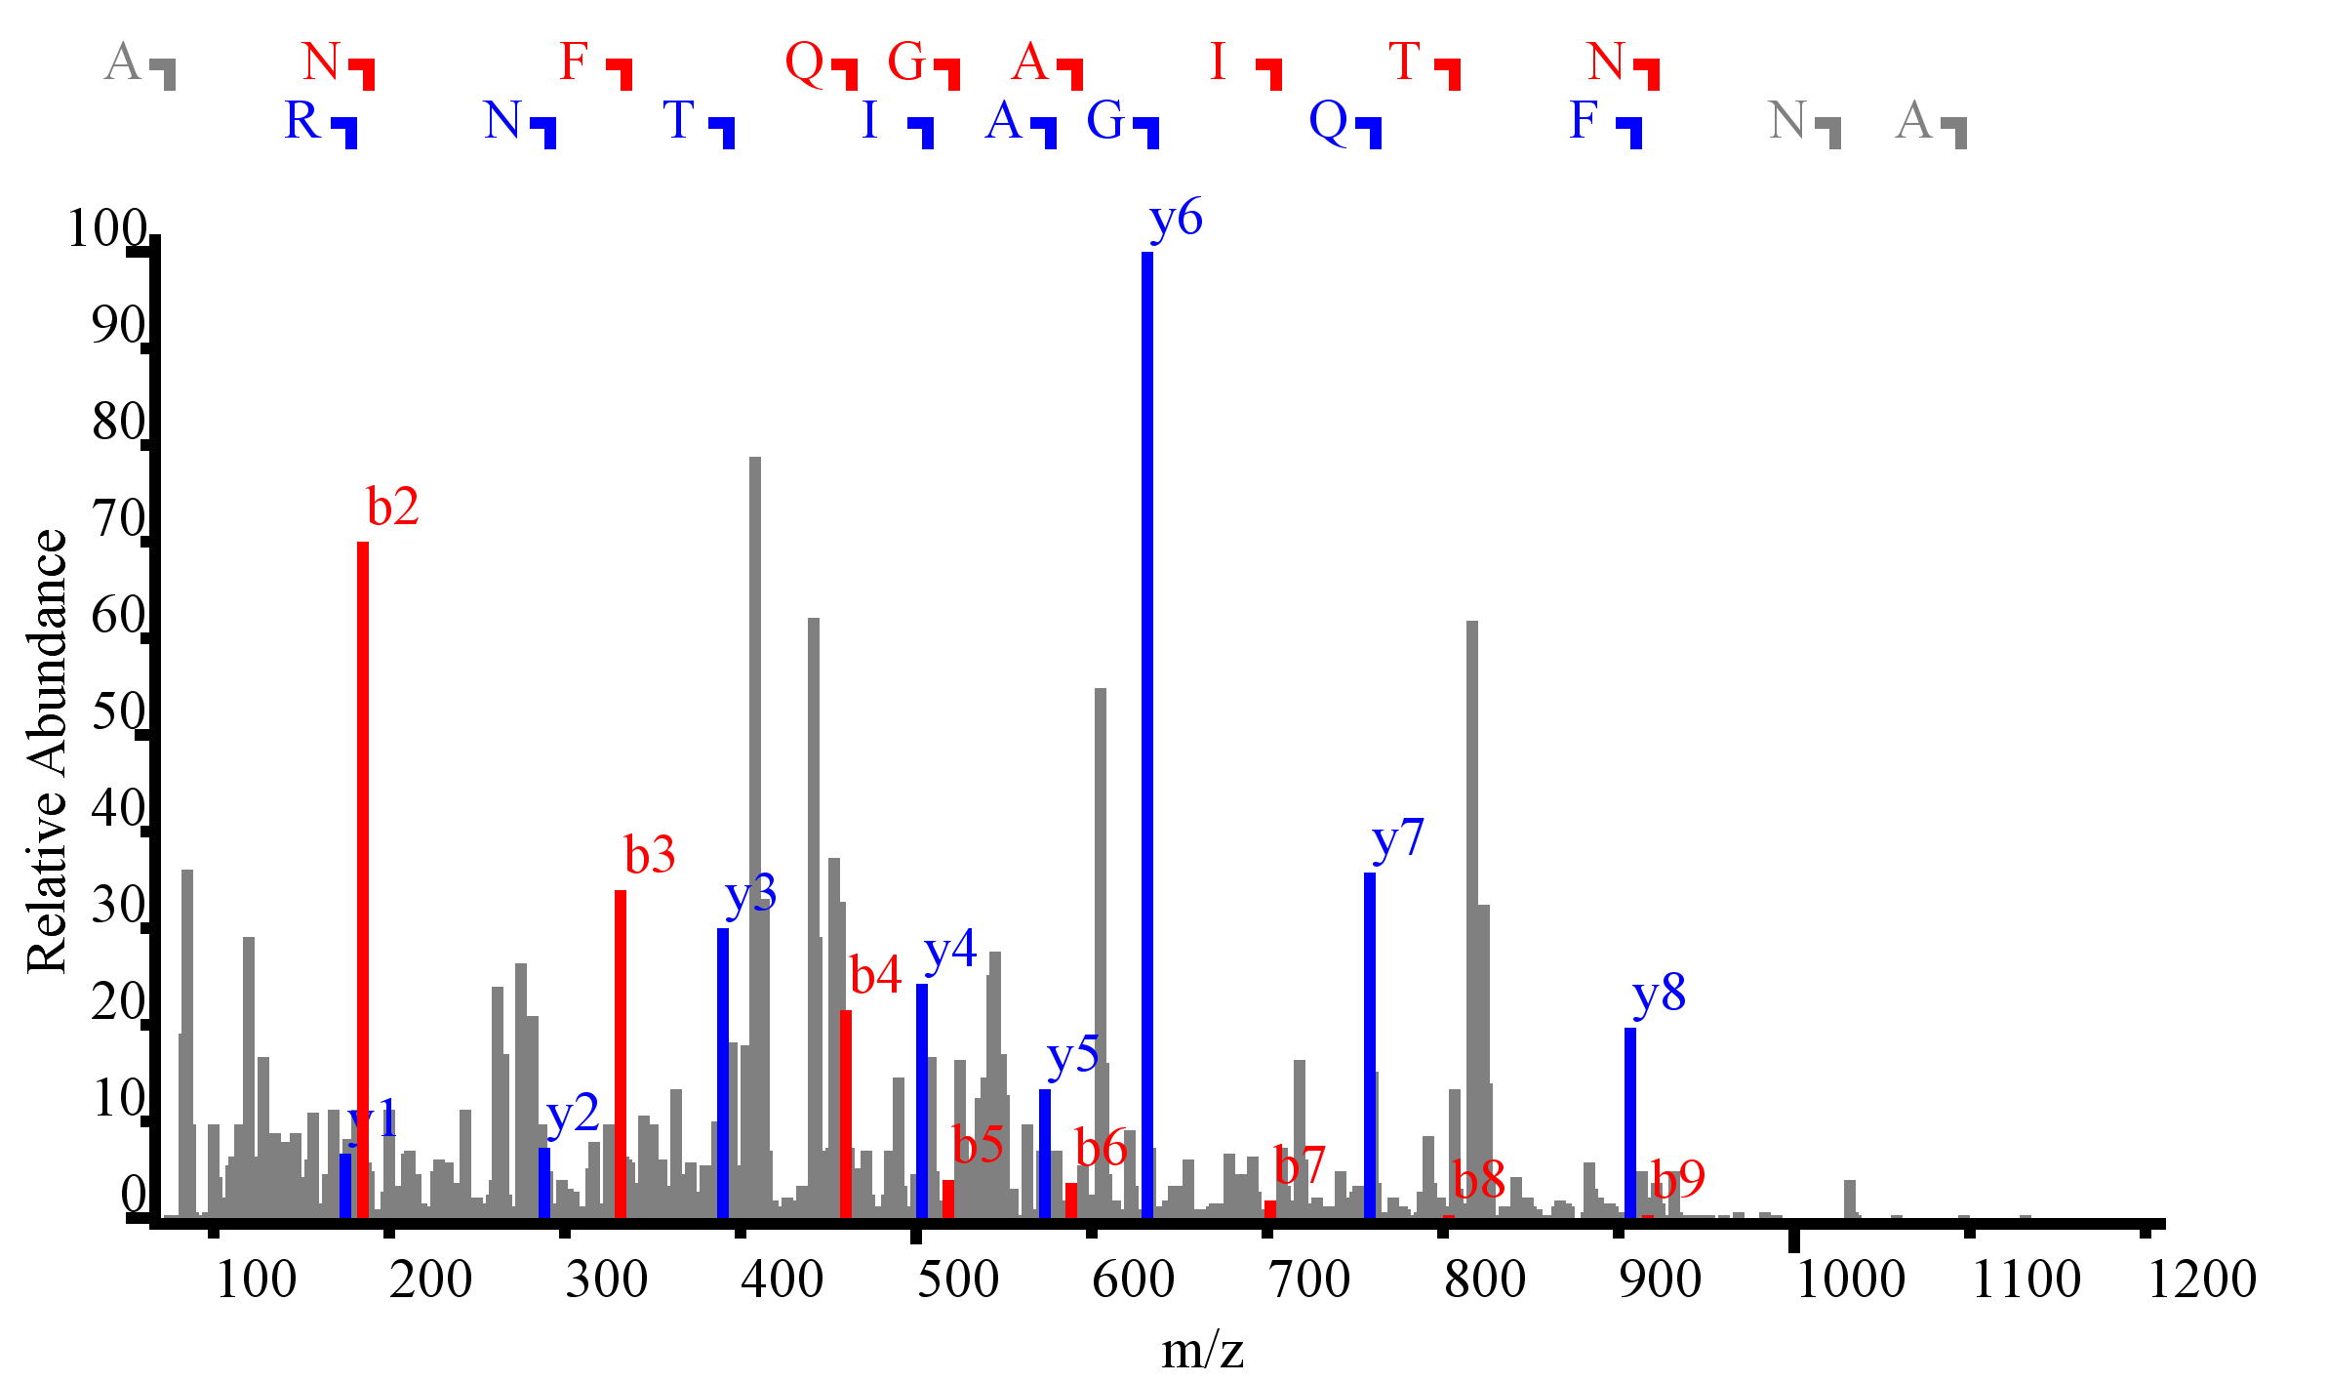
Precursor Selectivity
10 m/z
ANFQGAITNR
Notes:
Show the spectrum, and the chromatogram
Even with DDA >30% of the spectra are mixed
Quantitation can be limited by interference, show 10 m/z vs. 20 m/z (from overlap experiment)
Spectrum and chromatogram from loq data on a yeast background peptide

Slide 21
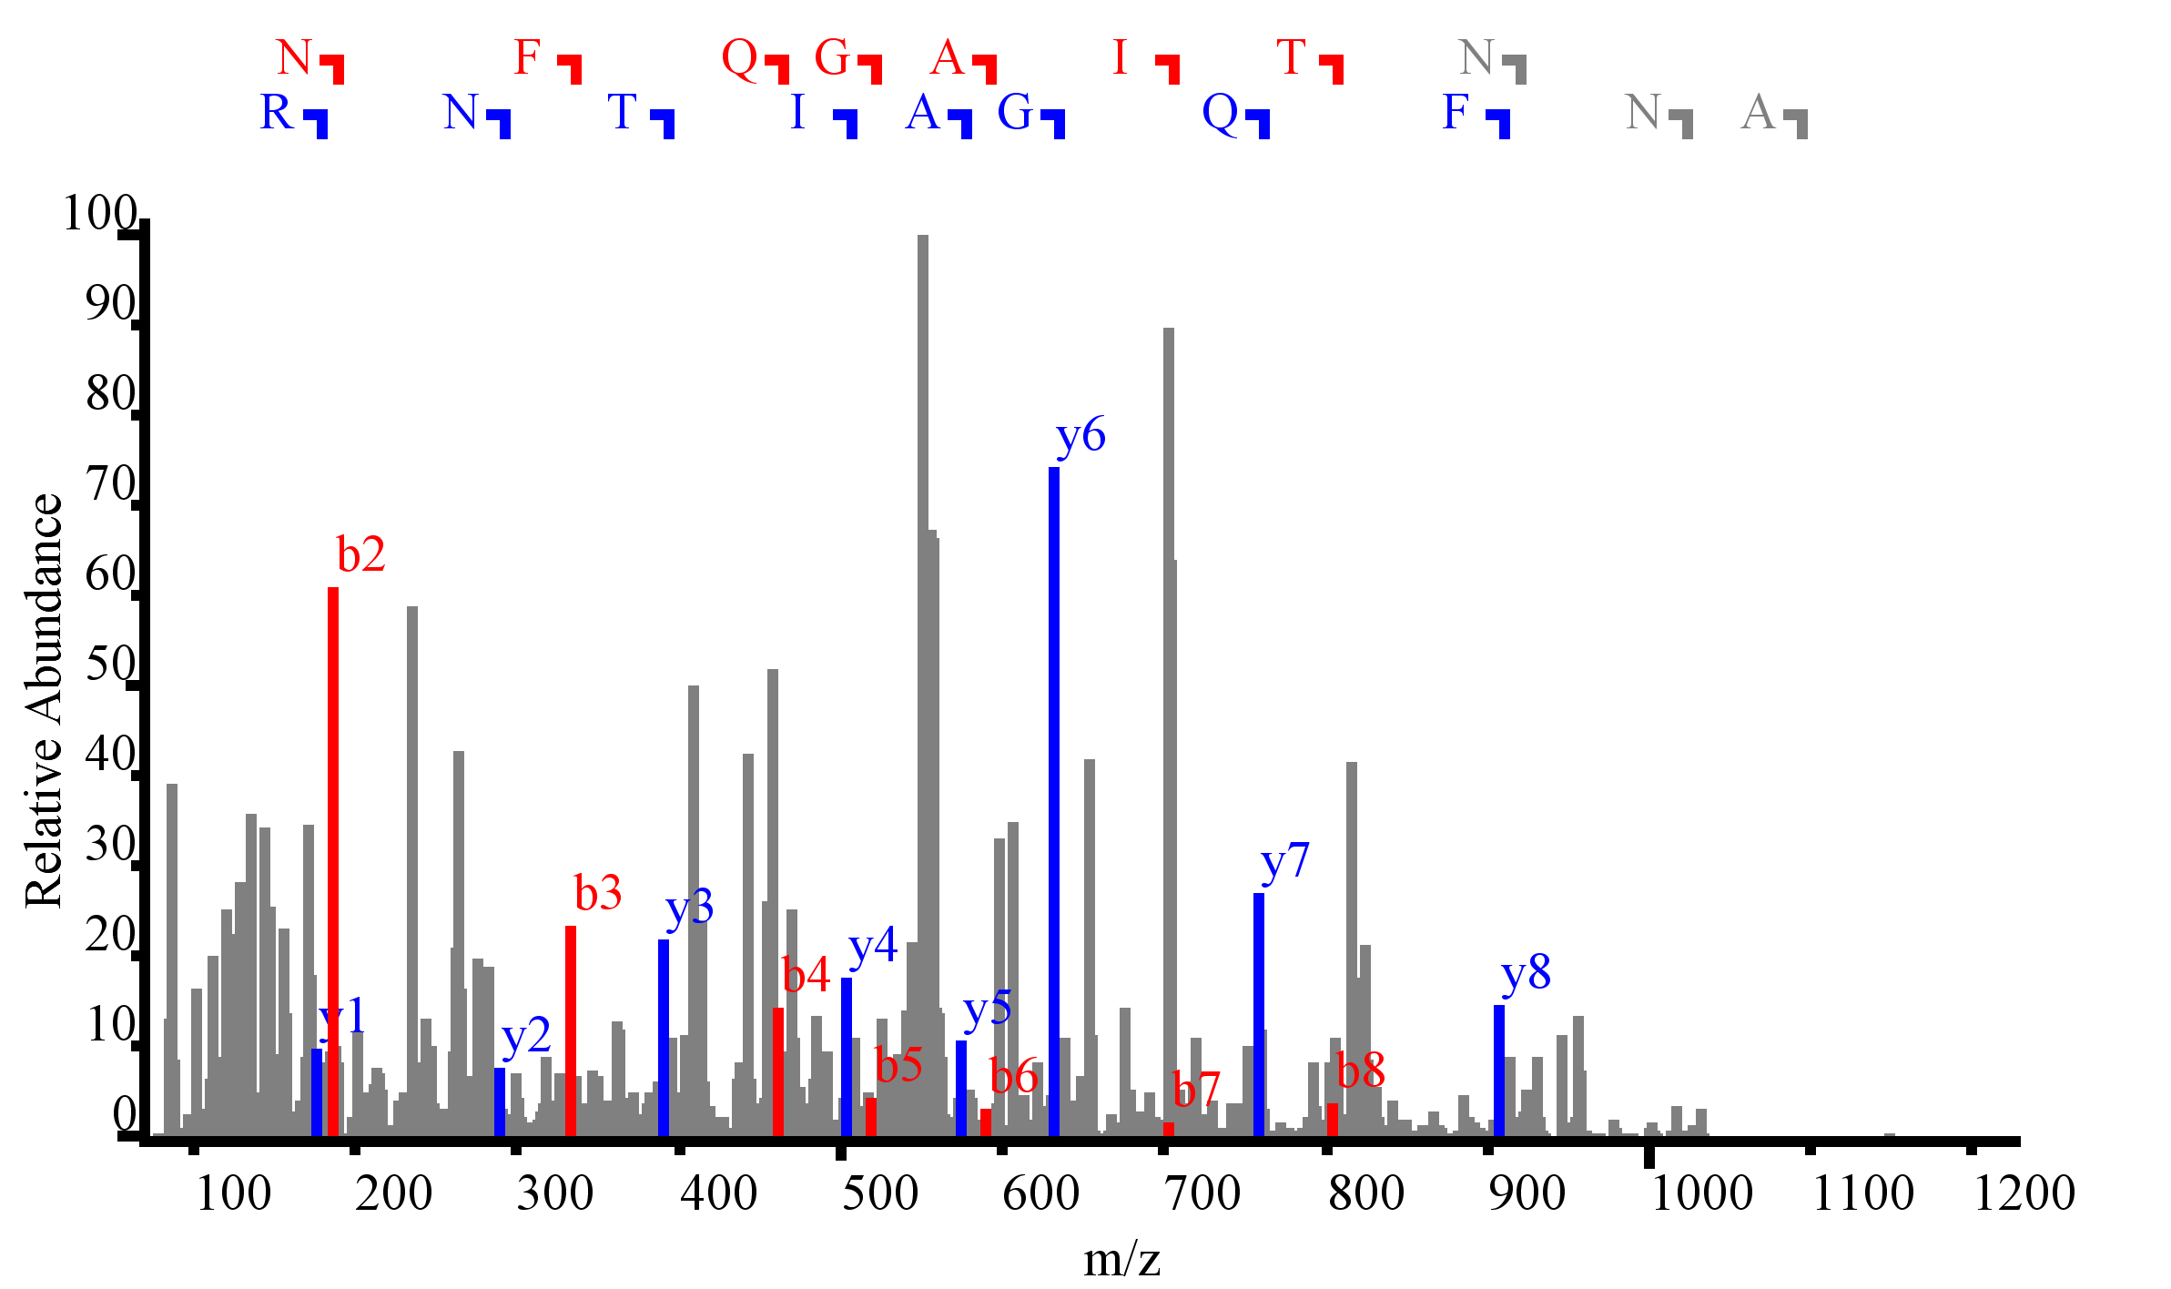
Precursor Selectivity
20 m/z
ANFQGAITNR
Notes:
Show the spectrum, and the chromatogram
Even with DDA >30% of the spectra are mixed
Quantitation can be limited by interference, show 10 m/z vs. 20 m/z (from overlap experiment)
Spectrum and chromatogram from loq data on a yeast background peptide

Slide 22
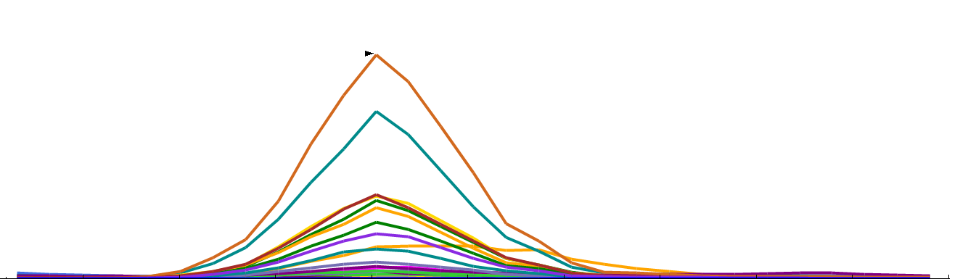
Precursor Selectivity
4e7
Intensity
10 m/z
ANFQGAITNR
25
Retention Time (min)
26
Notes:
RT 25-26 intensity 40e6

Slide 23
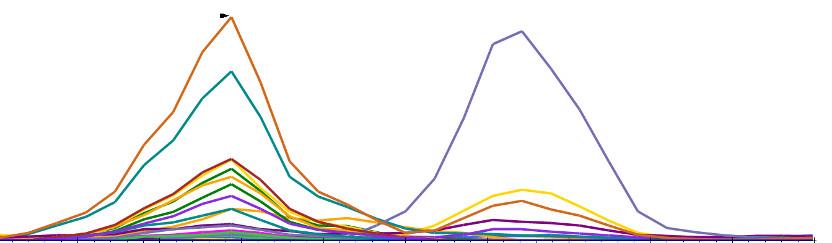
Precursor Selectivity
✓
X
4e7
Intensity
10 m/z
ANFQGAITNR
✓
X
4e7
✓
X
20 m/z
Intensity
25
Retention Time (min)
26
Notes:
RT 25-26 intensity 40e6

Slide 24
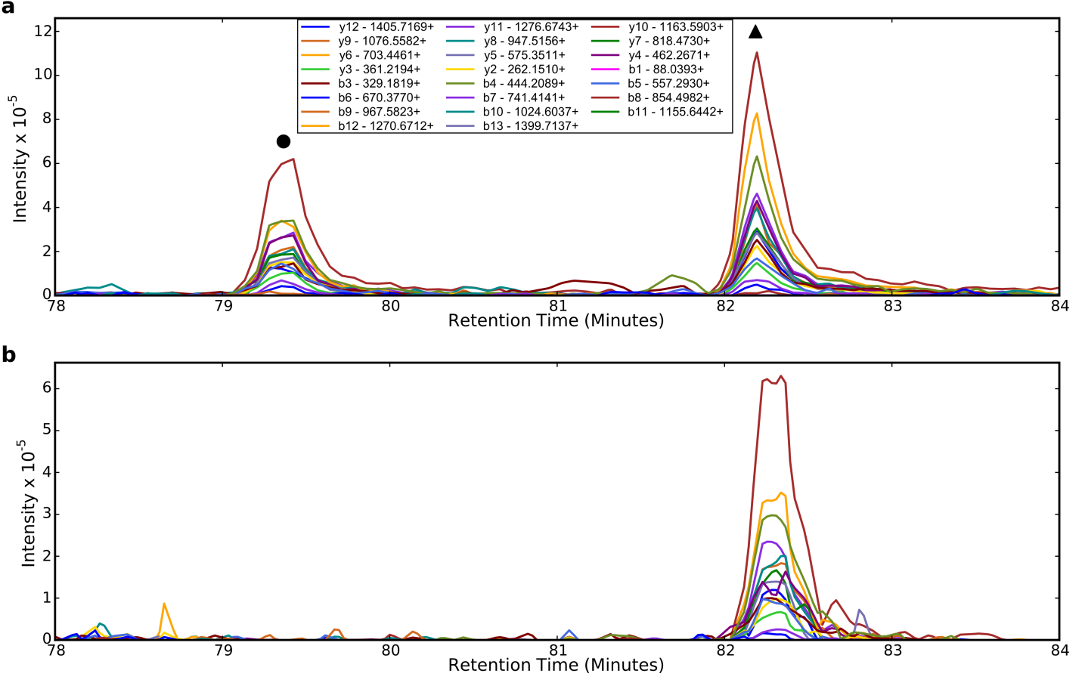
Precursor Selectivity
✓
X
890
900
SLQDIIAILGMDELSEEDKLTVSR+++
(897.8 m/z)
SLQDIIAILGMDELSEEDKLTVSR+++
(892.47 m/z)
✓
X
Notes:
Change to star and X

Slide 25
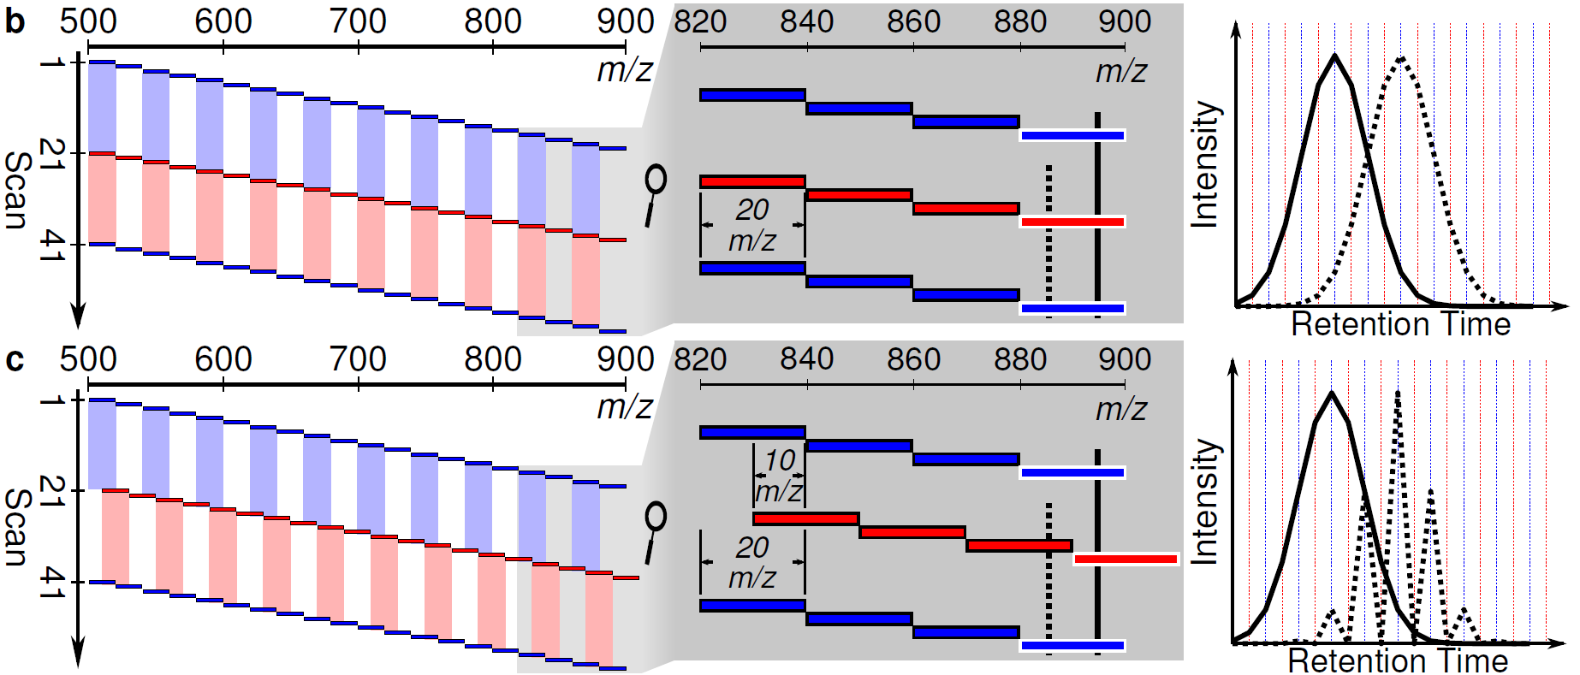
Improving Precursor Selectivity
X
✓
Notes:
Take a normal DIA scheme, with 20 m/z wide windows, overlap them (schematic figure)

Slide 26
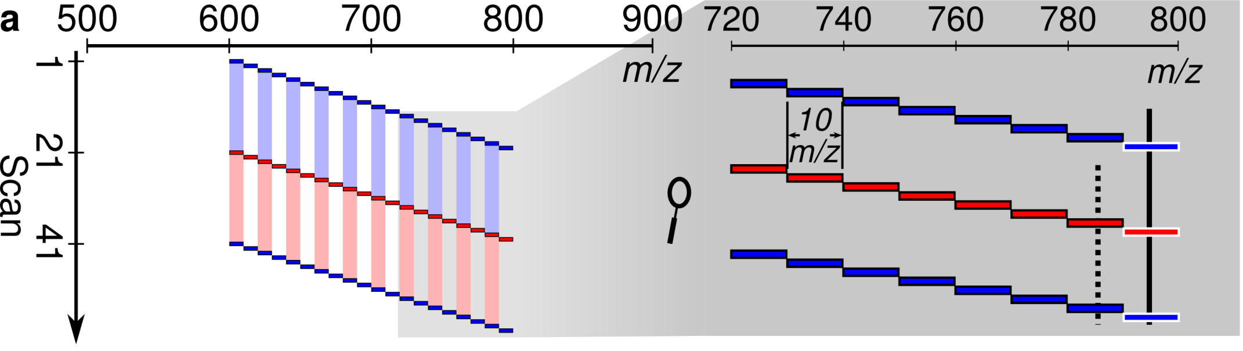
Improving Precursor Selectivity
X
✓
X
✓
Notes:
Remove the letters from these

Slide 27
Improving Precursor Selectivity
Notes:
Take a normal DIA scheme, with 20 m/z wide windows, overlap them (schematic figure)

Slide 28
Improving Precursor Selectivity
✓
X
Notes:
Take a normal DIA scheme, with 20 m/z wide windows, overlap them (schematic figure)

Slide 29
Improving Precursor Selectivity
✓
X
✓
X
Notes:
Take a normal DIA scheme, with 20 m/z wide windows, overlap them (schematic figure)

Slide 30
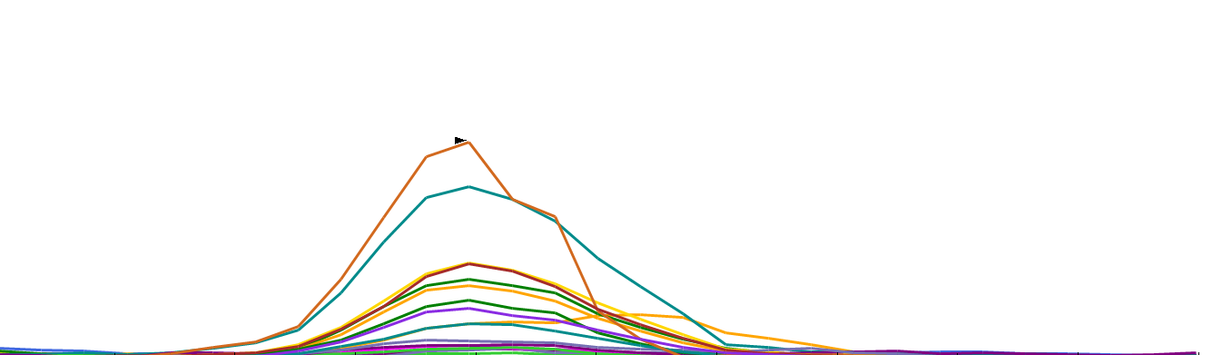
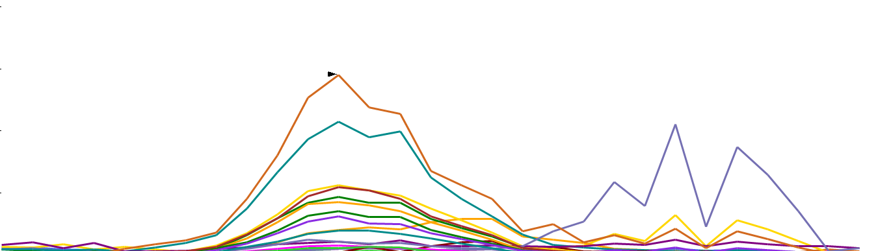
Overlapped Isolation Windows
4e7
✓
X
✓
X
ANFQGAITNR
No Overlap
20 m/z
Intensity
✓
X
4e7
Overlapped
Overlapped
✓
Overlapped
Overlapped
20 m/z
Intensity
Demultiplexed: ~10 m/z
X
25
Retention Time (min)
26
Notes:
Qualitative demultiplexing result
First show 20 m/z vs. 20 m/z overlap w/o demux

Slide 31
Improved Quantitation
21 Peptides Spiked Into
Yeast Lysate Quantified
Dario Amodei
Transitions Integrated
Notes:
Quantitative result:
LoQ

Slide 32
Conclusions
Overlapping Windows Improves Selectivity and Sensitivity of DIA
Easily applicable to virtually any DIA-capable instrument
De-multiplexing implemented in Skyline (multi-vendor support)
These experiments can be done now with Skyline-daily
Notes:
Improve charge state
Use precursor information

Slide 33
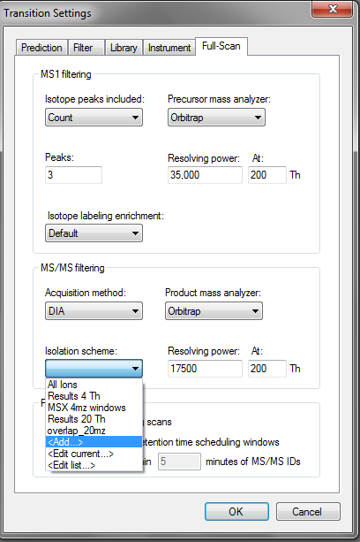
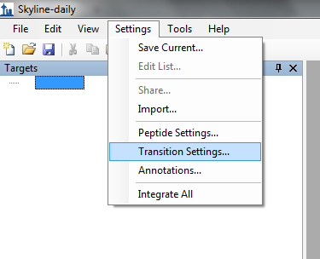
Generating a DIA Method Using Skyline: Generate a Target List
20 20 m/z-wide windows = 400 m/z
500
m/z
900

Slide 34
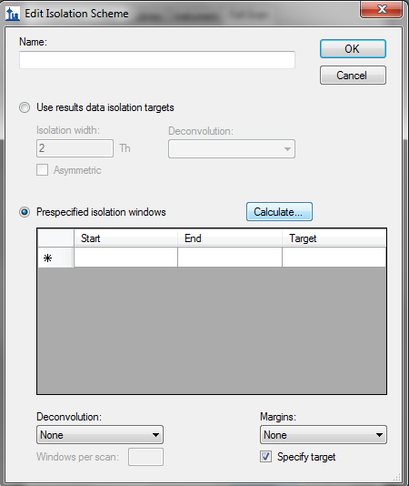
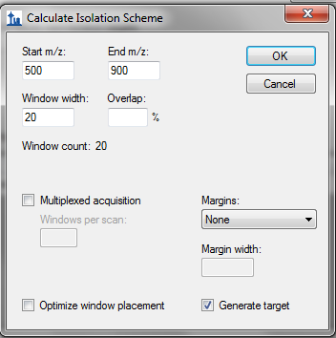
Generating a DIA Method Using Skyline: Generate a Target List

Slide 35

Generating a DIA Method Using Skyline: Generate a Target List

Slide 36
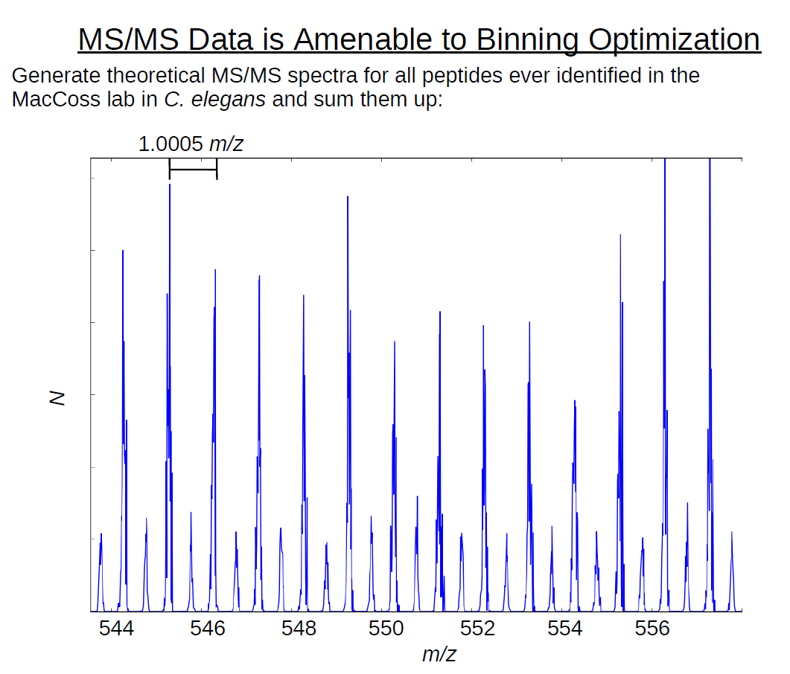
Generating a DIA Method Using Skyline: Generate a Target List
1.00045475 m/z
 | Mass | Excess
H | 1.00078 | 0.00078
C | 12 | 0.0
O | 15.9949 | 0.9949
N | 14.0031 | 0.0031
S | 31.9721 | 0.9721

Slide 37
Generating a DIA Method Using Skyline: Generate a Target List
1.00045475 m/z
 | Mass | Excess
H | 1.00078 | 0.00078
C | 12 | 0.0
O | 15.9949 | 0.9949
N | 14.0031 | 0.0031
S | 31.9721 | 0.9721

Slide 38
Generating a DIA Method Using Skyline: Generate a Target List
1.00045475 m/z
 | Mass | Excess
H | 1.00078 | 0.00078
C | 12 | 0.0
O | 15.9949 | 0.9949
N | 14.0031 | 0.0031
S | 31.9721 | 0.9721

Slide 39
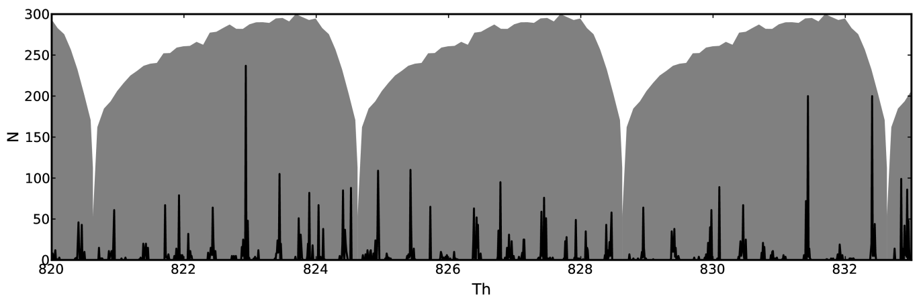
Generating a DIA Method Using Skyline: Generate a Target List

Slide 40
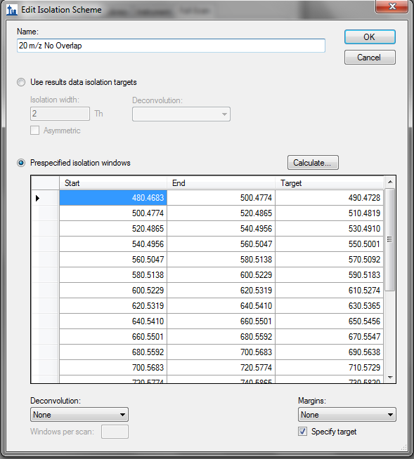
Generating a DIA Method Using Skyline: Generate a Target List

Slide 41
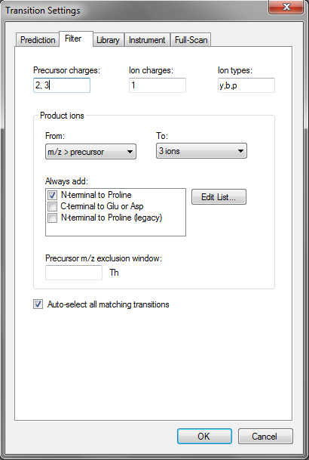
Importing Data: Filtering Settings

Slide 42
Acknowledgements
University of Washington
Mike MacCoss
Brendan MacLean
Don Marsh
Gennifer Merrihew
Richard Johnson
Sonia Ting
& the rest of the lab
Stanford University
Dario Amodei
Parag Mallick
Purdue University
Olga Vitek
Dario’s Poster: Tuesday June 11th
(#512) 10:30 AM – 2:30 PM
Jarrett’s Talk: Monday, June 10th 8:30-8:50AM Exhibit Hall A
Thermo Scientific
Markus Kellmann
Andreas Kuehn
Reiko Kiyonami
Yue Xuan
Notes:
Reproducibility

