Slide 1

Repository for Targeted Proteomics Assays
Josh Eckels
jeckels@labkey.com
Skyline Users Group - June 9, 2013

Slide 2
Goals
Organize and reuse targeted assays
Search and review a large body of data
Use previous results to inform new experiments
Facilitate data sharing
Private, with access for internal/external collaborators
Public, for published data
Excellent integration with Skyline
Import and retain the complete data model
Support data from various workflows
Notes:
Last year – progress on using results to inform new experiments

Slide 3
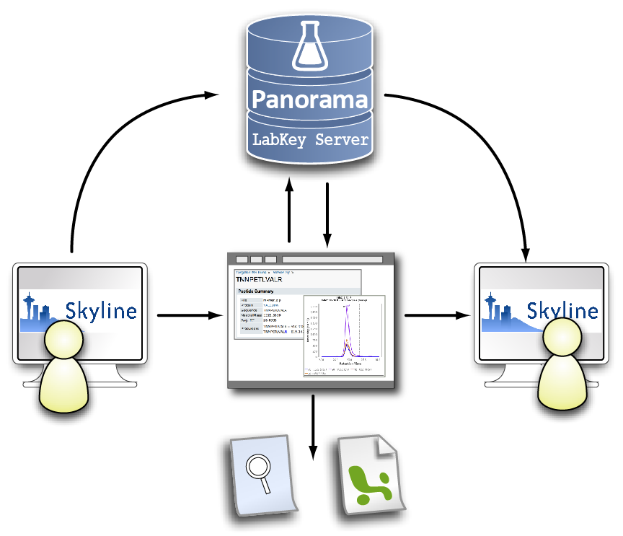
Skyline/Panorama Workflow
Notes:
Start w/ Skyline – fully annotated document uploaded into Panorama (not lossy)
Download – grab the original document, and build up chromatogram libraries for transitions and peptides (new, like spectra libraries)

Slide 4
History
Work started in late 2011
Announced at ASMS 2012
Publicly released in December 2012
Part of LabKey Server version 12.3
Released to PanoramaWeb.org in February 2013
Hosted server managed by MacCoss Lab
Recorded webinar has full details
Second public release in April 2013
Added search features, reporting enhancements, fixes
Next release scheduled for July 2013
Notes:
In the works for ~9 months before ASMS

Slide 5
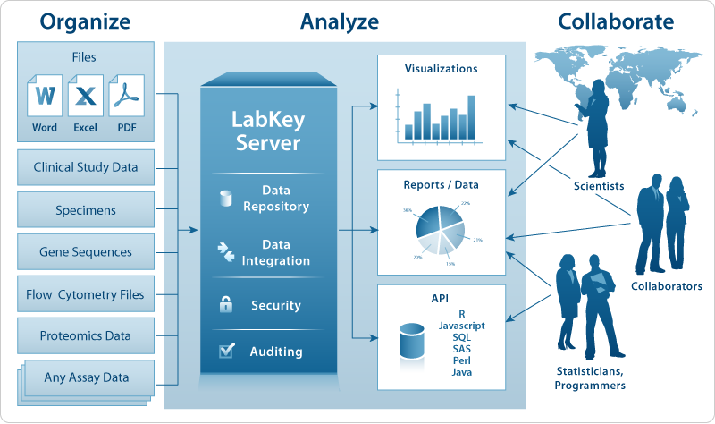

LabKey Server
Open source (Apache 2.0 license)
Web user interface
Powerful security and permissions system
Other assay data
MS/MS peptide search
Flow cytometry
Sequencing
Plate-based assays
Specimen tracking
Clinical study data
Collaboration tools
Extensive client APIs
Notes:
Use MS/MS peptide search (instead of Shotgun MS2)

Slide 6

LabKey Software
Co-developers with MacCoss Lab on Panorama
Consulting company focused on LabKey Server
25 employees in Seattle and San Diego
8 years history working with scientists
Strength in computer science and data management
Partner with researchers to develop software
Related service offerings include:
Training
Technical support
Customization
Hosting
Notes:
Mention size and history (25 person company, 8 year history building LabKey Server) These are impressive and make clear how established and successful LabKey Server is. To many in proteomics they either don’t know you, or remember you as CPAS which failed to gain real traction.
Gives stability and support, with a company behind it. Not just some bunch of code that’s dumped out there.

Slide 7
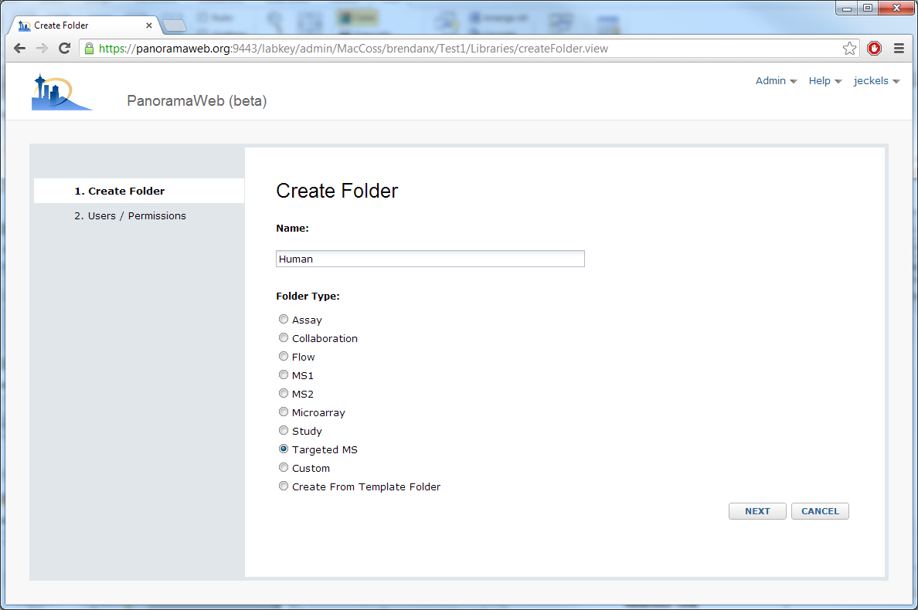
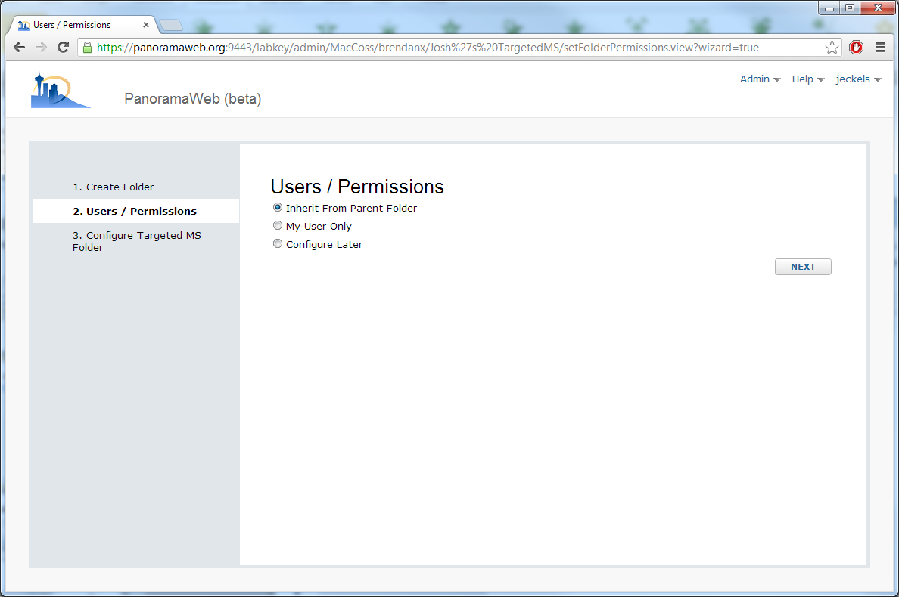
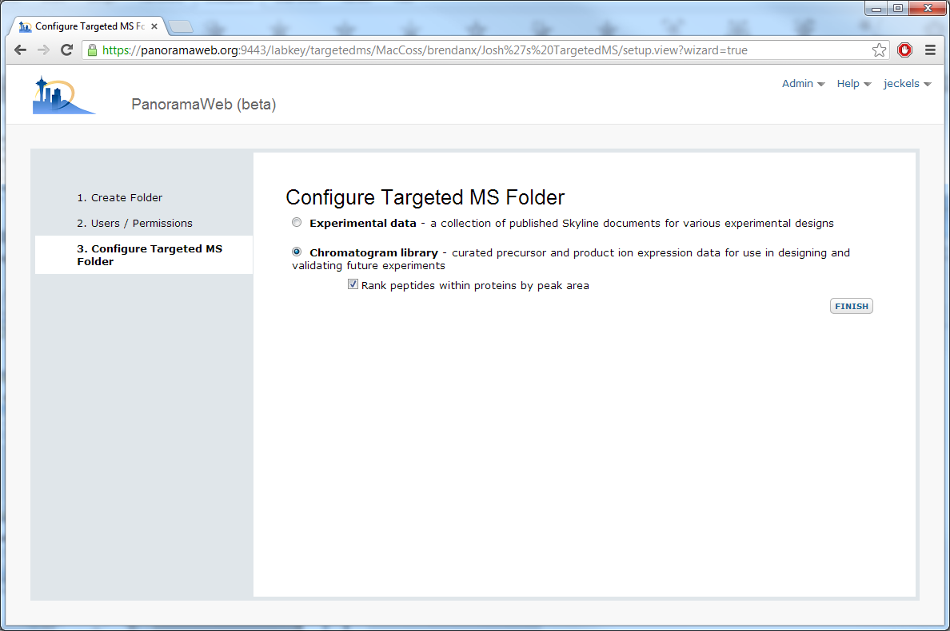
Panorama - Setup
Notes:
Don’t want to rank by protein for synthetic peptides.
Have synthentic proteins for demo, so checking the box

Slide 8
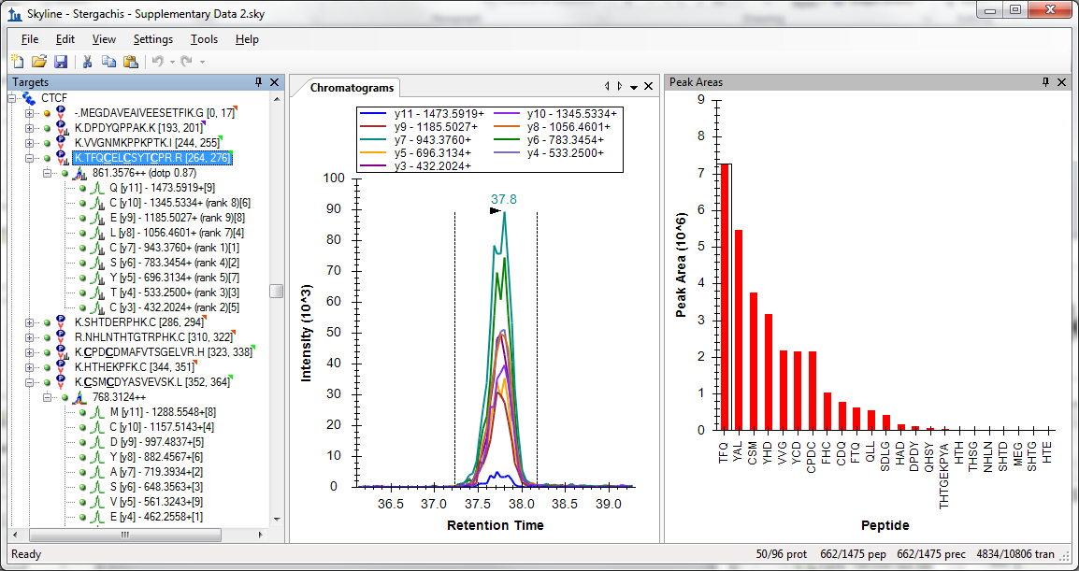
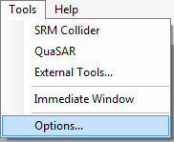
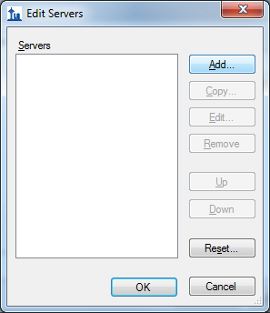
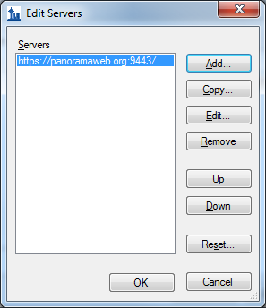
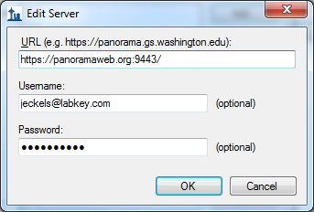
Publishing to Panorama - Setup
Stergachis AB, MacLean B, et al. Nat. Methods. 2011/08;8:1041-1043.
Notes:
Showing relative expression of peptides for this protein within Skyline
Chromatogram shows actual collection, and tree shows relative transitions. Rank is from spectra library. Numbers differ slightly between two library types.
Going to use this to create chromatogram library

Slide 9
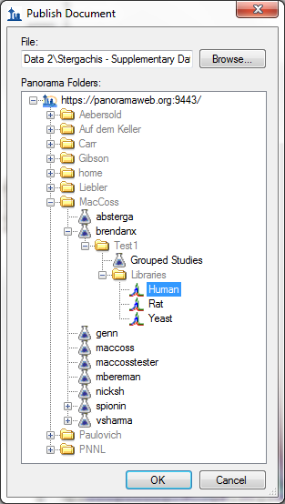
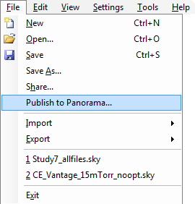
Publishing to Panorama
Notes:
Newest release – walks through setting up a server, potentially registering for panoramaweb.org

Slide 10
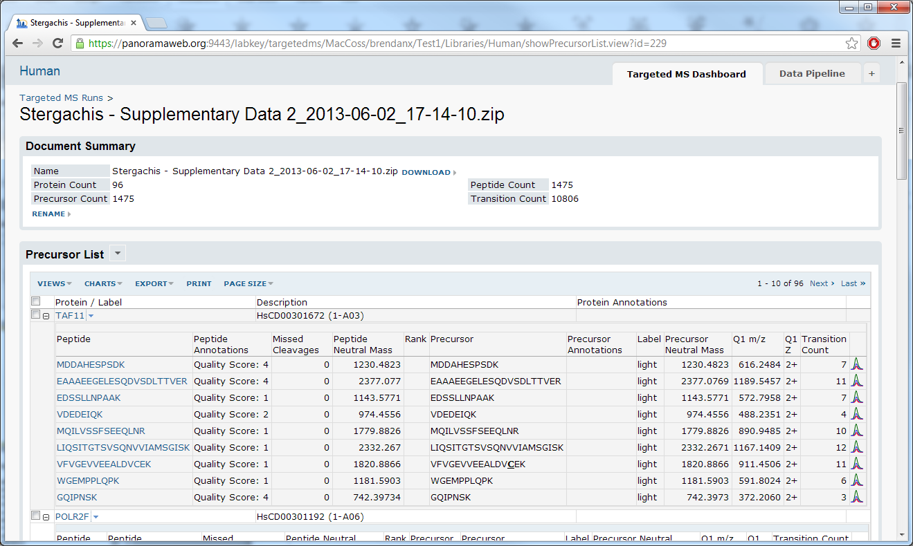
Viewing Runs - Precursors
Notes:
Mention that we’re now on the web site.
Here’s another protein from the same document.

Slide 11
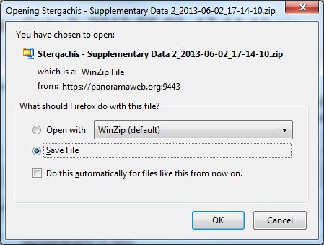
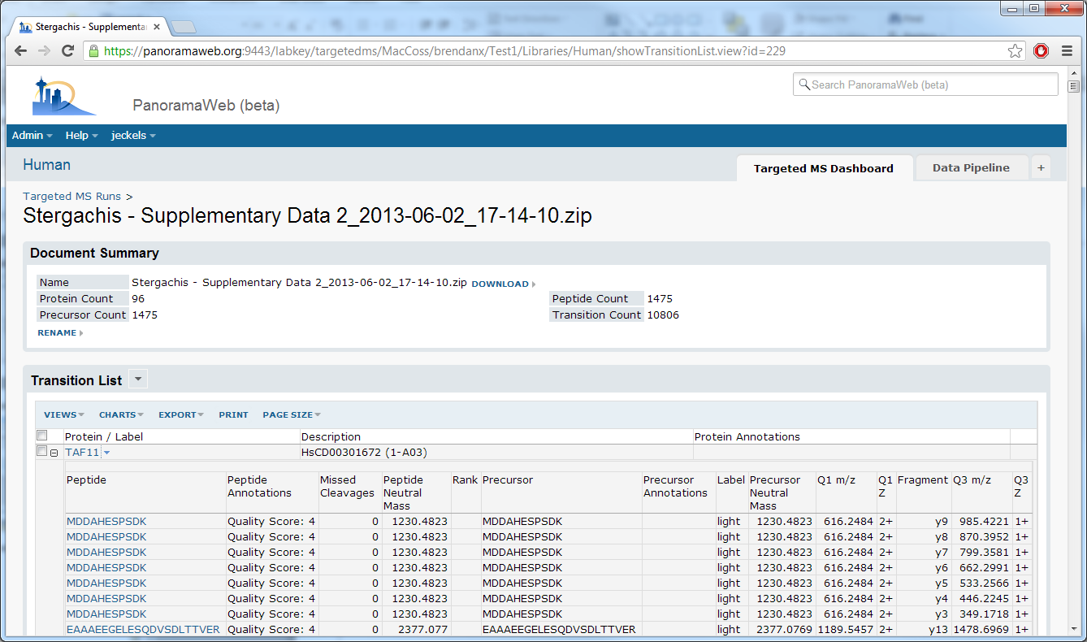
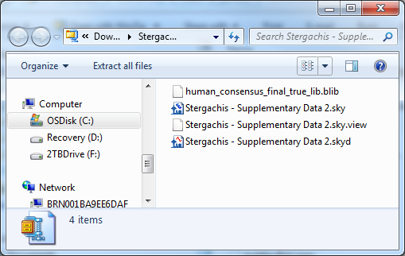
Viewing Runs - Transitions

Slide 12
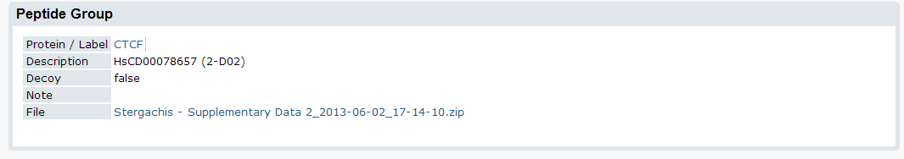
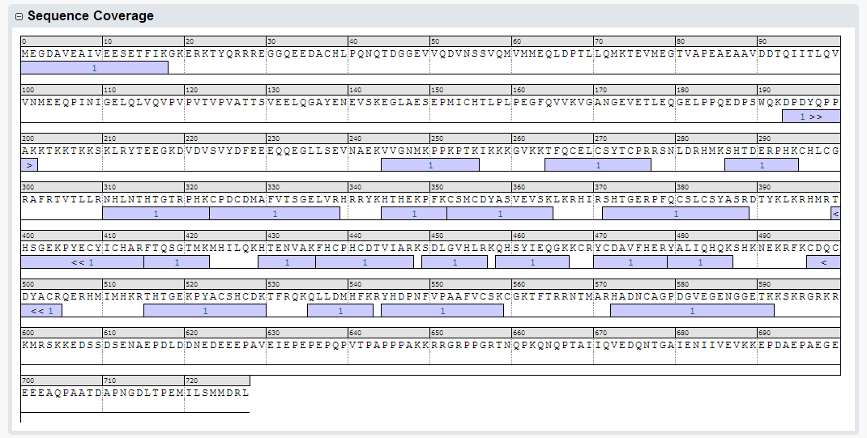
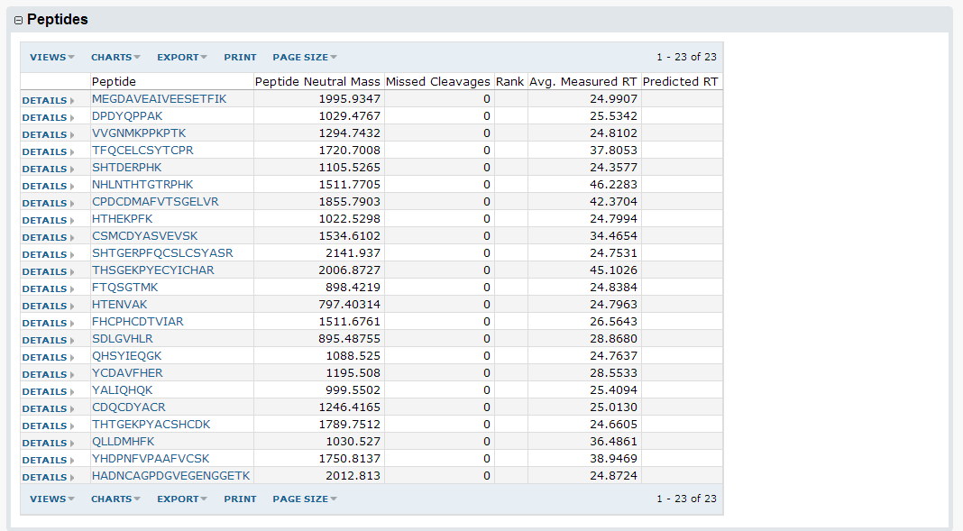
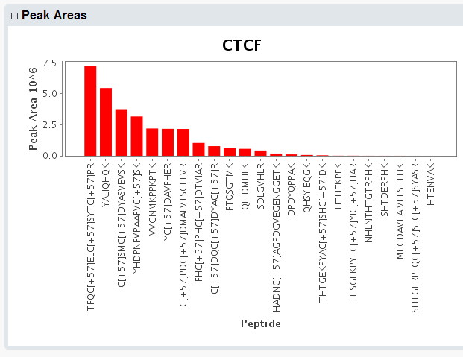
Viewing Proteins

Slide 13
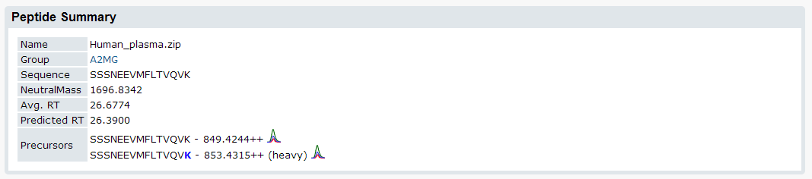
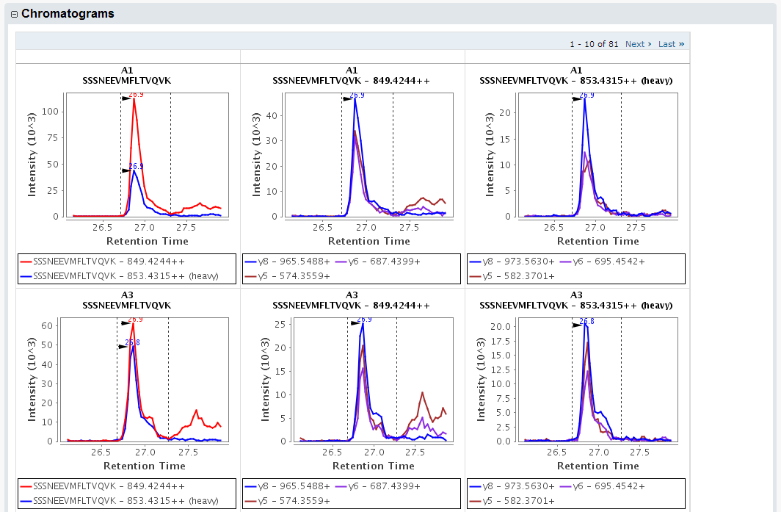
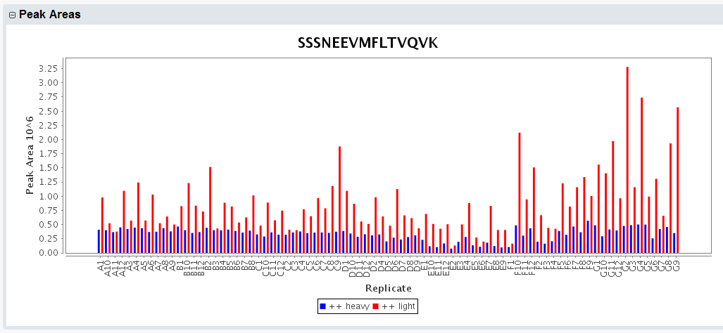
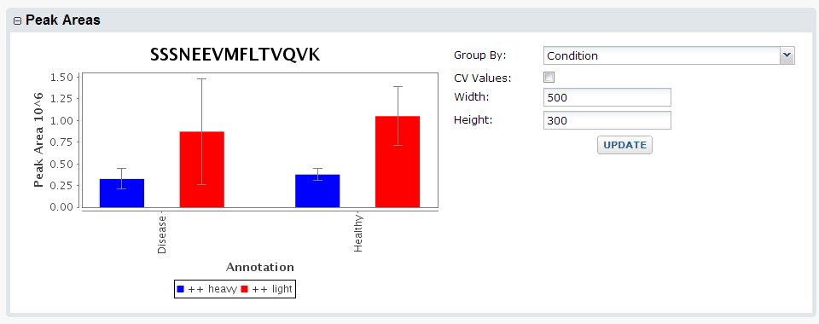
Viewing Peptides
Notes:
Switching to different document, with replicates.
“Condition” is a replicate annotation (added in the last year), and it’s available here for grouping purposes.

Slide 14
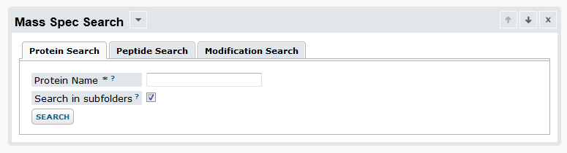
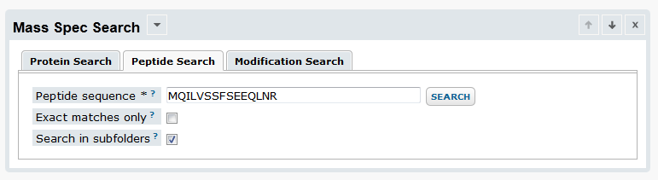
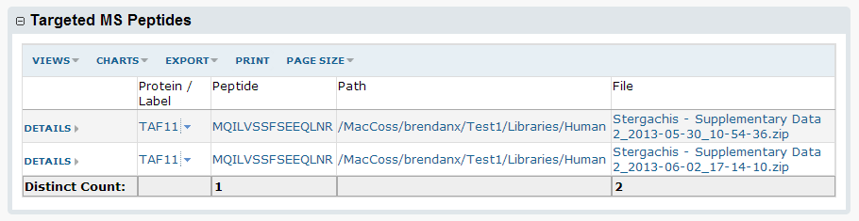
Protein and Peptide Search
Notes:
Talk about subfolder search option.
Describe the folder structure a bit in search results

Slide 15
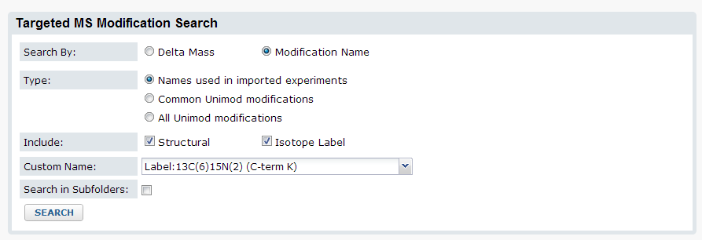
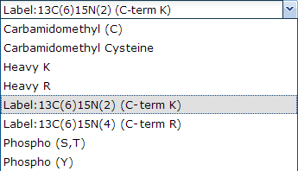
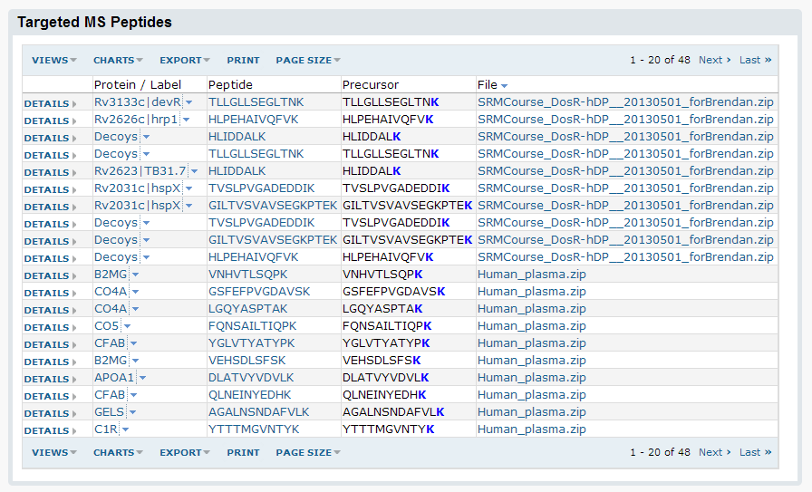
Modification Search
Notes:
Highlight that it’s not a subfolder search, so no path in results

Slide 16
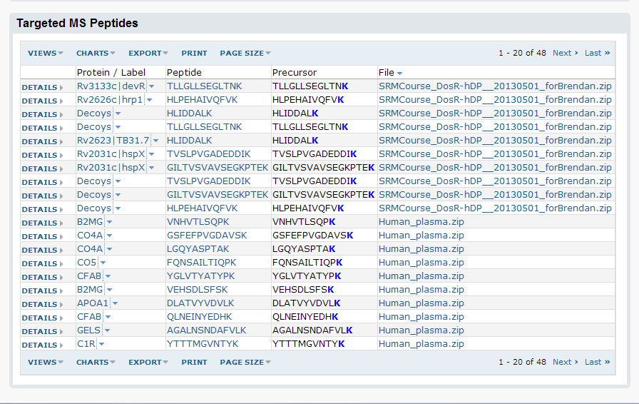
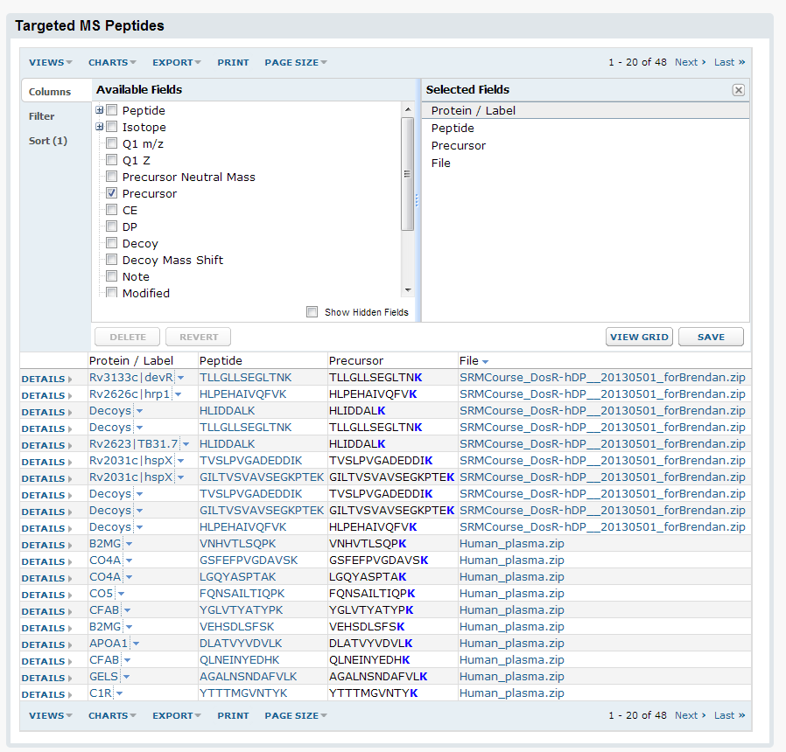
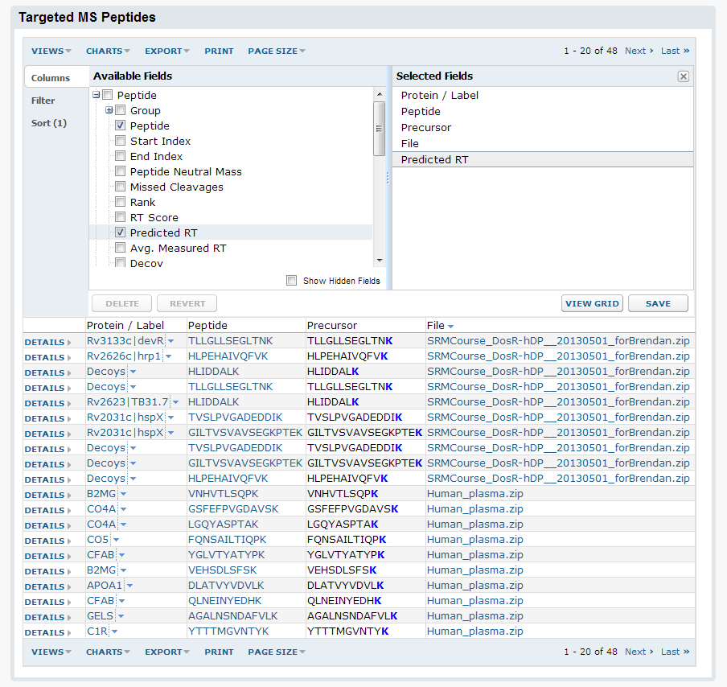
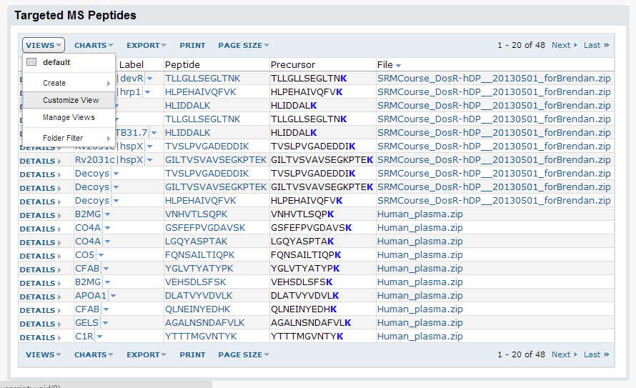
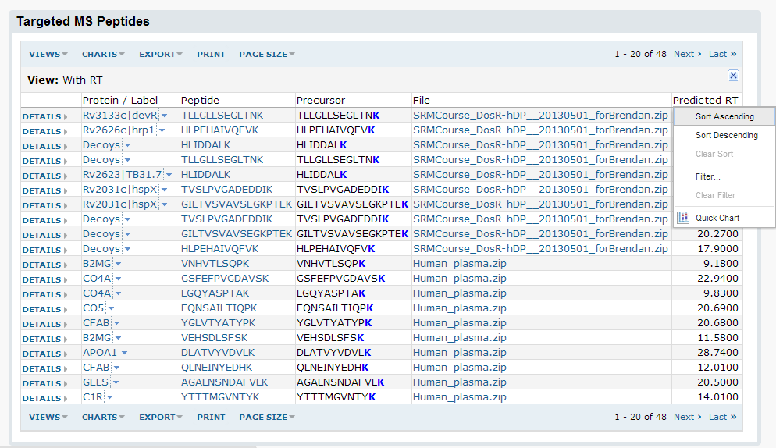
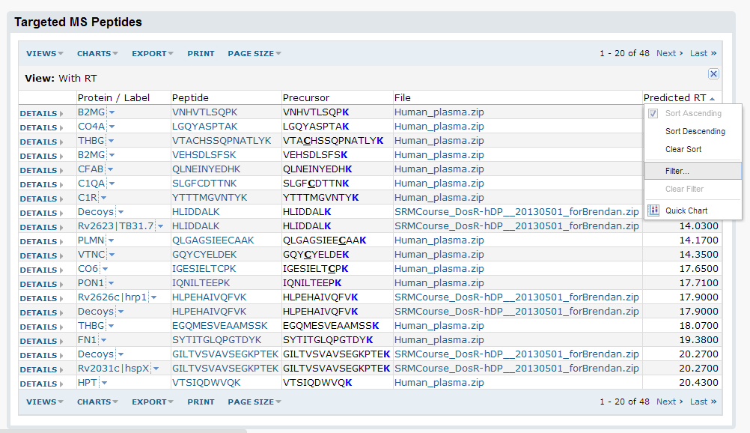
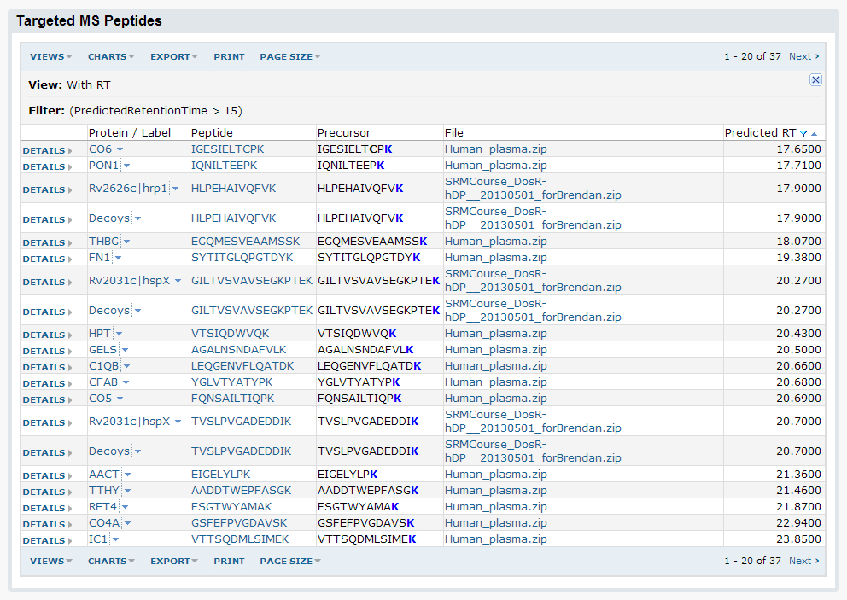
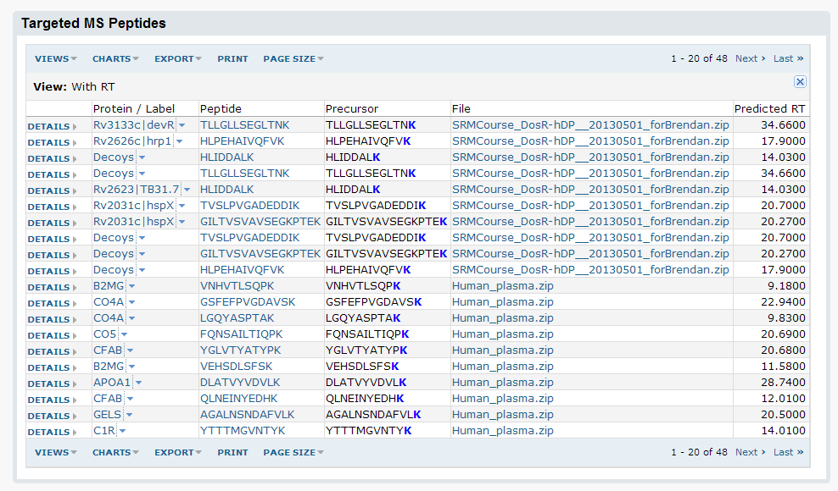
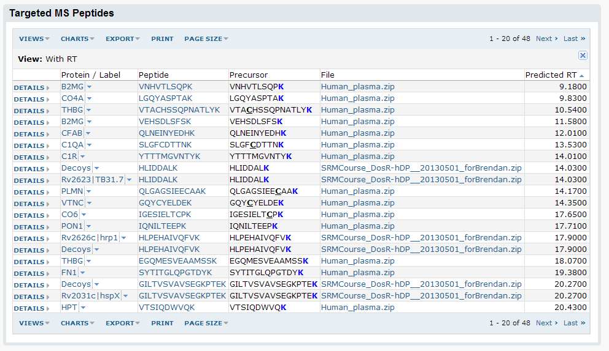
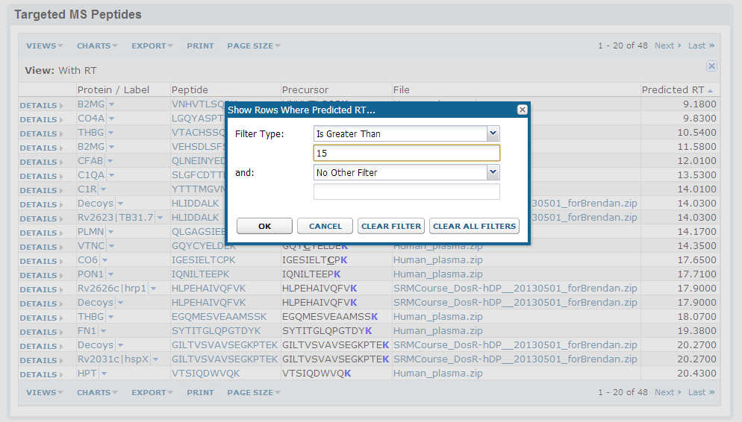
Customizing Views, Sorts, Filters

Slide 17
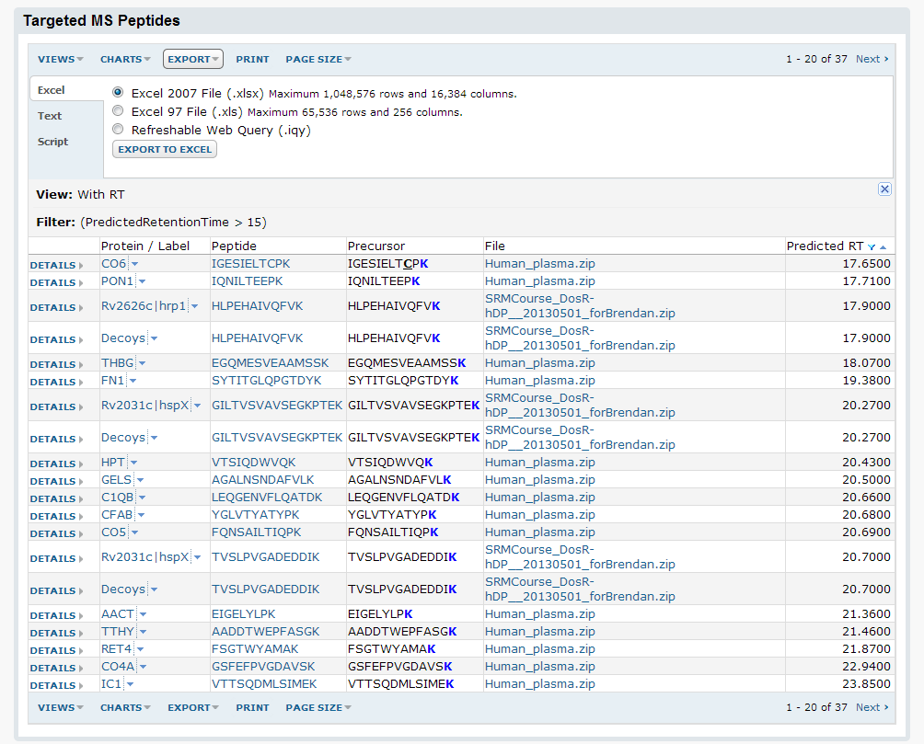
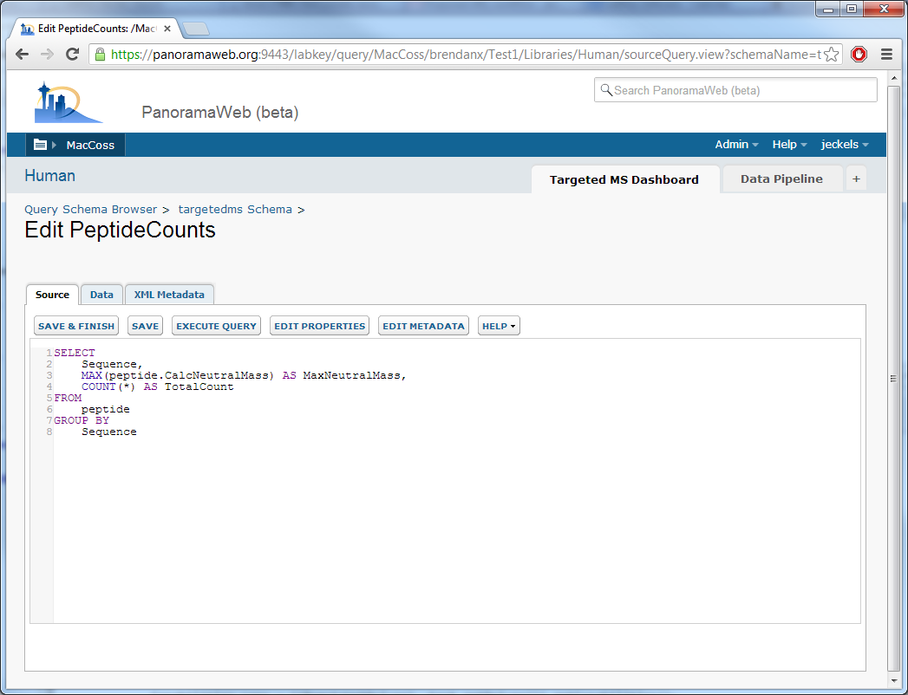
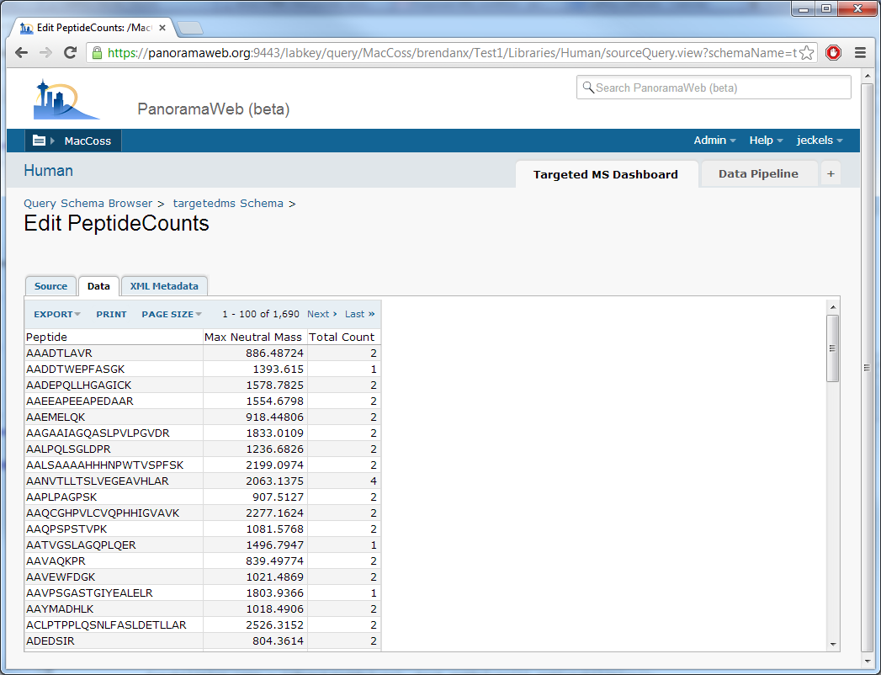
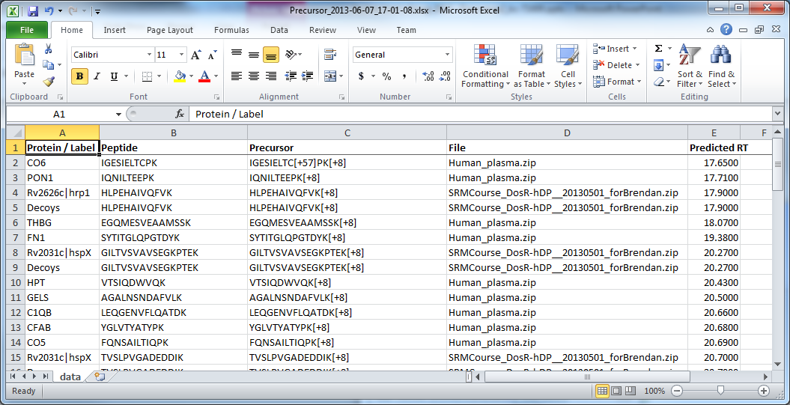
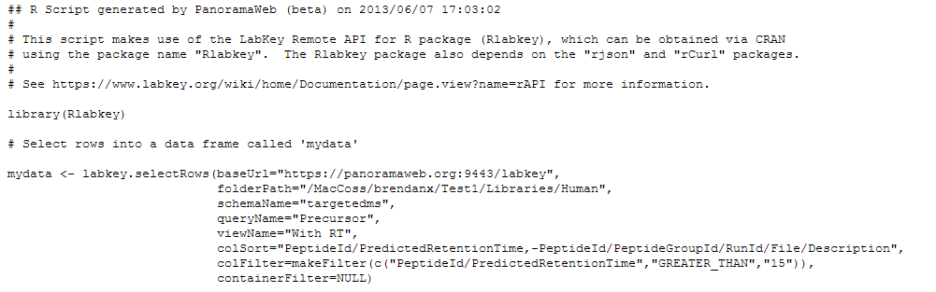
Export and Client APIs

Slide 18
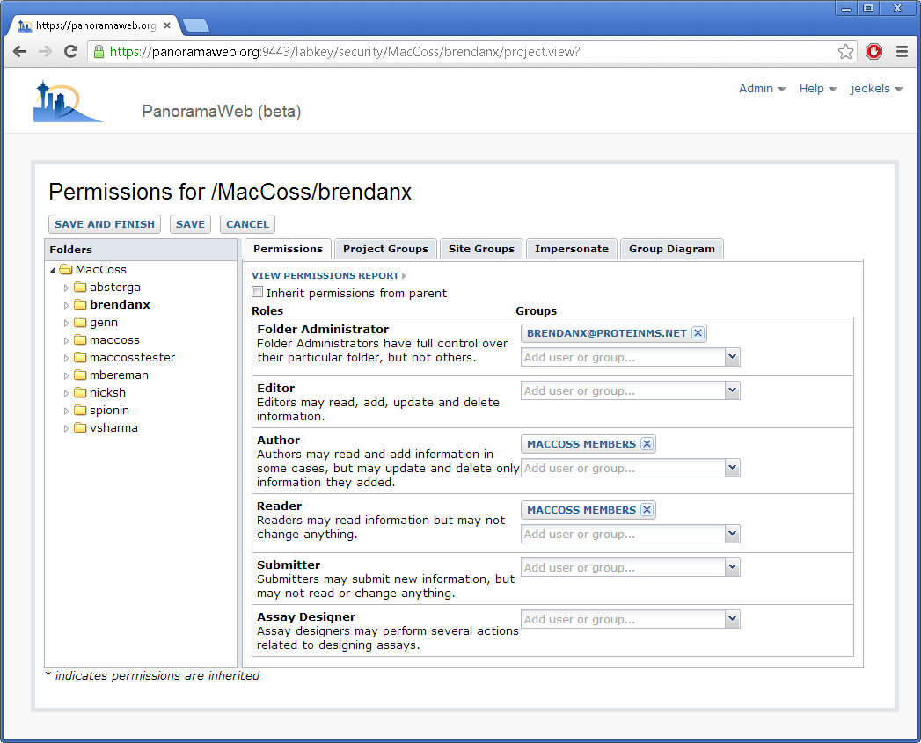
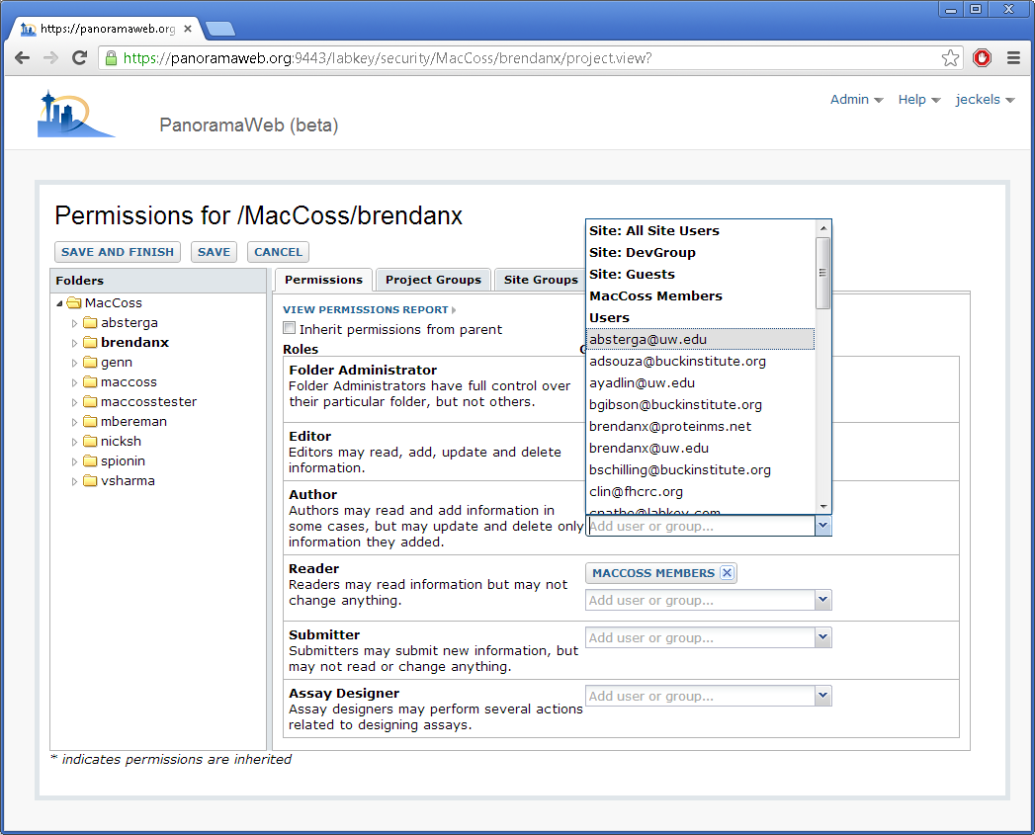
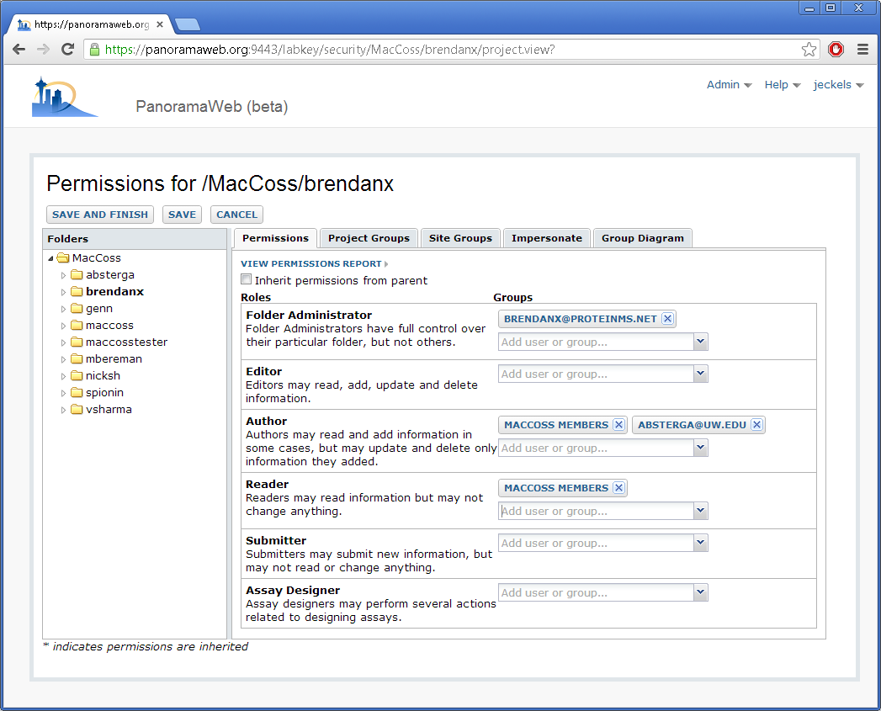
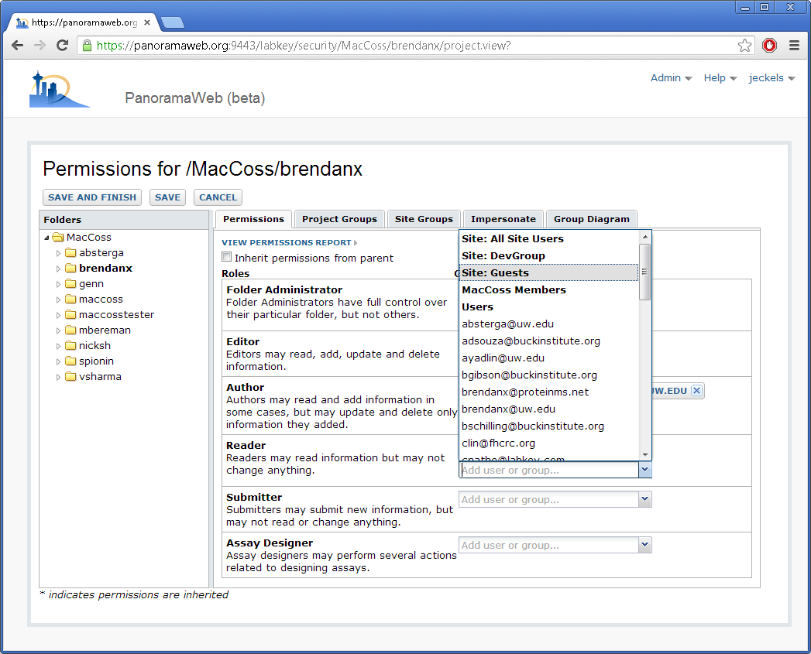
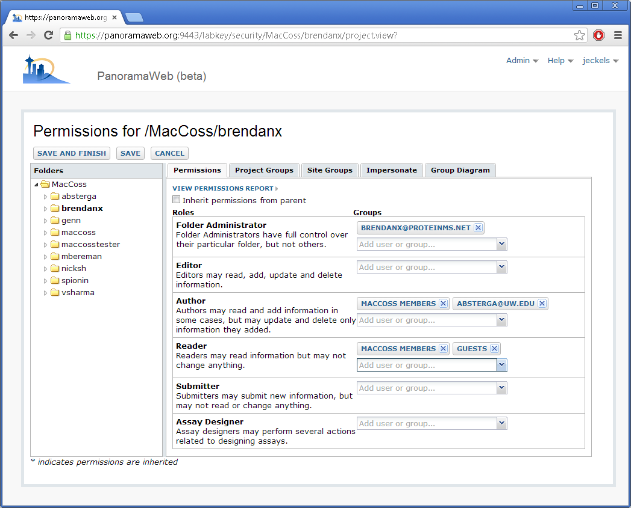
Permissions

Slide 19


Chromatogram Library Export
Notes:
Switching gears. Here’s what’s new. Poster coming tomorrow, come talk to me.
Lots of people build spectra libraries, now we can build chromatogram libraries. Build in Panorama automatically. Includes peptides/transitions/annotations.
Get this UI when you choose library folder type.

Slide 20

Chromatogram Library Import
Notes:
Have as a file. Open it in Skyline, using it much like you would use a spectra library. Setup is the same, with a different extension.
It has peptide rankings, so we can choose choose # of peptides to monitor. Chose 3 here.
Same thing with product ions.

Slide 21

Chromatogram Library Usage
Notes:
On the left is the set of targets we want to monitor. Two proteins, with top 3 peptides/transitions each.
Now we’ve acquired new data from this method. Left shows that, right shows library match.
We can see how they all match up on the far right, dot product of .98, which is good.
Chromatography has changed (29 minutes vs 37 minutes). Coming later, we’ll be working on iRT to normalize retention times.
If you’ve used spectra libraries, this should be pretty familiar, just with targeted results, so we can avoid collecting spectra.

Slide 22
How to Get Panorama
PanoramaWeb (panoramaweb.org)
Hosted at University of Washington
Request access for a lab or organization
Data can be private or public
Create your own installation
Download and documentation at labkey.com
Install on Windows, Linux, OSX, etc
Use LabKey Software’s private hosting

Slide 23
Future Plans
Release chromatogram library support
July 2013
Will coincide with new Skyline release
Store and calculate normalized retention times (iRT)
Store and view QC runs
Show more Skyline graphs
Support response curves with QuaSAR
Notes:
QuaSAR – limit of detection, quantitation

Slide 24
More Information
Poster tomorrow
Sharing Targeted Proteomics Assays using Skyline and Panorama
MP 382
panoramaweb.org
View recorded webinar
Request a project
labkey.org/labkey.com
General information
Downloads for installers and source code

Slide 25
Questions
Josh Eckels
jeckels@labkey.com
Skyline Users Group - June 9, 2013

