Slide 1
Batch Calibration
Nicholas Shulman
July 31, 2019

Slide 2
Introduction
Sometimes it is better to normalize measurements against the external standard that was collected on the same day as the particular replicates
Skyline allows specifying the “batch name” for each replicate. Replicates will use a calibration curve that uses only the standards with the same batch name.

Slide 3
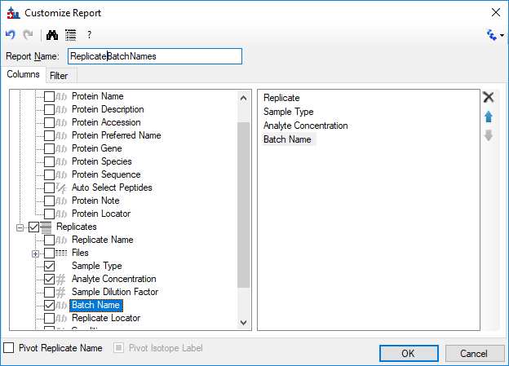
Setting the Batch Name in the document grid
The Batch Name column is not shown in any of the built-in reports in Skyline, but you can customize a new report that has that column.

Slide 4
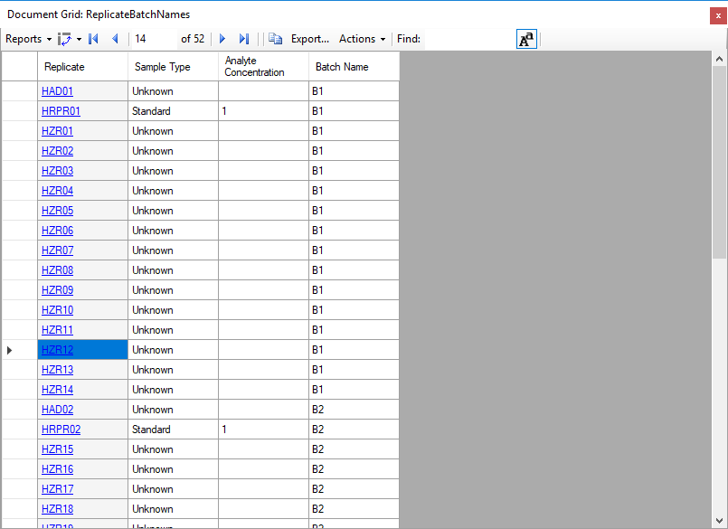
Fill in the batch name for each replicate, and identify the external standards
“Batch Name” can be any text.
If the external standard is a reference sample material, it is probably simplest to set the Analyte Concentration to 1.
If the concentrations of the individual peptides in that material are known, you can set the Concentration Multiplier on each peptide.

Slide 5
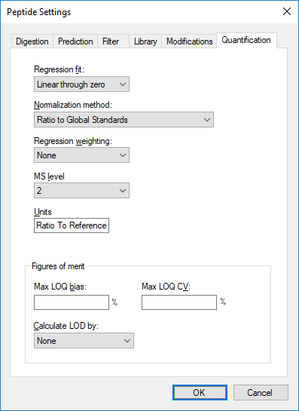
Set the Quantification options on the Peptide Settings
Since we only have one external standard per batch, we have to choose “Linear through zero” as the Regression Fit
We do not know the concentrations of the peptides in the reference material, so we say that the units are “Ratio to Reference”

Slide 6
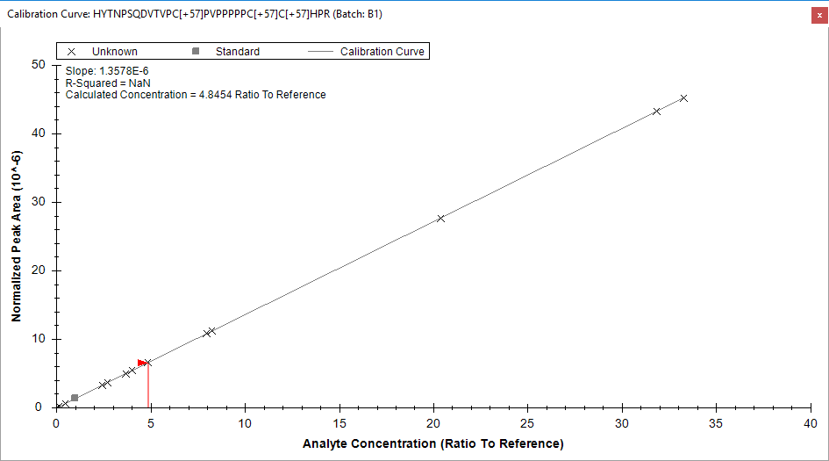
Different calibration curve for each batch
The calibration curve window can show only the replicates from a single batch.

Slide 7
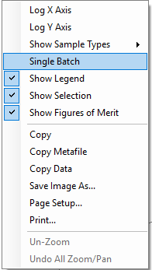
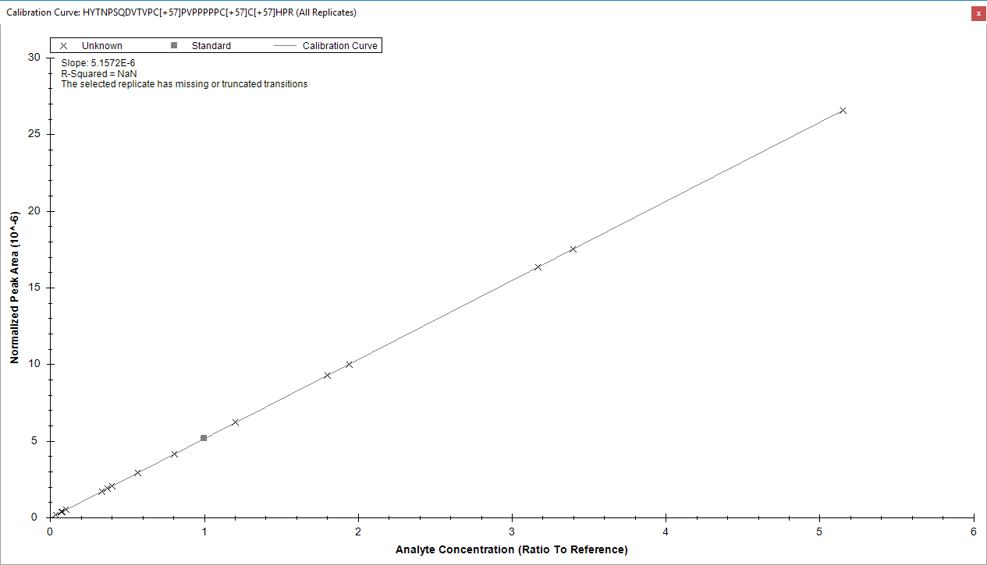
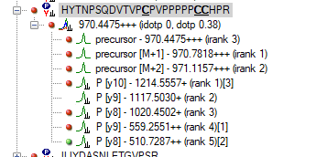
Each batch may have a different set of transitions
You can tell Skyline to display the calibration curve for all of the replicates by unchecking “Single Batch” on the right-click menu.
Only replicates which have chromatograms for the full set of transitions will be displayed on the All Replicates calibration curve. If the different batches have different transitions, some replicates may be excluded.

Slide 8
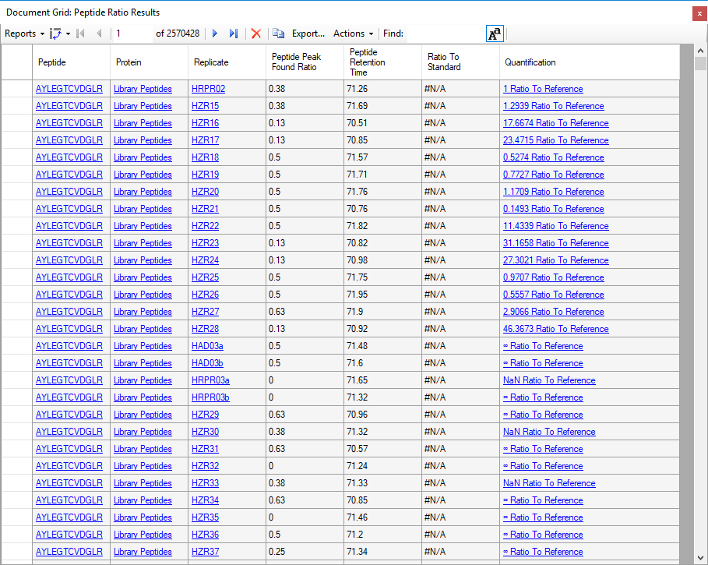
The “Quantification” column shows the calculated concentration
The “Quantification” column shows the calculated concentration formatted with the units specified.
To see the calculated concentration as a simple number use the column
Peptide Results > Quantification > Calculated Concentration

