Slide 1
Crosslinked Peptides in Skyline
June 9, 2021-November 27, 2022
Nicholas Shulman

Slide 2
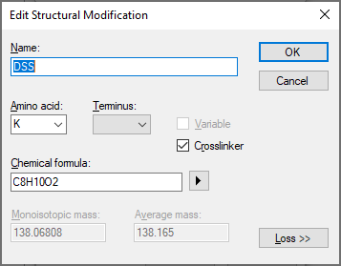
Defining a crosslinker
There is a new checkbox “Crosslinker” on the “Edit Structural Modification” dialog. Checking that will tell Skyline that this modification should gets linked to another peptide.
The Amino acid and Terminus restrictions, if specified, apply to both ends of the crosslinker
If the two ends of your crosslinker can attach to different amino acids, then you can either leave “Amino acid” blank, or put in a comma separated list of all the amino acids that the crosslinker might attach to

Slide 3
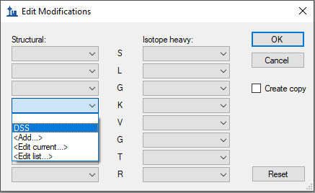
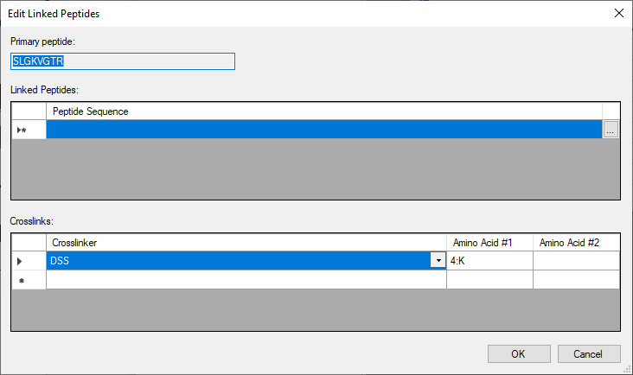
Adding a crosslinker to a peptide in a Skyline document
A crosslinker can be added to a peptide using the “Edit Modifications” menu item.
Selecting a crosslink modification brings up the “Edit Linked Peptides” dialog

Slide 4
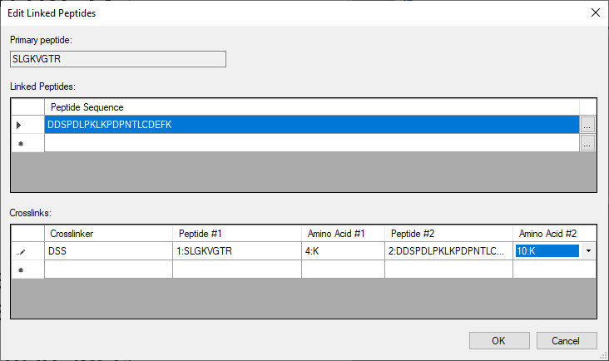
Edit Linked Peptides Dialog
In the upper grid, you can list zero or more peptide sequences to be linked to the primary panel.
In the lower grid, you can list crosslinkers and specify which amino acids they attach to
If the linked peptides have modifications of their own you can specify those by pressing the “…” button next to the linked peptide sequences in the upper grid

Slide 5
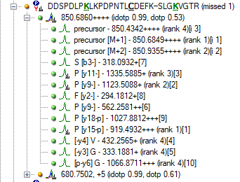
Display of linked peptides in Targets tree
Linked peptides will be displayed in the Targets tree as two peptide sequences separated by a hyphen
The crosslinked amino acid in each peptide is shown as bold, underline, and green
Fragment ions are displayed as the type of ion from the left peptide, and the right peptide, separated by a hyphen surrounded by square brackets
For non-precursor fragments, the amino acid corresponding to that fragment ion is displayed on the left or right side of the square brackets.

Slide 6
Control of which fragment ions you get
The set of available transitions is controlled by the “Max losses” settings at “Settings > Peptide Settings > Modifications”
If Max Losses is 1, then you only get ions where one or the other of the linked peptides fragmented. That is, you can get “precursor-y16” or “y7-precursor” but not “y16-y7”

Slide 7
Spectral Library support
BiblioSpec spectral libraries can be built from .proxl search results.
.proxl is an XML format designed to represent results from crosslink-aware search engines including Kojak.
In the future, BiblioSpec will be able to read some of these crosslink search results directly without having to first be converted to .proxl

Slide 8
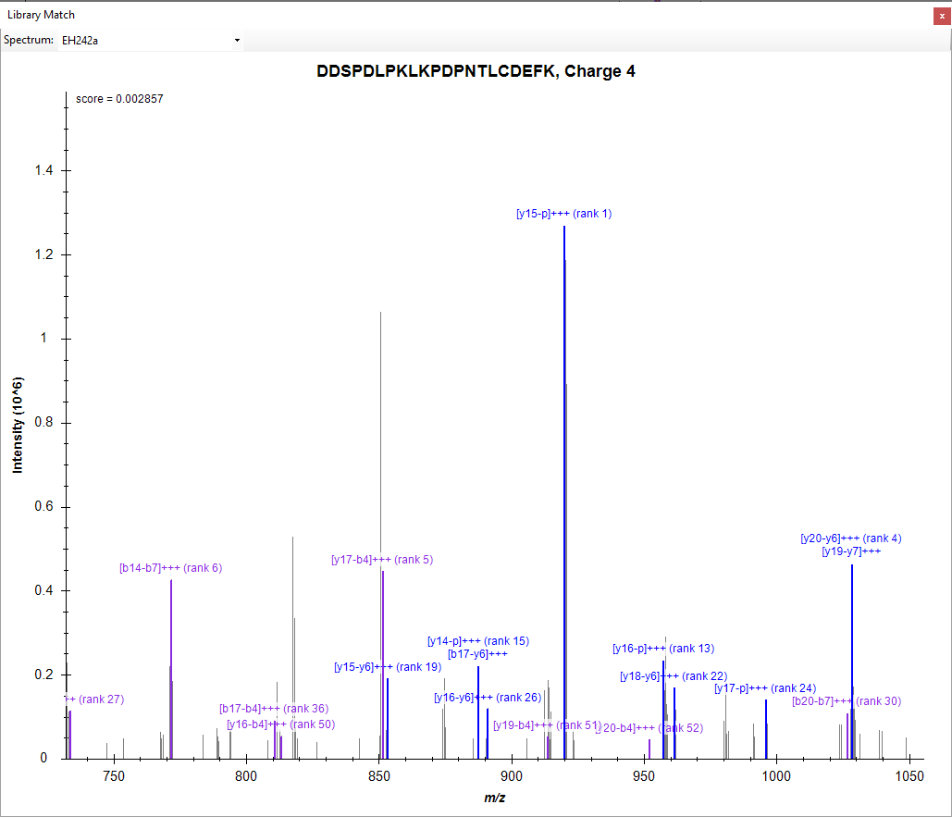
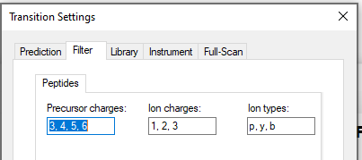
Annotation of peaks in a library spectrum
The Library Match window in Skyline annotates m/z values with the fragment names from the currently selected crosslinked peptide in the Targets tree
Ion types have an ordering controlled by the “Ion Types” setting at Settings > Transition Settings > Filter
When a fragment ion has two types (e.g. “y17-b4”), it is treated as being the “type” of the latest appearing ion type in that Transition Settings list. So, “y17-b4” is treated as a “b” ion in terms of hiding and showing it.

Slide 9
Modified Sequence for crosslinked peptides
The Modified Sequence for crosslinked peptides consists of the two flat peptides separated by a hyphen, followed by the crosslinker with an @ sign and a comma-separated list of the residue numbers where the crosslinker attaches
For example:
In a .blib file, the crosslinker will be described using its mass: AGKALKDAVN-QGGKAR-[+138.1@6,4] In other places, users may find it more convenient to use the name of the crosslinker modification: AGKALKDAVN-QGGKAR-[DSS@6,4]

Slide 10
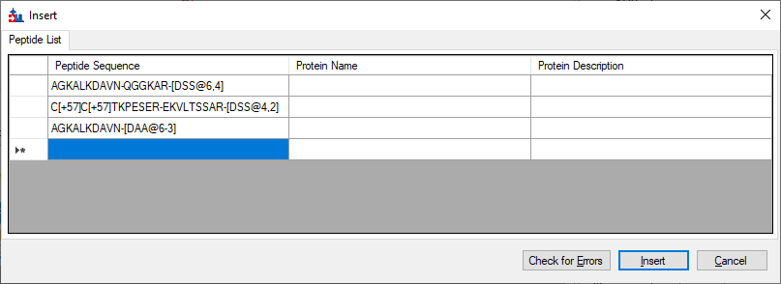
Using the Insert Peptides dialog to add crosslinked peptides to the Skyline document
The Edit > Insert > Peptides menu item can be used to insert crosslinked peptides using the new Modified Sequence.

Slide 11
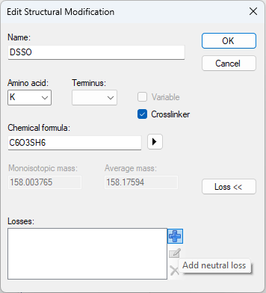
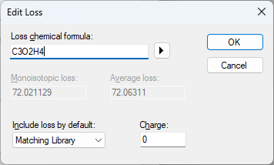
Cleavable crosslinks (Skyline 23.1)
Defining a “neutral loss” for a crosslink modification tells Skyline that the crosslinker is cleavable.
The chemical formula of the neutral loss represents what needs to be subtracted from the modification formula to result in the cleaved crosslinker.
Subtracting “C3O2H4” from “C6O3SH6” results in a cleaved crosslinker with the formula C3OSH2

